Slide 1
Earthquakes Detection using Data Mining
Ruizhu Yang
04/25/2014

Slide 2
References
Otari G V, Kulkarni R V. A Review of Application of Data Mining in Earthquake Prediction[J]. 2012.
Dzwinel W, Yuen D A, Boryczko K, et al. Cluster analysis, data-mining, multi-dimensional visualization of earthquakes over space, time and feature space[C]//Nonlinear Proc. in Geophys. 2005, 12: 117-128.
W. Dzwinel , D. A. Yuen , K. Boryczko , Y. Ben-Zion , S. Yoshioka , and T. Ito, “Nonlinear multidimensional scaling and visualization of earthquake clusters over space, time and feature space”, Nonlinear Processes in Geophysics (2005) 12: 117–128 ,SRef-ID: 1607-7946/npg/2005-12-117, European Geosciences Union© 2005Author(s).
Http://earthquakesandplates.wordpress.com/

Slide 3
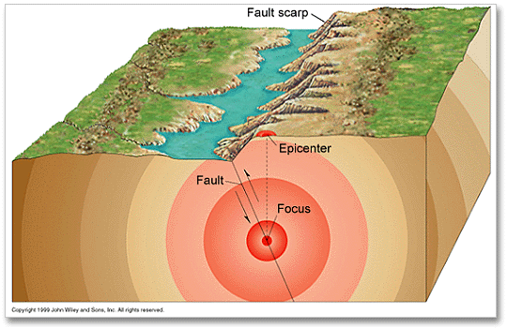
Data Mining and Earthquake
Earthquakes occur and cause loss of life and property
Predict potential earthquake risks, especially in earthquake-active areas
Help disaster preparation and prevention
Usually use previous records
From Ref.4

Slide 4
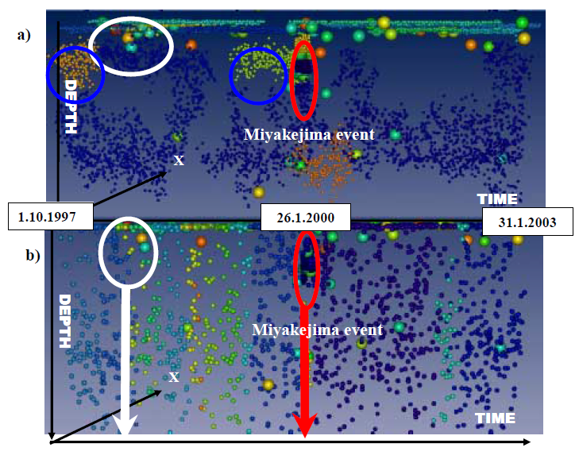
Basic Problem for detecting earthquake
Dataset: seismic activities of the
Japanese islands during
1997-2003.
Consist of 40,000 events
There are swarms of precursory
events (magnitude< 4)before
large earthquake
From Ref.3

Slide 5
Basic Problem for detecting earthquake
To detect the precursory events of a large earthquake precisely
How to detect precursory events?
Data mining techniques:
Analysis of multi-dimensional data
Agglomerative schemes& non-hierarchical clustering algorithms
Multi-dimensional scaling (MDS)

Slide 6
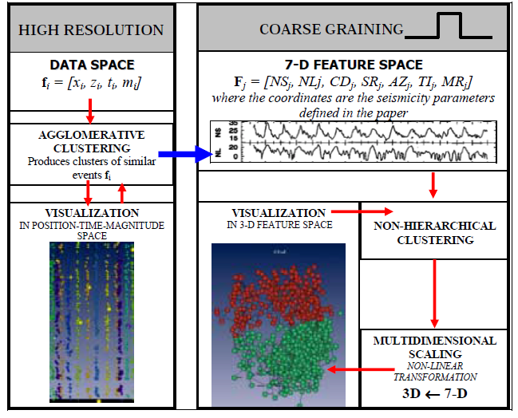
Data mining process
Agglomerative clustering for data space use the
largest cluster to compute the seismicity
parameters
Non-hierarchical clustering for 7-Dfeature space
Map 7-D feature space to 3D space through
MDS and visualize to observe easily.
Select the cluster that include the precursory
events and cluster it in 7-D feature space again .
From Ref.2

Slide 7
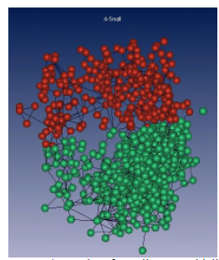
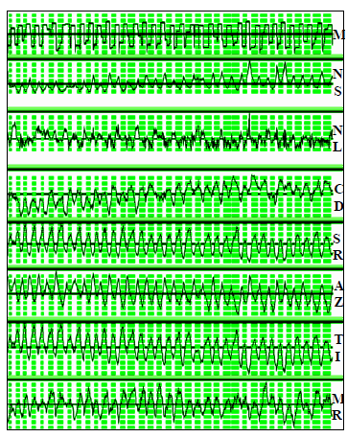
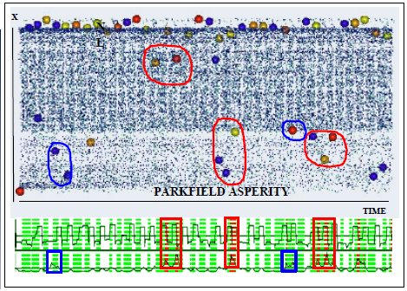
Clustering results analysis
From Ref.2
From Ref.2
From Ref.2
From Ref.2

Slide 8
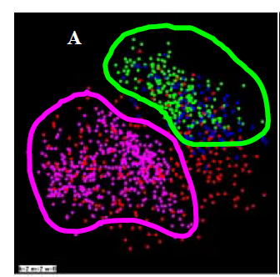
Recognizing precursory patterns
The area of green dots (precursory events for
training set) and the area of blue dots (precursory
events for test set) almost overlap.
From Ref.2
From Ref.3

Slide 9
Other methods:
Real-time detection by social sensors like twitter
Neural network based approach

Slide 10
THANK YOU

