Slide 1
Data Mining Applications in Robotics Engineering
Blink Sakulkueakulsuk

Slide 2
References
D. Wilking, and T. Rofer, Realtime Object Recognition Using Decision Tree Learning, 2005
http://www.informatik.uni-bremen.de/kogrob/papers/rc05-objectrecognition.pd
J. Li, Q. Pan, and B. Hong, A New Approach of Multi-robot Cooperative Pursuit Based on Association Rule Data Mining, 2009
http://cdn.intechopen.com/pdfs-wm/6967.pdf
A. Ravankar, Y. Hoshino, T. Emaru, and Y. Kobayashi, Robot Mapping Using k-means Clustering Of Laser Range Sensor Data, 2012
http://bncss.org/index.php/bncss/article/view/2/2
H. Lipson, Mining experimental data for dynamical invariants - from cognitive robotics to computational biology, 2010
http://videolectures.net/ecmlpkdd2010_lipson_med/

Slide 3
What is Robotics Engineering?
Interdisciplinary Field
RBE = ME + EE + CS
Computer Science components
Computer Vision
Artificial Intelligence
Machine Learning
DATA MINING!!!

Slide 4
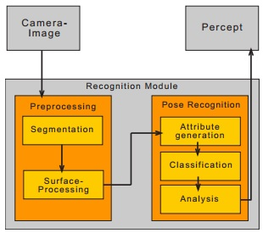
DM: Decision Trees
Realtime Object Recognition Using Decision Tree Learning
From Ref.1 page 2

Slide 5
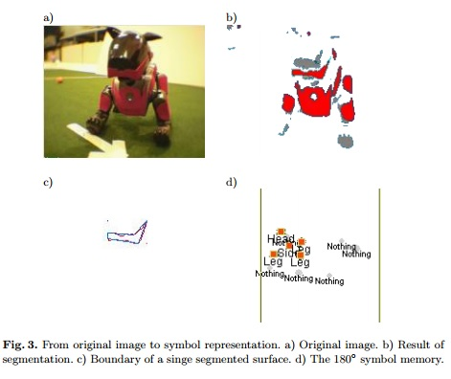
From Ref.1 page 3

Slide 6
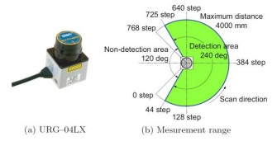
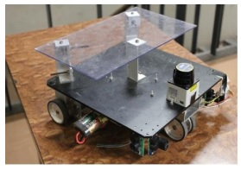
DM: Clustering
Robot Mapping Using k-means Clustering Of Laser Range Sensor Data
Create a map of the environment
From Ref.3 page 2

Slide 7
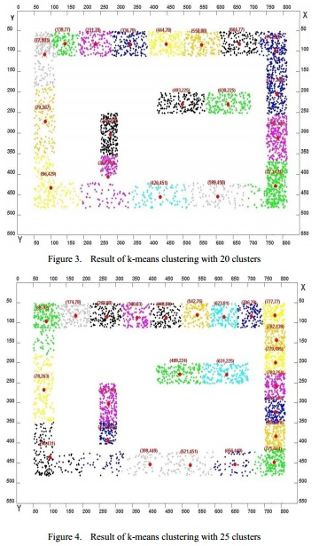
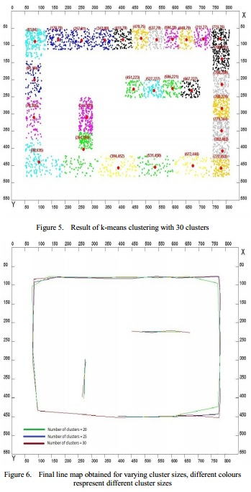
From Ref.3 page 2-3

Slide 8
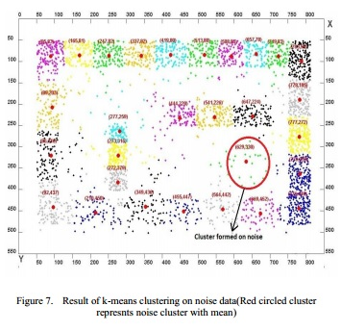
Clustering Limitations
Not good with noise.
From Ref.3 page 3

Slide 9
Other DM Applications
Association Rules
Multi-robot Cooperative Pursuit Based on Association Rule Data Mining
The robots try to pursuit a target. Using association rules, the robots form a group.
Other applications
Mining experimental data for dynamical invariants - from cognitive robotics to computational biology
Invariants = Something that is constant in the system
Finding invariants = using unsupervised learning to find patterns

