Slide 1
Data Mining against Terrorism
Tim Marsden
CS548 Showcase
2/11/14

Slide 2
Sources
Levitt, S.D. & Dubner, S. J. 2009. Superfreakonomics: Global cooling, patriotic prostitutes, and why suicide bombers should buy life insurance. New York: William Morrow.
Montalbano, E. Government Developing Data Mining tools to Fight Terrorism. 2011. http://www.informationweek.com/applications/government-developing-data-mining-tools-to-fight-terrorism/d/d-id/1097714
Pappalardo, J. NSA Data Mining: How it works. 2013. Popular Mechanics. http://www.popularmechanics.com/technology/military/news/nsa-data-mining-how-it-works-15910146
Margolin, E. Study asks: Does the NSA data mining program stop terrorists? 2014. msnbc. http://www.msnbc.com/news-nation/does-nsa-data-mining-stop-terrorists
Musgrave, S. Does Data mining our big data for terrorists actually make us any safer? 2013. Vice. http://motherboard.vice.com/blog/does-mining-our-big-data-for-terrorists-actually-make-us-any-safer
Snowden, E. PRISM (Surveillance Program). Wikileaks. http://en.wikipedia.org/wiki/PRISM_(surveillance_program)

Slide 3
Traditional Anti-Terrorism Methods
Problem with gathering terrorist data is that they are so rare.
Traditional 3 methods of anti-terrorism:
Gathering human intelligence
(difficult/dangerous)
Monitoring electronic chatter
(‘drinking from fire hose’)
Following the international money trail
(‘sifting the beach for a grain of sand’)

Slide 4
Biography of a Terrorist
Economist Alan Krueger compiled biographical data from 129 shahid (martyrs) from a Hezbollah newsletter Al-Ahd (The Oath)
Terrorists were less likely to come from a poor family (28 vs 33%)
More likely to have a high-school education (47 vs 38%)
Claude Berrebi analyzed Palestinian suicide bombers and found similar results:
16% from poor families vs. 30% total population
60% had at least high school education vs. 15% total population
Counter Intuitive to other criminal backgrounds
Considered a political act

Slide 5
Ian Horsley
Developed mining algorithms to detect British bank fraud
Focused on bank information of the 9-11 terrorists
Found several distinguishing traits:
Opened US accounts with ~$4k cash at well-known banks
Used P.O. boxes as an address, and changed frequently
Wire-transferred, always below the bank’s report limit
Usually made one large deposit, then small withdrawals
No normal living expenses like rent, utilities, car, etc.
No typical monthly deposits (direct deposit, etc.)
Ratio of cash withdrawals to checks written was high

Slide 6
Problems remaining…
Easier to retroactively find traits than ID future attackers
Too many false positives in large datasets
99% accuracy → 500k false ID
British police arrested a bunch of potential terrorists soon after his 9/11 mining efforts
100 of them had accounts at Horsley’s bank.

Slide 7
New algorithm rules → success!
Neutral indicators:
Employment status
Marital status
Living in close proximity to a Mosque
Negative Indicators:
Have a savings account
Withdraw from ATM on a Friday afternoon
Buy life insurance
Variable X
Behavioral attribute (not demographic)
Measures the intensity of a particular bank activity

Slide 8
Results
Flagged over 30 UK suspects
Information handed over to proper authorities
The direct success of his algorithms are classified, but he’s now known as Sir Ian Horsley…

Slide 9
NSA: Data Mining Us
Metadata tags on our files
File names/sizes/keywords
Allows analysts to not break the law
Accumulo: Tags all the incoming data
Google based, open source
PRISM: Ultimate database
9 Major Internet Companies
Digital photos
Stored data
File transfers
Email
Chats
Videos
Video conferencing
Xkeyscore
UTT: Unified Targeting Tool
https://accumulo.apache.org/
http://en.wikipedia.org/wiki/PRISM_(surveillance_program)
http://en.wikipedia.org/wiki/XKeyscore

Slide 10
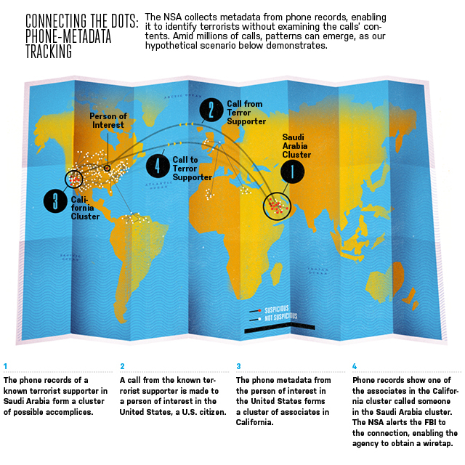
1
http://www.popularmechanics.com/technology/military/news/nsa-data-mining-how-it-works-15910146

Slide 11
2
http://en.wikipedia.org/wiki/File:Upstream-slide.jpg

Slide 12
3
http://en.wikipedia.org/wiki/File:Prism-slide-7.jpg

Slide 13
Does it actually stop terrorists?
NSA’s program has played an identifiable role in at most 1.8% of successful cases
Most began with evidence obtained with traditional methods before NSA got involved
Vice: NSA Interview
Fienberg insists that the rarity of terrorist events (and terrorists themselves) makes predicting their occurrence a fraught crapshoot.
He says that intelligence analysts lack training data – indicative patterns of behavior drawn from observing multiple iterations of a complex event – to verify whether their models have predictive validity.
Jim Jonas: “Unless investigators can winnow their investigations down to data sets already known to reflect a high incidence of actual terrorist information,” Jonas and Harper write, “the high number of false positives will render any results essentially useless.”

Slide 14
Sources
Levitt, S.D. & Dubner, S. J. 2009. Superfreakonomics: Global cooling, patriotic prostitutes, and why suicide bombers should buy life insurance. New York: William Morrow.
Montalbano, E. Government Developing Data Mining tools to Fight Terrorism. 2011. http://www.informationweek.com/applications/government-developing-data-mining-tools-to-fight-terrorism/d/d-id/1097714
Pappalardo, J. NSA Data Mining: How it works. 2013. Popular Mechanics. http://www.popularmechanics.com/technology/military/news/nsa-data-mining-how-it-works-15910146
Margolin, E. Study asks: Does the NSA data mining program stop terrorists? 2014. msnbc. http://www.msnbc.com/news-nation/does-nsa-data-mining-stop-terrorists
Musgrave, S. Does Data mining our big data for terrorists actually make us any safer? 2013. Vice. http://motherboard.vice.com/blog/does-mining-our-big-data-for-terrorists-actually-make-us-any-safer
Snowden, E. PRISM (Surveillance Program). Wikileaks. http://en.wikipedia.org/wiki/PRISM_(surveillance_program)

