Slide 1
Clustering in R
Xue li
CS548 showcase

Slide 2
Source
http://www.statmethods.net/advstats/cluster.html
http://www.r-project.org/
http://cran.r-project.org/web/packages/cluster/index.html
http://cran.r-project.org/web/packages/

Slide 3
Introduction to R
R is a free software programming language and software environment for statistical computing and graphics. (From Wikipedia)
For two kinds of people:
Statisticians and data miners
Two main applications:
Developing statistical tools,
Data analysis

Slide 4
If you have learned any other programming language, it will be very easy to handle R.
If you don’t, R will be a good start

Slide 5
Package and function
http://cran.r-project.org/web/packages/available_packages_by_name.html

Slide 6
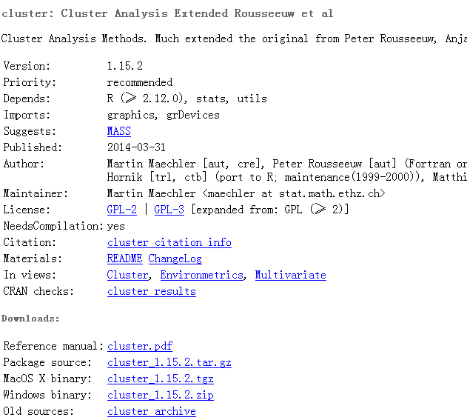

Slide 7
Clustering
Package:
“cluster”, “fpc”…
Functions:
“kmeans”, “dist”, “daisy”, “hclust”…

Slide 8
Main steps
Data preparation
(missing value, nominal attribute…)
K-means
Hierarchical
Plotting/Visualization
Validating/Evaluation

Slide 9
disadvantage
Cannot handle nominal attributes and missing values directly
Cannot provide evaluating matrix directly

Slide 10
Advantage
Can handle large dataset
Write our own functions
(Easier than Java in Weka)

