Slide 1
CS548 Showcase
Using SPSS for Data Mining
Ahmedul Kabir

Slide 2
References
http://www-01.ibm.com/software/analytics/spss/
http://en.wikipedia.org/wiki/Spss
http://www.ats.ucla.edu/stat/spss/output/reg_spss.htm (for a good interpretation of the results)

Slide 3
What is SPSS
Software Package used for Statistical Analysis of data.
Produced by SPSS Inc. in 1968.
SPSS used to stand for “Statistical Package for the Social Sciences”
Later changed to “Statistical Product and Service Solutions”
Acquired by IBM in 2009. Now known as IBM-SPSS Statistics

Slide 4
More on SPSS software
Current version is 22.0
SPSS is a commercial software
Statistic 17.0 (basic package) is freely available for WPI students
Several specialized packages can be bought:
  SPSS Data Collection (for surveys)
  SPSS Modeler (for data mining)
  SPSS Analytic Catalyst (for Big data) etc.

Slide 5
File formats
Basic format is .SAV
Supports other common formats such as .XLSX, .CSV, .DAT etc
SPSS syntax file (.SPS) can be used to convert other formats to SPSS format

Slide 6
Reasons for NOT using SPSS
Expensive (at least, not free!)
Basic Package is not tailored for Data Mining.
Heavy software

Slide 7
Why use it then?
Very rich collection of Statistical tests and methods
Outputs an extensive set of metrics and statistically important factors
Support available
Well known in non-CS fields

Slide 8
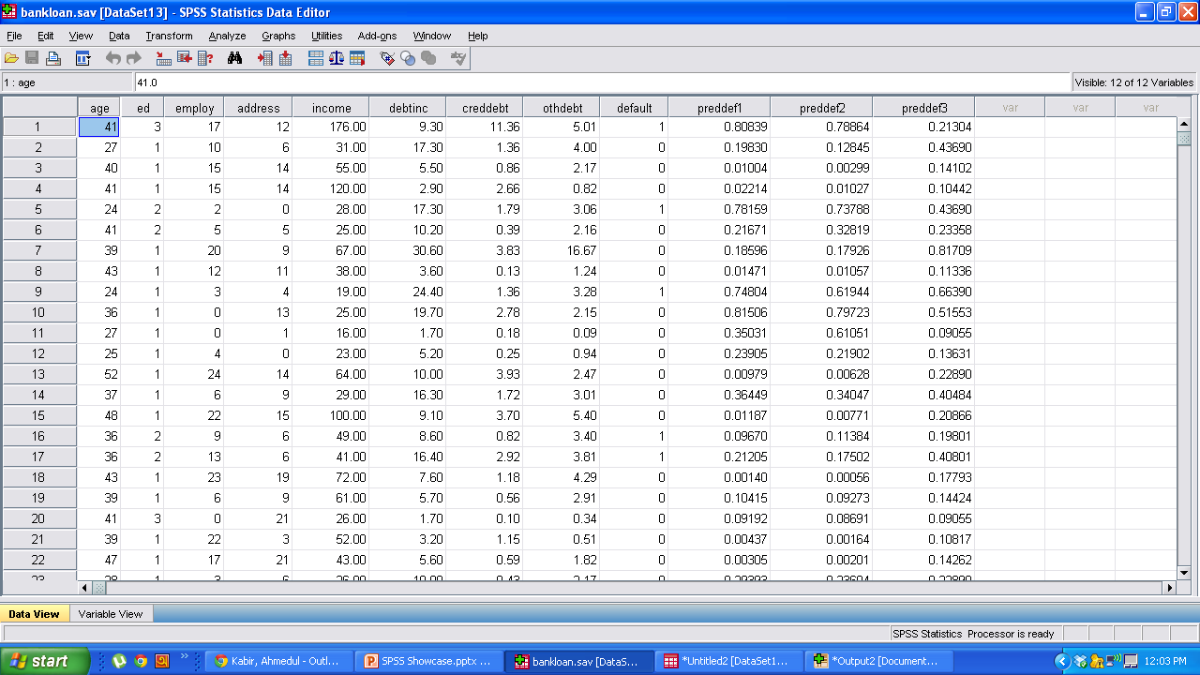
Demo (Data view)

Slide 9
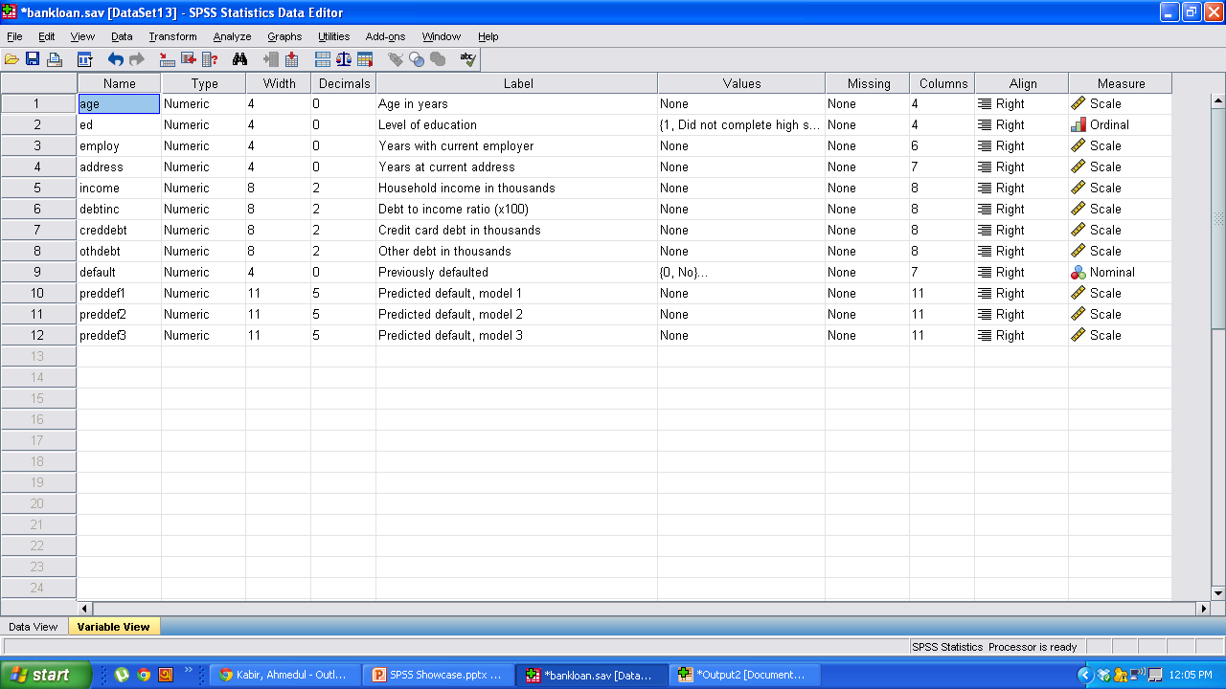
Demo (Variable view)

Slide 10
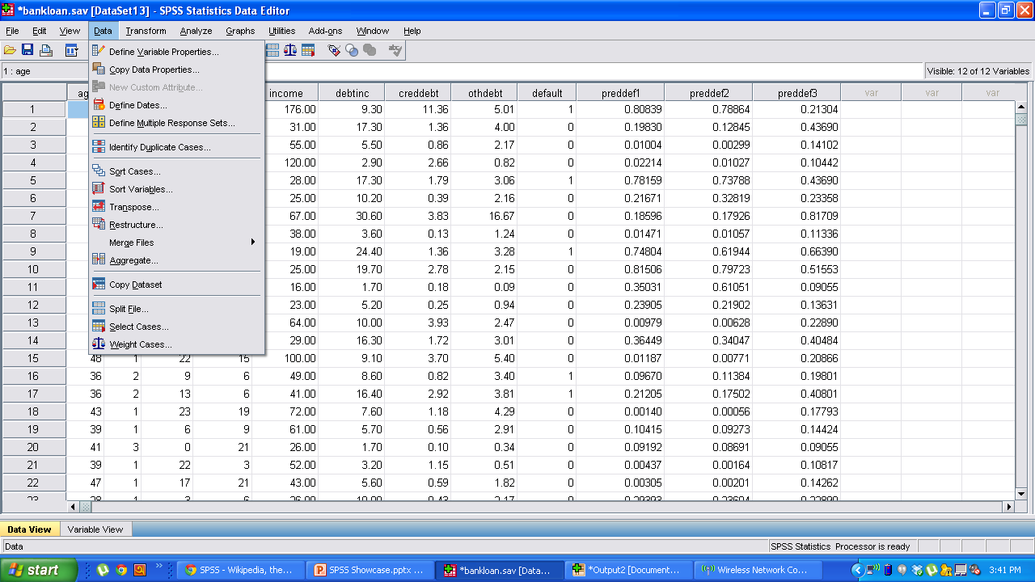
Available Features

Slide 11
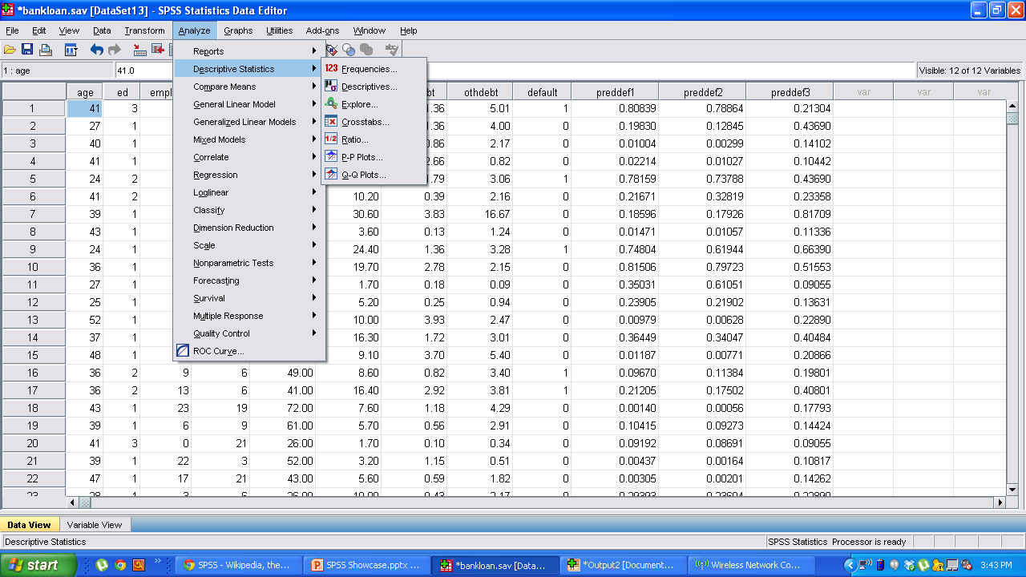
Available Features

Slide 12
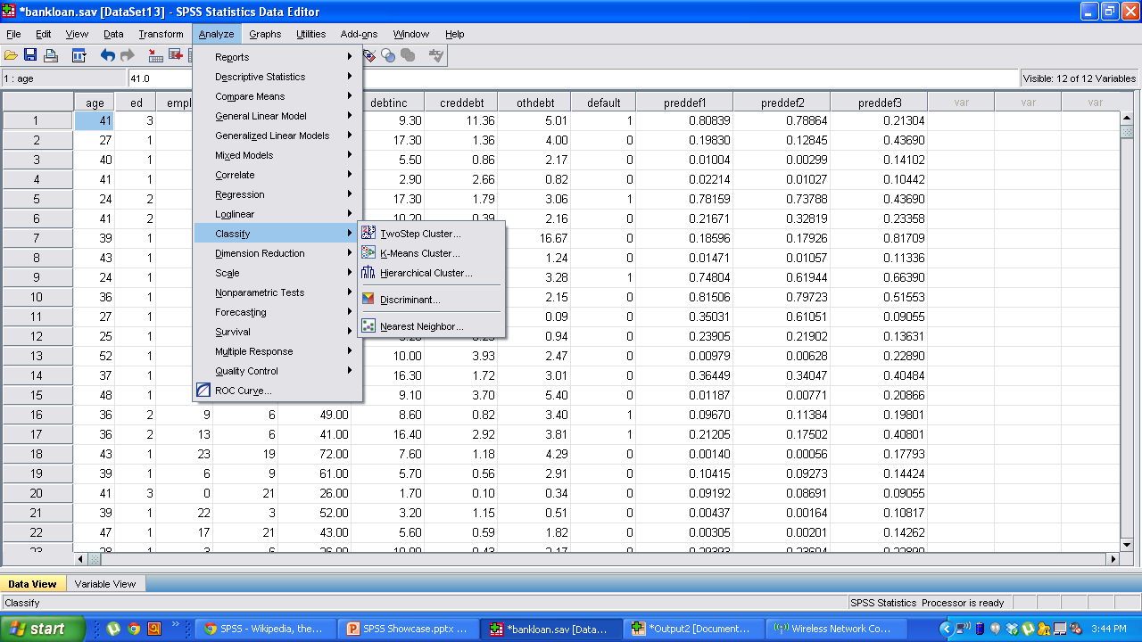
Available Features

Slide 13
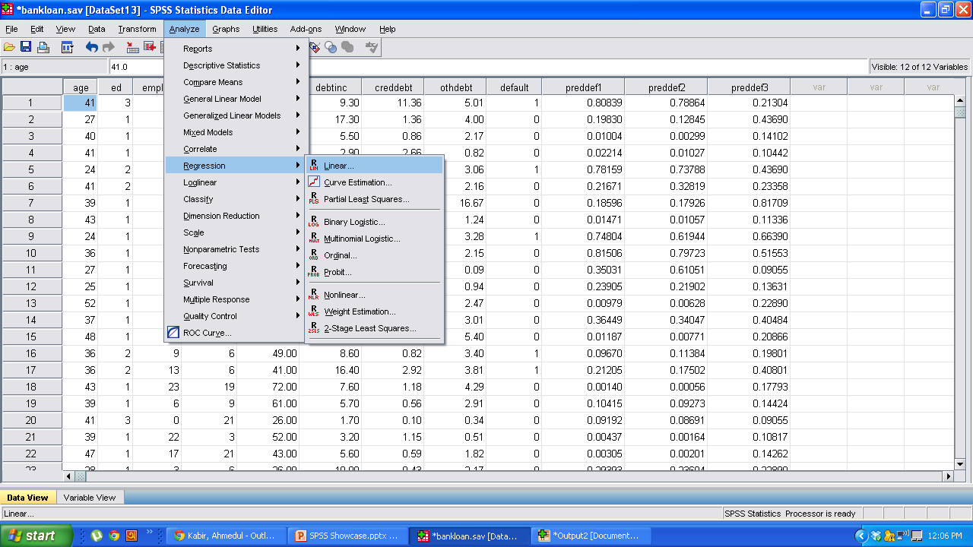
Demo (Linear Regression)

Slide 14
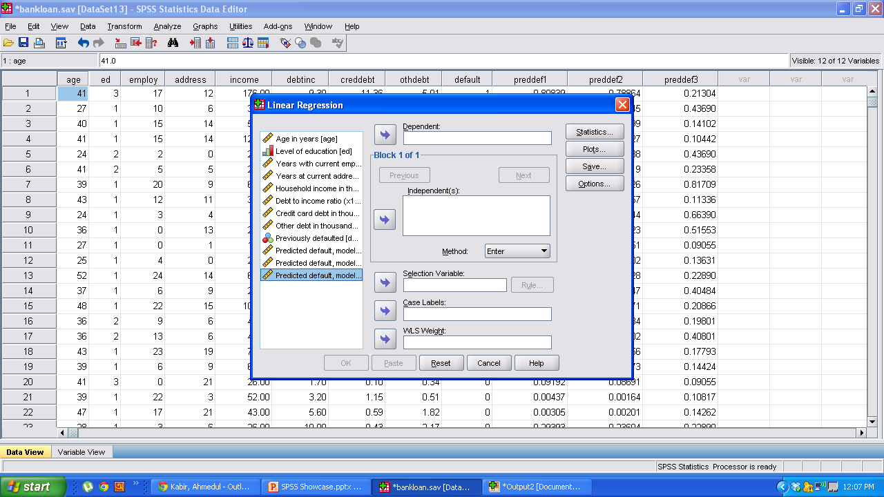
Demo (Linear Regression)

Slide 15
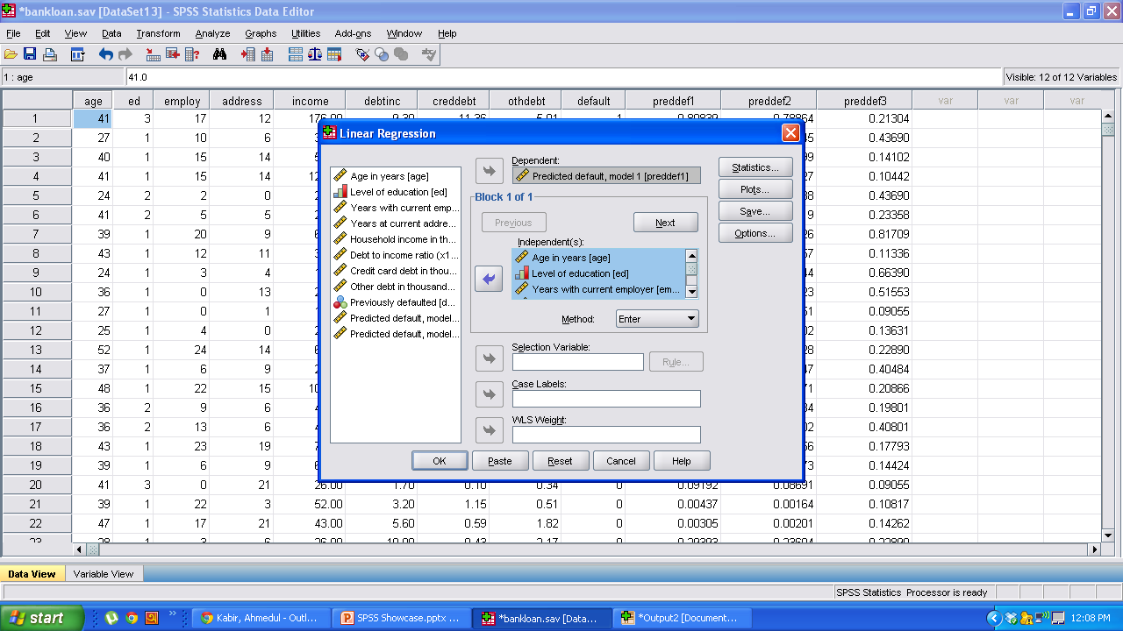
Demo (Linear Regression)

Slide 16
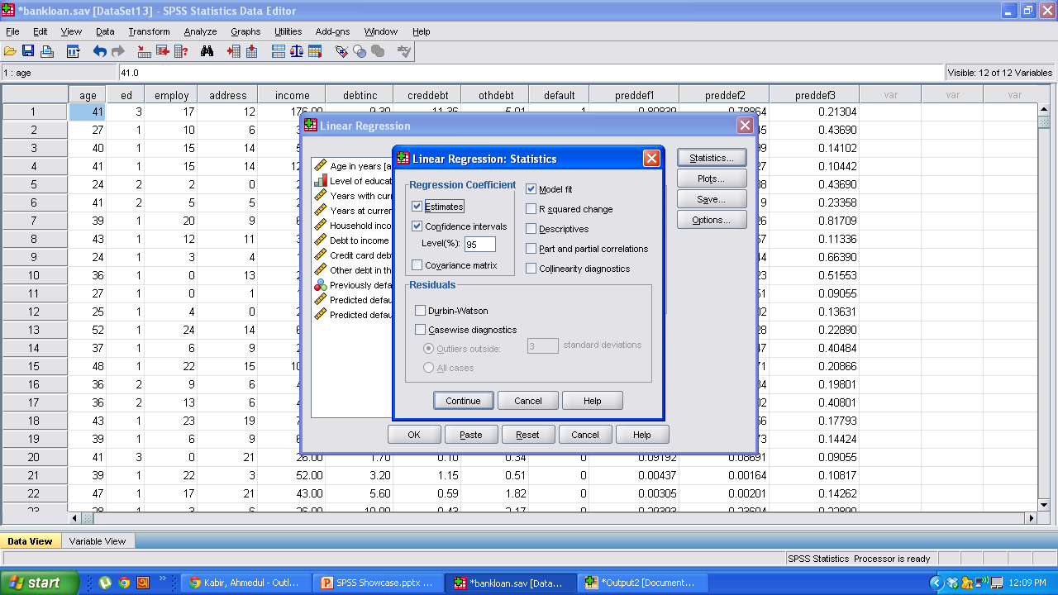
Demo (Linear Regression)

Slide 17
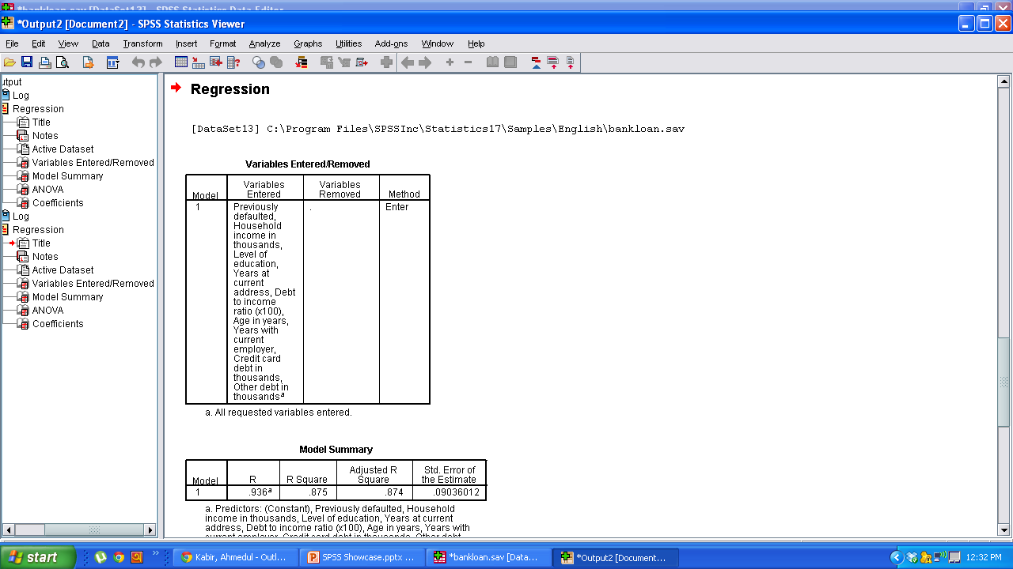
Demo Output

Slide 18
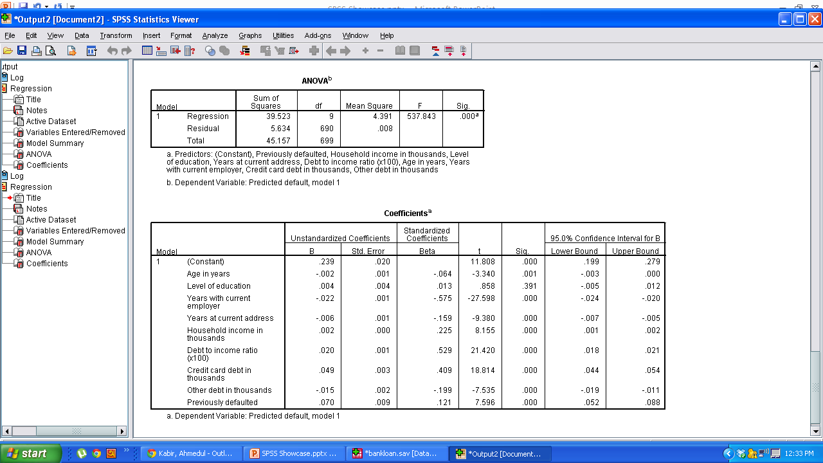
Predicted Score = -0.002*Age + 0.004*Level of Education – 0.22*Years with current employer + …..

Slide 19
Thank You!
Questions?

