Slide 1
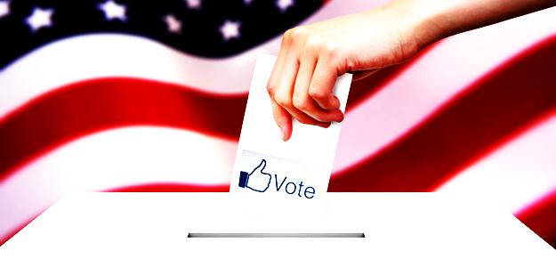
Data Mining in Politics
Alexis A. Espinoza J.
aaespinoza@wpi.edu
CS548 Showcase
04/11/14

Slide 2
Resources
http://poy.time.com/2012/12/19/obamas-data-team/ http://swampland.time.com/2012/11/07/inside-the-secret-world-of-quants-and-data-crunchers-who-helped-obama-win/ http://infospace.ischool.syr.edu/2013/01/24/data-mining-in-obamas-2012-victory/ http://www.stat.columbia.edu/~jakulin/Politics/ http://www.thenation.com/blog/174759/not-just-nsa-politicians-are-data-mining-american-electorate
- http://poy.time.com/2012/12/19/obamas-data-team/
- http://swampland.time.com/2012/11/07/inside-the-secret-world-of-quants-and-data-crunchers-who-helped-obama-win/
-http://infospace.ischool.syr.edu/2013/01/24/data-mining-in-obamas-2012-victory/
- http://www.stat.columbia.edu/~jakulin/Politics/
- http://www.thenation.com/blog/174759/not-just-nsa-politicians-are-data-mining-american-electorate
- http://www.huffingtonpost.com/karthika-muthukumaraswamy/campaign-data_b_2042524.html

Slide 3
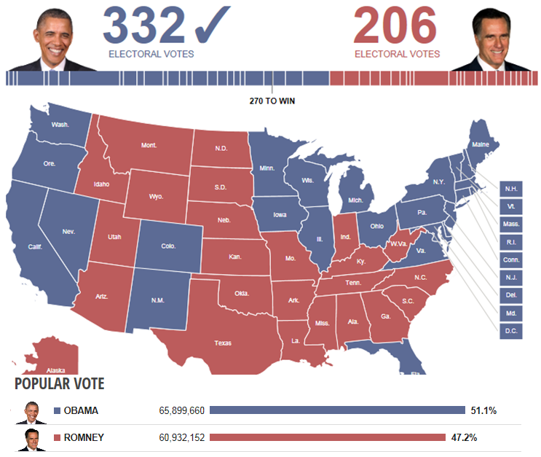
2012-Data mining from a political point of view
It is not just data, It is a mountain of political gold.
Less T.V. ads, leaflets, billboards or Yardsigns.
More complex high tech data mining.
Substancial victory thanks to data-mining techniques employed as opposed to a narrow one.
http://www.thenation.com/blog/174759/not-just-nsa-politicians-are-data-mining-american-electorate

Slide 4
2012-Data mining from a political point of view
Danger: Not for terrorists, people could be more easily manipulated.
The overall political goal is to sway substantial portions of voters by speaking to what is in their hearts, what is closest to them.
Lots of money into developing new data-mining algorithms
to maximize this sentiment analysis issue along with
fundraising.
http://www.thenation.com/blog/174759/not-just-nsa-politicians-are-data-mining-american-electorate

Slide 5
Data mining in Obama’s 2012 Victory
Efective mining of large databases of voters was a major factor.
Remade the process of targeting T.V. ads.
- Less phone calls and door knocks, more direct mailing
and social media.
Data crunching will be normal from now on in order for candidates to win elections.
http://infospace.ischool.syr.edu/2013/01/24/data-mining-in-obamas-2012-victory/

Slide 6
How did they do it?
Large amounts of data collected from different sources(Facebook,Twitter, Reddit, Other Private Corp) were accumulated into one big repository.
Combed through all the information to discover important patterns and draw conclusions about potential voters.
4 Metrics used:
1) Likelihood that they support Obama.
2) Likelihood that they show up at the polls.
3) Likelihood of unmotivated supporters to vote.
4) How persuadable someone could be by a phone
conversation.
http://infospace.ischool.syr.edu/2013/01/24/data-mining-in-obamas-2012-victory/

Slide 7
Results in action
How to raise 1 billion dollars?.
-Data analysis from social media: Affection for contests, small dinners and celebrities.
-West coast women age 40-49 liked George clooney and were likely to hand out cash.
Obama gets to dine with George Clooney and also gets 1 million dollars for his
campaign.
- Similar demographic patterns in the east coast liked Sarah
Jessica Parker and were likely to hand out cash too.
Obama gets a chance to eat at Parker’s West Village Brownstone.
http://swampland.time.com/2012/11/07/inside-the-secret-world-of-quants-and-data-crunchers-who-helped-obama-win/

Slide 8
Results in action
How to get the attention of voters?.
- Promote targeted facebook users with friends in swing states to send encouraging messages about the importance to vote.
-1 in 5 people who got the message to vote responded affirmatively just
because it came from someone they knew.
- Potential turn out voters were on reddit.
- T.V. Ads were bought during unconventional programs
such as: The walking dead, Sons of Anarchy, etc.
-14% more efficient than just buying an ad next to local news programming.
- Making sure they were talking to persuadable voters.
http://swampland.time.com/2012/11/07/inside-the-secret-world-of-quants-and-data-crunchers-who-helped-obama-win/

Slide 9
The Technology behind it
Too many databases. None of them talked to each other.
Open Source technology vs Private Technology.
1) Allow other programmers to review, build, improve and make changes
as they went.
2) Great Software Innovation as it was an in-house code.
http://infospace.ischool.syr.edu/2013/01/24/data-mining-in-obamas-2012-victory/

Slide 10
The future
About the Data…
-Unclear but probably will be used to assist other democrats in their campaigns.
- Unclear if it would work with other candidates
About the technology and code generated…
- Unclear, until this day, they have kept it a secret(Unclear if the software is licensed).
About the experts who worked on the code…
Most of them have been laid off, even some who worked for more ten years
http://infospace.ischool.syr.edu/2013/01/24/data-mining-in-obamas-2012-victory/

Slide 11
Conclusions
About the next 2016 elections….. and surely the rest to come
The party who invests more on technology, experts, and who understands best how to discover important knowledge in dynamic massive unreconciled data sources that show a meaningful representation of the voters tendency for favoring an option, could make a difference in winning future elections.

Slide 12
THANK YOU!!

