Slide 1
Using Data Mining in the Identification of Compromised Sensors
Presenter: Hang Cai

Slide 2
Reference
Advisor: Prof. Krishna Venkatasubramanian (kven@wpi.edu)
Kim, Duk-Jin, and B. Prabhakaran. "Motion fault detection and isolation in Body Sensor Networks." Pervasive and Mobile Computing 7.6 (2011): 727-745.
Kim, Duk-Jin, Myoung Hoon Suk, and B. Prabhakaran. "Fault detection and isolation in motion monitoring system." Engineering in Medicine and Biology Society (EMBC), 2012 Annual International Conference of the IEEE. IEEE, 2012.
Taghikhaki, Zahra, and Mohsen Sharifi. "A trust-based distributed data fault detection algorithm for wireless sensor networks." Computer and Information Technology, 2008. ICCIT 2008. 11th Int
Hajibegloo, Mohammad, and Amir Javadi. "Fast fault detection in wireless sensor networks." Digital Information and Communication Technology and it's Applications (DICTAP), 2012 Second International Conference on. IEEE, 2012.ernational Conference on. IEEE, 2008.
Klabunde, Richard. Cardiovascular physiology concepts. Lippincott Williams & Wilkins, 2011.
Malik, Marek, et al. "Heart rate variability standards of measurement, physiological interpretation, and clinical use." European heart journal 17.3 (1996): 354-381.
Goldberger, Ary L., et al. "Physiobank, physiotoolkit, and physionet components of a new research resource for complex physiologic signals."Circulation 101.23 (2000): e215-e220.

Slide 3
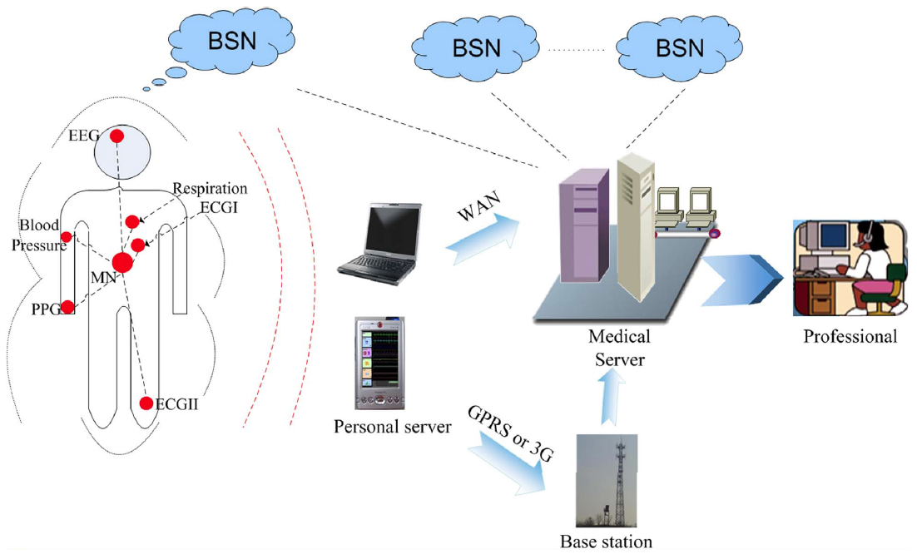
Introduction
Body Sensor Networks:
A network of wireless, wearable, and implanted health monitoring sensors
Designed to continually collect and communicate health information from the host
Security is important in BSNs due to:
Sensitive health information collected by them
Potential harm cause by tampering/modification of data
An important aspect of ensuring BSN security is prevention of physical compromise of nodes
Image from Physiological Signal Based Biometrics for Securing Body Sensor Network, By Fen Miao, Shu-Di Bao and Ye Li , DOI: 10.5772/51856

Slide 4
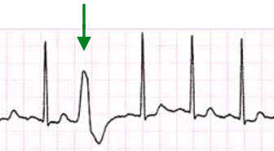
Node Compromise in BSN
Compromised Node
ECG Change
example
Erroneous Data generation
Our focus
Morphology Change
Inter-beat Change
Incorrect
patient state
Alarm Suppression
Safety Compromise
Normal Sinus Rhythm*
Compromised nodes are a big threat:
They can potentially introduce erroneous data into the BSN
Incorrect interpretation of patient health
Wrong diagnosis of a patient
Wearable sensors and those shared with others are particularly prone to compromise.
Atrial Tachycardia*
* From http://www.practicalclinicalskills.com/

Slide 5
Related Work & Problem Statement
Related work (mostly from Wireless Sensor Networks domain):
Use redundant nodes with same function to detect compromise
Divide the node into different subsets in terms of location
Use correlation of nodes from the same subset to determine the change
Constraints:
BSNs have few (usually zero!) redundant nodes
Cannot rely on node-level redundancy for compromise detection
Idea: physiological signals in BSN have inherent correlation with each other.
Problem Statement: find a compromised ECG sensors in the form of induced temporal variations, using cardiac features that manifest themselves in ECG as well as Systolic Blood Pressure (SBP) and Respiration (RESP) signal.

Slide 6
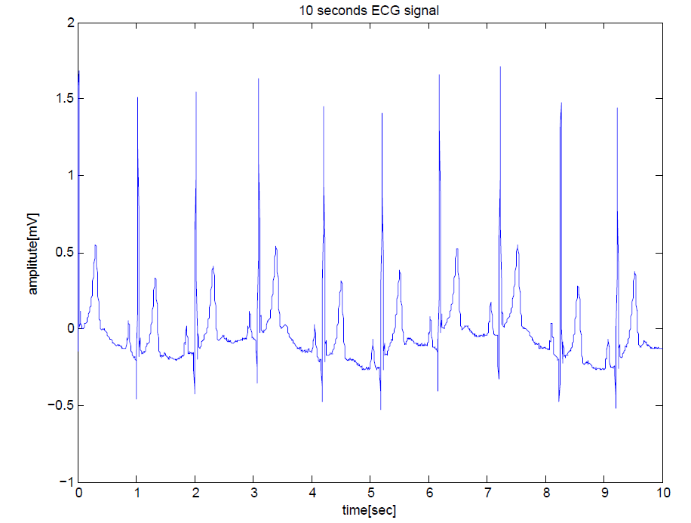
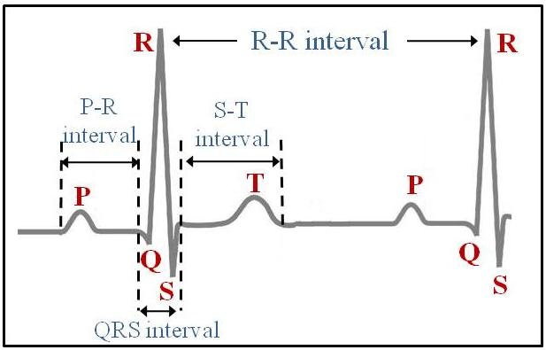
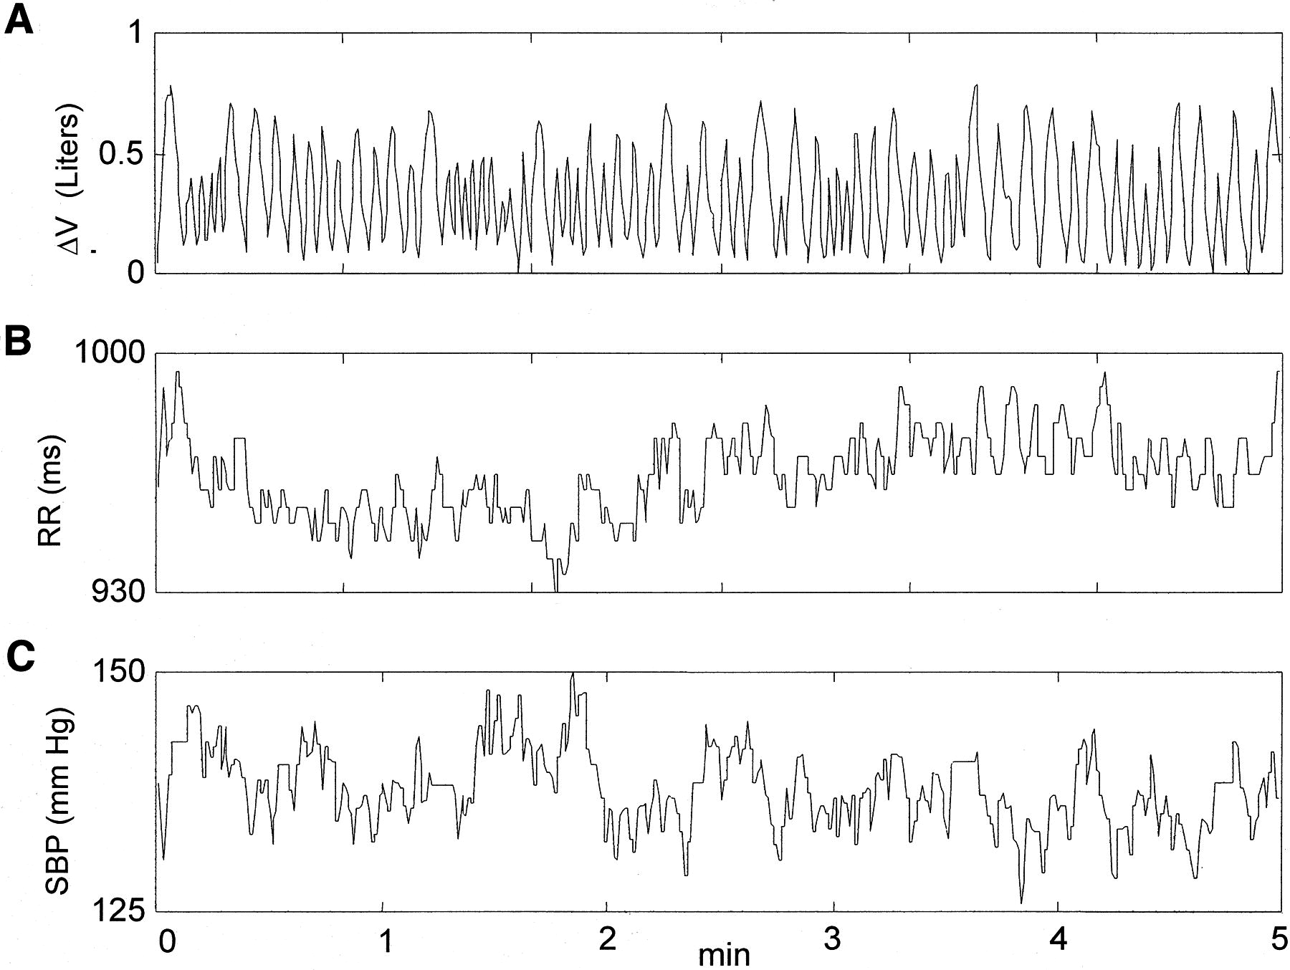
Physiological Background
ECG time series
Typical surface ECG complex (P, Q-R-S, T waves)
RR-interval, SBP and RESP are 3 cardiac-activity-related signals
Affected by autonomic nervous system
Sympathetic system(increase heart rate, blood pressure and respiration)
Parasympathetic system(slow heart rate, blood pressure and respiration)
A is RESP signal, B is RR-interval signal, C is SBP signal
Image from “GeM-REM: Generative Model-driven Resource efficient ECG Monitoring in Body Sensor Networks”, Sidharth Nabar, Ayan Banerjee, Sandeep K.S. Gupta and Radha Poovendran

Slide 7
Physiological Background
Mayer Wave
arterial blood pressure (AP) oscillations; observed in the 0.05 Hz – 0.15 Hz band
highly related with efferent sympathetic nervous activity
RSA Wave
oscillation in the RR tachogram due to parasympathetic activity; observed in the 0.15 Hz – 0.4 Hz band
synchronous with the respiratory cycle
alternation between inspiratory RR interval Shortening and expiratory RR interval lengthening
Image From “A Dynamical Model for Generating Synthetic Electrocardiogram Signals”, Patrick E. McSharry, Gari D. Clifford, Lionel Tarassenko, and Leonard A. Smith

Slide 8
Feature Generation
ECG Time series
Systolic Blood Pressure Time series
Calculate RR-interval
Time Domain Feature Generation
Respiration Time series
Magnitude Squared Coherence
Magnitude Squared Coherence
MSC Feature Generation
Power Spectrum Density (SPD)
Power Spectrum Density (PSD)
Power Spectrum Density (PSD)
Mayer Wave
[0.05 Hz – 0.15 Hz] band
Mayer Wave
[0.05 Hz – 0.15 Hz] band
RSA Wave
[0.15 Hz – 0.4 Hz] band
RSA Wave
[0.15 Hz – 0.4 Hz] band
PSD Feature Generation

Slide 9
Validation Setup
ECG Time series
5 minutes synchronized ECG, SBP & RESP collected from one subject
Feature Generation
Feature Labeling
Training Set
SBP
+
RESP Time Series
5 minutes ECG, SBP & RESP collected from two different subjects
Feature Generation
Feature Labeling
ECG Time series
(from different subject’s ECG)

Slide 10
Validation Setup
Dataset* Parameters | Values
Number of Subjects | 12
Subject Group 1 (f2o*) | 70-85 years (5 subjects)
Subject Group 1 (f2y*) | 21-34 years (7 subjects)
Signal Length | 90 minutes
Sampling Rate | 250Hz
Source | Feature Types
Time Domain Features | Average RR-interval
 | Average Systolic-peak-interval
 | Ratio of average RR-interval and average systolic-peak-interval
PSD Features | Mayer wave frequency difference
 | RSA wave frequency difference
MSC Features | Highest power in LF in MSC
 | Lowest power in LF in MSC
 | Average power in LF in MSC
 | Highest power in HF in MSC
 | Lowest power in HF in MSC
 | Average power in HF in MSC
 | Peak number in LF in MSC
 | Peak number in HF in MSC
 | Total peak number in MSC
Patient data obtained from www.physionet.org (Fantasia database)
*Iyengar N, Peng C-K, Morin R, Goldberger AL, Lipsitz LA. Age-related alterations in the fractal scaling of cardiac interbeat interval dynamics. Am J Physiol 1996;271:1078-1084.
*Iyengar N, Peng C-K, Morin R, Goldberger AL, Lipsitz LA. Age-related alterations in the fractal scaling of cardiac interbeat interval dynamics. Am J Physiol 1996;271:1078-1084.

Slide 11
Learning Algorithm
Decision Table
A schema, which consists of a set of features.
A body, which consists of a multi-set of labeled instances. Each instances has a value for each feature and value for the label.
Logistic Model Tree
Decision Tree
Random Forest
Random Forests grows many classification trees. To classify a new object from an input vector, put the input vector down each of the trees in the forest. Each tree gives a classification, and we say the tree "votes" for that class. The forest chooses the classification having the most votes (over all the trees in the forest).
Notes:
We assume that the user knows about the construction of single classification trees. Random Forests grows many classification trees. To classify a new object from an input vector, put the input vector down each of the trees in the forest. Each tree gives a classification, and we say the tree "votes" for that class. The forest chooses the classification having the most votes (over all the trees in the forest).

Slide 12
Results

Slide 13
Conclusion
This goal of this work is to detect a compromised ECG sensor in a BSN by leveraging the inherent correlation among ECG, SPB and RESP signals.
The results show that we can get over 94% accuracy with relatively average low error rates
Future work:
Improve compromise detection accuracy even further.
Develop a system that can detect morphology changes of ECG in addition to temporal .

