Slide 1
Showcasing work by Arbelaitz, Olatz - Lojo, Aizea - Muguerza, Javier - Perona, Iñigo
On
Web mining for navigation problem detection and diagnosis in Discapnet: A website aimed at disabled people
CS548 Fall 2016 Webmining Showcase
Showcase by: Abdulaziz Alajaji; Yupeng Su; Ye Wang; Tingwen Zhou

Slide 2
References
[1] M. T. Ramakrishna, L. K. Gowdar, M. S. Havanur and B. P. M. Swamy. Web mining: Key accomplishments, applications and future directions. 2010, . DOI: 10.1109/DSDE.2010.53.
[2] A. Scime, Books24x7 IT Pro Collection and I. ebrary. Web Mining: Applications and Techniques 2004.
[3] H. Zhang, SpringerLink ebooks - Computer Science and Lecture Notes in Computer Science Contemporary (1997-present).
[4] Advances in Web Mining and Web Usage Analysis: 9th International Workshop on Knowledge Discovery on the Web, WebKDD 2007, and 1st International Workshop on Social Networks Analysis, SNA-KDD 2007, San Jose, CA, USA, August 12-15, 2007 : Revised Papers 20095439. DOI: 10.1007/978-3-642-00528-2.
[5]Anitha, A. “A new web usage mining approach for next page access prediction”, International Journal of Computer Applications, 8(11),7–9. 2010
[6]Carmona, C., Ramírez-Gallego, S., Torres, F.,et al. “Web usage mining to improve the design of an e-commerce website: Orolivesur.com”. Expert Systems with Applications, 39(12), 11243–11249. 2012

Slide 3
Agenda
Web site Description
Motivation
Problem
Why Data mining
Data Acquisition / Preprocessing
Feature Extraction
Pattern Discovery
Operational Phase & Evaluation
Conclusion

Slide 4
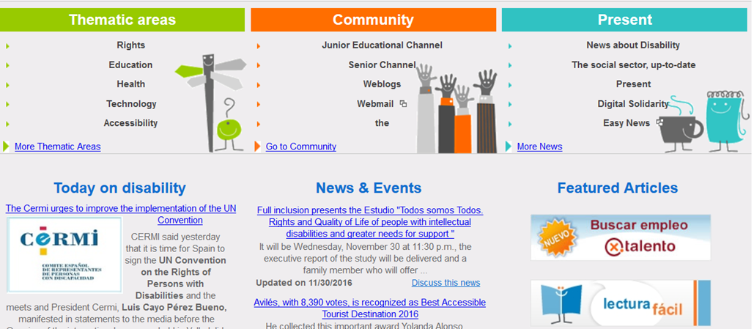
Discapnet: Portal for people with disabilities
Initiative to promote social and work integration of people with disabilities.
Aimed at visually disabled users.
Other disabled or elderly people might access it too.

Slide 5
Motivation
Information Era
Dramatic increase in amount of information stored.
Digital skills are considered fundamental.
Important to familiarize all types of users including disabled users with digital devices.
Adapt websites to be more accessible.
Navigating through audio web interfaces is a challenging task.
Up to 5X times longer to read than sighted users.

Slide 6
Problem
For assessing Accessibility in Web applications:
Theoretical accessible design is not sufficient to enable efficient access for people with disabilities.
Need to analyze users’ interactions with the website to detect possible problems and provide solutions.
To Enhance user experience

Slide 7
Proposed solution
Building non-invasive system, capable of modeling users in the wild.
By using Data mining:
Not disruptive,
Based on real-time navigation data,
Adaptive.

Slide 8
Web mining task
Web usage & web content mining
Mainly focus on Usage (gathered from web logs) to analyze interactions.
but also consider Content of webpages for finding the source of problems.

Slide 9
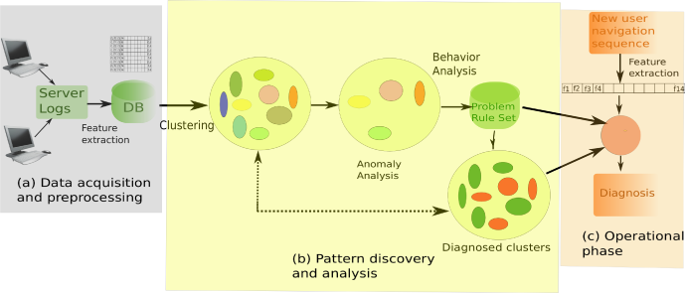
Proposed System Stages

Slide 10
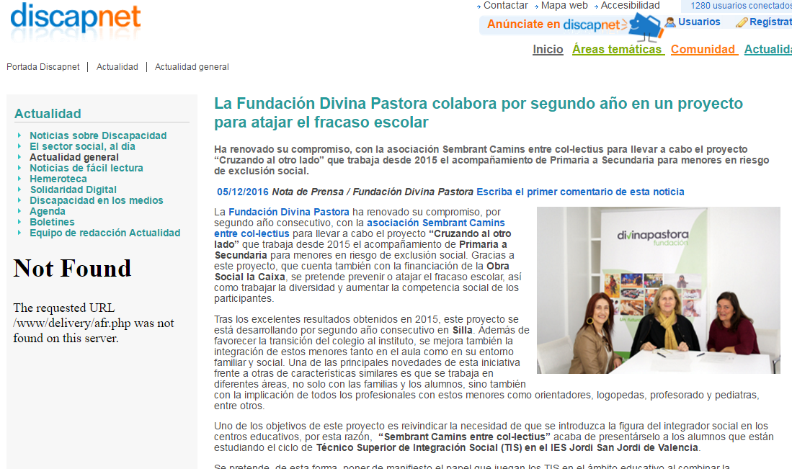
Discapnet Website: Structure
Content-type page:

Slide 11
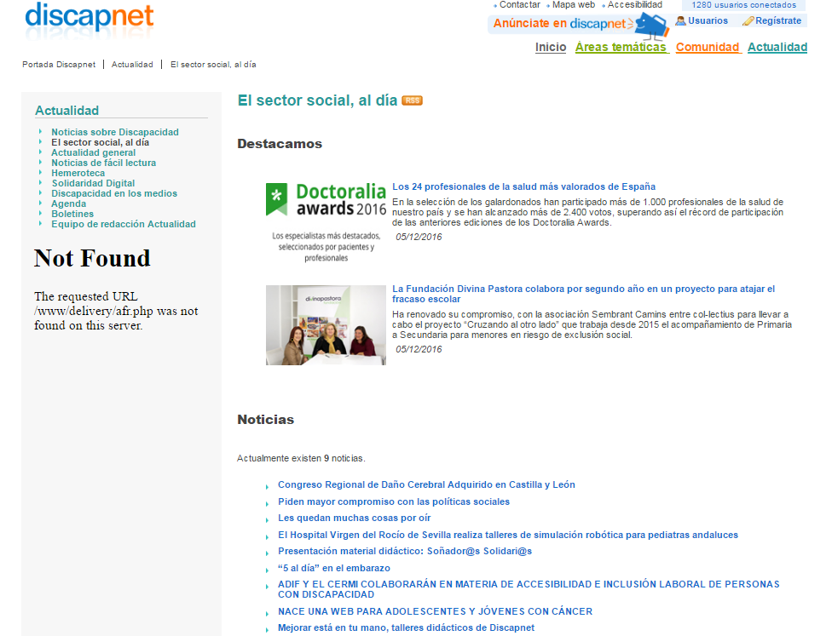
Discapnet Website: Structure
Link-type page:
Notes:
Nwords: number of words in page
NwordsLinks: number of words in the links of the page
Nlinks: number of links in the pages

Slide 12
Data Acquisition / Preprocessing
Data Acquisition:
Taken from Web-server logs, provided by Technosite (Interesting: IT provider, has a social mission, with many disabled workers).
The web-server (hosting Discapnet) logs contains requested pages information (URL, Ip Address, Timestamp, .. other http information).

Slide 13
Log example
For Each user requests, Web server log that with several lines:
(1)
Direct Request URL:
/Castellano/comunidad/websocial/Recursos/Bibliografia/A/Pag
inas/Implante+coclear++cuaderno+de+ejercicios+de+rehabilitacion.aspx
Indirect-Request URLS (requested by web browser):
/Castellano/Documents/ZonaBanners/Zona-CC.txt
/img/logo-discapnetMini.gif
/_layouts/3082/InitNoPresence.js
/img/bg/volver.gif
/img/bg/h-linea.gif

Slide 14
Data Acquisition / Preprocessing
Preprocessing
Initially, the dataset has 157M Requests.
Reduced to 13M Requests, removed indirect-requests & error connections.
Grouped by session ID, use 10 minutes timeframe)
Consider only sessions with at-least three clicks and remove outliers (web-robots, with so many clicks)
Process | Requests | Sessions
In log files | 157,527,312
Valid after sessioning | 13,352,801 | 907,404
After removing outliers | 2,828,248 | 241,311

Slide 15
Feature Extraction
/Castellano/comunidad/websocial/Recursos/Bibliografia/A/Paginas/Implante+coclear++cuaderno+de+ejercicios+de+rehabilitacion.aspx
/Castellano/Documents/ZonaBanners/Zona-CC.txt
/img/logo-discapnetMini.gif
/_layouts/3082/InitNoPresence.js
/img/bg/volver.gif
/img/bg/h-linea.gif

Slide 16
Feature Extraction
Goal: determine the features that would be appropriate to detect different types of difficulties in navigation.
Four types of pages:
Other-type: dynamic nature pages.
Index-type: default page.
Content-type: more contents than link.
Link-type:more link than contents.
Notes:
Question: What is the "index.html" page on a website?
Answer: The index.html page is the most common name used for the default page shown on a website if no other page is specified when a visitor requests the site.

Slide 17
Feature Extraction
type ∊ {content, link, other-type, index-type}
topic ∊ {topic1, topic2,....}
Use depth 3 as the topic
/Castellano/comunidad/websocial/Recursos/Bibliografia/A/Paginas/Implante+coclear++cuaderno+de+ejercicios+de+rehabilitacion.aspx

Slide 18
Feature Extraction
Determine web type.
LCindex = (Nwords - NwordsLinks)/Nlinks

Slide 19
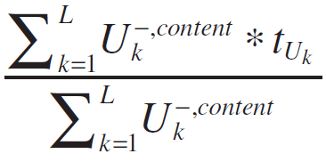
Feature Extraction
t_cont:
L = number of links
k = kth of L

Slide 20
Feature Extraction
Nreqs | Number of requests in the user session
t_avg | Average time spent in each link
t_link | Average time spent in each link type URLs
t_cont | Average time spent in each content type URLs
t_oth | Average time spent in each other-type URL
%link | Proportion of link type URLs
%cont | Proportion of cont type URLs
%other | Proportion of other type URLs
%index | Proportion of index-type URLs
%dirLink | Between all the transitions proportion of them done using direct links from the site
%change | Proportion of times the access of a new URL involved a change of topic or zone
%topic | Number of different topics or zone visited normalized with the length of the sequence
cha_top | Relation between number of topic or zone changes and different topics visited
ind_top | Relation between the number of times the index page is visited and amount of different topics or zones visited

Slide 21
Feature Extraction
 | Nreqs | time avgs | time link | timecont | time other | % link | % cont | % other | % index | %dir link | % chan | % topic | chan topic | index topic
Mean | 11.7 | 70.3 | 59.7 | 48.3 | 53.3 | 0.34 | 0.23 | 0.44 | 0.11 | 0.25 | 0.31 | 0.37 | 1.4 | 0.64
SD | 14.3 | 79.4 | 93.2 | 89.2 | 86.3 | 0.26 | 0.26 | 0.29 | 0.19 | 0.24 | 0.26 | 0.26 | 0.75 | 2.06
P10 | 3 | 2.5 | 0 | 0 | 0 | 0 | 0 | 0 | 0 | 0 | 0 | 0.09 | 1 | 0
P25 | 4 | 12.5 | 2 | 0 | 1 | 0.14 | 0 | 0.2 | 0 | 0 | 0 | 0.17 | 1 | 0
P50 | 6 | 45.4 | 22.5 | 4 | 14 | 0.33 | 0.15 | 0.5 | 0 | 0.25 | 0.29 | 0.33 | 1 | 0
P75 | 12 | 95.8 | 75 | 58.3 | 69 | 0.5 | 0.33 | 0.67 | 0.2 | 0.43 | 0.52 | 0.5 | 1.5 | 0.67
P90 | 26 | 179 | 167 | 152 | 156 | 0.67 | 0.67 | 0.8 | 0.4 | 0.6 | 0.67 | 0.75 | 2 | 2
Notes:
The average time spent on link-type pages is greater than expected!
It’s greater than time spent on other pages (content-type / other-types)
Another issue they have discovered: There is a small proportion of URL transitions made using the links, which might suggest unusual navigation, maybe they use Google/Search engines.

Slide 22
Pattern Discovery and Analysis
Identification of Problematic Session
Anomaly Detection
Problem Discovery and Detection
Generating the problem rule set (PRS).

Slide 23
Pattern Discovery and Analysis
-Identification of Problematic Session
Using the K-Mean with Euclidean Distance.(K = 1000)
Find the centroids for each cluster.
Identify the outlier cluster
For the centroid in one cluster, when it has more than 4 anomaly features, the cluster is outlier cluster
254 Outlier Clusters
feature_{value} < P₁₀
feature_{value} > P₉₀
Anomaly feature

Slide 24
Pattern Discovery and Analysis
Problem Discovery and Detection
Combining the anomaly feature in the outlier cluster and the domain knowledge, find the patterns in the dataset.
Example:
‘t_link > P90 ∧ (t_cont < P10 ∨ t_oth < P10) & ∧%link > P90 ∧ (%cont < P10 ∨ %oth < P10)‘ will be find in some cluster’s anomaly features.
Interpret with domain knowledge
High number of link-type pages
Long time spending in each link-type pages.
Users may have visual disability

Slide 25
Pattern Discovery and Analysis
-Problem Rule Set(PRS)
 | Indicators | Behavioral Description | Hypothetical source
Profile 1 | t link> P90 ∧(Lcont < P10 V Loth < A%link > Pm n (%cont < P10 v %oth < Pal) | — High number of link-type pages. — Long time spent in each link-type page | User
Profile 2 | index topic > P90 ∧(%topic < P10 ∧change_topic < P10) — Index page visited very often | — Index page visited very often — While navigating in a single topic User | User
Profile 3 | (Llink > P00, Lcont > P90, Loth> P90) two out of three | — Long time spent in the visited pages User | User
Profile 4 | %topic > P90 | — Changing topics very often | Web
Profile 5 | (t_cont > P90 v loth P90) A%directLink <P10 | — Long time in content- or other-type pages — Short time spent in link-type pages — However, navigation using external links | Web
Profile 6 | change_topic > P90 | — Constantly changing topics, but visiting few topics Web Profile? | Web

Slide 26
Pattern Discovery and Analysis
-Problem Rule Set(PRS)
 | Indicators | Behavioral Description | Hypothetical source
Profile 7 | Llink> P90 ∧%directLink > P90 | — Long time spent in link-type pages — Navigation using links of the website structure | Web
Profile 8 | %link> P90 ∧ %directLink> P90 | — Navigation using links of the website structure — High number of accesses to link-type pages | Web
Profile 9 | %index > P90 | — High number of accesses to index pages Web | Web

Slide 27
Explanation for PRS
The profile shows the properties for the outliers, the reason is different for different users.
Users
For person with disabilities, they may show something special when clicking the website.
Website
Some website is not efficient or uncomfortable for users.

Slide 28
Operational Phase
33.5% of Discapnet users have navigation problem in this website. This method can test the requirement for the improvement of the website.
For a new user, according to the behaviour, the website can classify the user based on PRC or the label of the nearest cluster.
Notes:
Evaluate the website.
Find the disability.

Slide 29
Evaluation and Conclusion
Evaluate the detection rate using 254 anomaly clusters.
2. Evaluate new users in experiment.

Slide 30
Detection rate of 254 clusters
 |  |  | User Related |  |  | Web Related
 |  |  | p1 | p2 | p3 | p4 | p5 | p6 | p7 | p8 | p9 | Total
N examples in complete database |  |  | 1,680 | 2,525 | 17,298 | 20,219 | 376 | 25,125 | 1,130 | 202 | 21,985 | 80,787
% in clusters labeled anomalous |  |  | 85.34 | 90.7 | 58.5 | 82.3 | 100.0 | 30.3 | 15.1 | 42.1 | 24.9 | 43.4
First row: Number of problematic sessions of different profiles.
Second row: How many of them are found in 254 anomaly clusters. (Detection rate)
Higher proportion in user-related profiles!

Slide 31
PRS + Clusters
80, 787 problematic sessions
254 anomaly clusters

Slide 32
Experiment-based evaluation
 | Free navigation | Target navigation | Total
Visually impaired | 13 | 11 | 24
Physically impaired | 11 | 11 | 22
Test result
Visually impaired | 8 | 10 | 18
Physically impaired | 10 | 10 | 20
Total | 18 | 20 | 38
Percentage | 75% | 90.9% | 82.6%
10 able-bodied people are also invited into the experiment and 50% of them are detected to have navigation problem. But all the problems are web-based.

Slide 33
Result analysis:
Most disabled users are diagnosed by our system as having experienced problem during navigation
Physically impaired users tend to have navigation problems with higher probability than visually impaired users.
Distribution of hypothetical source of problems: 20 are from users and 18 are from the website.

Slide 34
Thank You!!

