Slide 1
CS548 Fall 2016 Model and Regression Trees Showcase by Tom Hartvigsen, Mu Niu, Qingyun Ren, and Allison Rozet
Showcasing work by Jinxian Weng, Yang Zheng, Xiaobo Qu, and Xuedong Yan on “Development of a maximum likelihood regression tree-based model for predicting subway incident delay,” Transportation Research Part C: Emerging Technologies, vol. 57, pp. 30-41, Aug. 2015.

Slide 2
References
H. Akaike, “A New Look at the Statistical Model Identification,” IEEE Transactions on Automatic Control, vol. 19, issue 6, pp. 716-723, Dec. 1974.
Y. Chung, “Development of an Accident Duration Prediction Model on the Korean Freeway Systems,” Accident Analysis & Prevention, vol. 42, issue 1, pp. 282-289, Jan. 2010.
G. James, D. Witten, T. Hastie, R. Tibshirani, An Introduction to Statistical Learning: With Applications in R, New York: Springer-Verlag New York, 2013.
X. Su, M. Wang, J. Fan, “Maximum Likelihood Regression Trees,” Journal of Computational and Graphical Statistics, vol. 13, no. 3, pp. 586-598, Sep. 2004.
J. Weng, Y. Zhang, X. Qu, X. Yan, “Development of a Maximum Likelihood Regression Tree-Based Model for Predicting Subway Incident Delay,” Transportation Research Part C: Emerging Technologies, vol. 57, pp. 30-41, Aug. 2015.
Hong Kong Subway Delay Penalty News (2014, May 15). [Online]. Available: http://news.sina.com.cn/c/2014-05-15/090830140431.shtml
Hong Kong Subway Delay Frequency and Penalty Article (2015, Sep. 8). [Online]. Available: http://www.vccoo.com/v/f54362

Slide 3

Outline
Background & Case Study
Methodology
Model Evaluation
https://cleantechnica.com/2014/11/17/hong-kongs-metro-success/

Slide 4
Background & Case Study

Slide 5
Preliminaries
Subway incident - the breakdown of a subway service caused by system component failures
Delay - the difference between the scheduled and actual subway train departure times
Hong Kong’s Mass Transit Railway (MTR) is fined up to $1.9 million USD every time there is a delay that lasts 31 minutes or more.
In 2012 and 2013, the MTR was fined $5.2 million USD.
  2012 → $1.7 million USD; 2013 → $3.5 million USD
In 2015, the MTR had a 5-minute delay for every 1.7 million km run.
  Fined $770,000 USD for the first half of the year.

Slide 6

Contributions to MTR
To build a model that accounts for the heterogeneity effect and avoids the overfitting problem.
To help subway staff to quickly implement the most effective strategies for reducing subway incident delays.
https://cleantechnica.com/2014/11/17/hong-kongs-metro-success/

Slide 7


Data resource
Hong Kong subway incident data between 2005 and 2009
  Legislative Council of Hong Kong
  Google research

Slide 8

Data
11 attributes
  2 attributes represent time
  8 major causes of subway incidents
  1 target attribute represents delay time
1332 subway incident records
  80% for training (1066 records).
  20% for tree validation (266 records)

Slide 9
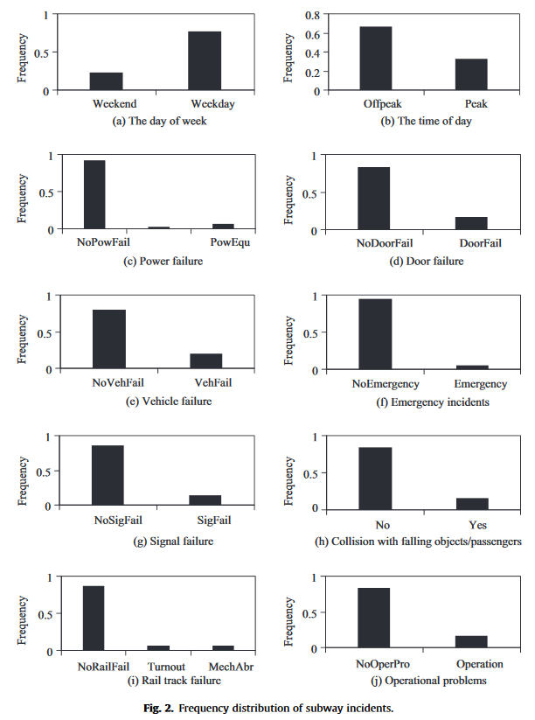
Frequency distribution
Statistical numbers
  Range: 8 min to 418 min
  Standard deviation: 18.2 min
  Mean: 14.6 min
Showed the distribution of subway incident records

Slide 10
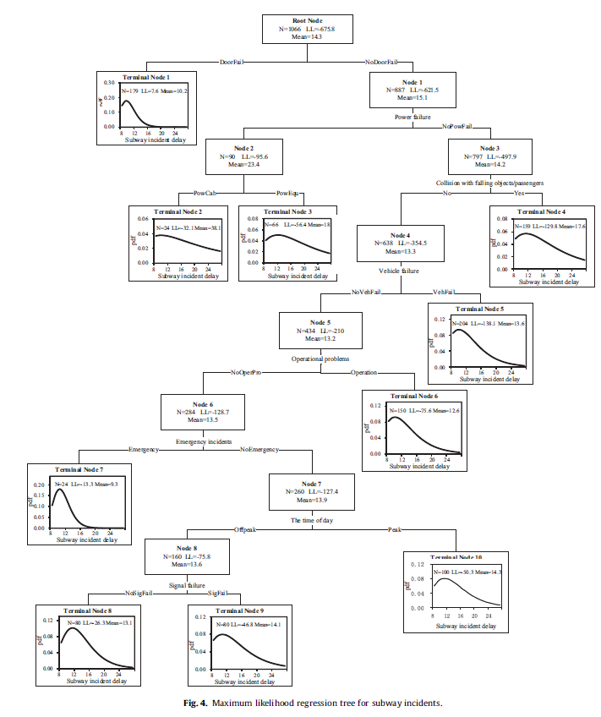
Result
Initial split is at door failure
10 terminal nodes in total
Check increment of log-likelihood
  If positive, split further
  If negative, set as terminal node
Assigned unique AFT models to each terminal nodes

Slide 11
Methodology

Slide 12
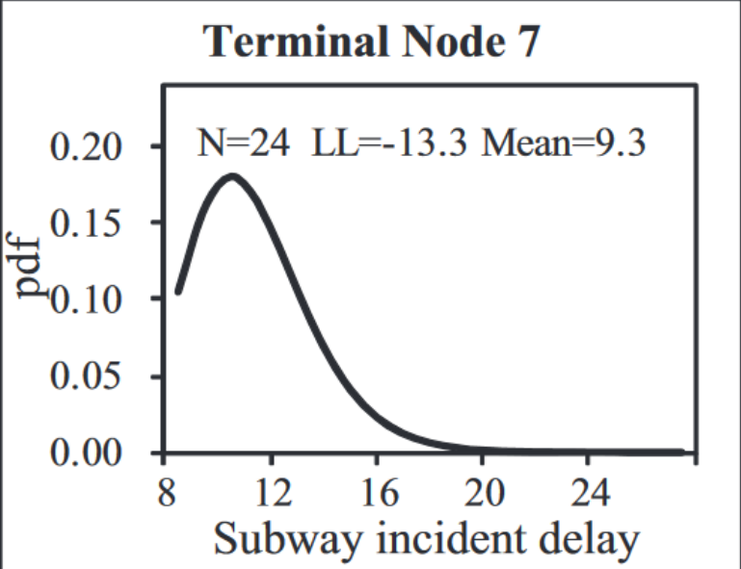
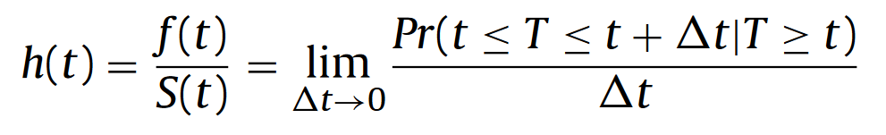
Accelerated Failure Time (AFT) Model
Chung, 2010
Variable | Coefficient | Percent Change
Day of the week | -0.2126 | e^{-0.2126} ≈ 0.81→ 19% decrease
Notes:
Hazard-based duration model: analyzes data in the form of time between a starting event and an ending event.
Assumes explanatory variables are independent and homogeneous.
Day of the week: Weekend = 0; Weekday = 1

Slide 13
Maximum Likelihood Regression Tree-Based Model
Subway Incident Delay is a Continuous Target Variable
Notes:
Algorithm: Break up data into tree by features. Create a pdf of the lognormal distributed AFT Model

Slide 14
Maximum Likelihood Tree Structure
Two steps: Tree Growing and Tree Pruning

Slide 15
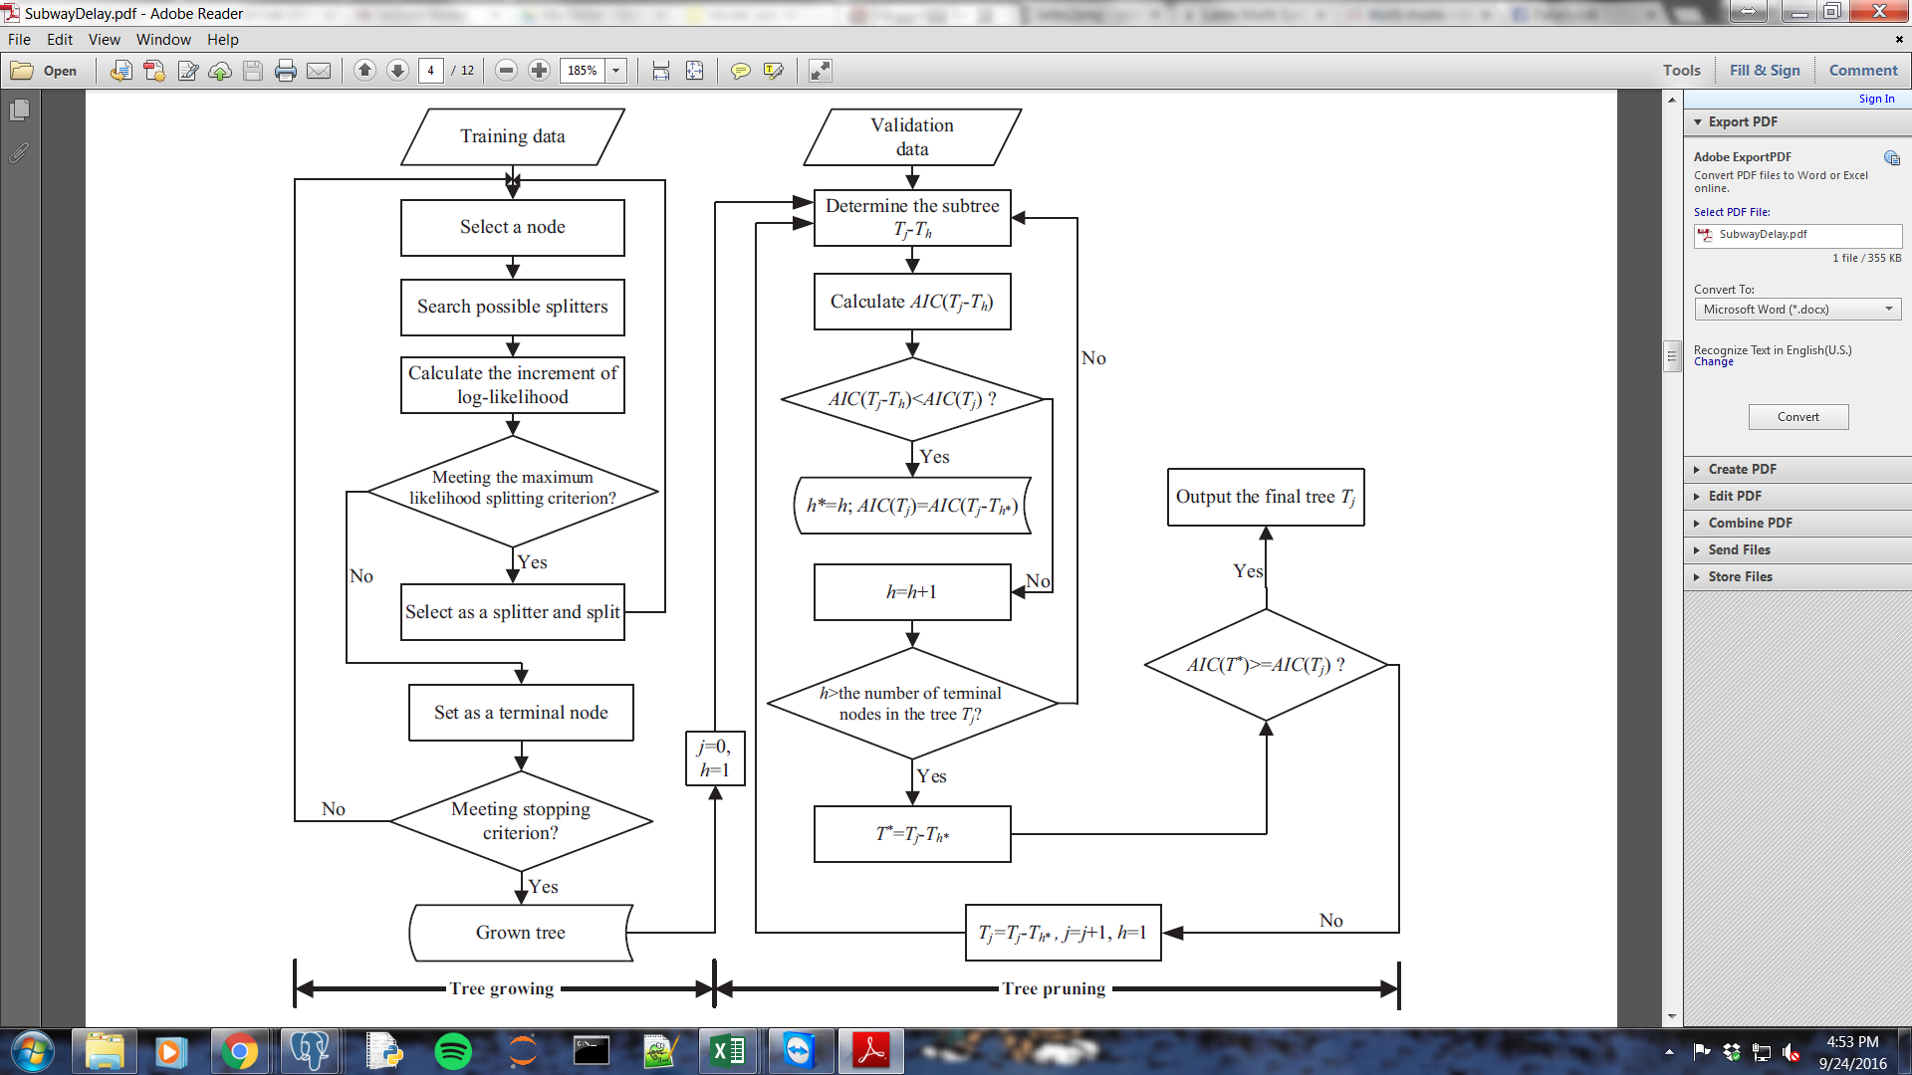
Maximum Likelihood Tree Structure
Two steps: Tree Growing and Tree Pruning

Slide 16
Maximum Likelihood Tree Structure
Two steps: Tree Growing and Tree Pruning
Tree Growing

Slide 17
Maximum Likelihood Tree Structure
Two steps: Tree Growing and Tree Pruning
Tree Growing
  Determining the best variable and split point
Notes:
Mention that it’s a recursive algorithm

Slide 18
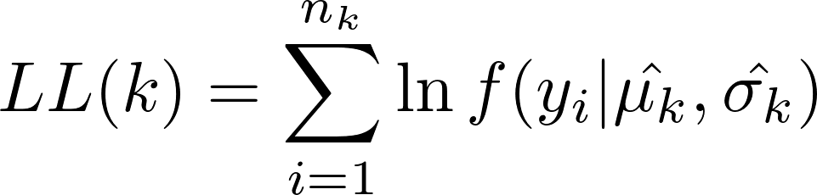
Maximum Likelihood Tree Structure
Two steps: Tree Growing and Tree Pruning
Tree Growing
  Determining the best variable and split point
    Step 1. Determine parameters of the AFT models using maximum likelihood estimation techniques
Notes:
Maximize the log likelihood by estimating mu and sigma, which are then used in the corresponding aft model

Slide 19
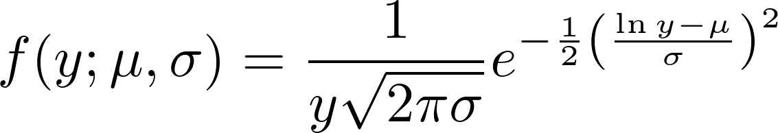

Maximum Likelihood Tree Structure
Two steps: Tree Growing and Tree Pruning
Tree Growing
  Determining the best variable and split point
    Step 1. Determine parameters of the AFT models using maximum likelihood estimation techniques
Notes:
Maximizing the log likelihood function corresponds to minimizing the standard deviation

Slide 20
Maximum Likelihood Tree Structure
Two steps: Tree Growing and Tree Pruning
Tree Growing
  Determining the best variable to and split point
    Step 1. Determine parameters of the AFT models using maximum likelihood estimation techniques
    Step 2. Compute maximum log-likelihood increment on the parent node by a split s
Notes:
From these log likelihood calculations, we calculate the change in log-likelihood by adding the log-likelihood of each child node and subtracting the log-likelihood of the parent node

Slide 21
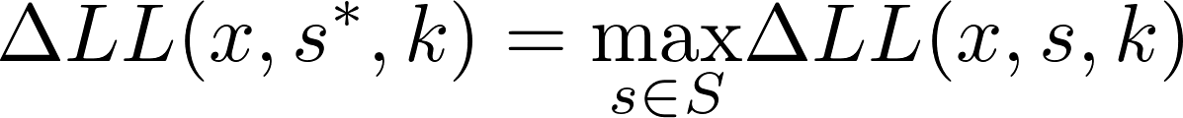
Maximum Likelihood Tree Structure
Two steps: Tree Growing and Tree Pruning
Tree Growing
  Determining the best variable and split point
    Step 1. Determine parameters of the AFT models using maximum likelihood estimation techniques
    Step 2. Compute maximum log-likelihood increment on the parent node on var. x
      Choose s based on log-likelihood gain
Notes:
Choose split point s that maximizes the log-likelihood for that specific node

Slide 22
Maximum Likelihood Tree Structure
Two steps: Tree Growing and Tree Pruning
Tree Growing
  Determining the best variable and split point
    Step 1. Determine parameters of the AFT models using maximum likelihood estimation techniques
    Step 2. Compute maximum log-likelihood increment on the parent node on var. x
      Choose s based on log-likelihood gain
      Split can only be used if this increment is greater than zero (purity must improve)
Notes:
Choose split point s that maximizes the log-likelihood for that specific node

Slide 23
Maximum Likelihood Tree Structure
Two steps: Tree Growing and Tree Pruning
Tree Growing
  Determining the best variable and split point
    Step 1. Determine parameters of the AFT models using maximum likelihood estimation techniques
    Step 2. Compute maximum log-likelihood increment on the parent node on var. x
    Step 3. Best variable is chosen based on log-likelihood gain
Notes:
Choose the variable that increases the log-likelihood the most

Slide 24
Maximum Likelihood Tree Structure
Two steps: Tree Growing and Tree Pruning
Tree Growing
  Determining the best variable and split point
    Step 1. Determine parameters of the AFT models using maximum likelihood estimation techniques
    Step 2. Compute maximum log-likelihood increment on the parent node on var. x
    Step 3. Best variable is chosen based on log-likelihood gain
    Step 4. If gain is less than or equal to zero, parent node becomes a terminal node
      Otherwise, we choose variable x* and split s* to split parent node k

Slide 25
Maximum Likelihood Tree Structure
Two steps: Tree Growing and Tree Pruning
Tree Growing
  Determining the best variable and split point
    Step 1. Determine parameters of the AFT models using maximum likelihood estimation techniques
    Step 2. Compute maximum log-likelihood increment on the parent node on var. x
    Step 3. Best variable is chosen based on log-likelihood gain
    Step 4. If gain is less than or equal to zero, parent node becomes a terminal node
      Otherwise, we choose variable x* and split s* to split parent node k
    Step 5. Stop splitting based on a criterion
      No nodes can be split further
      Tree depth has reached a preset maximum depth threshold

Slide 26
Maximum Likelihood Tree Structure
Two steps: Tree Growing and Tree Pruning
Tree Growing
  Determining the best variable and split point
    Step 1. Determine parameters of the AFT models using maximum likelihood estimation techniques
    Step 2. Compute maximum log-likelihood increment on the parent node on var. x
    Step 3. Best variable is chosen based on log-likelihood gain
    Step 4. If gain is less than or equal to zero, parent node becomes a terminal node
      Otherwise, we choose variable x* and split s* to split parent node k
    Step 5. Stop splitting based on a criterion
      No nodes can be split further
      Tree depth has reached a preset maximum depth threshold
      Otherwise, return to step 1

Slide 27
Maximum Likelihood Tree Structure
Two steps: Tree Growing and Tree Pruning
Tree Growing
Tree Pruning

Slide 28
Maximum Likelihood Tree Structure
Two steps: Tree Growing and Tree Pruning
Tree Growing
Tree Pruning
  Large trees may raise generalization error: Overfitting
Notes:
This is an assumption

Slide 29
Maximum Likelihood Tree Structure
Two steps: Tree Growing and Tree Pruning
Tree Growing
Tree Pruning
  Large trees may raise generalization error: Overfitting
  Cost-complexity pruning approach
Notes:
So they implement a cost-complexity pruning approach

Slide 30
Maximum Likelihood Tree Structure
Two steps: Tree Growing and Tree Pruning
Tree Growing
Tree Pruning
  Large trees may raise generalization error: Overfitting
  Cost-complexity pruning approach
    Minimize Akaike Information Criterion (AIC)
Notes:
LL(T) is maximum log-likelihood for tree T
|T|+1 is the total number of parameters for the AFT models in the tree T

Slide 31
Maximum Likelihood Tree Structure
Two steps: Tree Growing and Tree Pruning
Tree Growing
Tree Pruning
  Large trees may raise generalization error: Overfitting
  Cost-complexity pruning approach
  Bottom-up, examine each node and subtree

Slide 32

Maximum Likelihood Tree Structure
Two steps: Tree Growing and Tree Pruning
Tree Growing
Tree Pruning
  Large trees may raise generalization error: Overfitting
  Cost-complexity pruning approach
  Bottom-up, examine each node and subtree
    Step 1. Calculate AIC for the tree after removing node h
Notes:
Goal is to reduce the total AIC

Slide 33
Maximum Likelihood Tree Structure
Two steps: Tree Growing and Tree Pruning
Tree Growing
Tree Pruning
  Large trees may raise generalization error
  Cost-complexity pruning approach
  Bottom-up, examine each node and subtree
    Step 1. Calculate AIC for the tree after removing node h
    Step 2. Search for the best parent node h* to remove
      Based on the smallest AIC(T_{j}-T_{h})

Slide 34
Maximum Likelihood Tree Structure
Two steps: Tree Growing and Tree Pruning
Tree Growing
Tree Pruning
  Large trees may raise generalization error
  Cost-complexity pruning approach
  Bottom-up, examine each node and subtree
    Step 1. Calculate AIC for the tree after removing node h
    Step 2. Search for the best parent node h* to remove
    Step 3. Let the optimal tree be T*
      If AIC(T*) ≥ AIC(T_{j}), return T*
      Otherwise, set the initial tree T_{j} as T* and j = j + 1

Slide 35
Model Evaluation

Slide 36
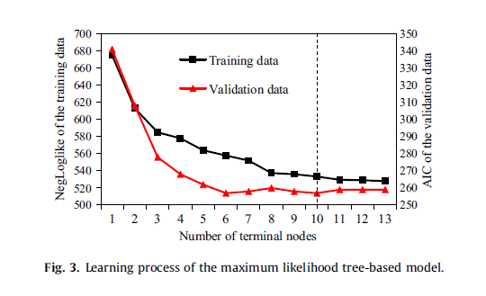
Tree Analysis
The optimal tree has 10 terminal nodes
More terminal nodes won’t lower the AIC value of the validation set

Slide 37
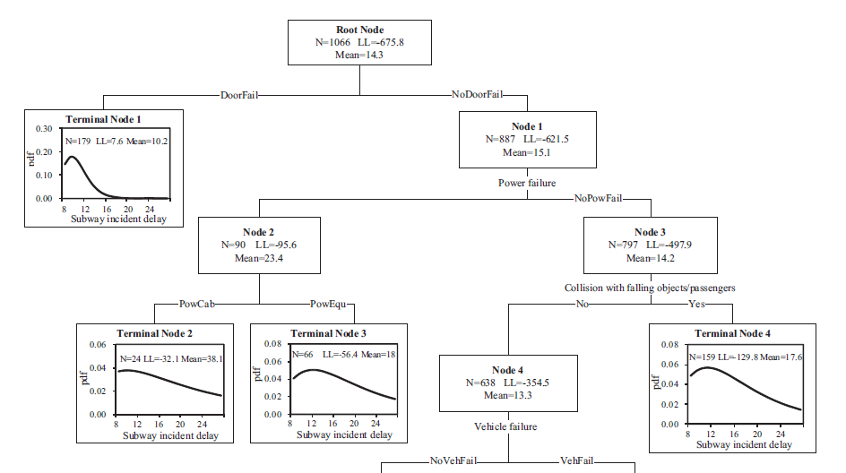
Result

Slide 38
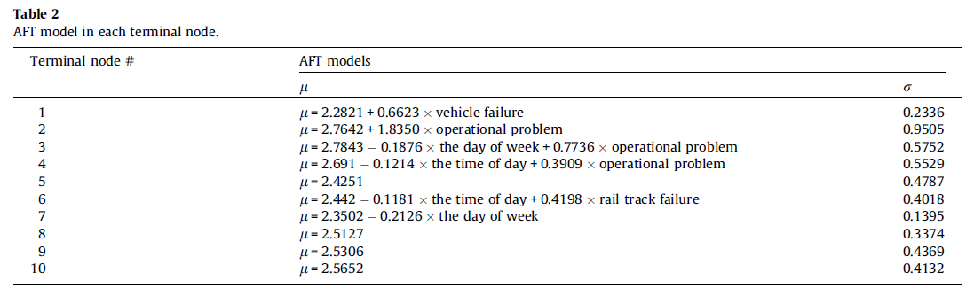
Impact analysis
Assigned unique AFT model to each terminal node
Repeatedly remove variables with significant level larger than 0.1

Slide 39
Terminal 1: vehicle failure could increase delay by 93.9% (=e^0.6623-1)

Slide 40
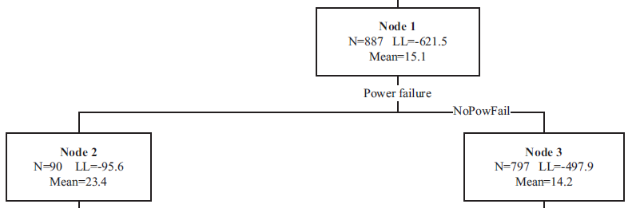
Compare Node 2 & 3: delays caused by power failure is 64.8%(=(23.4-14.2)/14.2) longer than not caused by power failure. (Baysari et al.,2009)

Slide 41
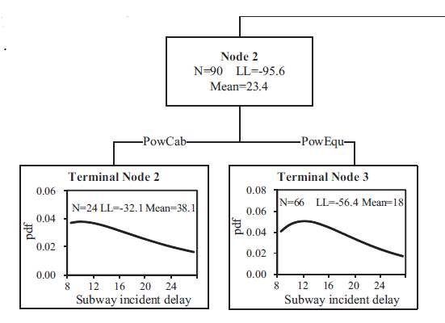
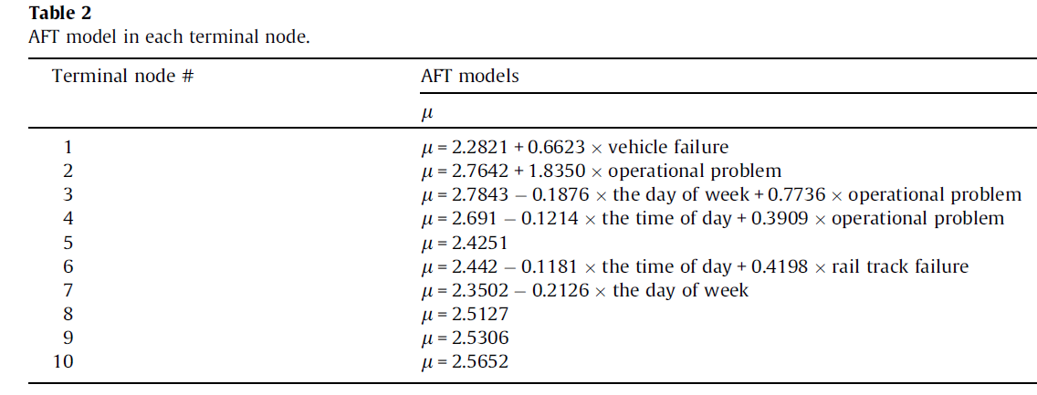
Terminal 2 : subway incident delay will increase 527%(=e^1.835-1) when the delay involving power failure also involve operation problems.

Slide 42
Merits
Subway staff could easily determine the distribution of subway delays
Assigns an AFT model instead of the sample mean value to each terminal node
Avoids the overfitting problem
Overcomes the shortcomings of traditional AFT models *.
*AIC =257 in validation set, which is the smallest.
*MAPE=27.2% and RMSE=4.9% both are smallest.

Slide 43
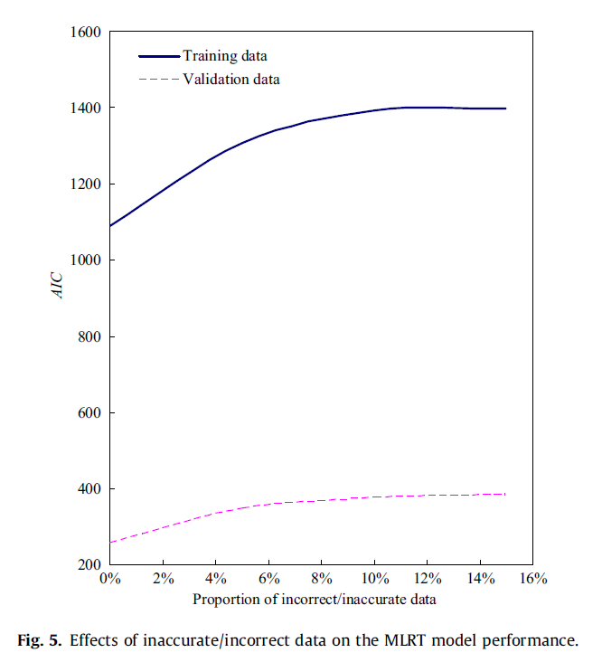
Limitations
Requires a large data sample
  Samples need to be divided into training set and validation set
  Each terminal node needs adequate data so that AFT model for each terminal node can be developed
Computational cost is high
We’ll have biased/incorrect results if insufficient data are used

Slide 44
Questions?

Slide 45
Thank you

