Slide 1

CS 548 FALL 2016
Association Rules Showcase by Deepan Sanghavi, Dhaval Dholakia, Peter Wang & Karan Somaiah Napanda
Showcasing work by Gang Li ,Rob Law ,Jia Rong & Huy Quan Vu on
“Incorporating Both Positive and Negative Association Rules into the Analysis
of Outbound Tourism in Hong Kong ”,
Journal of Travel & Tourism Marketing, 27:812–828, 2010

Slide 2
References
Rob Law Catherine Cheung Ada Lo, (2004),"The relevance of profiling travel activities for improving destination marketing strategies", International Journal of Contemporary Hospitality Management, Vol. 16 Iss 6 pp. 355 – 362.
Ceglar, A., & Roddick, J. F. (2006). Association mining, ACM Computing Survey, 38(2), article no. 5.
GÜL GÖKAY EMEL , ÇAĞATAN TAŞKIN & ÖMER AKAT (2007) Profiling a Domestic Tourism Market by Means of Association Rule Mining, Anatolia, 18:2, 334-342.
King, B., & Tang, C. H. (2009). China’s outbound tourism during the 1980s—A socio-political perspective. Anatolia: An International Journal of Tourism and Hospitality Research, 20(1), 18–32.
Min, H., Min, H., & Eman, A. (2002). A data mining approach to developing the profiles of hotel customers. International Journal of Contemporary Hospitality Management, 14(6), 274–285.
Savasere, A., Omiecinski, E., & Navathe, S. (1998). Mining for strong negative associations in a large database of customer transactions. In Proceedings of the Fourteenth International Conference on Data Engineering (pp. 494–502). Washington, DC: IEEE Computer Society.
Wu, X. D., Zhang, C., & Zhang, S. (2004). Efficient mining of both positive and negative association rules. ACM
Transactions on Information Systems, 22(3), 381–405.
Song, H., Romilly, P., & Liu, X. (2000). An empirical study of outbound tourism demand in the U.K. Applied Economics, 32, 611–624

Slide 3


Slide 4
Motivation
Increased spending power for the people.
Travel and tourism sector is heavily influenced by personal and national income
Travel is primarily viewed as a luxury product.
Analysis of traveler’s behavior is important.

Slide 5
Association Rules
Finds correlation among items to form rules
Rules: “A ⇒ B”
Data Sources: purchase repositories or transaction databases
Every rule has a support and confidence
MBA
Earlier Study:
  Hotel guest and their behavior
  Travel package customer likely to buy

Slide 6
Disadvantages of Association Rules & Improvement
Sometimes do not cover all promising situations
Negative associations : A ⇒ ¬B, ¬A ⇒ B or ¬A ⇒ ¬B
Determine which travel packages are of no interest to certain groups of people.

Slide 7


Slide 8
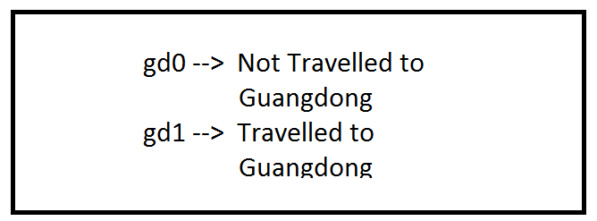
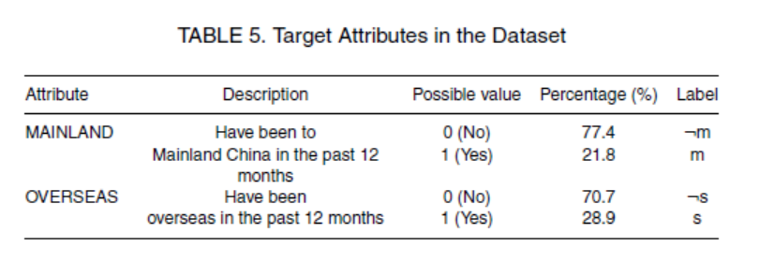
Data collection
3 largest tourist surveys (2007, 2008, 2009)
  2007 & 2008: Training
  2009: Testing
  Random digit dialing method
    Generate a sample list of residential tel (>=16 years old)
Attributes:
  Education Level
  Age Groups
  House Size
  Monthly Income
  Travel Experience

Slide 9
Problem Definition & Algorithm

Slide 10
Problem Definition
Negative associations - conflicts between different products
Associations Challenges:
  Combined infrequent item sets are not considered
  Does not discover negative relationships
  Computational cost and produce results which are not targeted for application
Mining Targeted Positive and Negative Rules
  Positive item sets- support(item) > threshold
Method:
  Promising item sets identification
  Rules extraction

Slide 11
Identifying Promising Item-Sets
Infrequent item sets are considered only if they are part of target
In combination, each item should be frequent
Process:
  Frequent 1-item-sets F⁽¹⁾ = {A⁽¹⁾, A⁽²⁾…..}
  If [sup(A^{(K)}_{(i)} ∪ T_{j}) ≥ δ_{s}] then [A^{(K)}_{(i)} ∪ T_{j} ] OR [A^{(K)}_{(i)} ∪ ¬ T_{j} ]
  Leverage Threshold
  Different combination of frequent item sets F^{(k)} is considered with Tj and steps 2 and 4 are repeated
Leverage
  Used for pruning the sets
  PS(X⇒Y)=leverage(X⇒Y)=supp(X⇒Y)−supp(X)supp(Y)=P(X∧Y)−P(X)P(Y)
  Measures difference of X and Y appearing together in the data set and what would be expected if X and Y where statistically dependent

Slide 12
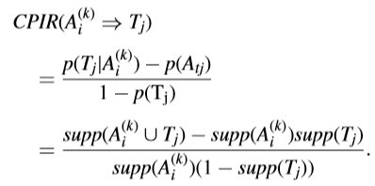
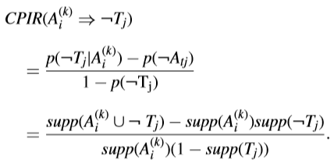
Extracting Promising Rules
Previous process results
  Promising positive item set F⁽¹⁾, F⁽²⁾...
  Promising negative frequent item set l⁽¹⁾, l⁽²⁾…
Usually, confidence value is used to measure the strength of rules
CPIR (Conditional Probability Increment Ratio)
  Value is between -1 and 1
  Close to 0 signifies item is independent of target
  Positive higher value signifies positive dependency
  Negative higher value signifies negative dependency

Slide 13
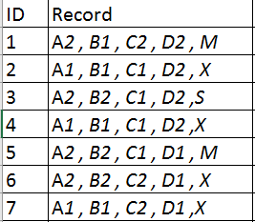
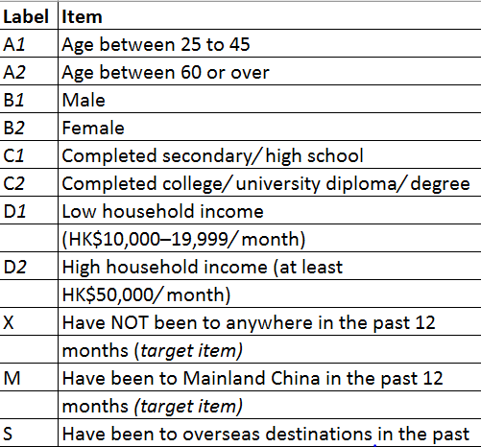
Example:
δs =0.2, δi =0.05, and δc =0.55
Frequent item sets w.r.t. target:
F⁽¹⁾= {A1 M, A1 X, B1 M, B2 M, C1 M ……}
Using leverage and support, 2 promising 1-item sets are generated:
F⁽¹⁾ = {A1 X, A2 X, B1 X, B2 X ..}, l1 = {D2 ¬X, A1 ¬M, A2 ¬M ..}
Based on the above F(1) sets, we generate initial 2-item sets:
F⁽²⁾= {A1B1X, A1B2X, A1D1 X, A2B1X…}
Rules:
D1 ⇒ X, with CPIR value of 0.563 (Rule 1)
D2 ⇒ ¬X, with CPIR value of 0.583(Rule 4)
Interpreting the Rule:
  D1-High income
  D2-Low income
  X-Will have a outbound travel
  High income travelers have a higher likelihood of outbound travelers (Rule 1 and 4)

Slide 14
Results & Findings

Slide 15
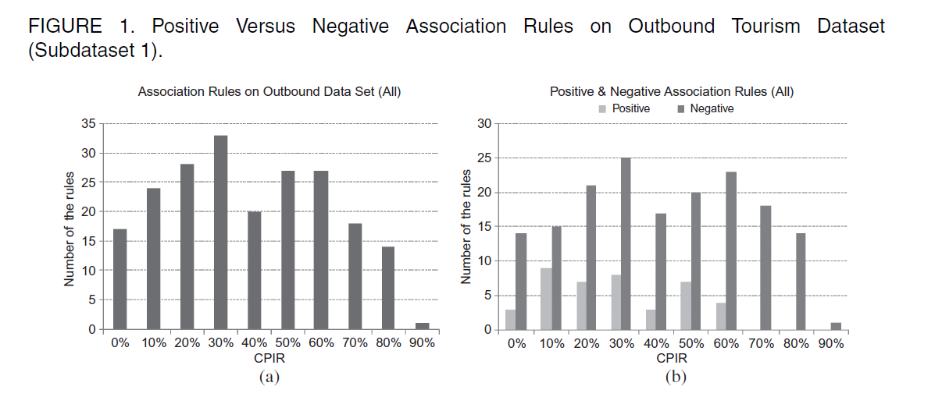
Results & Findings

Slide 16
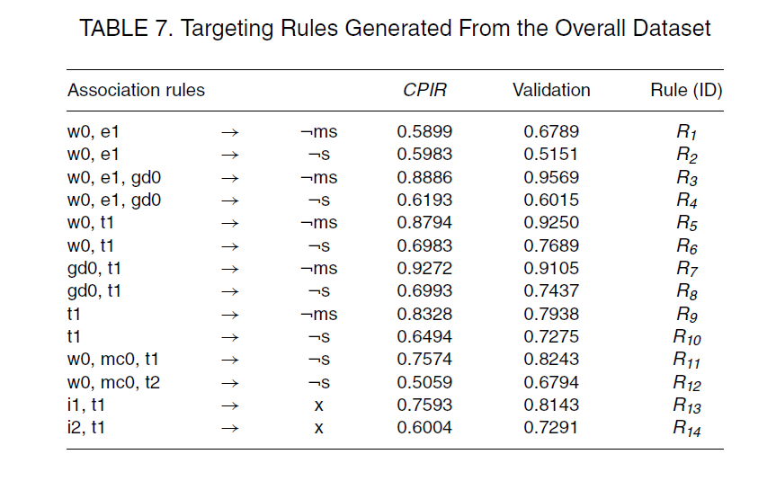
Targeted Rules on the overall dataset

Slide 17
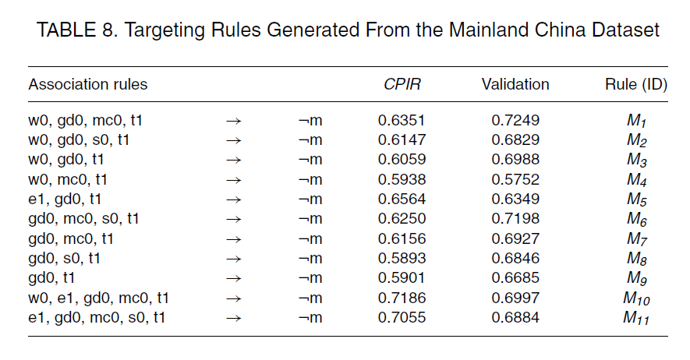
Targeted Rules for Travelers to Mainland China

Slide 18
Discussion & Implications

Slide 19
Discussion and Implication
Major difference
  Allow negative items to be included in the rules
    Negative rules
  Extend traditional association rules
    Considering infrequent items
  Provide more number of rules
  Loose instead of strict output
  Comparison with decision trees

Slide 20


