Slide 1

INTRODUCTION
TO
Machine
Learning
3rd Edition
Lecture Slides for
ETHEM ALPAYDIN
© The MIT Press, 2014
alpaydin@boun.edu.tr
http://www.cmpe.boun.edu.tr/~ethem/i2ml3e
Modified by Prof. Carolina Ruiz
for CS539 Machine Learning at WPI

Slide 2
CHAPTER 11:
Multilayer Perceptrons

Slide 3
Neural Networks - Inspired by the human brain
Networks of processing units (neurons) with connections (synapses) between them
Large number of neurons: 10¹⁰ (other estimates say10¹¹)
Large connectitivity: 10⁵ connections per neuron: synapses
Parallel processing
Distributed computation/memory
Robust to noise, failures

Slide 4
Understanding the Brain
Levels of analysis (Marr, 1982)
  Computational theory
  Representation and algorithm
  Hardware implementation
Reverse engineering: From hardware to theory
Parallel processing: SIMD (single instruction, multiple data machines) vs MIMD (multiple instruction, multiple data machines)
Neural net: SIMD with modifiable local memory
Learning: Update by training/experience

Slide 5
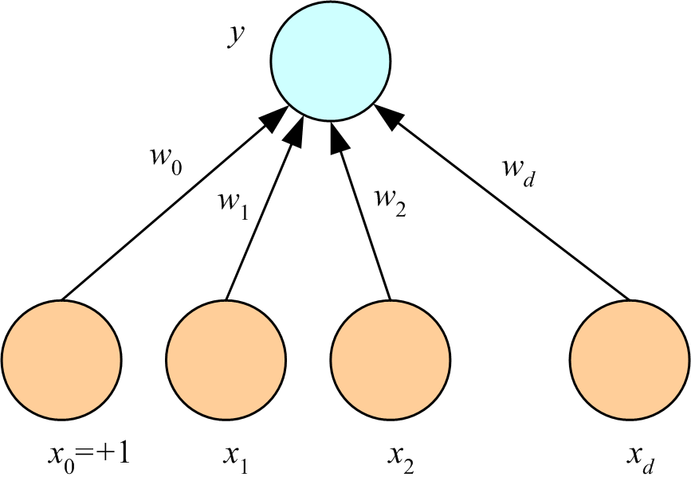
Perceptron = one “neuron” or computational unit
perceptron
output
weights
(Rosenblatt, 1962)
inputs

Slide 6
What a Perceptron Does
Regression: y=wx+w₀
Classification:y=1(wx+w₀>0)
y
y
s
y
w₀
w
w₀
w
x
w₀
x
x
x₀=+1

Slide 7
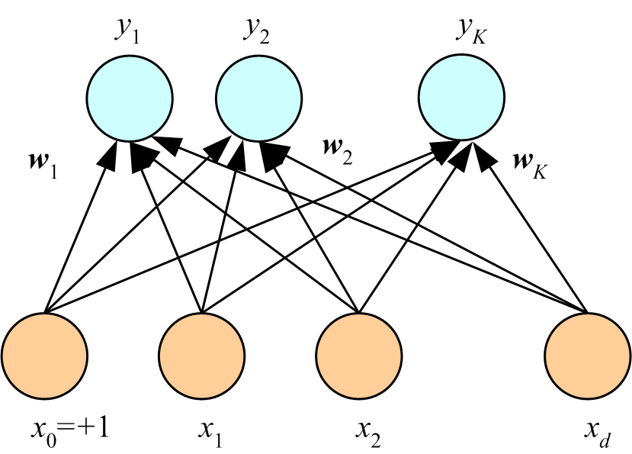
K Outputs
Regression:
Classification:
softmax
softmax function or normalized exponential function converts a real vector into one with values in the range (0, 1) that add up to 1

Slide 8
Training (i.e., learning the right weights)
Online (instances seen one by one) vs batch (whole sample) learning: In online (= incremental) learning:
  No need to store the whole sample
  Problem may change in time
  Wear and degradation in system components
Stochastic gradient-descent (= incremental gradient descent): Update after a single data instance
Generic update rule (LMS rule):

Slide 9
Training a Perceptron: Regression
Regression (Linear output):

Slide 10
Classification
Single sigmoid output
K>2 softmax outputs
cross-entropy cost function:
used instead of the quadratic error function to speed up learning
cross-entropy
cost function
see Chapter 3 of Michael Nielsen’s “Neural Networks and Deep Learning” online texbook for an explanation of cross-entropy

Slide 11
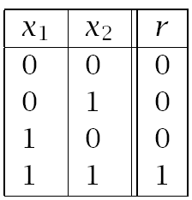
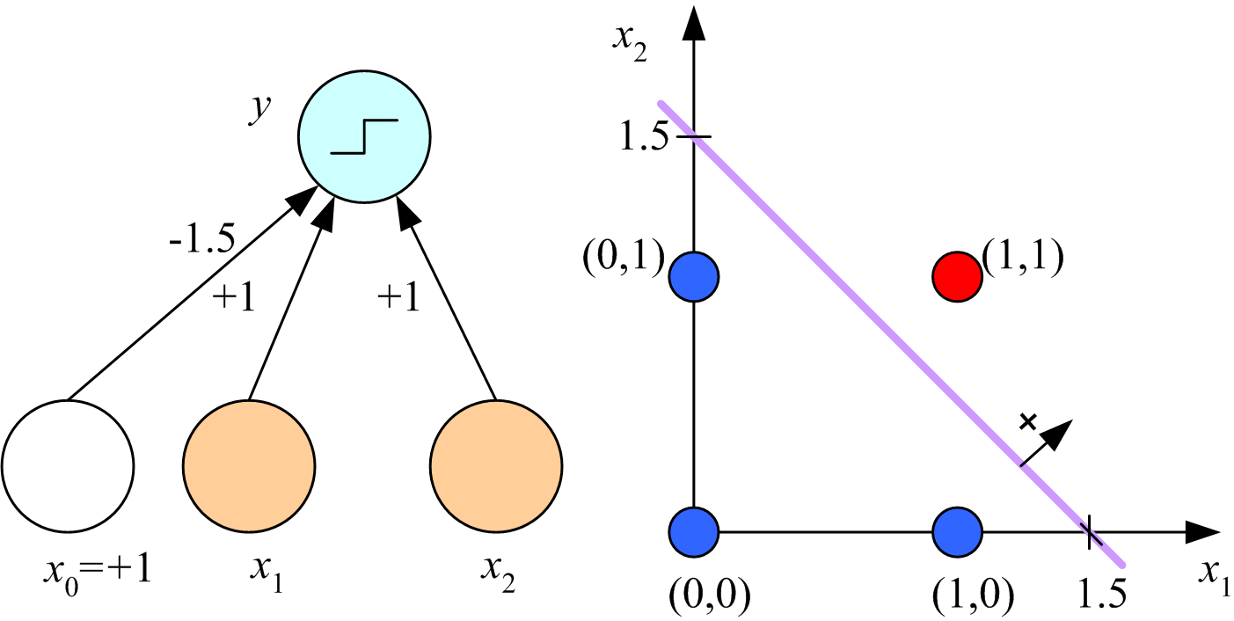
Learning Boolean AND

Slide 12
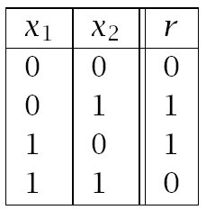
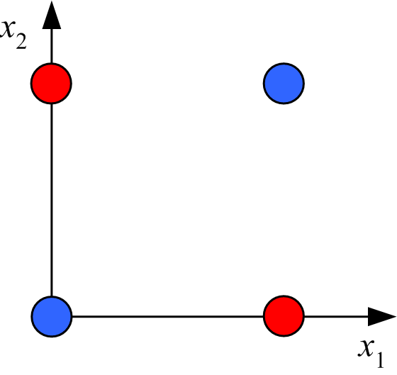
XOR
No w₀, w₁, w₂ satisfy:
(Minsky and Papert, 1969)

Slide 13
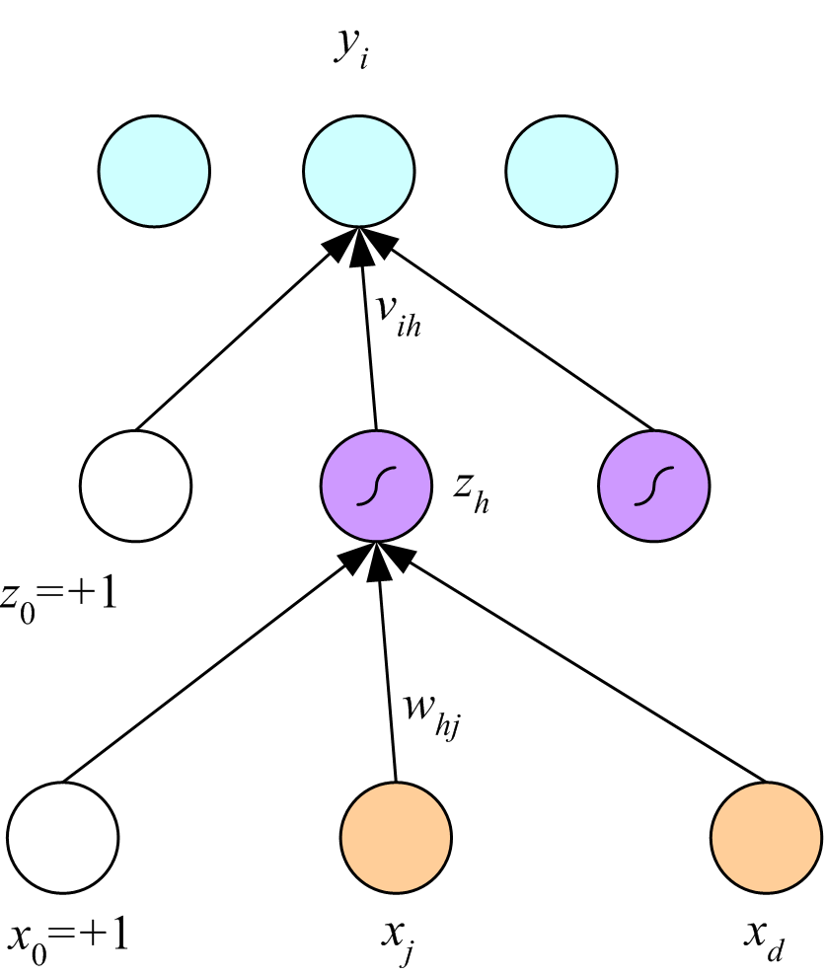
Multilayer Perceptrons
outputs
hidden layer
(Rumelhart, Hinton, and Williams, 1986)
inputs

Slide 14
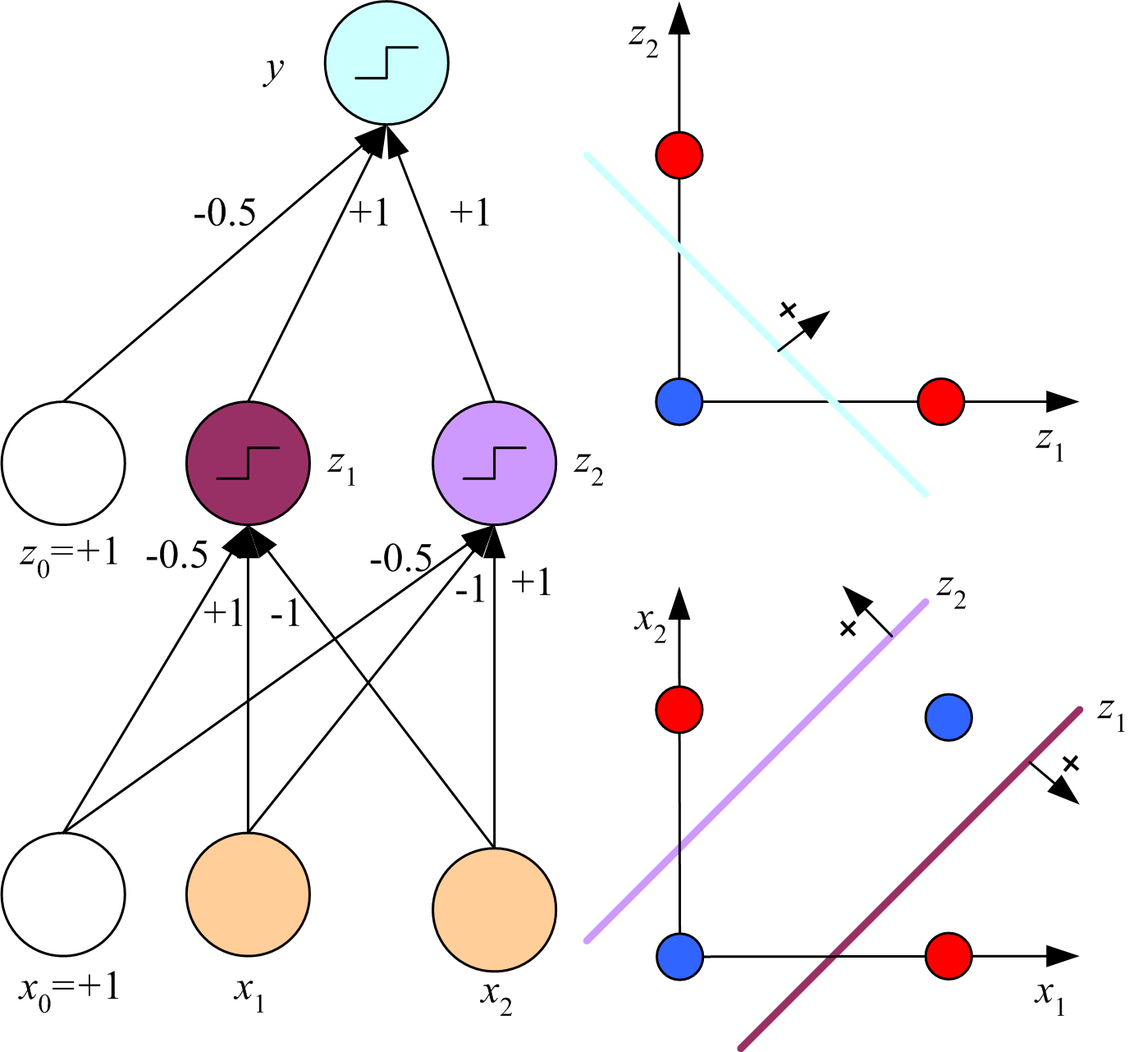
x₁ XOR x₂ = (x₁ AND ~x₂) OR (~x₁ AND x₂)

Slide 15
Backpropagation (Rumelhart, Hinton & Williams, 1986)
gradient of the error function

Slide 16
Regression
Backward
Forward
x

Slide 17
Regression with Multiple Outputs
y_{i}
v_{ih}
z_{h}
w_{hj}
x_{j}

Slide 18
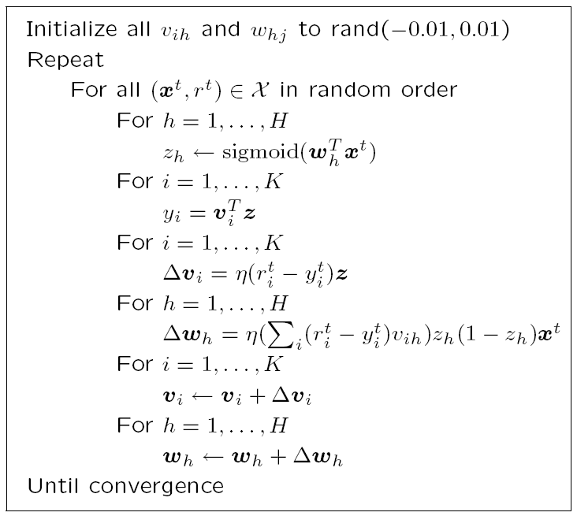
Error Back Propagation Algorithm using Stochastic Gradient Descent
small random values
(an epoch)
(h: index over hidden units)
forward propagation
of inputs
(i: index over output units)
backward propagation
of errors
weights
update
let’s talk about termination criteria

Slide 19
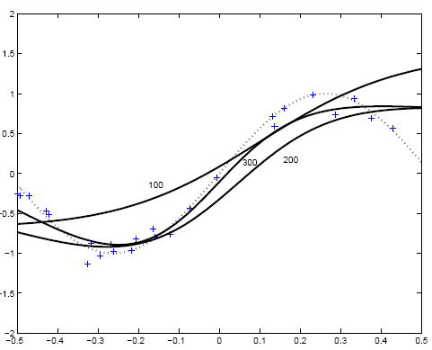
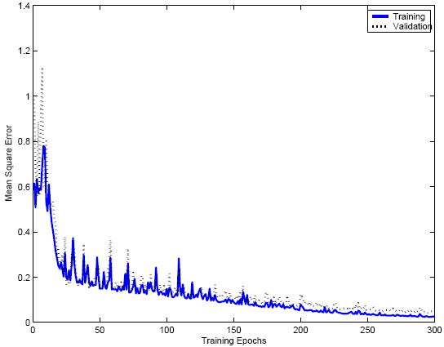
+: training instances
…: f(x) = sin(6x)
100,200, 300: Fit of an MLP with two hidden units after 100, 200, and 300 epochs

Slide 20
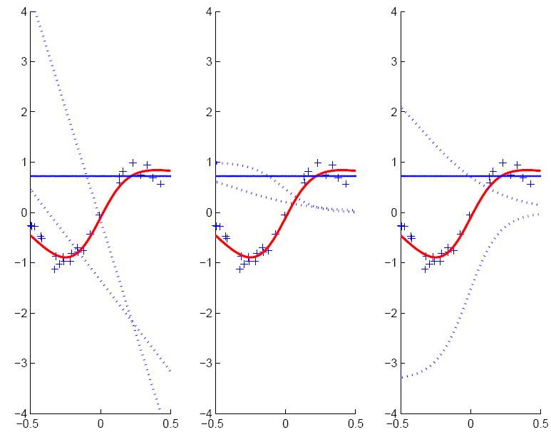
hyperplanes of two hidden units weights on 1st layer
hidden unit outputs multiplied by weights on 2nd layer
hidden unit outputs
w_{h}x+w₀
v_{h}z_{h}
z_{h}
MLP fit is formed as the sum of the outputs of the hidden units

Slide 21
Two-Class Discrimination
One sigmoid output y^{t} for P(C₁|x^{t}) and
P(C₂|x^{t}) ≡ 1-y^{t}

Slide 22
K>2 Classes
softmax

Slide 23
Multiple Hidden Layers
MLP (multi-layer perceptrons) with one hidden layer is a universal approximator (Hornik et al., 1989), but using multiple layers may lead to simpler networks

Slide 24
Improving Convergence
Momentum
Adaptive learning rate
where t is time (= epoch) and α is a constant, say between 0.5 and 1
if error rate is decreasing, increase learning rate by a constant amount;
otherwise, decrease learning rate geometrically

Slide 25
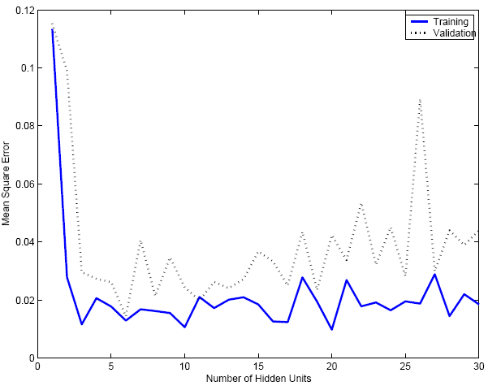
Overfitting/Overtraining
Number of weights: H (d+1)+(H+1)K
MLP with d inputs, H hidden units, and K outputs: has Hx(d+1) weights in 1st layer and Kx(H+1) in 2nd layer

Slide 26
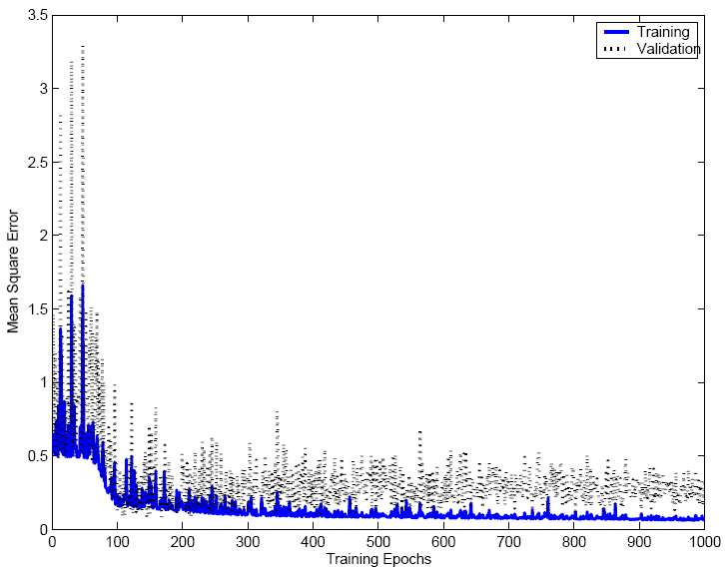

Slide 27
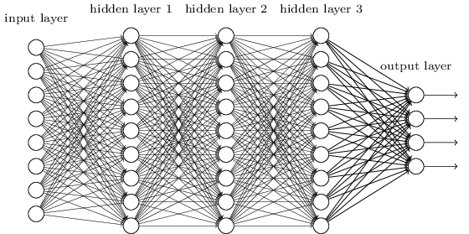
Fully Connected, Layered MLP Architecture
Taken from Chapter 6 of Michael Nielsen’s “Neural Networks and Deep Learning” online texbook

Slide 28
Expressive Capabilities of ANNs
(Taken from Tom Mitchell’s “Machine Learning” Textbook)
Boolean Functions:
  Every Boolean function can be represented by a network with a single hidden layer
  but might require exponential (in number of inputs) hidden units
Continuous Functions:
  Every bounded continuous function can be approximated with arbitrary small error by a network with one hidden layer [Cybenko 1989; Hornik et al. 1989]
  Any function can be approximated to arbitrary accuracy by a network with two hidden layers [Cybenko 1988].

Slide 29
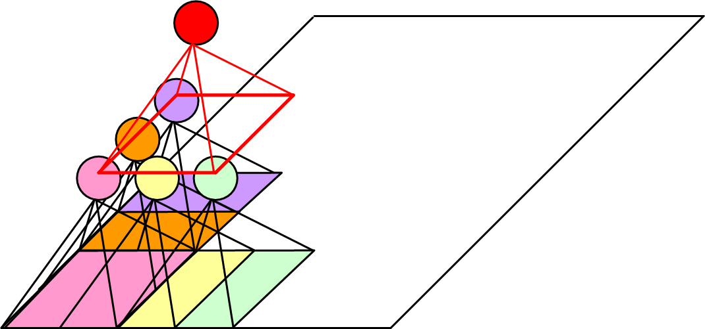
Other ANN Architectures: Structured MLP
Convolutional networks (Deep learning)
Useful on data that has “local structure” (e.g., images; sound)
each unit is
connected to a local
group of units, and
intends to capture a particular aspect of the data (e.g., an object in an image; a speech phoneme in a speech signal)
(Le Cun et al, 1989)
see Chapter 6 of Michael Nielsen’s “Neural Networks and Deep Learning” online texbook for an explanation of convolutional networks

Slide 30
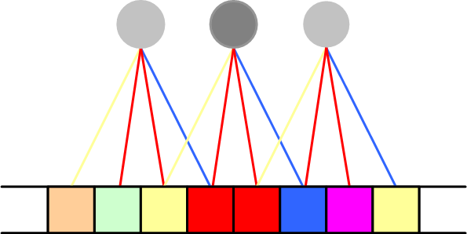
Weight Sharing
three translations over the data of the same “filter”
Each “filter” is applied on overlapping segments of the data, and uses the same weights each time that is applied during the same epoch (“translation invariance”).
These weights are updated after each epoch.

Slide 31

Hints
Invariance to translation, rotation, size
Virtual examples
Augmented error: E’=E+λ_{h}E_{h}
If x’ and x are the “same”: E_{h}=[g(x|θ)- g(x’|θ)]²
Approximation hint:
the “A” remains an “A”
(Abu-Mostafa, 1995)

Slide 32
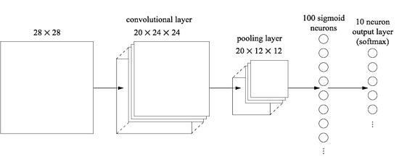
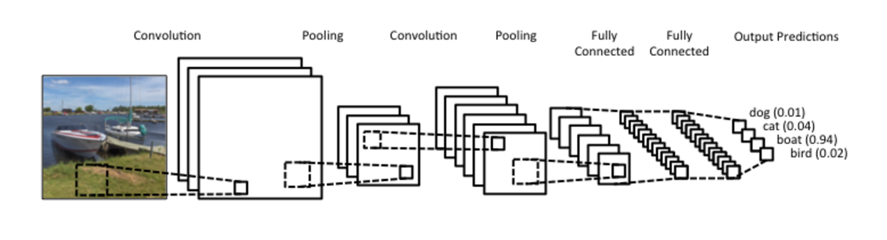
Convolutional Neural Networks in Practice
Taken from Chapter 6 of Michael Nielsen’s “Neural Networks and Deep Learning” online texbook
Taken from ”Understanding Convolutional Neural Networks for NLP”

Slide 33
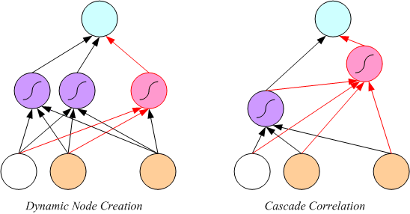
Tuning the Network Size
Destructive
Weight decay:
Constructive
Growing networks
(Ash, 1989)
(Fahlman and Lebiere, 1989)

Slide 34
Bayesian Learning
Consider weights w_{i} as random vars, prior p(w_{i})
Weight decay, ridge regression, regularization
cost=data-misfit + λ complexity
More about Bayesian methods in chapter 14

Slide 35
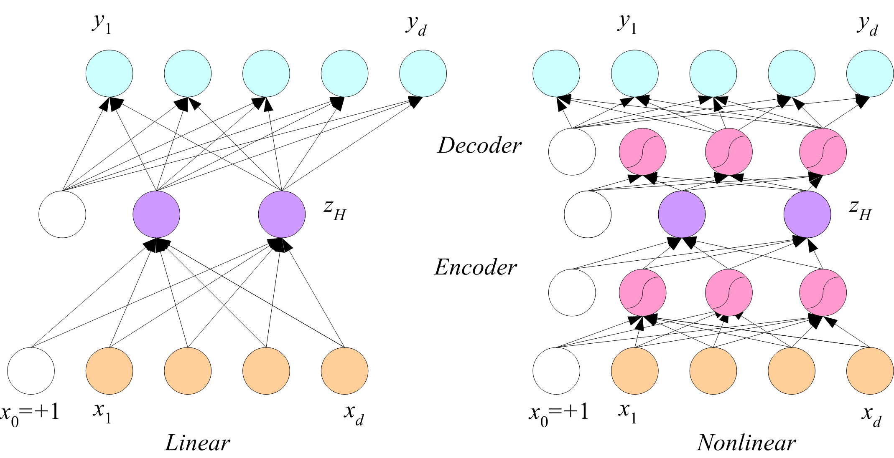
Dimensionality Reduction
Autoencoder networks

Slide 36
Autoencoder: An Example
Figure from Hinton and Salakhutdinov, Science, 2006

Slide 37
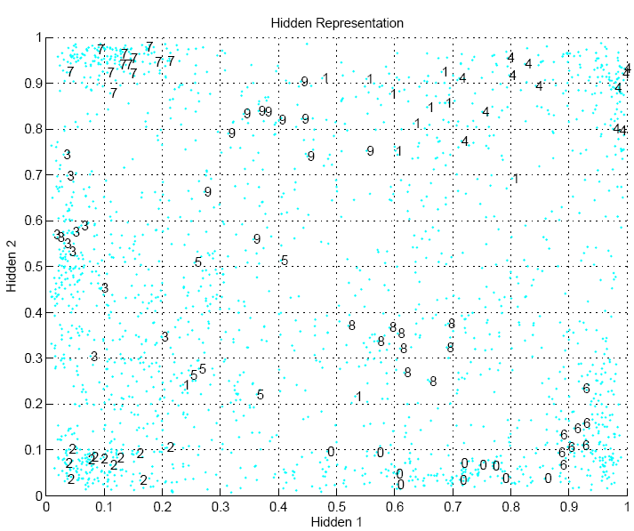

Slide 38
Learning Time
Applications:
  Sequence recognition: Speech recognition
  Sequence reproduction: Time-series prediction
  Sequence association
Network architectures
  Time-delay networks (Waibel et al., 1989)
  Recurrent networks (Rumelhart et al., 1986)

Slide 39
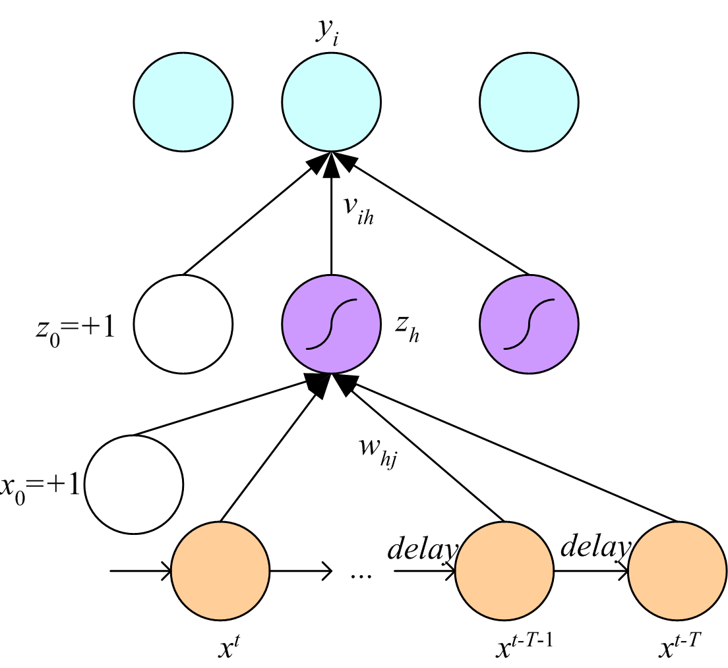
Time-Delay Neural Networks

Slide 40
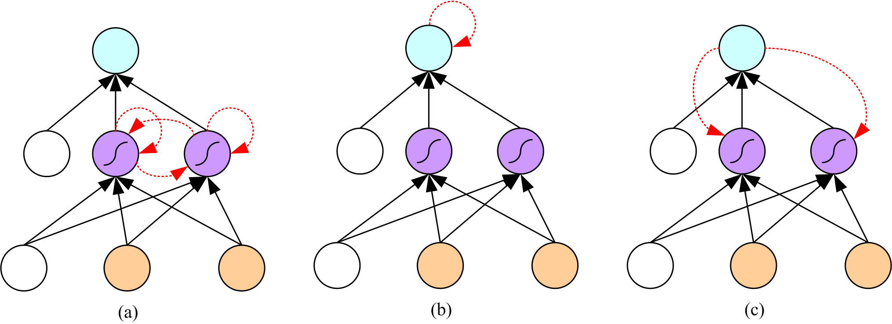
Recurrent Networks

Slide 41
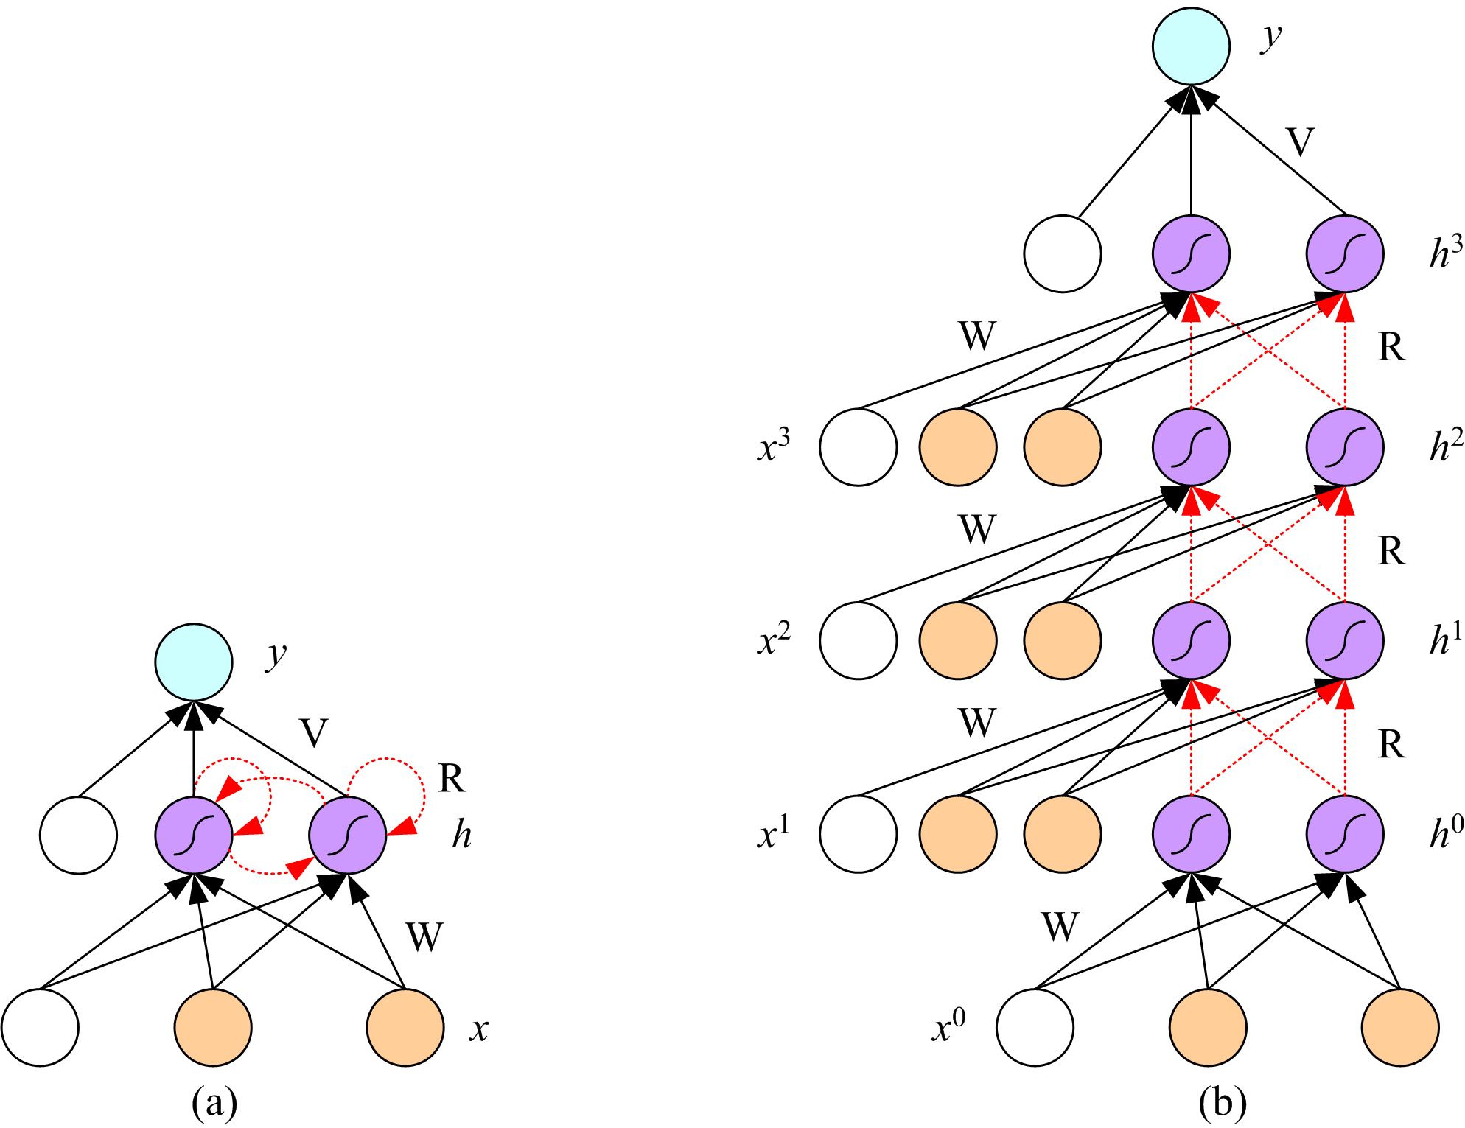
Unfolding in Time

Slide 42
Deep Networks
Layers of feature extraction units
Can have local receptive fields as in convolution networks, or can be fully connected
Can be trained layer by layer using an autoencoder in an unsupervised manner
No need to craft the right features or the right basis functions or the right dimensionality reduction method; learns multiple layers of abstraction all by itself given a lot of data and a lot of computation
Applications in vision, language processing, ...

