Slide 1
CS534 Spring 2019 Robotics Showcase by Chase St. Laurent, Alexander Stylos, Kangjie Mi, Jiahou Hou
Showcasing work by CAMBADA on “RoboCup Soccer - Middle Size”

Slide 2
REFERENCES
[1] A. J. R. Neves, J. Luis, B. Cunha, N. Lau, J. Silva, F. Santos, G. Corrente, D. A., N. Figueiredo, A. Pereira, L. Almeida, L. Seabra, A. J., J. Rodrigues, and P. Pedreiras, “CAMBADA Soccer Team: from Robot Architecture to Multiagent Coordination,” Robot Soccer, 2010. http://robotica.ua.pt/CAMBADA/docs/pub2010/Neves-2010b.pdf
[2] A. J. Neves, A. J. Pinho, D. A. Martins, and B. Cunha, “An efficient omnidirectional vision system for soccer robots: From calibration to object detection,” Mechatronics, vol. 21, no. 2, pp. 399–410, 2011. http://robotica.ua.pt/CAMBADA/docs/pub2011/Neves-2011a.pdf
[3] J. Silva, N. Lau, and A. Neves, “Cooperative detection and identification of obstacles in a robotic soccer team,” 2014. http://robotica.ua.pt/CAMBADA/docs/pub2014/Silva-2014a.pdf
[4] R. Dias, N. Lau, J. Silva, and G. H. Lim, “Multi-object tracking with distributed sensing,” 2016 IEEE International Conference on Multisensor Fusion and Integration for Intelligent Systems (MFI), 2016. http://robotica.ua.pt/CAMBADA/docs/pub2016/RD2016a.pdf
[5] N. Andre and S. Filipe, “Individual and Coordinated Decision for the CAMBADA team,” rep., 2008. http://robotica.ua.pt/CAMBADA/docs/pub2008/filipe.08a.pdf
[6] R. Dias, F. Amaral, L. Azevedo, M. Azevedo, B. Cunha, P. Dias, N. Lau, A. Neves, E. Pedrosa, A. Pereira, F. Pinto, D. Silva, J. Silva, and E. Sousa, CAMBADA '2017: Team Description Paper, 2017. http://robotica.ua.pt/CAMBADA/docs/qualif2017/CAMBADA-tdp-2017.pdf
[7] J. Cunha, R. Serra, N. Lau, L. S. Lopes, and A. Neves. “Batch Reinforcement Learning for Robotic Soccer Using the Q-Batch Update-Rule,” Journal of Intelligent and Robotic Systems, vol 80, no 3-4, December, 2015. [Online serial]. Available: https://www.researchgate.net/publication/272162101_Batch_Reinforcement_Learning_for_Robotic_Soccer_Using_the_Q-Batch_Update-Rule. [Accessed Apr. 7, 2019]

Slide 3
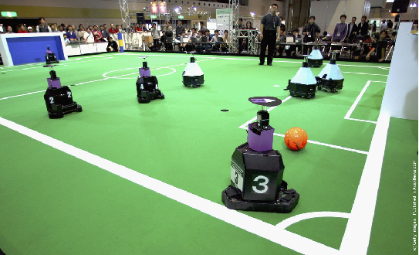
RoboCup Background
RoboCup is an annual international robotics competition proposed and founded in 1996 (Pre-RoboCup) by a group of university professors.
In this league, two teams composed of 5 robots play on a 18 m × 12 m field. The environment is structured, with the elements of the game constituted mainly by uniform colors. The field is green with white field lines, the ball has a dominant color (usually orange or yellow) and the robots are mainly black.

Slide 4
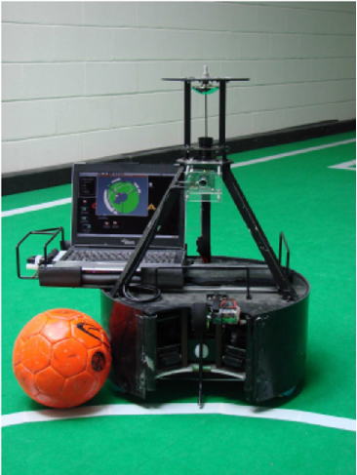
RoboCup Background
Each robot must not exceed a squared base of 52 cm with a maximum height of 80 cm. The robots are completely autonomous being the human-interaction restricted to the human referee commands which are relayed to the robots through a control station via a WiFi network. The robots can also share information with each other and a control station that acts as a coach.
A CAMBADA Robot
https://www.researchgate.net/profile/Antonio_Teixeira4/publication/221333943/figure/fig3/AS:305579718397956@1449867290781/The-CAMBADA-robot.png

Slide 5
RoboCup DEMO
https://www.youtube.com/watch?reload=9&v=ZcQzM7CNLfA

Slide 6
SYSTEM OVERVIEW
Basically, the CAMBADA robot has four main aspects.
Vision System
How the robots sense their environment
Sensor Fusion
How the robots understand their environment
Machine Learning
How the robots perform behaviors in the competition
Game Strategy
How the robots make decisions given in-game circumstances and make coordinated movements

Slide 7
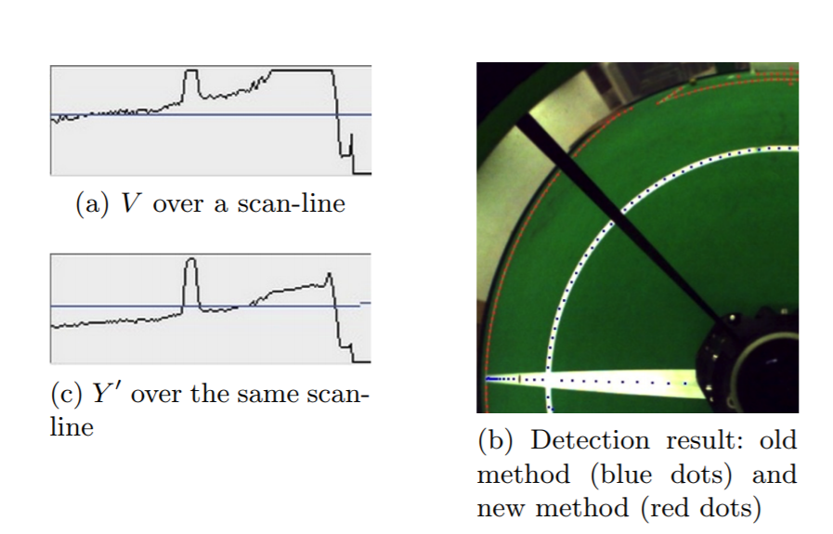
VISION SYSTEM: Line Detection
Hough Transformation
Long Range Line Segmentation
Detect field lines using HSY’
Transform RGB->HSY’
Y’=0.21R+0.72G+0.07B
Source [6] pg. 3

Slide 8
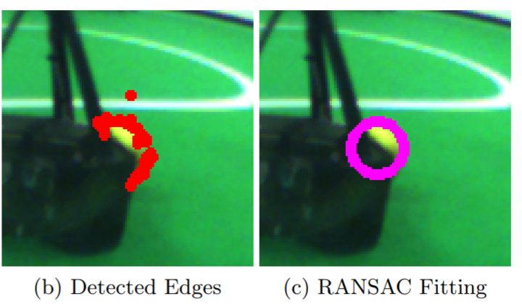
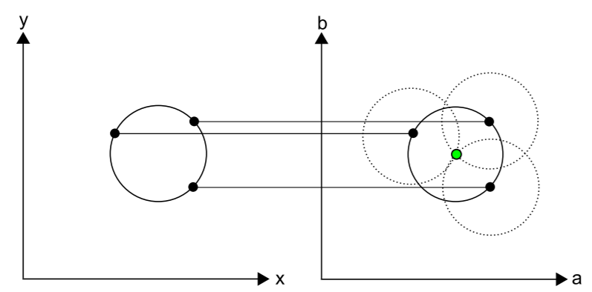
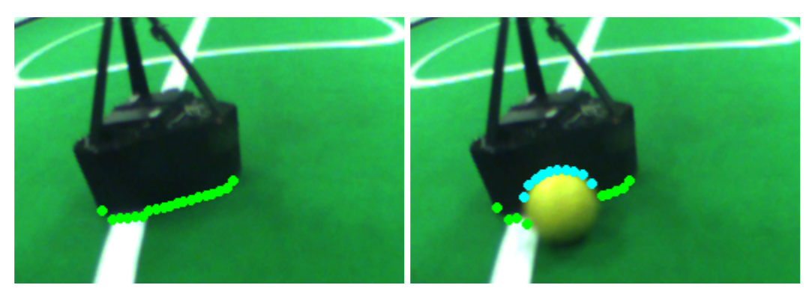
VISION SYSTEM: Object & Obstacle Detection
RANSAC Fitting
Object detection with occlusion
Circular Hough Transform
Source [6] pg. 4
Source [6] pg. 4

Slide 9
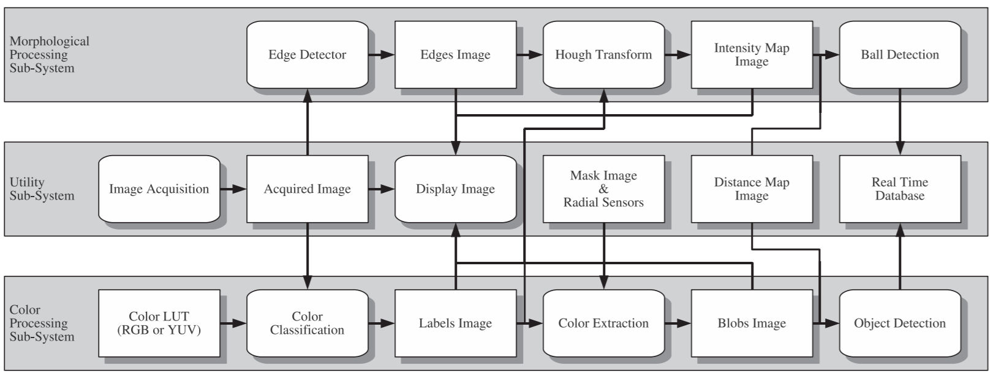
VISION SYSTEM: Omnidirectional Summary
Source [2] pg. 7 & 9

Slide 10
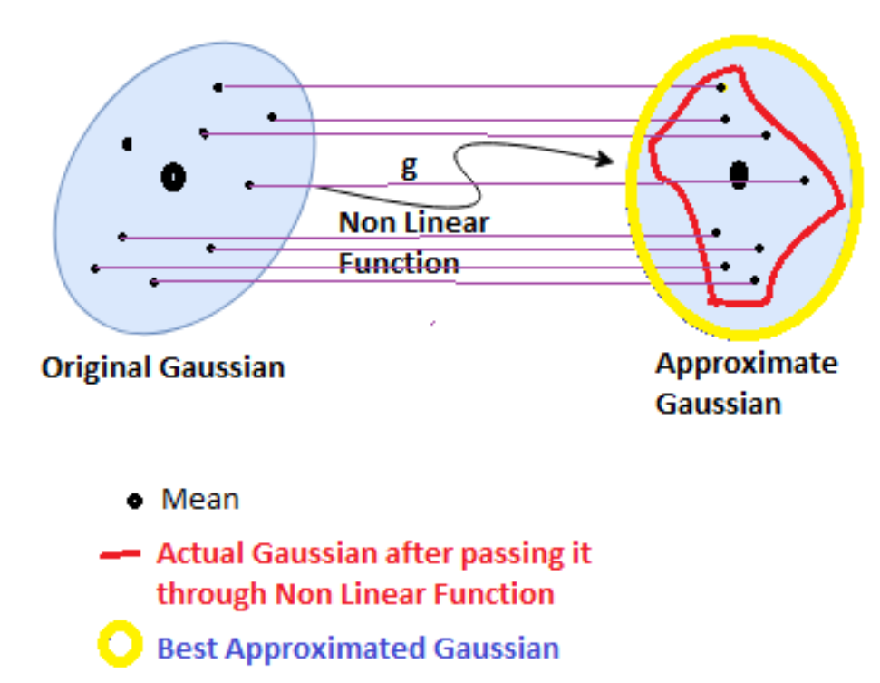
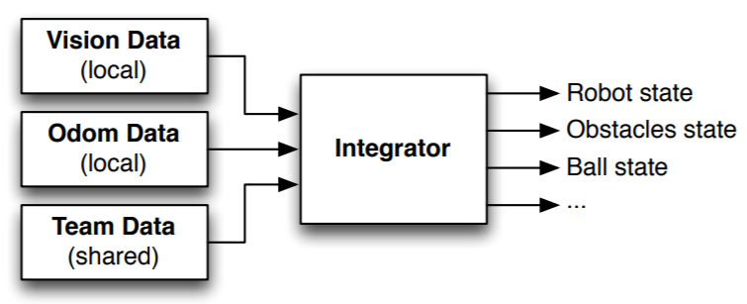
SENSOR FUSION: Localization
Kalman Filtering
Gaussian Processes with state variables: (x,y) pos, vel
Integrator Agent for Sensor Fusion
Source [4] pg. 589

Slide 11
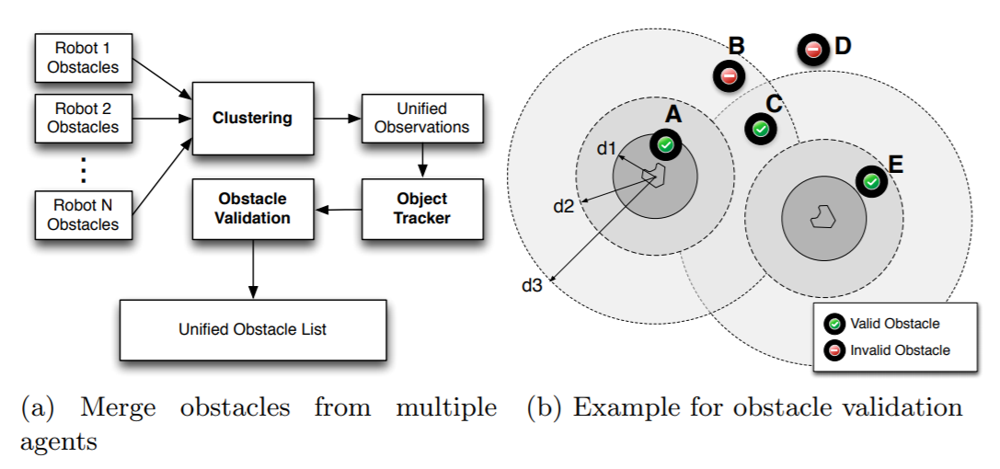
SENSOR FUSION: Multi-Object Tracking
Source [4] pg. 591-592

Slide 12
MACHINE LEARNING: Q-Batch Reinforcement Learning
RL is essentially a Markov Decision Process {S, A, P, R}
Find best policy 𝝅 where 𝝅 : S -> A
Sometimes the P(S’ | S, A) is too complex or unavailable
Estimate P using Q-function: Q(S, A)
Batch RL
estimates a Q-Function based on a batch of (S, A), rather than at when (S, A) is observed.
Transition Batch
Q-Function
Source [7] pg. 3
Notes:
S-> State, A-> Action, P-> Probability Distribution P(S’ | S, A), R-> reward function R(S, A, S’), i.e. the reward for completing an action given the current state and next state.
Find best policy 𝝅 where 𝝅 maps the S -> A that maximizes cumulative sum of rewards
Guaranteed to converge optimal policy if all (S, A) transition-pairs are visited infinitely often. However, it’s difficult to visit every (S, A) transition-pair infinitely when you’re a real robot

Slide 13
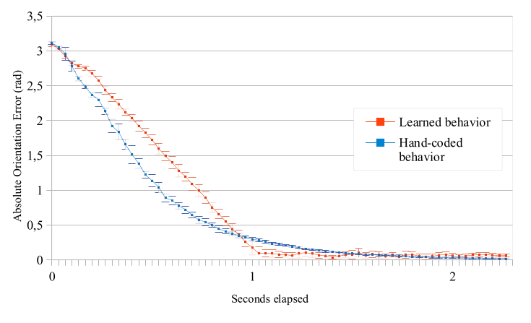
MACHINE LEARNING: Training Task 1
Rotate To A Point
Source [7] pg. 8
Notes:
A basic tasks that allows the team to verify Q-Batch RL works for their needs.
The learned behavior is swift and clean rotation to a point, which is handled by tuning the Proportional, Integral, and Derivative values of the PID controller.
This was tested by setting a point in space and solving for the differential inverse kinematics between the robot’s coordinate frame and the point. The results for the hand-tuned PID controller vs. the RL tuned controller can be seen in this graph, and we can see that initially the hand tuning performs better, but after a second the RL behavior equalizes and remains somewhat steady.
Overall there isn’t too much difference between the hand-tuned behavior vs. the learned behavior for this task, but it proves to the team that they can use RL to train behaviors.

Slide 14
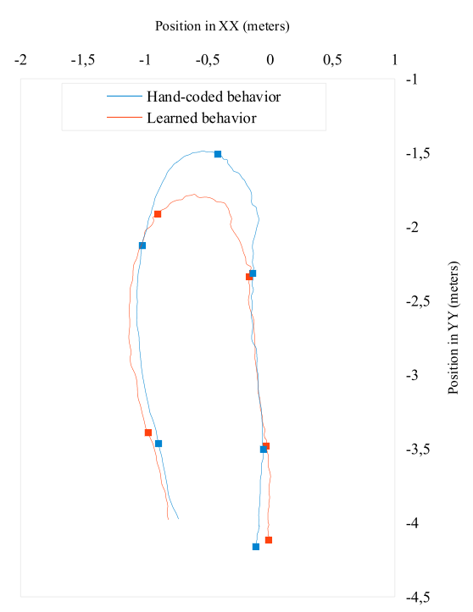
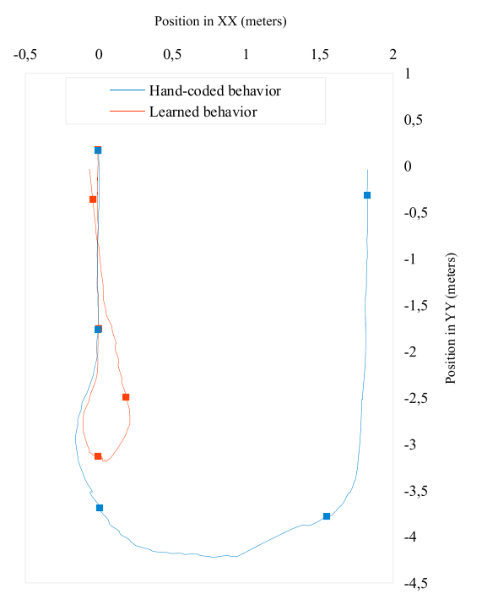
MACHINE LEARNING: Training Task 2
Dribble a Ball
Simulation
Live
Source [7] pg. 10
Source [7] pg. 11
Notes:
Dribbling a ball is a basic skill in soccer, and thus also in robot soccer. This was the next behavior the team set out of learn.
They define dribbling as the robot having control over the ball, and the goal of the learned behavior was to minimize the time it took for a robot to dribble a ball in a certain direction past a certain distance.
The team laments that the hand-coded behavior performs very large and wide turns, which reduces how quickly they can dribble a ball to a goal.
RL was used to calculate optimal cartesian and angular velocity values for an action set which would allow for fast translational and rotational movement while still keeping a calculated trajectory of the ball in line with the goal destination.
On the left we can see how the hand-coded behavior performs compared to the learned behavior. The authors note that this huge gap in performance is likely due to an error in the simulator, but they still note an improvement in behavior.
On the right we can see the comparison on a real robot, and can see that overall the robot accomplishes the learning goal, which is to be able to turn in a smaller radius while dribbling the ball.

Slide 15
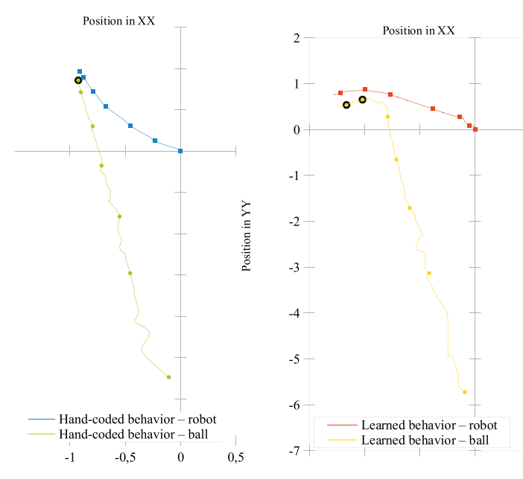
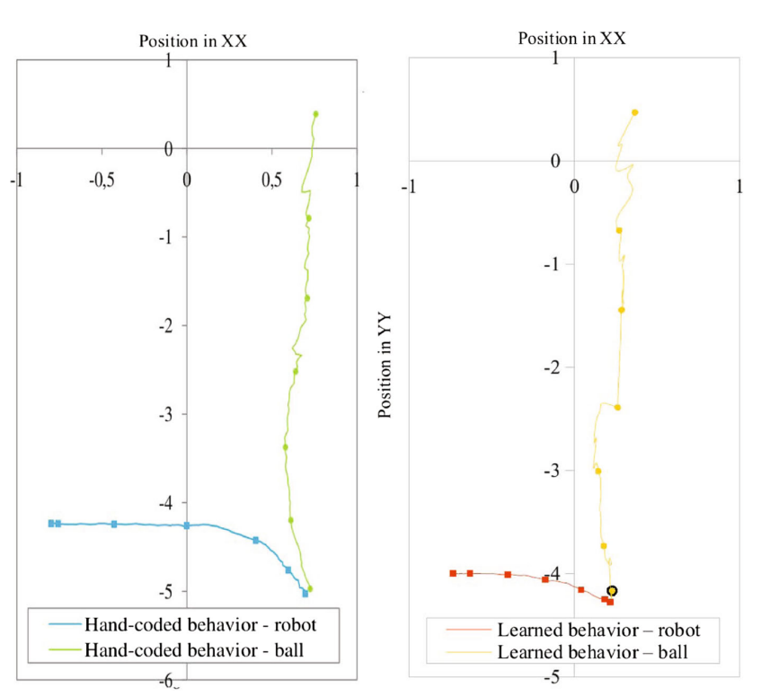
MACHINE LEARNING: Training Task 3
Receiving a Pass
Simulation
Live
Source [7] pg. 13
Source [7] pg. 13
Notes:
The last behavior the team teaches the robot is receiving a pass, another core skill in soccer.
The team makes a distinction that the task is not to gain control over the ball as quick as possible, but to gain control over the ball with the minimum movement possible.
Thus, they behavior they want to teach is the ability to position itself in the balls path and absorb the balls momentum such that the robot still maintains control.
This behavior is optimization of just the linear movement of the robot, as they can reuse the original learned behavior to keep the robot facing the ball.
On the left we can see how the comparison between the hand-coded behavior vs. the learned behavior. We can see that the hand coded behavior doesn’t actually stop the ball's momentum too well, so actual control over it is limited.
On the right we can see how an actual robot performs with both behaviors. Once again the learned behavior shows an improved ability to stop the ball and retain control. The team notes that there was a dramatic increase in success ,from 10% in hand-coded behavior vs. 50% in the learned behavior.

Slide 16
GAME STRATEGY: Individual Robot Strategy
Each robot analyze the current situation through the information in the world state
Chooses the individual attitude to be taken by the agent in order to maximize the team performance (How?)
->The player will choose one role according to that information
->Execution of the role will determine which behavior will be used
Roles:Striker, midfielder, supporter, barrier, parking, tour, goalie

Slide 17
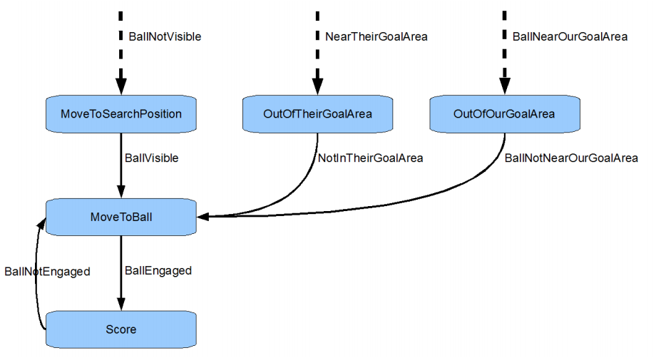
GAME STRATEGY: Individual Robot Strategy
If one player has the ball, then that player becomes the Striker
Represents the most active and main robot player when the game is in the free play state
Source [5] pg. 42

Slide 18
GAME STRATEGY: Individual Robot Strategy
Dribbling: Progressing in field while keeping ball engaged
Takes the goal direction as parameter
If robot got hold of the ball, go straight toward opponent goal and perform obstacle avoidance if needed
Go in direction of a higher value surrounding position (in world state) until ready to kick
Kicking:
Flag indicating it is a pass to a teammate which Kick with lower power
Target is the opponent goal then choose parameter indicating centre, left or right side of the goal
If no target not selected, Kick will automatically select a target

Slide 19
Sensing-actuating delays
Cause the robot to move on a curved path
image acquisition time:
(around 150 ms)
Image analysis and determine robot response:
(around 30 ms)
Synchronise the agent orders with the low level motors:
(up to 70 ms in worst case)

Slide 20
Approach used in rotational movement
If the angular velocity is greater than π rad/s, no translational movement performed
If the angular speed is greater than π 2 rad/s, move at half speed
If angular speed smaller than π 2 rad/s, move at the speed calculated through the PID filter

Slide 21
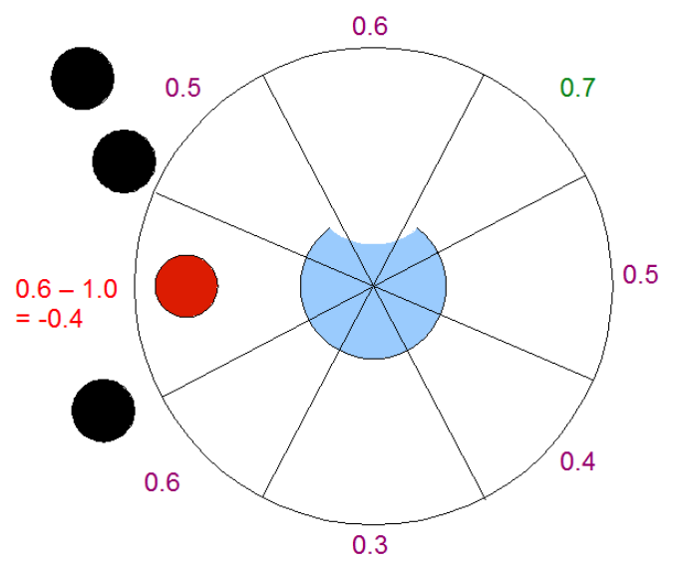
GAME STRATEGY: Utility Maps
The full sized field has value per square meter
Given number of directions with predetermined length, that divide robots surrounding into slices
If obstacle appear within one slice, the corresponding utility value of that direction is decreased by 1.0
Direction with highest utility value is chosen.
Source [5] pg. 30

Slide 22
GAME STRATEGY: Multi-Robot Coordination
Teams have adopted role-based coordination with dynamic role exchange methodologies utilised a greedy strategy. But the strategy could be different
Concentrate in center of the field and around penalty marker and leave sidelines and adjacent area free
Determine the best direction to follow with the ball based on utility values across the field

Slide 23
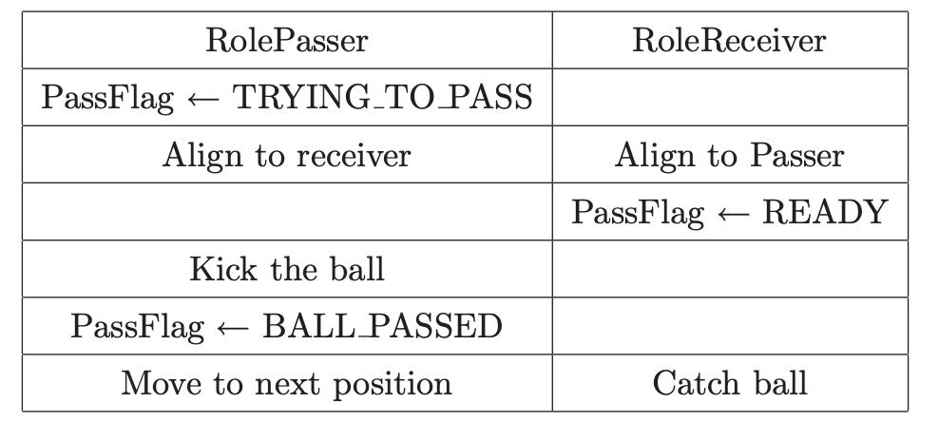
GAME STRATEGY: Multi-Robot Coordination
Passer and Receiver roles
perform coordinated passes.
Passer role-> Kick
Receiver role -> CatchBall
PassFlag to signal action
Visible by entire team
Values: None, ready, trying to pass, ball passed.
Source [5] pg. 58

Slide 24
CAMBADA Team Success
Achievements:
Performance in all tournaments:
8 1st Place
8 2nd Place
9 3rd Place
National Champions since 2007
World Champion in 2008

Slide 25
QUESTIONS?

