Slide 1
CS534 Spring 2019:
Logic Based Systems with Minesweeper
Showcase by: Steven McAteer, Alex Perucic, Robert Curtis, William Schwartz
Showcasing work by Duke on Mini Mine Sweeper and Drew Roos on Minesweeper

Slide 2
References
[1] Russell, S., Norvig, P., & Davis, E. (2010). Artificial intelligence : a modern approach (3rd ed.). Upper Saddle River, NJ: Prentice Hall.
[2] Becerra, D. (2019). Algorithmic approaches to playing Minesweeper. [online]
dash.harvard.edu. Available at:
https://dash.harvard.edu/bitstream/handle/1/14398552/BECERRA-SENIORTHESIS-2015.pdf?sequence=1 [Accessed 3 Feb. 2019].
[3] Richard Kaye. Minesweeper is NP-complete. The Mathematical Intelligencer, 22(2): 9–15, 2000.
[4] Allan Scott, Ulrike Stege, and Iris van Rooij. Minesweeper may not be NP-complete but is hard nonetheless. The Mathematical Intelligencer, 33(4):5–17, 2011.
[5] Tomasi, C. (2006). Mini Mine Sweeper. [online] Www2.cs.duke.edu. Available at:
https://www2.cs.duke.edu/courses/spring06/cps102/notes/sweeper.pdf [Accessed 3
Feb. 2019].
[6] Roos, D. (2013). Minesweepr. [online] Mrgris.com. Available at:
https://mrgris.com/projects/minesweepr/ [Accessed 3 Feb. 2019].

Slide 3
Agenda
Definition
Minesweeper Background
Automating Minesweeper
Propositional Logic
Predicate Logic
Demo

Slide 4
Definition
Logic Agent:
In which we design agents that can form representations of a complex world, use a process of inference to derive new representations about the world, and use these new representations to deduce what to do.[1]
Notes:
looking at a logic system since the agent and the game are involved

Slide 5
Minesweeper
Background

Slide 6
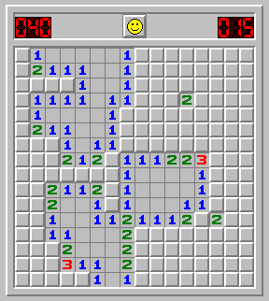
Background
Player clicks on a square
Specific number of mines on the board
Numbers show the number of mines nearby
Player loses if a mine is clicked
Player wins if they uncover all squares without hitting mine
In fact, Minesweeper is in a class of mathematically difficult problems known as co-NP-complete [2][3][4].
Image from www.freeminesweeper.org
Notes:
little background on minesweeper
basic game click on squares, try to find and not
explain co-np-complete
https://www.phil.pku.edu.cn/cllct/ann_attachments/np.pdf
https://link.springer.com/article/10.1007/s00283-011-9256-x

Slide 7
Automating Minesweeper
3x3 Board with exactly 1 Mine

Slide 8
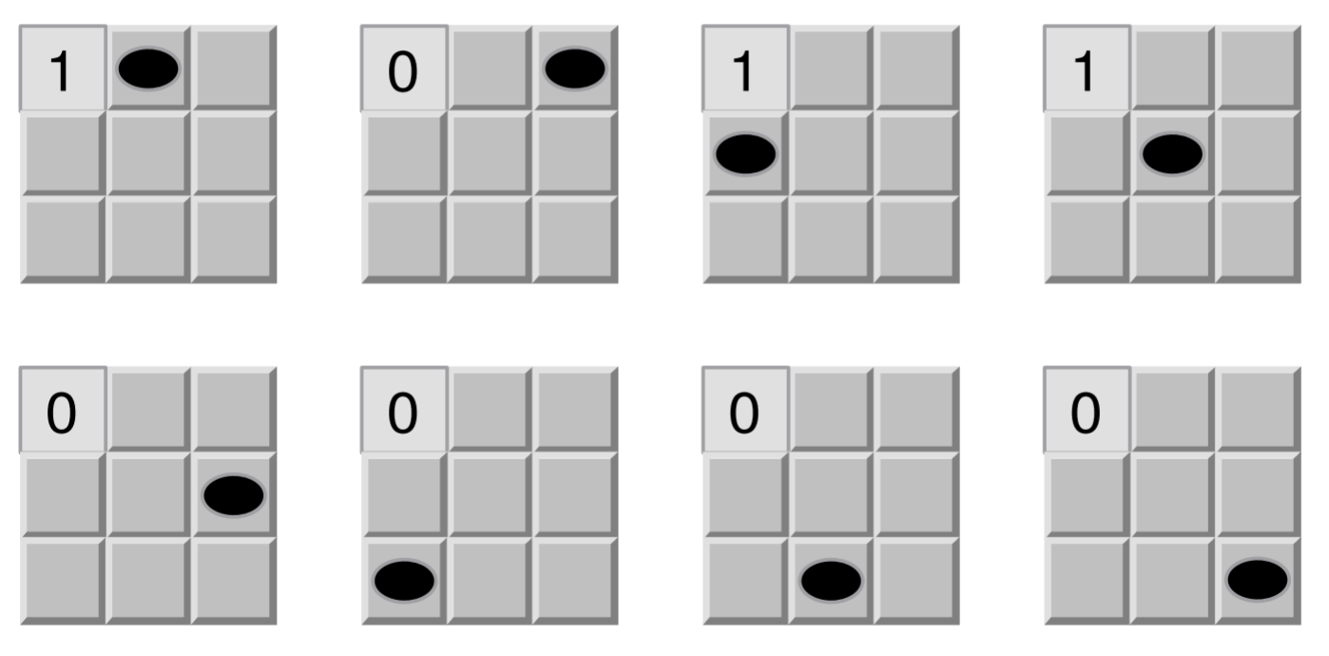
Image from Mini Mine Sweeper [5]
Notes:
Here we see the possible mine configurations for the mini minesweeper game. After revealing the first square, there are 3 possible positions of the mine if the square is 1, and 5 if the square is 0. We need a mathematical way of representing these positions in order to automate the solving process.

Slide 9
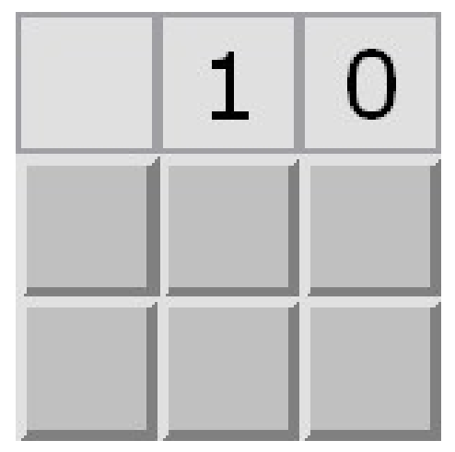
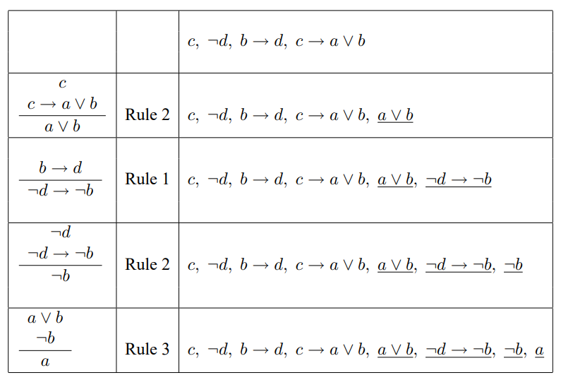
Propositional Logic
1 2 3
1 2 3
Images and text from Mini Mine Sweeper [5]
Notes:
We can use propositional logic to infer the location of the mine with limited starting information. This is done by creating 4 base assumptions that cover all possible locations of the mine relative to the board state, and then applying the rules of minesweeper to the base assumptions, until we infer a conclusion. We will go over the game rules in detail in a later slide.

Slide 10
Propositional Logic
1 2 3
(1,2)
(1,3)
1 2 3
c
¬d
b → d
c → a ∨ b
We apply game rules to create theorems:
a ∨ b
¬d → ¬b
¬b
a
=
(2,1)
(2,2)
(2,3)
There is a mine at Row 2, Column 1
Images and text from Mini Mine Sweeper [5]
Notes:
We start with our base assumptions, and then we apply game rules to reach certain conclusions about the state of the board. In 1, we state that there is a mine in one of the squares adjacent to square at row1, column 2. We know this is true since we have already revealed a '1' on the board at that location.
We also know d is not true, since we have revealed a 0 at that location.
In assumption 3, we state that if b is true, then d also has to be true, since if there is a mine at either row 2, column 2, or row 2, column 3, that means that there is a mine adjacent to row 1, column 3.
Finally, in the 4th assumption, we state that if there is a mine in one of the squares adjacent to row 1, column 2, that means that the mine could be in any column of row 2.
By applying game rules, we reach theorems that allow us to find out the position of the mine.
In theorem 1, we know for sure that the mine is in the second row.
In theorem 2, we know that if there is no adjacent mine to row 1, column 3, the mine can't be in row 2, column 2 or column 3.
In theorem 3, we know that the mine cannot be in row 2, column 2 or row 2, column 3
Finally, in theorem 4 we conclude that the only valid position of the mine is in row 2, column 1
Through propositional logic, we discover the position of the mine has to be at row 2, column 1.

Slide 11
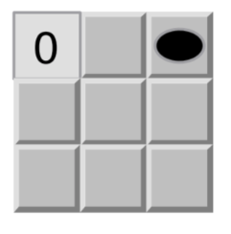
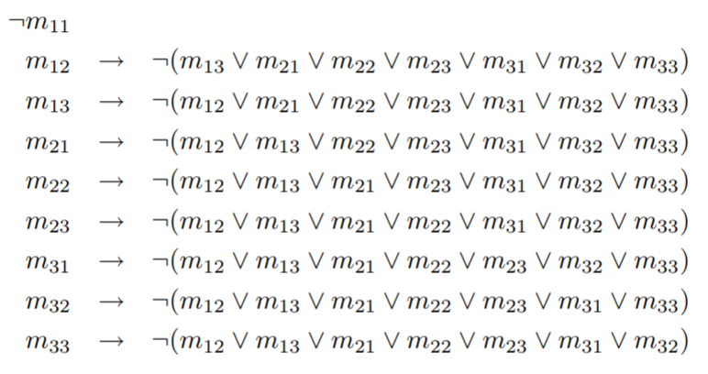
Existence Axiom: Mines
where m₁₃ = mine at row 1, column 3
1 2 3
1 2 3
Images and text from Mini Mine Sweeper [5]
Notes:
States that there is exactly one mine on the board and none of the start square
https://www2.cs.duke.edu/courses/spring06/cps102/notes/sweeper.pdf

Slide 12
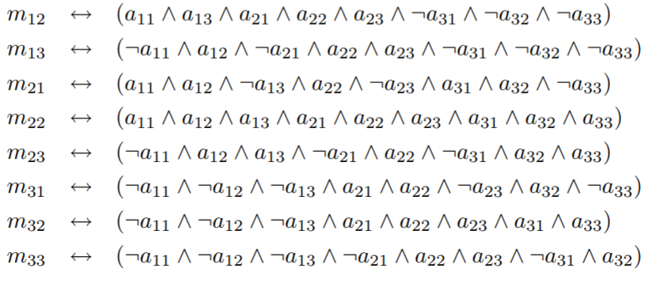
Axioms: Adjacencies
1 2 3
a₁₁ = there is a mine adjacent to the square at row 1, column 1
1 2 3
Images and text from Mini Mine Sweeper [5]
Notes:
We then need to describe adjacency: there is a mine in the square at row 1, column 2 if and only if the following two facts are true. First, there is a mine adjacent to each of the following squares: row 1, column 1; row 1, column 3; row 2, column 1; row 2, column 2; row 2, column 3. Second, there are zero mines adjacent to each of the following squares: row 3, column 1; row 3, column 2; row 3, column 3.

Slide 13
A Problem
1 2 3
Mines and adjacency axioms are not enough
a₁₁ → we infer that m₁₂ m₂₁ m₂₂ , that there is a mine next to the start square
We do not know which to pick, have to ask for new axiom
Must ask for one from the game keeper
Not part of logical inference
1 2 3
Image and text from Mini Mine Sweeper [5]
Notes:
Steve
Even though we have these axioms, they don’t give us enough info
We can narrow down to a certain point, but can’t decide further
Need to ask the game and pick a random square out of those three

Slide 14
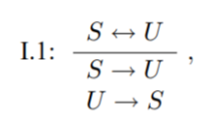
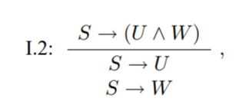
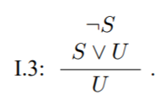
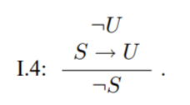
Logical Equivalences & Inferences
Image from Mini Mine Sweeper [5]
Notes:
Steve
These are the logical equivalences and inferences we are using
Each rule can be used to narrow down choices at each step
Not going to step through the sentences (too much time)

Slide 15
Example
Start with the existence axiom:
Mine must be somewhere other than the start square
Find adjacency axioms whose right side contains
= true and false
These adjacency axioms fit the description:
1 2 3
1 2 3
Image from Mini Mine Sweeper [5]
Images and text from Mini Mine Sweeper [5]
Notes:
Steve
Start with the given that there is one mine on the board (not at the start square)
From there, go to list of adjacency axioms and fine the one that matches 1 and 0.
The following fit the description

Slide 16
Example Cont.
Need to prove/be told by game that
don’t have a mine
Use elimination rule to infer that the following are false:
From here, we have one left:
1 2 3
1 2 3
Images and text from Mini Mine Sweeper [5]
Notes:
Steve
We know that m12 and m13 don’t have a mine because they gamekeeper uncovered them for us
By using one of the previous rules (elimination) we infer that all of these axioms are false
One left

Slide 17
Example Cont.
Now, we know where the mine is:
Check the mine axiom:
Can infer that all other squares are safe, we win the game
1 2 3
1 2 3
Images and text from Mini Mine Sweeper [5]
Notes:
Steve
We know the mine is at this location now
Double check the mine axiom
Can infer we win

Slide 18
Predicate Logic (first order logic)
Assuming 3x3 board with 1 mine
There exists a mine somewhere on the board that is not the starting location [5].
M(i,j) means “there is a mine in the square at row i and column j.” [5]
If there is a mine in a square then there is not a mine adjacent to it.[5]
Images and text from Mini Mine Sweeper [5]
Notes:
same as earlier rules
much shorter though more complex
differs from propositional logic by introducing variables
go over rules

Slide 19
Predicate Logic (first order logic)
If there is a mine in a square then the adjacent squares to the mine are adjacent to a mine.[5]
A(i,j) means “there is a mine in a square adjacent to the square at row i and column j.” [5]
If there is no mines in a square, the adjacent squares are not adjacent to a mine.[5]
Images and text from Mini Mine Sweeper [5]
Notes:
go over rules
These rules are less lengthy than the equivalent propositional logic rules, though they are harder to interpret and harder to program

Slide 20
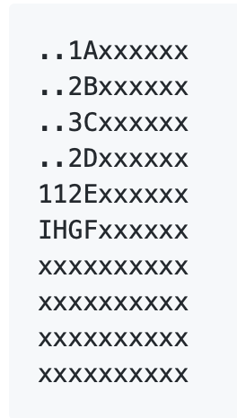
Implementation of Minesweeper
Each rule represents information gleaned from the uncovered cells of the board. A single Rule consists of a set of cells, along with how many mines are to be found among that set. So for a given uncovered cell (say we uncovered a 3), we'd generate:
Rule(3, [set of cells adjacent to the uncovered cell]).
Board
Image and text from minesweepr [6]
Notes:
the rules are, the number of adjacent mines, followed by the adjacent squares.
on the right we have the board, so the first rule, for column 3 row 1 will be Rule(1, [A, B]) as we will see on the next slide

Slide 21
Implementation of Minesweeper
Function
Board
minesweeper.solve([
Rule(1, ['A', 'B']),
Rule(2, ['A', 'B', 'C']),
Rule(3, ['B', 'C', 'D']),
Rule(2, ['C', 'D', 'E']),
Rule(2, ['D', 'E', 'F', 'G', 'H']),
Rule(1, ['G', 'H', 'I']),
Rule(1, ['H', 'I']),
], MineCount(total_cells=85, total_mines=10))
Returns
{'A': 0.0, 'B': 1.0, 'C': 1.0, 'D': 1.0, 'E': 0.0, 'F': 0.0779, 'G': 0.0, 'H': 0.9221, 'I': 0.0779, None: 0.0779}
10x10, 10 mines
Image and text from minesweepr [6]
Notes:
this is an implementation of a minesweeper AI that uses logic similar to the logic previously above.
in this implementation mine sweeper.solve takes a list of rules, and the rules are, the number of adjacent mines, followed by the adjacent squares.
the program then predicts the likelihood that each of the squares is a mine, to come up with the best next move.
the prediction is a permutation that counts up the possible board configurations in which the current square is a bomb.
https://github.com/mrgriscom/minesweepr/

Slide 22
Live Demo
https://mrgris.com/projects/minesweepr/demo/player/
Success Rate
Notes:
As the board increases and the number of mines increases that chances that we will have to guess where the next mine is also increases. this guessing is what makes this game impossible to win everytime, but we can have a very high success rate.

