Slide 1
Dynamic Adaptive Streaming over HTTP2.0

Slide 2
What’s in store
All about – MPEG DASH, pipelining, persistent connections and caching
Google SPDY - Past, Present and Future Perfect (HTTP2.0)
Test setup
Parameters Evaluated: Overhead and Bandwidth utilization
Bandwidth shaping for tests
Future Work

Slide 3
MPEG-DASH over HTTP
MPEG issued a call for proposal for an HTTP streaming standard in April 2009
Traditional streaming uses stateful RTSP, in contrast HTTP is stateless
Tracks client state until client disconnects
Frequent client server communication related to state (overhead)
HTTP based streaming (or, progressive download) from servers
Waste of bandwidth if user moves away
Not bit rate adaptive
No support for live media
DASH uses existing setup like HTTP based CDNs, caching at web proxies and redirection
Media exists in 2 parts - Media Presentation Description(MPD) and actual content
Notes:
Image source: http://dashif.org/mpeg-dash/

Slide 4
MPEG-DASH over HTTP
Video and audio are encoded at different bitrates
Playback starts in one quality, switches to a lower quality based on bandwidth
Audio bitrate independently varied
User pauses and rewinds, trick-mode used without sound

Slide 5
Pipelining, Persistent Connections, Caching
Sending multiple requests
Not closing connections
Maintaining cache data despite expiry
Notes:
http://www.chromium.org/spdy/spdy-whitepaper

Slide 6
Google SPeeDY for Chrome
Part of the “let’s make the web faster” initiative for chrome browser to reduce latency
Its an session layer protocol that resulted in 64% reduction in load times
Allows multiplexing HTTP requests over a single TCP connection
Less number of TCP connections less chance of window size delaying load time
Header compression and server push
Notes:
http://www.chromium.org/spdy/spdy-whitepaper

Slide 7
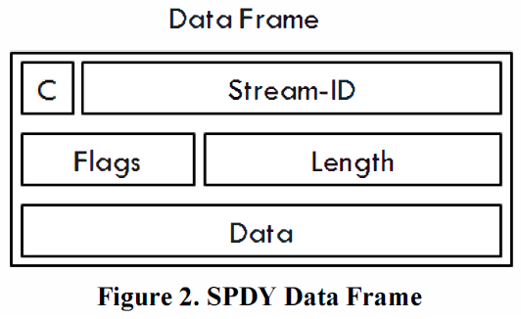
SPDY
8 byte header for both types of frames
SYN_STREAM, SYN_REPLY, RST_STREAM SETTINGS, NOOP, PING, GOAWAY etc.
Priority from 0-7 sent as part of SYN_STREAM
31 bit stream identifier
Name-Value pairs in data portion of control frame are header block contents from HTTP
Status codes for termination

Slide 8
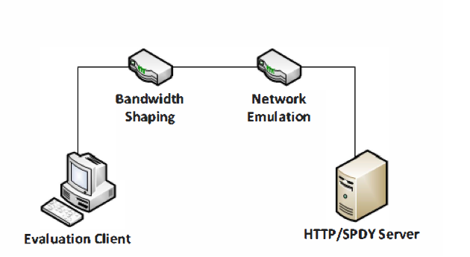
Experimental Setup
Evaluation client, Bandwidth Shaping, Network Emulation
Content encoded at 14 different bit rates 100 – 4500 kbps
Bandwidth restriction using Linux traffic control - tc
Linux ‘netem’ used for RTT configuration,
Apache server with SPDY plugin
Evaluation client is VLC MPEG DASH plugin
Notes:
http://www.chromium.org/spdy/spdy-whitepaper

Slide 9
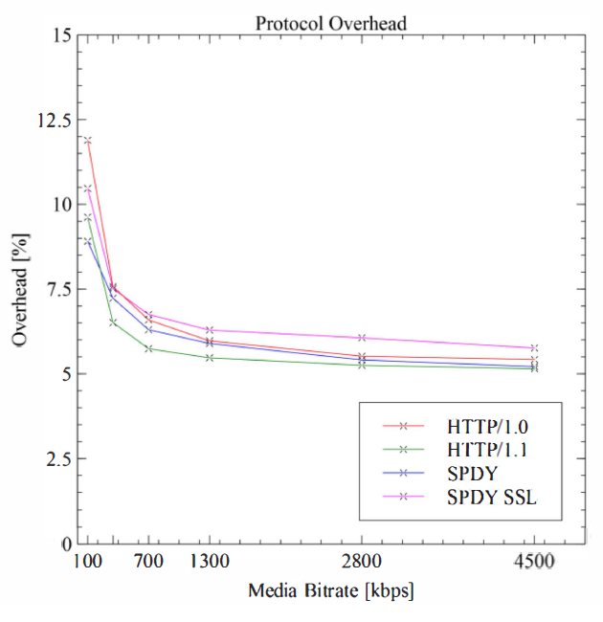
Overhead Evaluation
Overhead evaluation done at 3 times and the average is used
Bandwidth shaping is disabled
Overhead = 1 – (media throughput/overall throughput)

Slide 10
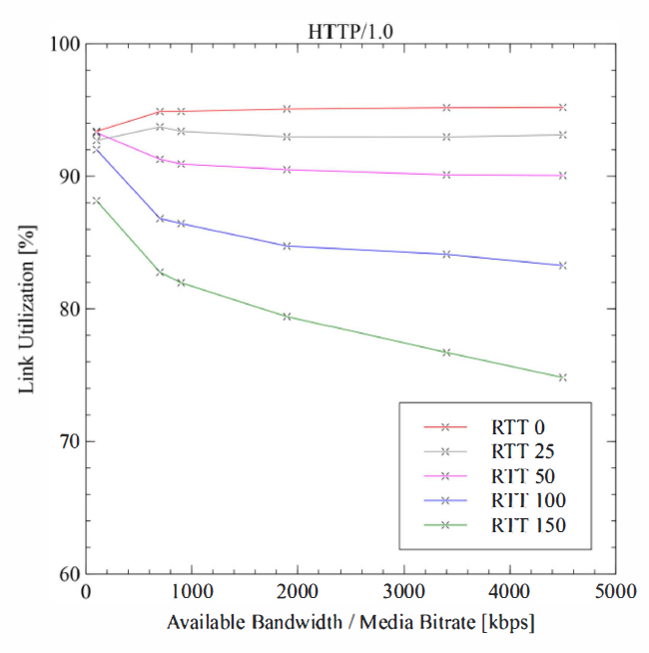
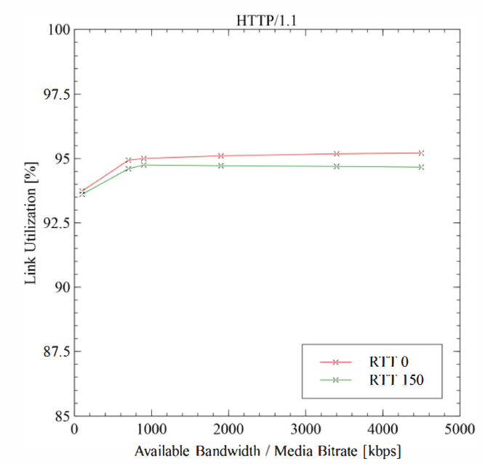
Link Utilization HTTP1/1.1
Restricted bandwidth and RTT
RTT ranges 0-150ms: 0-25 ms for LANs, 50-100 ms for fixed lines and 150 ms for wireless
media throughput/available bandwidth
HTTP1.1 takes advantage of pipelining and persistent connections
Only 1 TCP connection used for a session

Slide 11
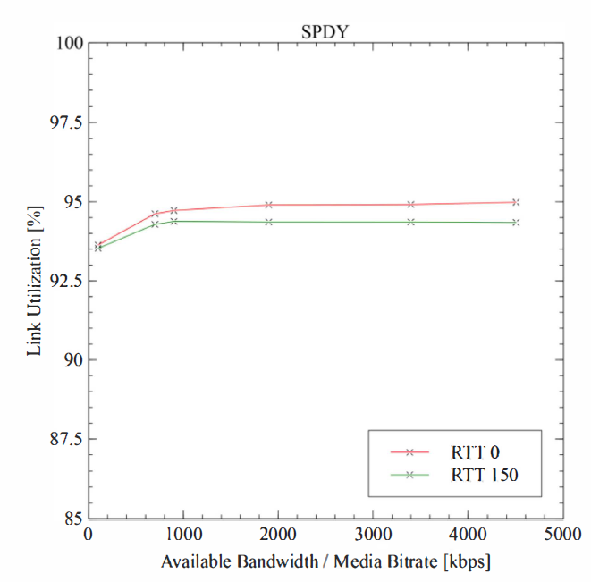
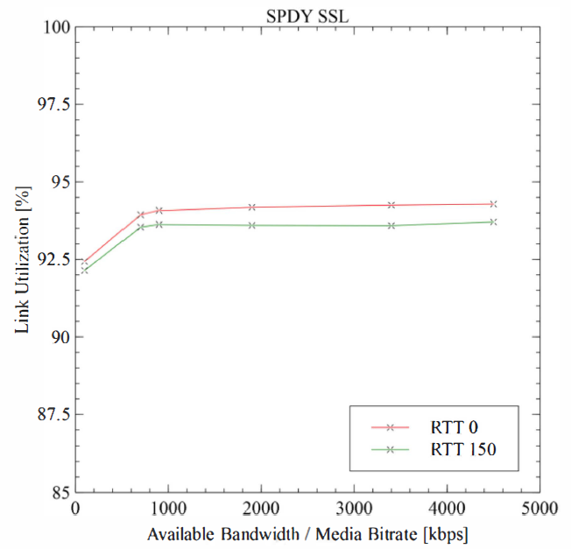
Link Utilization SPDY
The excessive processing power consumed is not apparent

Slide 12
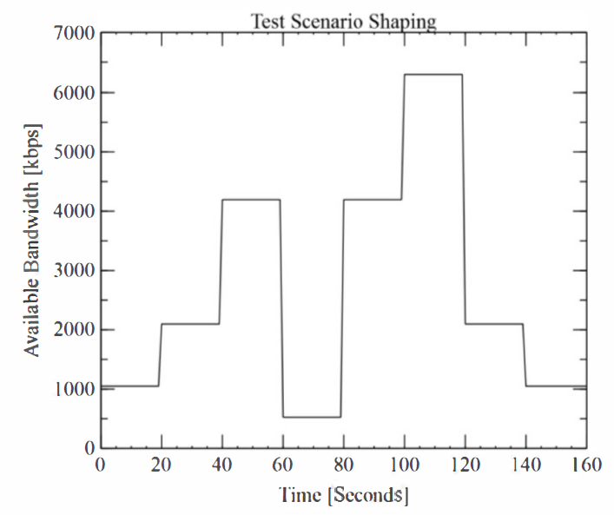
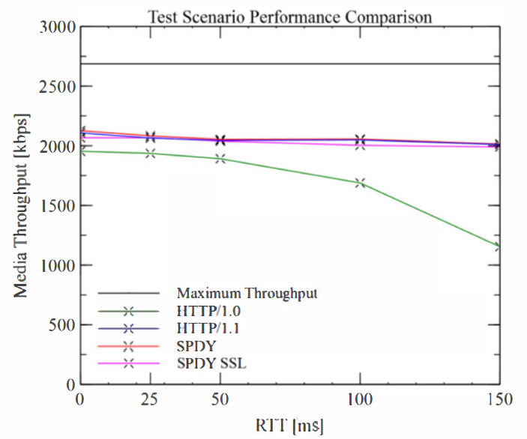
Bandwidth Shaping for tests
Buffer restricted to 40 seconds
Experiment lasts 160 seconds
The values plotted on the graph are averages of several repetitions
Avg. maximum throughput has been calculated as the average from pre-defined trace

Slide 13
Future work
Evaluation of SPDY on real world mobile devices
Notes:
http://www.ietf.org/blog/2015/02/http2-approved/
https://http2.github.io/
Sample performance demo: http://http2.golang.org/gophertiles?latency=30

Slide 14
Breaking News!
HTTP2.0 standard has been approved by IESG on Feb 17th 2015
Substantial change to the format, compression scheme and mapping to HTTP
Focus is not the API but performance: perceived latency and network resource usage
Approved HTTP/2 is comprised of two specifications:
Hypertext Transfer Protocol version 2
HPACK - Header Compression for HTTP/2
Notes:
http://www.ietf.org/blog/2015/02/http2-approved/
https://http2.github.io/
Sample performance demo: http://http2.golang.org/gophertiles?latency=30

Slide 15
HTTP2.0
Flow control not applicable to control frames
Multiple algorithms for flow control
Streams are bidirectional and can be closed from either end
Streams are denoted by integers
Header lists are serialized into a header block divided into octet sequences
Frame sizes varies between 2^14 – 2^24 -1
Notes:
http://www.ietf.org/blog/2015/02/http2-approved/
https://http2.github.io/
Sample performance demo: http://http2.golang.org/gophertiles?latency=30

Slide 16
Thank you

