Slide 1
An Empirical Study of Video Messaging Services on Smartphones
Presented by Tianhe Wang

Slide 2
Background Knowledge: Client-server model

Slide 3
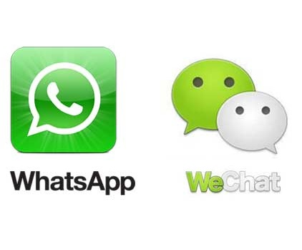
Motivation
Mobile applications: People send/receive messages using wireless network much more frequently.
Multimedia messages are often much larger than text messages
Challenging for delivering video messages in real-time.

Slide 4
Service Architecture(1/3)
WhatsApp (store-and-forward):
Sender:
TCP connection with c.whatsapp.net for updating status and transmission text messages
TCP connection with mms.whatsapp.net for uploading multimedia messages
Recipient:
TCP connection with c.whatsapp.net for receiving text messages
TCP connection with mms***.whatsapp.net for receiving multimedia messages

Slide 5
Service Architecture(2/3)
WeChat(store-and-forward):
Setting up two TCP connections:
Short.weixin.qq.com for transmitting periodic heartbeat messages and client-side statistics to WeChat server
Long.weixin.qq.com for sending/receiving both text messages and multimedia messages
Periodic Heartbeat:
Let receiver know if the sender is no longer available

Slide 6
Service Architecture(3/3)

Slide 7
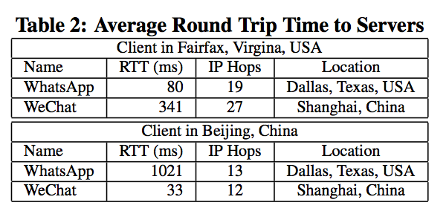
Server Location(1/2):
Identify the physical locations of the servers using “IP Locator”.
IP locator, www.ip-adress.com/ip_tracer/ :A reliable IP Address Location Database
WhatsApp: Dallas, Texas, USA
WeChat: Shanghai, China

Slide 8
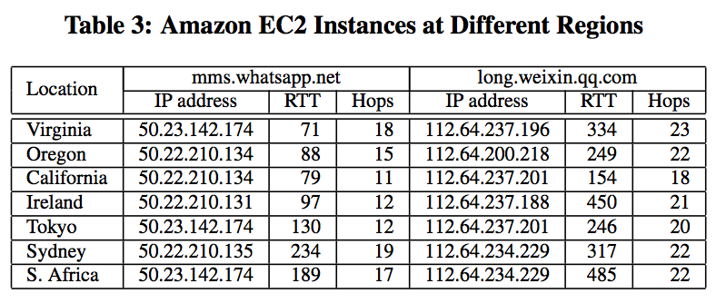
Server Location(2/2):
(Elastic Compute Cloud)EC2 instance at each Amazon AWS
AWS: Amazon Web Service:
Offers reliable, scalable and inexpensive cloud computing services.

Slide 9
Methodology(1/2): setting up
Using 6 smartphones: iPhone 4S (iOS 6.0.1), iPhone 3GS (iOS 5.0.1), Galaxy S III (Android 4.0.4), Nexus One (Android 2.3.4), Nokia Lumia 920 (Windows Phone 8), and Meizu MX (Android 4.0).
WeChat/WhatsApp versions

Slide 10
Methodology(2/2): Process
Upload time for sender
Notification Latency
Download time for receiver
Wireshark to capture and analyze the captured traffic file offline.
Wireshark: a network protocol
Analyzer for Unix and Windows

Slide 11
Upload time(1/5):
Record from the first packet being transmitted to the last TCP ACK from the server arrives.
Device: Andoid 4.0.x device:
Galaxy S III in the USA
MX in China

Slide 12
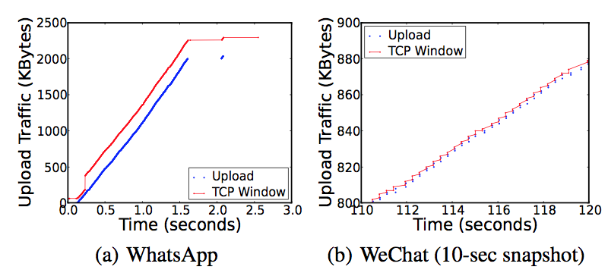
Upload time(2/5):
Result:
Bandwidth issue?
TCP congestion
control
TCP window size
at server-side?
150KByte/s
2.8KByte/s

Slide 13
Upload time(3/5):
WeChat: small TCP window size for each such connection
beneficial for supporting text messages or photo messages where the message size is relatively small.
WhatsApp: single connection with a single server for all messages
Separating video messages from text messages give the WhatsApp server more chances for optimization without sacrificing the user experience.

Slide 14
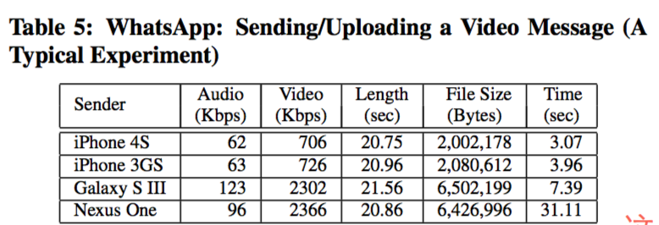
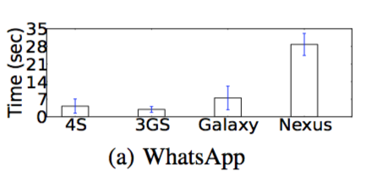
Upload time(4/5):
File size of video messages affects uploading time
WhatsApp:
IOS: Around
800 Kbps
Andoid:
Around
2400 Kbps

Slide 15
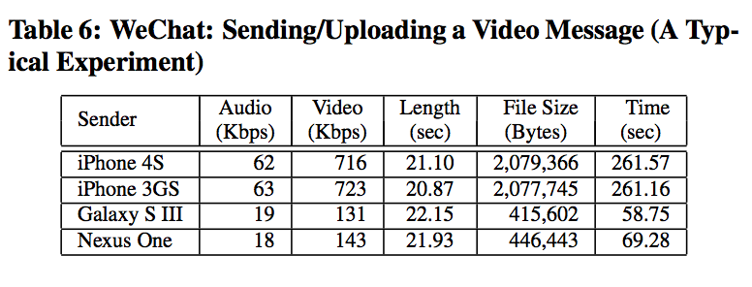
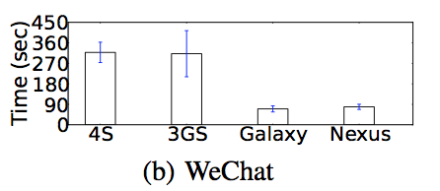
Upload time(5/5):
File size of video messages affects uploading time
WeChat:
IOS: Around
800 Kbps
Andoid:
Around
160 Kbps

Slide 16
Notification Latency:
The sever will send a notification message to the recipient.
From when the last uploading packet is sent out by the sending device to when the notification message arrives at the receiving device.
WhatsApp in USA, WeChat in China

Slide 17
Download time(1/2):
Video Messages are sent from iOS devices via both WeChat and WhatsApp separately.
Received by Galaxy S III in the USA, MX in China
Message: around 2MB, 20-secs
Clients in different locations can experience significantly different downloading throughput.

Slide 18
Download time(2/2):
Sent from different devices
Both WhatsApp and WeChat client are in the USA
Video messages size

Slide 19
Summary:
Two main factors affect transmission speed:
File size
Client/server location
Improvements?
Reduce file size when uploading/downloading content
Set up servers at different data centers in the cloud all over the world

Slide 20
Improvement(1/5):
Client-side transcoding:
Record high quality video but transmit low quality video messages if only limited bandwidth is available.
Powerful hardware for smartphone to do computation intensive transcoding tasks.
Using ffmpeg on Nexus 4: a cross-platform solution to record, convert and stream audio and video.

Slide 21
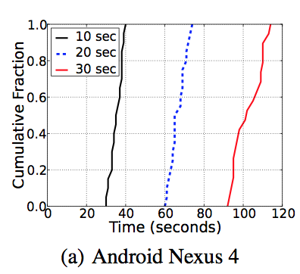
Improvement(2/5):
Client-side transcoding:
Resolution: 1920 × 1080 to 480×270
Bit rate: 12,000 to 430 kbps
96% reduction
Used in urgent message, reduce sending time

Slide 22
Improvement(3/5):
Server-side transcoding:
Record high quality video but transmit low quality video messages
Server: Amazon Elastic Transcoder: allows users to utilize cloud resources including Amazon Elastic Compute Cloud (EC2) and Amazon Simple Storage Service (S3) in an easy way for transcoding video content between different codecs, formats, and sizes

Slide 23
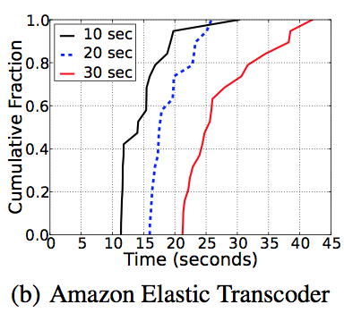
Improvement(4/5):
Server-side transcoding:
Resolution: 1920 × 1080 to 480×270
Bit rate: 12,000 to 720 kbps
94% reduction
Not desirable

Slide 24
Improvement(5/5):
Cloud-assisted Video Message Delivery
Location awareness
Set up servers at different data centers in the cloud all over the world
leverage the inter-datacenter bandwidth
Existing research: Airlift [9]

Slide 25
Related work
Short Message Service (SMS): bulk message delivery may cause network congestion [12]
Signaling load for delivering SMS messages [13]
Message security for WhatsApp [14]
Watching stream videos online: how to address heterogeneity problem by leveraging server-side resource for transcoding [10, 11]

Slide 26
Conclusion:
Larger number of users make it even more difficult
Existing video messaging services lack adequate network support.
Enhancement on readily-available techniques

Slide 27
End
Thanks

