Slide 1
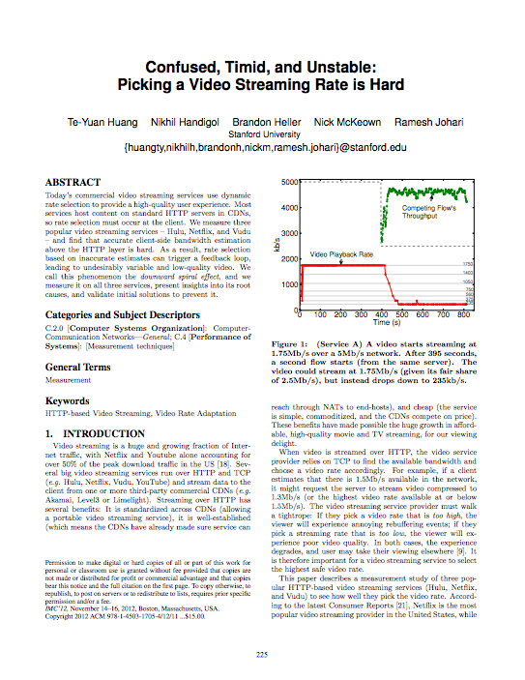
Confused, Timid, and Unstable: Picking a Video Streaming Rate is Hard
Published in 2012
ACM’s Internet Measurement Conference (IMC)
Five students from Stanford
Notes:
This paper was published only a few years ago, which is nice because it’s very relevant.
The title is of course humorous, but I think it also accurately describes the experience we often have while trying to stream online video. It can be kind of a mess, at times.

Slide 2
Background Knowledge
Research Motivation
Experimental Setup
First Results
Downward Spiral
Intervention
Before, After
Typical HTTP streaming setup
Client must pick what to request
Careful balance for user satisfaction
Notes:
First, some quick background that I believe we’re all comfortable with.
As you’ll see, these guys are specifically interested in streaming video over HTTP.
This is this our typical HTTP video streaming architecture, where:
First the client connects to and authenticates with the video streaming service provider.
Ultimately switch communicating with the CDN to get the video.
It’s HTTP, so the client is responsible for requesting what it needs at any given time.
There is a careful balance to maintain, not wanting to cause a re-buffer, and not wanting to deliver unnecessarily low quality.

Slide 3
Background Knowledge
Research Motivation
Experimental Setup
First Results
Downward Spiral
Intervention
Before, After
How well do they pick what to request?
Notes:
This experiment begins with them asking the question “how accurately do typical service providers make these estimations?”
Are they making requests that maximize quality the quality delivered with the bandwidth available.
They consider these three of the largest video streaming service providers: hulu, netflix and vudu
However, they’re not looking for how these services compare to each other: they’re looking to analyze problems that affect HTTP streaming in general.
Thus they are referred to as Services A, B, and C throughout the paper.
Anyway, they found initially that if you’re streaming video and your home network is otherwise quiet, then all three services do a fine job maintaining consistent optimal quality.
But of course, with nothing competing on the network that’s not super hard to do.
More importantly: how do these services react and adjust when competing connections are introduced?

Slide 4
It’s bad
Maximum: 5 Mb/s
Fair Share: 2.5 Mb/s
Optimal: 1.75 Mb/s
Used: 235 kb/s
What makes this so difficult?
Notes:
The answer is it’s pretty bad. They don’t handle it well.
This example happens to be from Service A, but it is a typical example of how all three of them behave.
When a competing connection is introduced about 400 seconds into the stream, the streaming client reduces its rate far below optimal quality, even though the optimal quality (1.75 MB/s) which it was already streaming at is still much less than its reasonable fair share (2.5 MB/s).
And so, this experiment ultimately considers the question: Why is this happening?

Slide 5
Background Knowledge
Research Motivation
Experimental Setup
First Results
Downward Spiral
Intervention
Before, After
Services are similar - not identical
Ways to stream HTTP video:
Web browser vs. PS3
Single connection vs. many
Entire file vs. chunks
Notes:
So, let’s look at how they designed the experiment and measurements, to ideally treat each of the three services equally.
All three services are similar in that they offer some kind of HTTP video streaming.
But of course they don’t all implement it in the same way.
Companies tend to keep implementation details like that private. In order to make good accurate experimental measurements, our researchers had to do a little reverse engineering.

Slide 6
Implementation Details
Notes:
Services B and C for example each have web-browser clients which do not implement HTTP but instead a proprietary protocol.
Fortunately each of them has a Playstation 3 client as well which does use HTTP.
The formatting of the HTTP GET requests varies a little from service to service as well.
Really, we don’t need to worry about this too much – what’s important is that they account for these differences as they come up in measurements and analysis.

Slide 7
Network Parameter Controls
NetFPGA rate limiter: 5 MB/s
Competing flow: same file, same CDN, simple TCP file download
Notes:
There are a few controlling factors introduced for the experiment.
The NetFPGA machine sits in the middle of every connection, and forcefully limits the bandwidth to whatever exact value they want – 5 Mb/s in most cases.
When necessary, a local proxy was introduced in front of the CDN to eliminate variance in CDN server locations and internet paths.
In the bottom left of the diagram we have the source of the competing connection on the network, which is introduced 400 seconds or so into the streaming session.
The competing connection which they introduce, in each case, is made to be a simple TCP file download for the same exact file, from the same exact CDN.
So, the only real difference between the connections is that the competing flow is limited by the TCP congestion control algorithm, while original video stream is being limited by whichever video streaming client algorithm

Slide 8
Background Knowledge
Research Motivation
Experimental Setup
First Results
Downward Spiral
Intervention
Before, After
No surprises - they’re terrible ☹
Repeated 76 times over four days
91% of cases failed predictably
Notes:
Now that we’ve seen the context that these measurements are taken with, let’s look at the results for each service.
Like I said earlier though, that graph was a typical example.

Slide 9
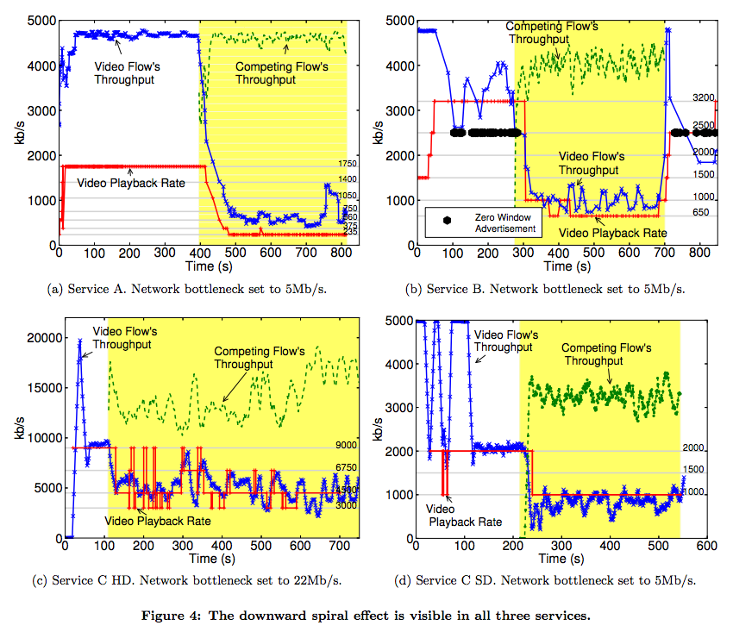
Notes:
Here we have the results from each service side by side.
Each case displays the unnecessary plummet in video playback rate.
Note that Service C here has two figures, because it makes a complete distinction between its standard quality streaming service, and its HD quality one which operates at much higher bandwidths. Nonetheless, they are both underperforming.

Slide 10
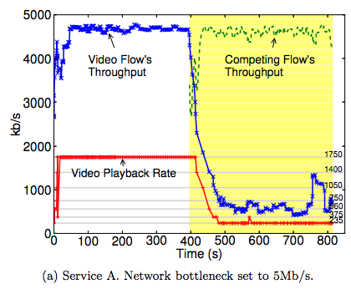
Sanity Check?
Notes:
It’s uncanny that every one of these streaming clients from different places would exhibit such similarly inefficient behavior.
Your forced to wonder: are we missing something? Is this somehow an inherent characteristic of streaming video over HTTP that we cannot avoid? Or are all of these clients legitimately just making bad decisions about what to request and when.
It turns out the client for Service A has a feature which allows you to manually select the desired rate, and disable the client’s rate selection algorithm.
So they set it to play at what to original optimal rate was: 1.75 Mb/s
And it worked great.

Slide 11
Background Knowledge
Research Motivation
Experimental Setup
First Results
Downward Spiral
Intervention
Before, After
Follow the spiral down
Monitor everything:
TCP throughput
Buffer size
Request interval
Congestion window
Where do these algorithms go wrong?
Notes:
Each one of the rate selection algorithms is highly prone to fall into this downward spiral, and not recover.
The next step is to walk through one of these failures step by step, monitoring every parameter you can, in hopes of getting some insight as to where exactly these algorithms mess up, and why.
For brevity, the analysis starts to concern primarily Service A – with a couple details specific to the other two services addressed at the end.

Slide 12
Client Network Behavior
Notes:
Carefully looking at the client’s network behavior is a good place to start.
On the left, we have a graph of the raw TCP throughput for the connection. On the right, we have a graph of how frequently requests are being made.
Neither of these figures is showing us a competing flow: this is before that.
These two figures are looking at how the client changes once the buffer fills.
Once that happens, the client enters a periodic ON-OFF sequence. Originally it was requesting 4s of video every 1.5s, but drops to 4s of video every 4s. To maintain the buffer instead of filling it.
So, does this tell us much? Give us any insight? Well, no. I think I would have implemented something very similar myself: When the buffer is full, slow down! No need to be greedy.
And like we saw – this is working just fine when the home network is quiet. So what exactly goes wrong when a competing flow is introduced?
It turns out, those longer OFF periods become kind of a problem.

Slide 13
TCP Congestion Window
Times out in 4s OFF period
Reset to initial value of 10 packets, every time
Single persistent connection
Ramp up from slow start for each segment anyway
No competing flow? No problem
Notes:
To understand why, we’ve got to think down to exactly how TCP handles the ON-OFF period.
We have the TCP congestion window, which of course TCP is varying over time to control congestion.
It times out from more than 200ms of inactivity, so after 4 seconds of inactivity the window size will always be reset to its initial value of 10 packets.
The connection has to ramp up from a slow start every time a new segment is requested.
Artificially limits the bandwidth available to the client.
Clearly it’s not bad enough to confuse the client on a quiet network. But can we see a more significant impact from these slow starts when there is a competing flow?

Slide 14
Completely Squashed
Notes:
Remember that the TCP congestion window is of course maintained and adjusted by the server – the client has absolutely no knowledge about it.
To investigate this, they set up their local proxy in front of the CDNs, and used tcp_probe to keep track of the congestion window for the video stream, and for the competing download.
Here they found their first root cause of the problem.
When the video stream goes on for each segment, it is immediately beaten down by the competing download. During the OFF period, the competition has already filled the buffer, so the video stream sees high packet loss at the beginning of every segment it requests.
So its bandwidth is being kept artificially low – and the client has no way to tell.
The congestion window is managed on the server. For the client, there’s no difference between legitimately not having bandwidth available and having it temporarily low because TCP is adjusting.
So is that the issue? Clients estimate this artificially low bandwidth, and adjust accordingly?

Slide 15
Rational Behavior
Notes:
They perform one simple test to see how the client adjust its playback rate given the bandwidth it perceives.
This is on a quiet network, no competition. The client is able to make accurate estimates about the bandwidth available.
And it does exactly what you would think: Use the highest rate possible with the given bandwidth.

Slide 16
A More Complete Picture
Playback buffer fills – starts periodic ON-OFF
During OFF period:
Video stream congestion window idle resets
Competing flow is still going, filling the routers buffer
ON period starts:
Very high initial packet loss
Estimate artificially low bandwidth
Lower playback rate
Notes:
We can combine those last two ideas to start to get a more complete idea of what’s happening.

Slide 17
Another Thing - Timing
Notes:
And another thing to consider about this process.
On the left we have the figure you’ve already seen, with the congestion window getting beaten down.
The slow start isn’t ideal, but what’s even worse is that the window doesn’t have nearly enough time to climb back up to its steady state value, before its done downloading the segment.
So if the client were downloading much longer segments, we would still see this slow start behavior but overall the bandwidth perceived will be much higher because the congestion window size has time to work at its steady state size for a while.
In the right figure here, they confirm this assumption experimentally by measuring the congestion window if the client were to instead download segments five times as long.

Slide 18
The “Spiral” Part
ON period starts:
Very high initial packet loss
Estimate artificially low bandwidth
Lower playback rate – which means shorter segments
Each estimate is ever lower than the previous
Spiral down until you can’t play lower quality
Notes:
And another thing to consider about this process.
On the left we have the figure you’ve already seen, with the congestion window getting beaten down.
The slow start isn’t ideal, but what’s even worse is that the window doesn’t have nearly enough time to climb back up to its steady state value, before its done downloading the segment.
So if the client were downloading much longer segments, we would still see this slow start behavior but overall the bandwidth perceived will be much higher because the congestion window size has time to work at its steady state size for a while.
In the right figure here, they confirm this assumption experimentally by measuring the congestion window if the client were to instead download segments five times as long.

Slide 19
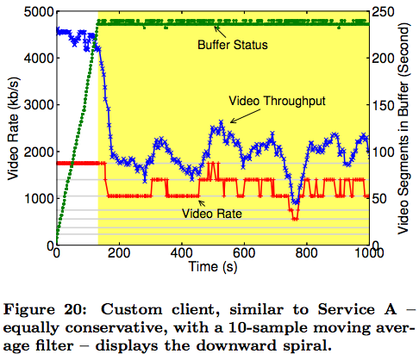
Background Knowledge
Research Motivation
Experimental Setup
First Results
Downward Spiral
Intervention
Before, After
Mimic Service A
Notes:
Now equipped with a pretty solid understanding of what’s causing this downward spiral, the next step is of course to see what can be done to mitigate it.
They start by implementing their own custom client, which behaves as similarly as possible to Service A’s client – especially in the downward spiral behavior.
Then, they test out a few different adjustments to their algorithms to see what helps the most.

Slide 20
Less Conservative
Service A ~40%
Try out 10%
Notes:
First of all, let’s take advantage of the fact that we know we’re getting consistent underestimates for bandwidth. Since this is the case, we really don’t need to be so conservative in what we’ll allow ourselves to request.
Service A operates with about 40% conservatism, meaning that if it thinks there’s 1 MB/s of bandwidth available, it will use only 600 kb/s – and conserve 40% of it.
Here they have the results of tuning their custom client to be 10% conservative – and the improvement is clear. It’s still choppier than it needs to be. But it’s not such a vicious spiral, and it maintains optimal quality for some of the time.

Slide 21
Better Filtering
Service A: ten sample moving average
Try: 80th percentile
Notes:
Next, they take a look at how the bandwidth estimations are actually made.
The closest the couple come to mimicking the behavior of Service A was by implementing a 10-sample moving average of the last measured throughputs.
However, outliers have a big impact on moving averages. So when, for instance, the connection has to ramp up from slow start briefly for a new segment, bandwidth estimates suffer.
To neutralize the impact of outliers, they implement a filter which estimates bandwidth as the 80th percentile of the last 10 measurements, not as a moving average.
The results here are dramatically improved. The rate drops briefly once or twice, but is no where near a rebuffer

Slide 22
Finally: Bigger Segments
Notes:
Last but not least, like we said earlier a longer time spent downloading each segment would allow the congestion window to climb to its steady state size more frequently.
By now, they’ve got they’re custom client doing exactly what we would like it to in the presence of a competing flow.

Slide 23
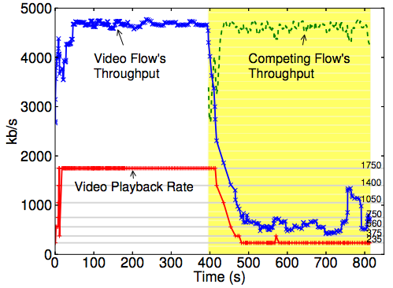
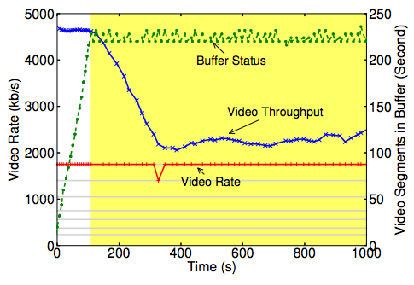
Background Knowledge
Research Motivation
Experimental Setup
First Results
Downward Spiral
Intervention
Before, After

Slide 24
To Conclude
On the one hand, there are changes to how the client estimates bandwidth which can improve its interplay with TCPs congestion control
A more radical solution:
Don’t attempt to estimate bandwidth at all
Competing goals: highest bitrate, and no underruns
Goal is NOT “keep the buffer full”
Goal is “don’t let the buffer get empty”
Increase the playback bitrate when the buffer is high
Decrease the playback bitrate when the buffer is low
Perfect layer of separation:
TCP responsible for delivering fair share bandwidth
Video player responsible for showing the highest rate it can

