Slide 1
Thin to Win? Network Performance Analysis of the OnLive Thin Client Game System
By Mark Claypool, David Finkel, Alexander Grant, and Michael Solano
Submitted March 2013
Presented by Anthony Botelho

Slide 2
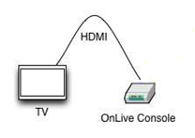
Thin Clients
All (or most) of the game computations occur on a server, and send back rendered frames
The client needs only send small amounts of data, and stream back the resulting images (like a video)

Slide 3
Motivation
Network load is important to plan infrastructures
A variety of applications have been studied
PC & console games
Video streaming (both live and pre-recorded)
No comparisons exist between thin clients and these other applications

Slide 4
Turbulence
A way is needed to compare applications in similar terms
Turbulence describes common network characteristics:
Overall bitrate
Packet size
Frequency of packets
Together can be used to build traffic models and classifiers

Slide 5
Overview
Background/Motivation
OnLive turbulence
Comparison of game genres
OnLive vs similar applications
Reactions to network conditions
Summary/Conclusions

Slide 6
Research Question 1
What is the network turbulence for OnLive games?
Games are shown to have:
High downstream bitrates: ~5Mb/s with 1000 byte packets
Moderate upstream bitrates: ~100Kb/s with 150 byte packets

Slide 7
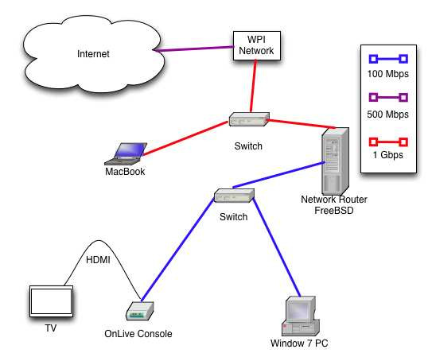
OnLive Thin Client
MicroConsole runs games connected to HDTV over HDMI running at 1080p
All OnLive traffic uses UDP for both up and down streams
Want to first look at the overall turbulence of games using OnLive

Slide 8
First Experiment
Three popular games with comparable graphics qualities chosen to represent possible differences in turbulence
Unreal Tournament III (2007)
Batman: Arkham Asylum (2009)
Grand Ages: Rome (2009)
Each has similar system requirements, differing slightly in minimum RAM and processor requirements

Slide 9
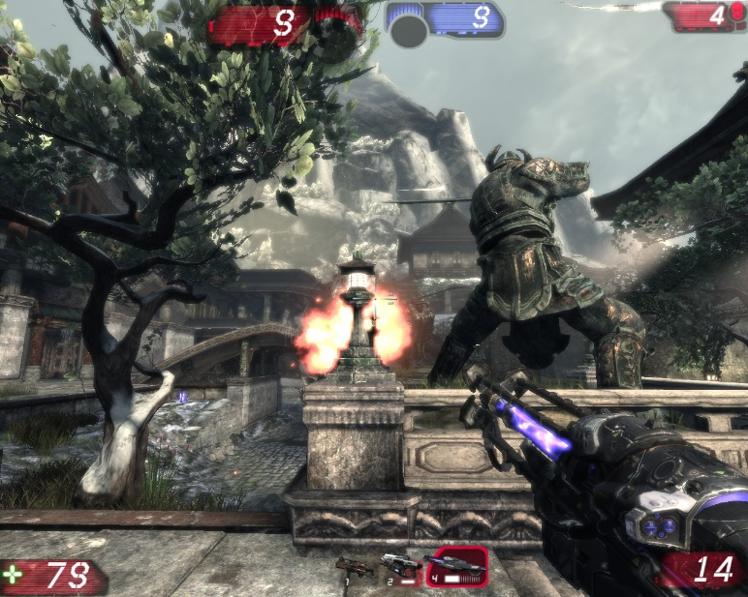
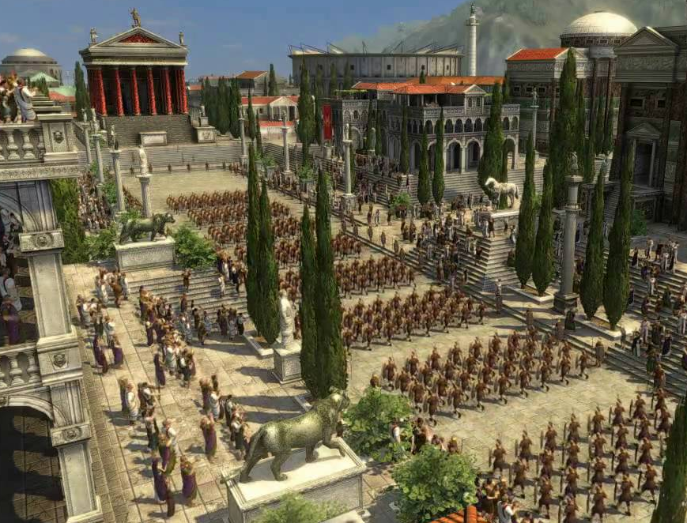
First Experiment
Each game was played for 2.5 minutes in a chosen scenario that best represents that game’s gameplay
Long enough to experience all core game interactions
Unreal Tournament III
Batman: Arkham Asylum
Grand Ages: Rome
http://insomnia.ac/reviews/pc/unrealtournament3/screenshot1.jpg
http://static.gamespot.com/uploads/original/mig/7/2/3/5/1267235-952337_20100304_004.jpg
http://i.ytimg.com/vi/fN-extoW7Rs/maxresdefault.jpg

Slide 10
Overall Turbulence
OnLive appears very asymmetric
Approx. 50:1 bitrates, 6:1 inter-packet times, 10:1 packet sizes
Onlive Up:Down Turbulance (mean values)

Slide 11
Overview
Background/Motivation
OnLive turbulence
Comparison of game genres
OnLive vs similar applications
Reactions to network conditions
Summary/Conclusions

Slide 12
Research Question 2
Does the network turbulence for different game genres differ from each other?
The games observed show:
Similar trends, but different rates
Large variance in downstream and upstream traffic

Slide 13
Experiment 2
Each game’s bitrate, packet size, and frequency of packets is compared
Both downstream and upstream are compared separately
Any differences in the graphs would suggest differences in the genres represented by each game

Slide 14
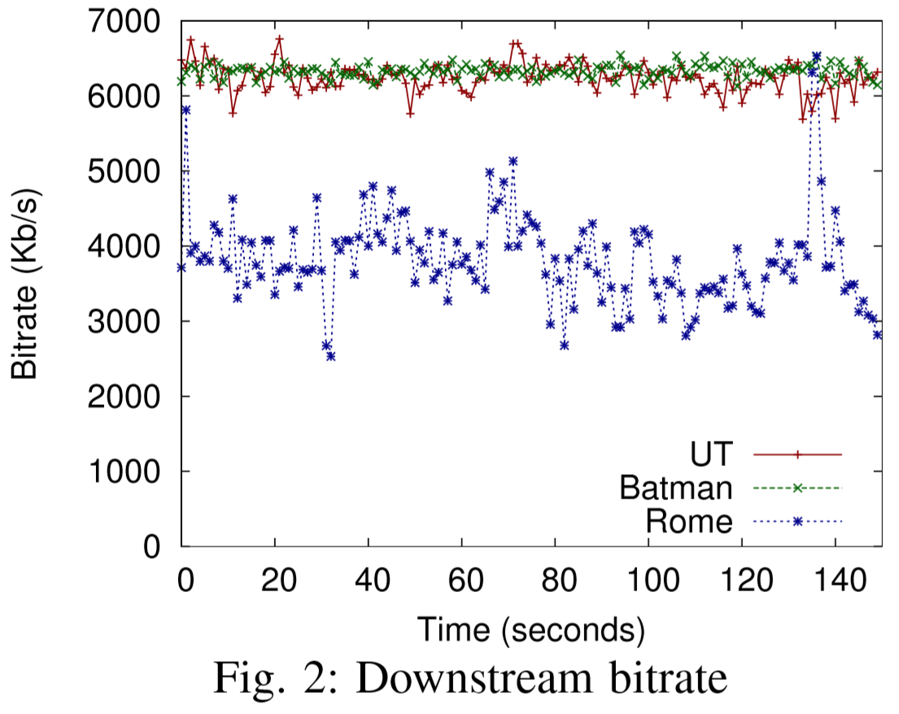
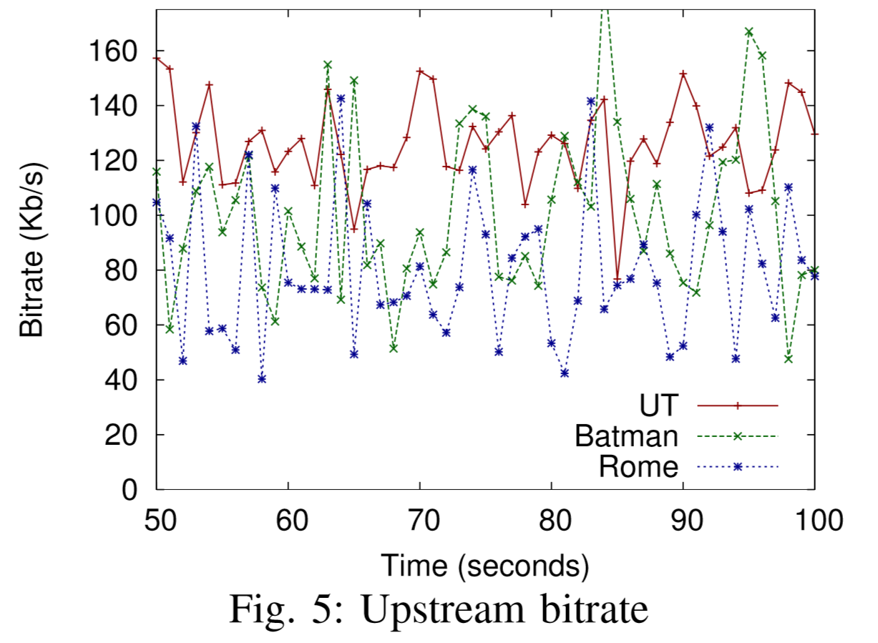
OnLive Client Bitrates

Slide 15
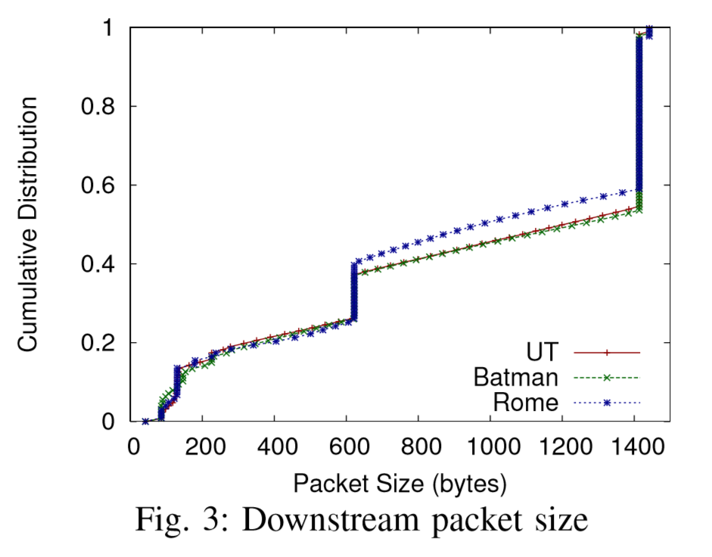
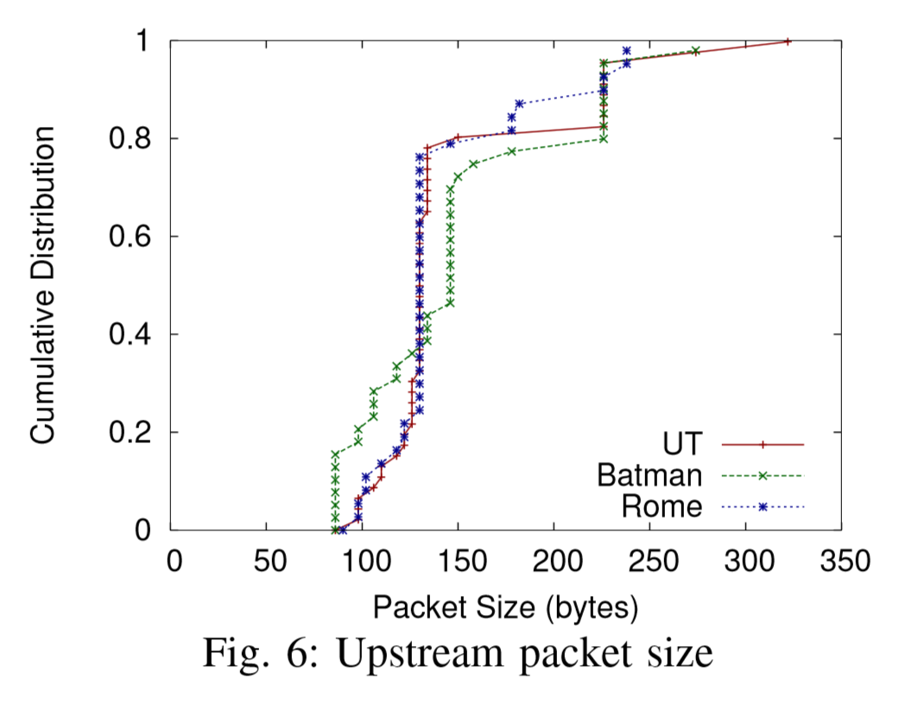
OnLive Client Packet Size

Slide 16
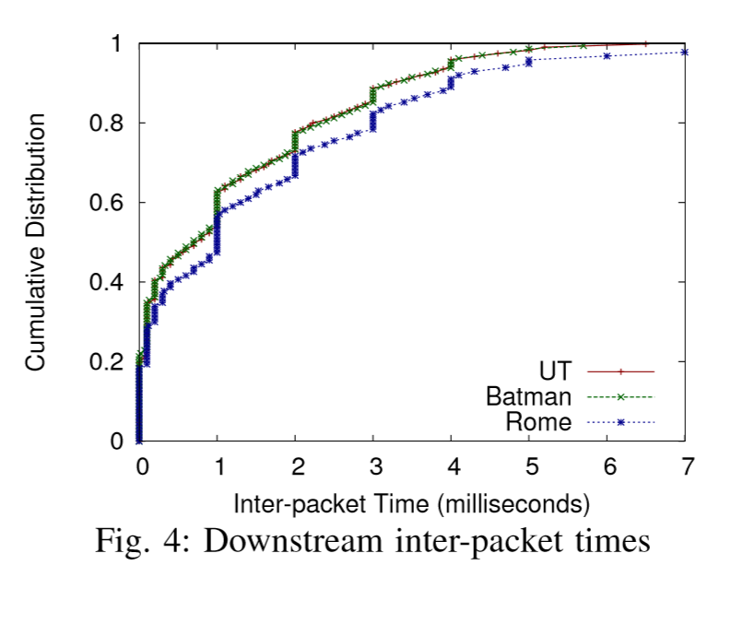
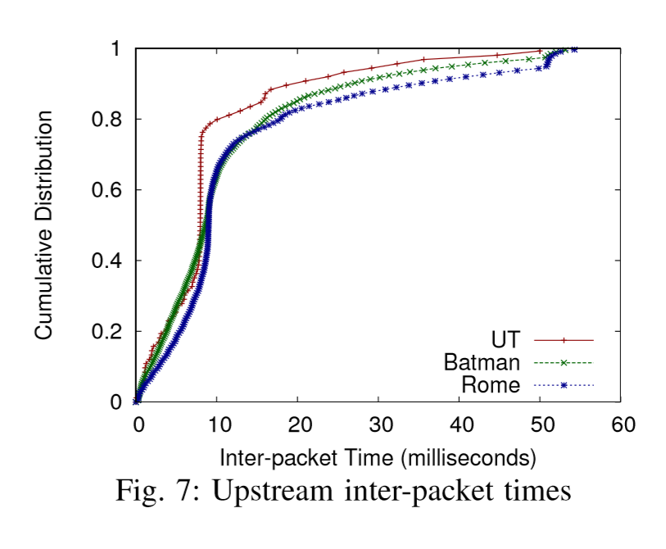
OnLive Client Inter-Packet Times

Slide 17
Comparison
There appear to be similar trends
Unreal Tournament III shows higher bitrates and more frequent packets
Illustrates certain genres (like a fast-paced FPS) produce a larger network load
Aspects such as camera angle, and the pace of the game may effect downstream requirements

Slide 18
Overview
Background/Motivation
OnLive turbulence
Comparison of game genres
OnLive vs similar applications
Reactions to network conditions
Summary/Conclusions

Slide 19
Research Question 3
Does the network turbulence for OnLive games differ from traditional games?
When compared:
Upstream traffic appears similar to traditional games
Downstream traffic more resembles live video

Slide 20
Experiment 3
Observe OnLive compared to similar applications as well
Traditional Games (UTIII on PC)
Virtual Environment (Second Life)
Youtube (pre-recorded video)
Skype (live video)
Only Unreal Tournament III is compared

Slide 21
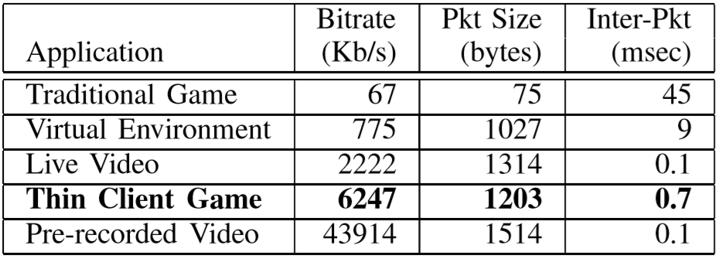
Comparison of Turbulance
Medians of downstream turbulence

Slide 22
Comparison of Turbulance
OnLive behaves more like live video streaming than any other in terms of down stream
Even OnLive upstream produces more turbulence than traditional games
Suggests large network impact when using thin clients
Medians of downstream turbulence

Slide 23
Overview
Background/Motivation
OnLive turbulence
Comparison of game genres
OnLive vs similar applications
Reactions to network conditions
Summary/Conclusions

Slide 24
Research Question 4
Does the network turbulence for OnLive change with different network conditions?
The OnLive client:
Adapts bitrates to capacity limits, but not to loss or latency
Adapts frame rate to capacity limits and loss, but not latency

Slide 25
Experiment 4
Different network conditions are simulated to view effects of the OnLive downstream
Bitrate capacity restrictions
10 Mb/s and 5 Mb/s
Packet Loss
1% and 1.5% Loss
Latency
40ms and 70ms latency
Only Unreal Tournament III is observed

Slide 26
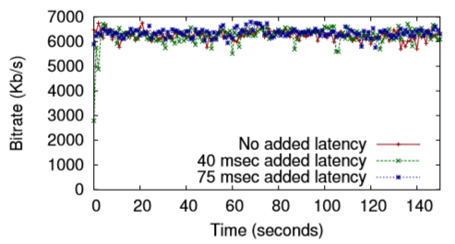
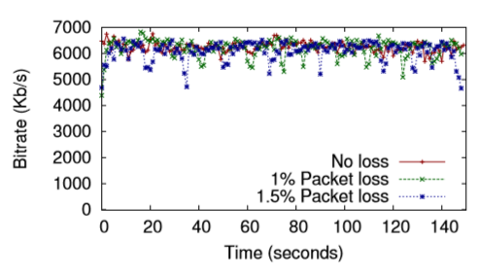
Onlive Responses to Network Conditions
Bitrate under capacity restrictions
Bitrate with latency and packet loss

Slide 27
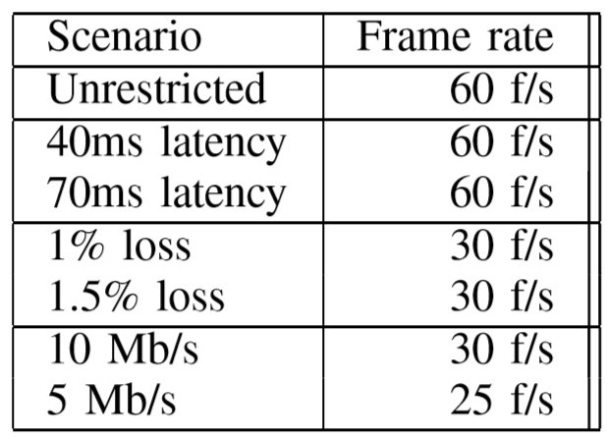
OnLive Frame Rates
The impact on frame rate is also observed
The OnLive client responds to capacity and loss, but does not respond to latency in any observed metrics

Slide 28
Overview
Background/Motivation
OnLive turbulence
Comparison of game genres
OnLive vs similar applications
Reactions to network conditions
Summary/Conclusions

Slide 29
Summary
OnLive traffic is asymmetric, and illustrate similar trends in turbulence
Genres do seem to display variance in actual values
The use of a thin client reduces hardware requirements, but increases network turbulence
Even when comparing the upstream to traditional games

Slide 30
Summary
The client behaves more similarly to live video streaming in terms of downstream
The OnLive client does not appear to respond to latency
It does respond to capacity limitations in terms of lowering bitrate and frame rate
It also responds to loss by lowering frame rate

