Slide 1
The Good, the Bad and the Muffled: the Impact of Different Degradations on Internet Speech
Anna Watson and M. Angela Sasse
Department of CS
University College London, London, UK
Proceedings of ACM Multimedia
November 2000

Slide 2
Introduction
Multimedia conferencing is a growing area
Well-known that need good quality audio for conferencing to be successful
Much research focused on improving delay, jitter, loss
Many think bandwidth will cure all problems
But bandwidth has been increasing exponentially while quality has not!

Slide 3
Motivation
Large field trial from 1998-1999
13 UK institutions
150 participants
Recorded user Perceptual Quality (PQ)
Beginning, Middle, End
(Why not only at end?)
(Why not continuously?)
Matched with objective network performance metrics
Analysis suggested that network was not primary influence on PQ!

Slide 4
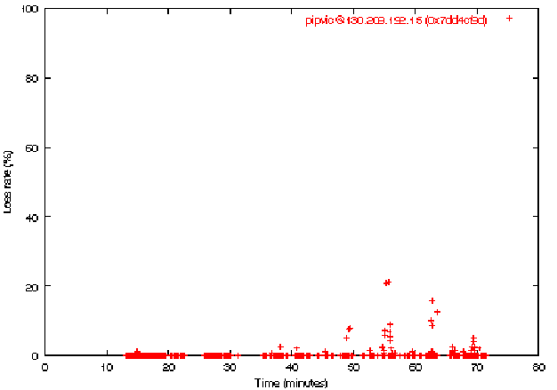
Example
- 1 hour meeting
- UCL to
Glasgow
Super Janet
RTCP reports 2-5 secs
Missing words throughout … but loss usually far less than 5%!

Slide 5
Problems Cited
Missing words
Cause?
Variation in volume
Cause?
Variation in quality among participants
Cause?

Slide 6
Problems Cited – Probably Causes
Missing words
Likely causes: packet loss, poor speech detection, machine glitches
Variation in volume
Likely causes: insufficient volume settings (mixer), poor headset quality
Variation in quality among participants
Likely causes: high background noise, poor headset quality
Experiments to measure which affect quality

Slide 7
Outline
Introduction
Experiments
Results
Conclusions

Slide 8
Audioconference Fixed Parameters
Robust Audio Tool (RAT)
Home brewed in UCL
Does some repair of packets lost
Coded in DVI
40 ms sample size
Use “repetition” to repair lost packets
Good for small packets (20ms)
Not as good for large packets (80ms)
(Why not?)

Slide 9
Audioconference Variables
Packet loss rates
5% (typical of multicast) and 20% (upper limit of tolerance)
“Bad” microphone
Hard to measure, but Altai A087F
Echo
From open microphone
(What is this?)
Volume differences
Quiet, normal, loud through “pilot studies”
(Why can’t users just adjust volume?)

Slide 10
Measurement Method: Perceptual Quality
Not ITU standard (paper at ACM MM ‘99)
Text labels bad
Built for television quality
Subjective through “slightly” labeled scale
“Fully subscribe that … speech quality should not be treated as a unidimensional phenomenon…”
But …

Slide 11
Measurement Method: Physiological
User “cost”
Fatigue, discomfort, physical strain
Measure user stress
Using a sensor on the finger
Blood Volume Pulse (BVP)
Decreases under stress
Heart Rate (HR)
Increases under stress (“Fight” or “Flight”)

Slide 12
Experimental Material
Take script from “real” audioconference
Act-out by two males without regional accents
Actors on Sun Ultra workstations on a LAN
Only audio recorded
16 bit samples (DVI compresses to 4 bits)
Used RAT
With silence deletion (hey, project 1!)
Vary volume and feedback (speakers to mic)
Split into 2-minute files, 8Khz, 40 ms packets
Repetition when loss

Slide 13
Experimental Conditions
Reference – non-degraded
5% loss – both voices, with repetition
20% loss – both voices, with repetition
Echo – one had open mic, no headset
Quiet – one recorded low volume, other norm
Loud – one recorded high volume, other norm
Bad mic – one had low quality mic, other norm
→Determined “Intelligibility” not affected by above

Slide 14
Subjects
24 subjects
12 men
12 women
All had good hearing
Age 18 – 28
(Probably students)
None had previous experience in Internet audio or videoconferencing

Slide 15
Procedure
Each listened to seven 2-minute test files twice
Played out by their audio tool
Used 1-100 slider
First file had no degradations (“Perfect”)
Users adjusted volume
Were told it was “best”
Randomized order of files
Except “perfect” was 1st and 8th
So, 7 conditions heard once than in another order
Baseline physiological readings for 15 min
When done, explain rating (tape-recorded)

Slide 16
Outline
Introduction
Experiments
Results
Conclusions

Slide 17
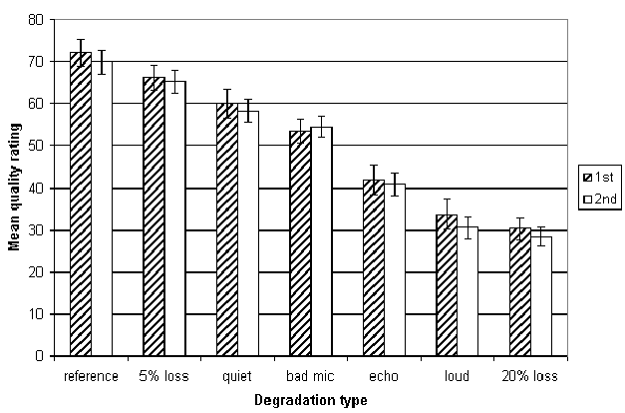
Quality Under Degradation
Statistically significant?

Slide 18
Statistical Significance Tests
ANOVA Test
For comparing means of two+ groups: first hearing and second hearing
No statistical difference between the two groups
Analysis of variance
Degradation effect significant
Reference and mean of all others are different
Reference and 5% loss the same
Reference and Quiet the same
5% Loss and Quiet the same
20% Loss and Echo and Loud the same

Slide 19
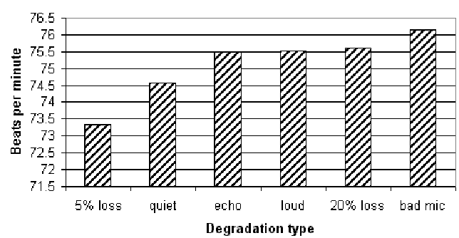
Physiological Results: HR

Slide 20
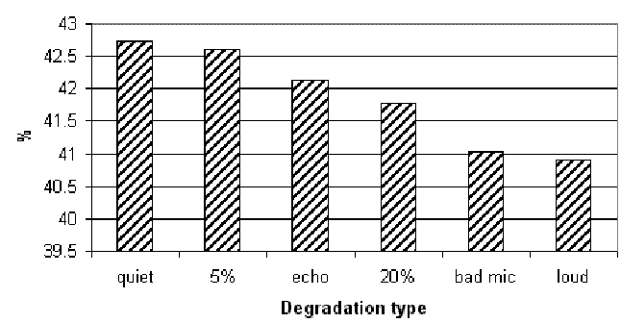
Physiological Results: BVP
Statistically significant?

Slide 21
Physiological Statistical Significance Tests
Bad mic, loud and 20% loss all significantly more stressful than quiet and 5% loss
Echo significantly more stressful than quiet in the HR data only
Contrast to quality!
Bad Mic worse than 20% loss
Least stressful were quiet and 5% loss

Slide 22
Qualitative Results
Asked subjects to describe why each rating
Could clearly identify
quiet, loud and echo
Bad mic
‘distant’, ‘far away’ or ‘muffled’
‘on the telephone’, ‘walkie-talkie’ or ‘in a box’

Slide 23
Qualitative Results of Loss
5% loss
‘fuzzy’ and ‘buzzy’ (13 of 24 times)
From waveform changing in the missing packet and not being in the repeated packet
‘robotic’, ‘metallic’, ‘electronic’ (7 times)
20% loss
‘robotic’, ‘metallic’, ‘digital’, ‘electronic’ (15 times)
‘broken up’ and ‘cutting out’ (10 times)
‘fuzzy’ and ‘buzzy’ infrequently (2 times)
5 said ‘echo’, 10 described major volume changes
Not able to reliably see the cause of the degradation

Slide 24
Discussion
5% loss is different than reference condition (despite stats) because of descriptions
But subjects cannot identify it well
Need a tool to identify impairments
20% loss is worse than bad mic based on quality, but is the same based on physiological results
need to combine physiological and subjective
Methodology of field trials to design controlled experiments can help understand media quality issues

Slide 25
Conclusion
Audio quality degradation not primarily from loss
Volume, mic and echo are worse
And these are easy to fix! Educating users harder.
By getting descriptions, should be easier to allow users to diagnose problems
Ex: ‘fuzzy’ or ‘buzzy’ to repetition for repair
Volume changes harder
Could be reflected back to the user
Could do expert system to make sure certain quality before being allowed in

Slide 26
Future Work?

Slide 27
Future Work
Delay and jitter compared with other degradations
Interactive environments rather than just listening
Ex: echo probably worse
Combination effects
Ex: bad mic plus too loud

