Slide 1
An Empirical Study of Delay Jitter Management Policies
D. Stone and K. Jeffay
Computer Science Department
University of North Carolina, Chapel Hill
ACM Multimedia Systems
Volume 2, Number 6
January 1995

Slide 2
Introduction
Want to support interactive audio
“Last mile” is LAN (including bridges, hubs) to desktop
Study that
(MLC: 1995 LANs looked a lot like today’s WANs)
Transition times vary, causing gaps in playout
Can ameliorate with display queue (buffer)

Slide 3
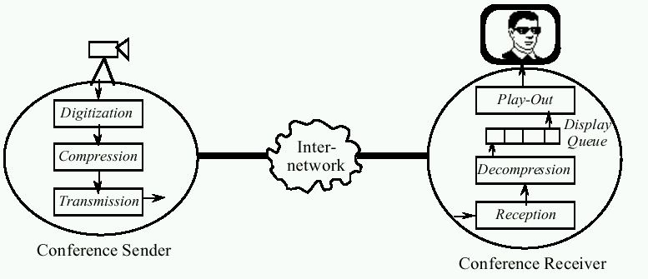
Introduction
(Frames)
Display latency – time from acquisition at sender to display at receiver (gap occurs if > previous frame)
End-to-end delay – time from acquisition to decompression
Varies in time (transmit + (de)compress), delay jitter
Queuing delay – time from buffer to display (change size)

Slide 4
Gaps versus Delay
Can prevent gaps by having constant delay
Network reserves buffers
Ala telephone networks
But not today’s Internet
Plus
will still have (unreserved) LAN as “last mile”
OS and (de)compression can still cause jitter
Thus, tradeoff between gaps and delay must be explicitly managed by conferencing system
Change size of display queue
The larger the queue, the larger the delay and the fewer the gaps and vice versa

Slide 5
This Paper
Evaluates 3 policies for managing display queue
I-policy and E-policy from [NK92]
(I is for late data ignored, E is for late data expand time)
Queue Monitoring from this paper
Empirical study
Audioconference (VoIP) on a LAN
Capture traces
Simulator to compute delay and gaps

Slide 6
Outline
Introduction (done)
The I- and E-policies (next)
The Queue Monitoring policy
Evaluation
The Study
Summary

Slide 7
The Effect of Delay Jitter
If display latency worse than largest end-to-end latency, then no gaps
(When is this not what we want?)
Playout with low latency and some gaps preferable to high-latency and no gaps
What if a frame arrives after its playout time?
Two choices:
I-policy – single fixed latency (the queue parameter), so discard
E-policy – late frames always displayed, so expand playout time

Slide 8
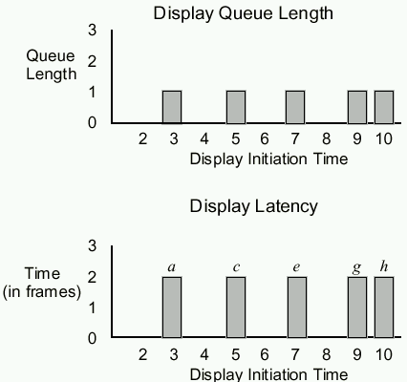
I-Policy
(3 gaps)
(set display latency
to 2)

Slide 9
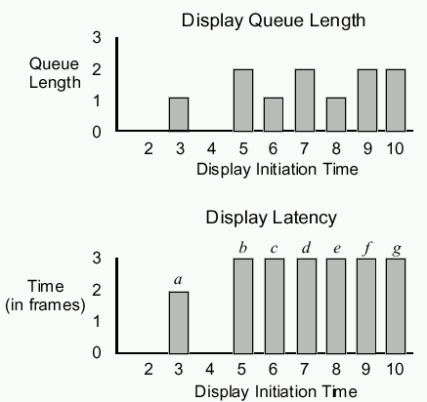
E-Policy
(1 gap,
resulting display
latency of
3 at end)

Slide 10
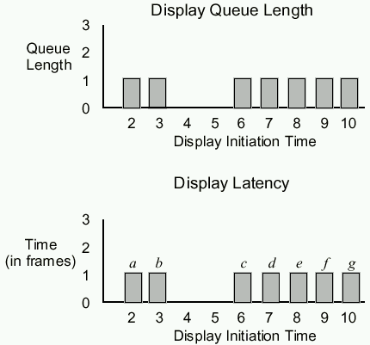
I-Policy (2)
One event,
but latency
still low
(set display latency
To 1)
(e, f, g, …)

Slide 11
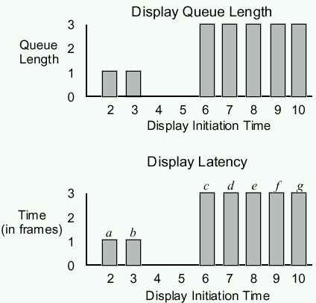
E-Policy (2)
One event,
latency
higher

Slide 12
Policy Summary
Display latency chosen implicitly with E-policy
Choose it explicitly with I-policy
What is the right display latency amount?
Depends on application
Example: surgeon interacting during operation vs. viewing televised lecture
Depends on network and machines
Can vary across a long run
So, need a policy that allows display latency to be chosen dynamically

Slide 13
Outline
Introduction (done)
The I- and E-policies (done)
The Queue Monitoring policy (next)
Evaluation
The Study
Summary

Slide 14
Adjusting Display Latency
VoIP with silence detection can be modeled as series of talkspurts
Sound and then silence
Adjust display latency between talkspurts
[NK92] said observe last m fragments, discard k largest delays and choose display latency as greatest delay
Recommend m > 40 and k = 0.07 x m
(Other approaches proposed, since)

Slide 15
Monitor the Display Queue
Measuring end-to-end latency is difficult because needs synchronized clocks
Instead, observe length of display queue over time
If end-to-end delay constant, queue size will remain the same
If end-to-end delay increases, queue shrinks
If end-to-end delay decreases, queue expands
If queue length > 2 for some time, can reduce queue (hopefully) without causing a gap
“some time” is parameter, n, in frame times
Implement with counters for each of m frames in queue
If any of the m times > n, discard frame and reset
(However, keep queue at least 2)
Use QM-120 as default
Adjust every 120 frames (about 2 seconds)

Slide 16
Outline
Introduction (done)
The I- and E-policies (done)
The Queue Monitoring policy (done)
Evaluation (next)
The Study
Summary

Slide 17
Comparing Policies
If A has lower latency and gaps than B, then A is better
If A lower latency, but also A more gaps then which is better?
Depends upon
relative amounts
resolution
application requirements
Few standards

Slide 18
Comparing Policies
Assume:
Differences in latency of 15 ms or more significant
Difference in gap rate of 1 per minute significant
A is better than B if either gap or latency better and other is same or better
Equal if same in both dimensions
Incomparable if each is better in one dimension
Note, for I-policy, synchronized clocks difficult
Instead, delay first packet for amount of time (try 2 and 3 frames in this paper)

Slide 19
Outline
Introduction (done)
The I- and E-policies (done)
The Queue Monitoring policy (done)
Evaluation (done)
The Study (next)
Summary

Slide 20
The Study
Run videoconference
Use audio only
Record end-to-end delay
Input into simulator to evaluate different policies
Effectively, a trace-driven simulation
Ensures network conditions “the same” when comparing policies

Slide 21
Videoconference
Built at UNC
Runs on IBM PS/2
Uses UDP
IBM-Intel ActionMedia 750
30 fps, 256x240, 8-bit color (6-8 k frames)
But video is disabled
Audio 60 fps, 128 kb/second into 16.5ms frames (266 byte packets)

Slide 22
Network
10 Mb Ethernets and 16 Mb token rings
400 Unix workstations and Macs
NFS and AFS (file systems)
Send machine → token-ring → gateway → department Ethernet → bridge → department Ethernet → gateway → token-ring → Display machine

Slide 23
Data
Gather data for 10 minute interval
28 Runs total
24 runs between 6am and 5pm
4 runs between midnight and 1am
Record:
Acquisition times
Display times
Adjust times for clock difference and drift
Input traces into simulator
Outputs average display latency
Outputs average gap rate

Slide 24
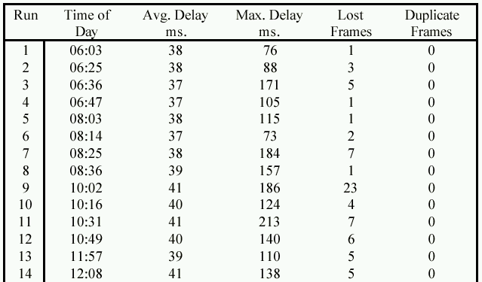
Basic Data
(Comments?)

Slide 25
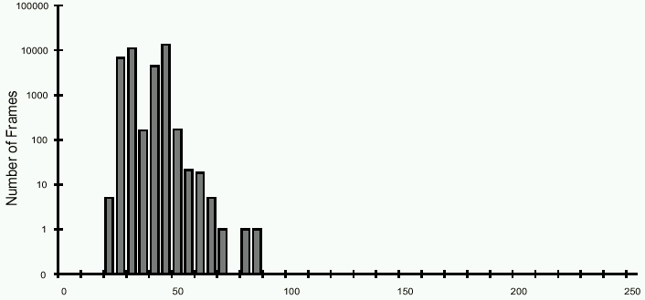
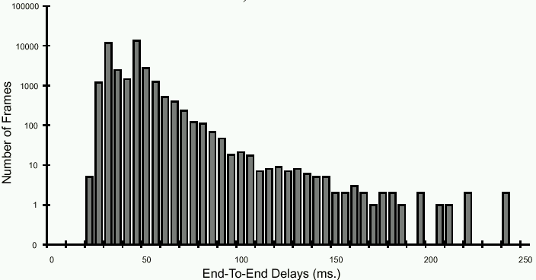
Two Example Runs
Low jitter
High jitter

Slide 26
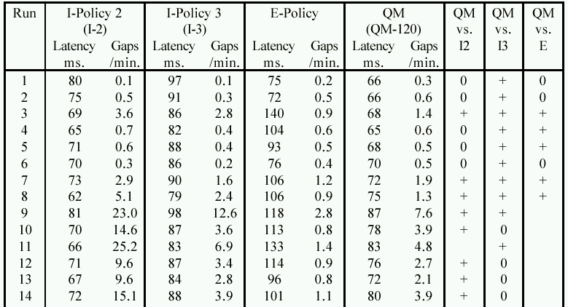
Results
QM-120 better than I-2 for all but 11
(I-2 has gap per 2 seconds vs per 11 seconds)

Slide 27
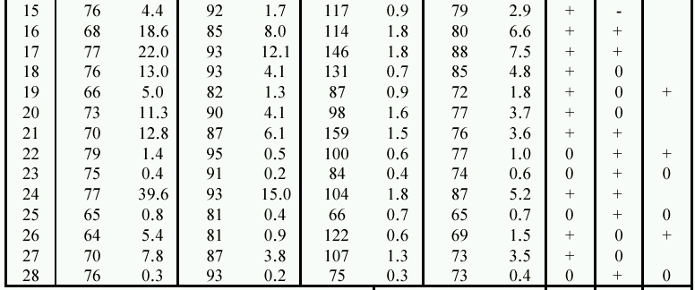
Results
QM-120 better than I-3 for all but 15
Latency of QM-120 better than that of I-3
Better than E
for low jitter
runs

Slide 28
Summary Results
If want low latency, not large gap rate
→ QM out performs all I-policies, E-policies

Slide 29
Threshold as a Parameter
Vary thresholds for adjusting queue latency
30 frame times (.5s)
60 frame times (1s)
120 frame times (2s)
600 frame times (10s)
3600 frame times (1 min)

Slide 30
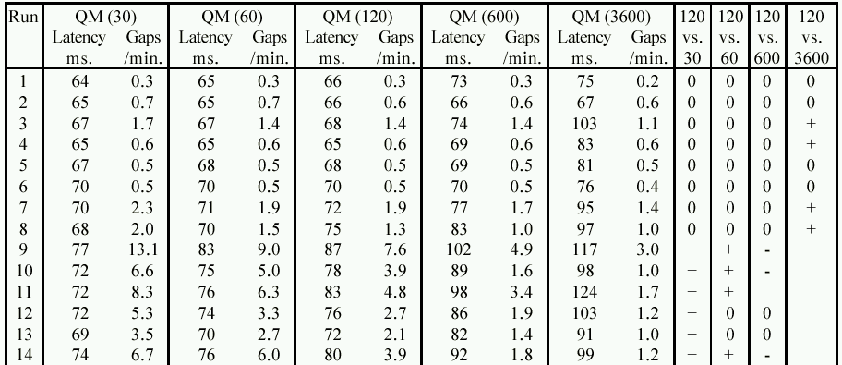
Results
Comments?

Slide 31
Summary
QM-600 is best relative to QM-120
QM-120 better than all others
(MLC: what about in between? Should be optimal for each setting)
Also:
QM-3600 similar to E-policy
QM-30 and QM-60 similar to I-2

Slide 32
Decay Thresholds
Want to converge slowly to lowest latency
Define base threshold for queue length of 3
Define decay factor for other queue lengths
Base of 3600, decay of 2 would have:
Wait 3600 frame times when queue is 3
1800 for 4
900 for 5
…

Slide 33
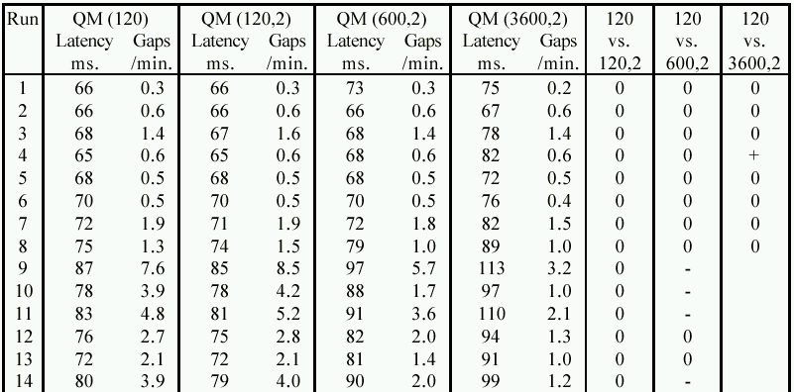
Results

Slide 34
Summary Results
QM-(120,2) didn’t help
QM-(600,2) better than QM-120
Also better than QM-600 by decreasing latency and gap rate almost the same
QM-(3600,2) better than QM-120
Also better than QM-3600
So, decay is useful for large base thresholds, but may hurt for small base thresholds

Slide 35
Summary
Will always be delay
From network or OS or …
Need to adjust queue latency
QM-(600,2) is the best, QM-120 almost as good
Queue monitoring can be effective
35-40 ms delay, variation up to 200ms, even 80 ms when quiet
Run 3 Best vs. E-policy
E: 140ms, .9 gaps/min
QM-(600,2): 68ms, 1.4 gaps/min
Run 24 Best vs. I-policy
I: 93 ms, 15 gaps/min
QM-(600,2): 90 ms, 4 gaps/min
QM is flexible, can be tuned to app or user

Slide 36
Future Work?

Slide 37
Future Work
Compare against I-policy where threshold changes each talkspurt
Compare using different metrics, say that combine latency and gaps or looks at distribution
PQ studies to measure tradeoffs
Larger networks
Combine with repair
Other decay strategies for QM

