Slide 1
An Algorithm for Determining the Endpoints for Isolated Utterances
L.R. Rabiner and M.R. Sambur
The Bell System Technical Journal, Vol. 54, No. 2, Feb. 1975, pp. 297-315

Slide 2
Outline
Intro to problem
Solution
Algorithm
Summary

Slide 3
Motivation
Word recognition needs to detect word boundaries in speech
Recognizing silence can reduce:
Processing load
(Network not identified as savings source)
(Hands-free operation not identified as convenience)
Relatively easy in sound proof room, with digitized tape

Slide 4
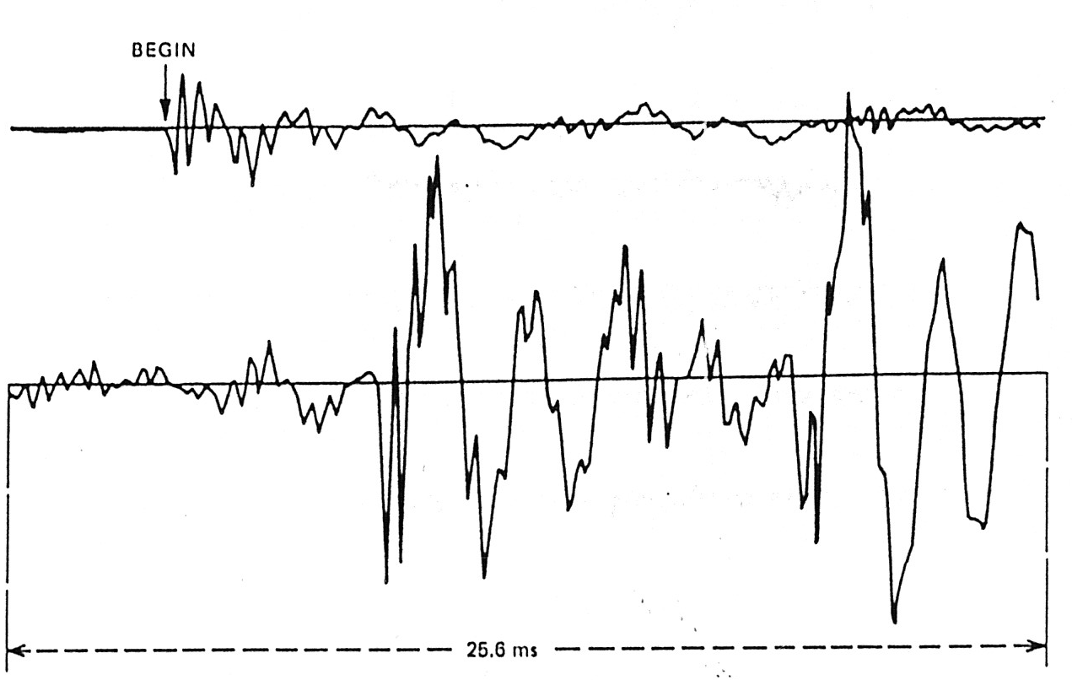
Visual Recognition
“Eight”
Easy
Note how quiet beginning is (tape)

Slide 5
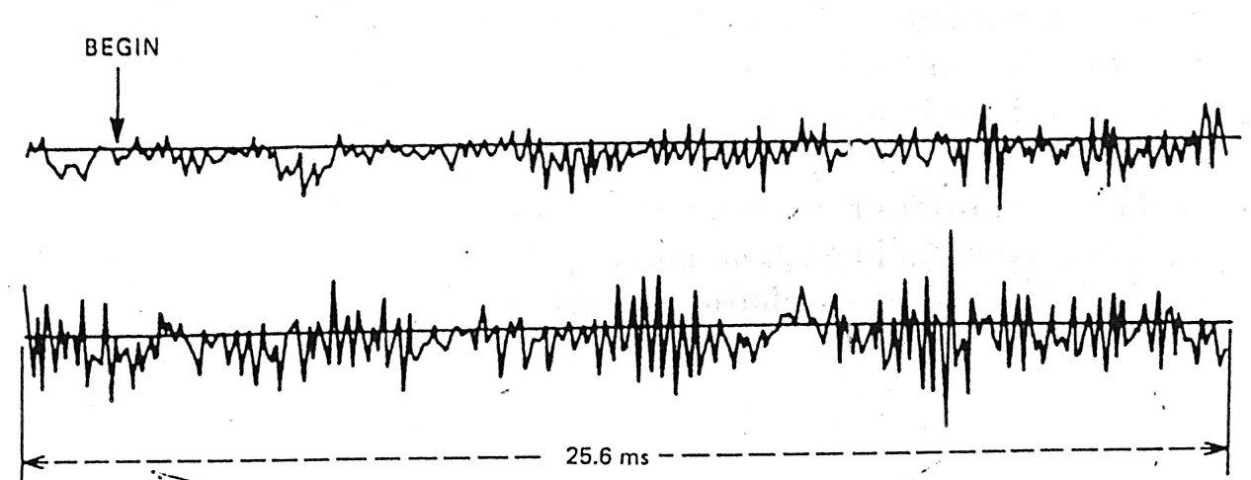
Slightly Tougher Visual Recognition
“Six”
“sss” starts crossing the ‘zero’ line, so can still detect

Slide 6
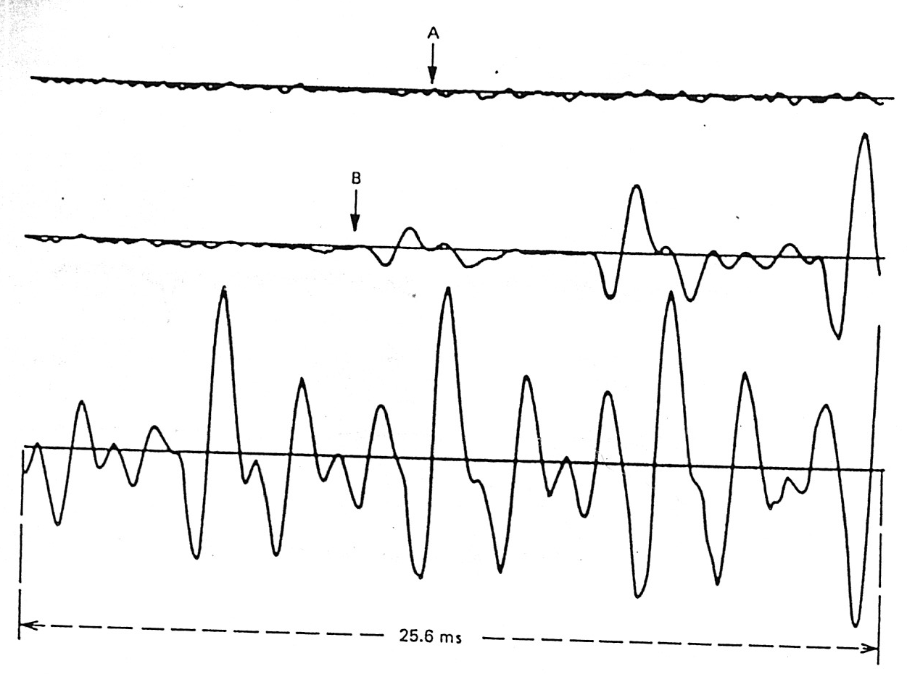
Tough Visual Recognition
“Four”
Eye picks ‘B’, but ‘A’ is real start
/f/ is a weak fricative

Slide 7
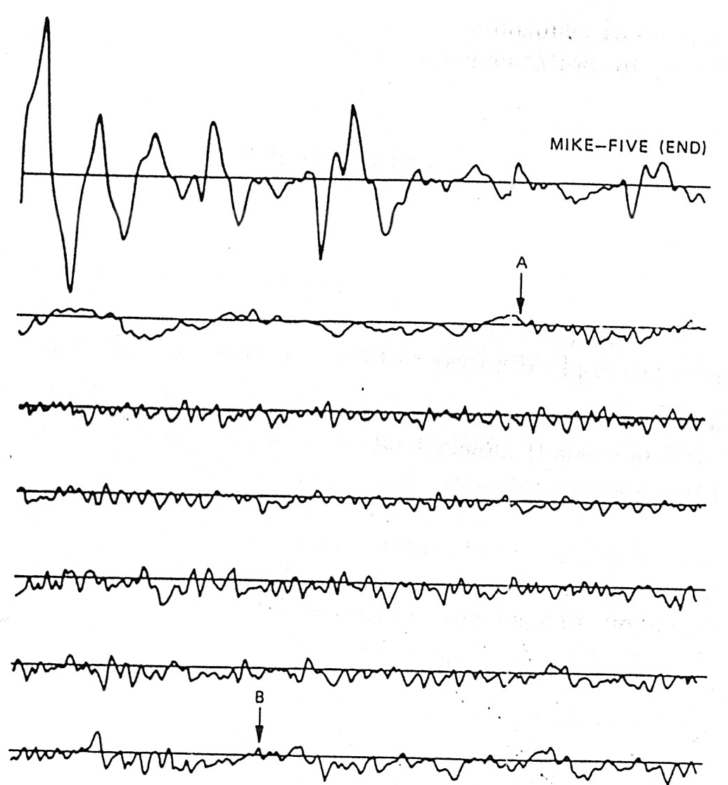
Tough Visual Recognition
“Five”
Eye picks ‘A’, but ‘B’ is real endpoint
V becomes devoiced

Slide 8
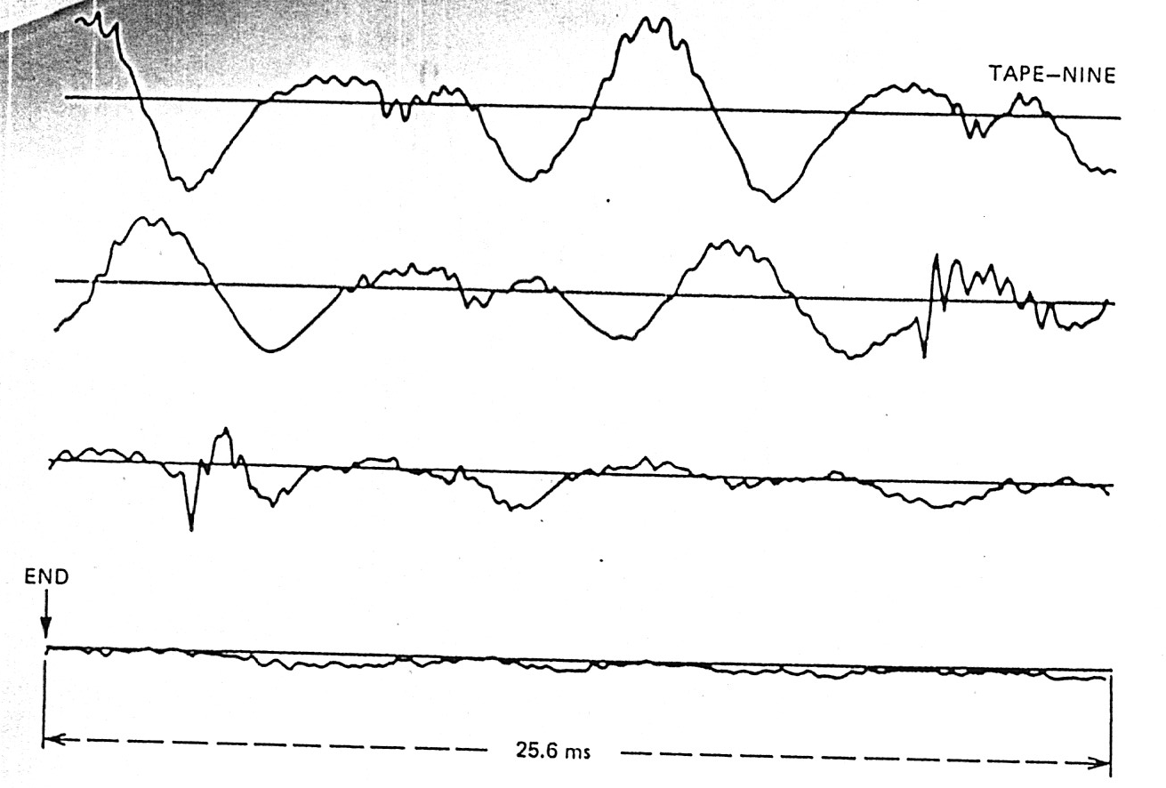
Tough Visual Recognition
“Nine”
Difficult to say where final trailing off ends

Slide 9
The Problem
Noisy computer room with background noise
Weak fricatives: /f, th, h/
Weak plosive bursts: /p, t, k/
Final nasals (ex: “nine”)
Voiced fricatives becoming devoiced (ex: “five”)
Trailing off of sounds (ex: “binary”, “three”)
Need to do with simple, efficient processing
Avoid hardware costs

Slide 10
The Solution
Two measurements:
Energy
Zero crossing rate
Show: simple, fast, accurate

Slide 11
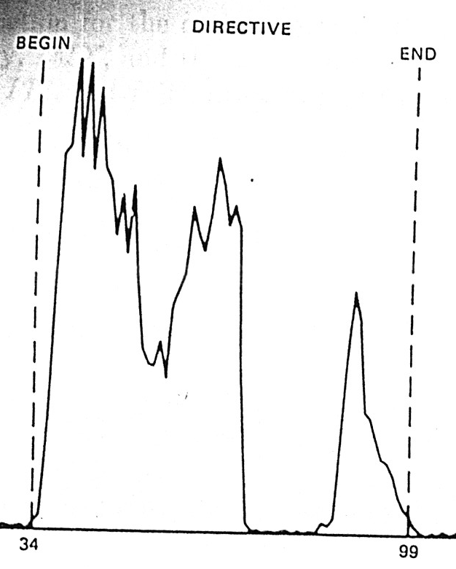
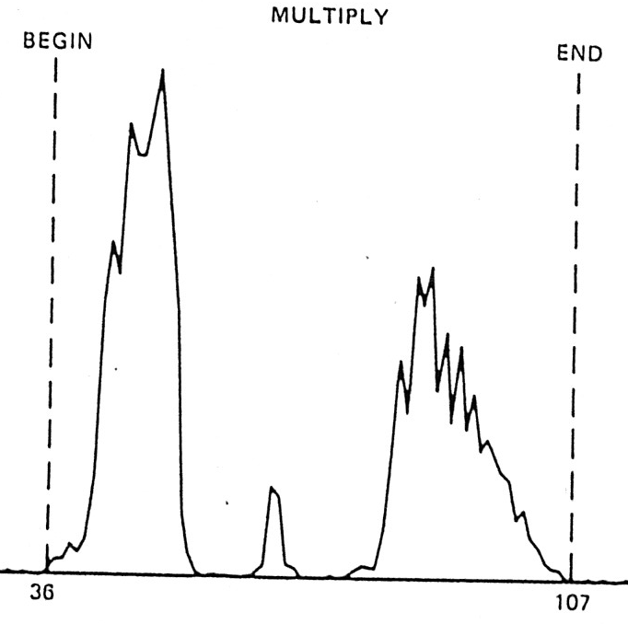
Energy
Sum of magnitudes of 10 ms of sound, centered on interval:
E(n) = Σ _{i=-50 to 50} |s(n + i)|

Slide 12
Zero (Level) Crossing Rate
Remember, digital audio values are changes in air pressure (higher or lower than base)
Base/midpoint is “zero”
But is always positive if unsigned (e.g., 127 if unsigned byte)
Zero crossing rate is number of zero crossings per 10 ms
Normal number of cross-overs during silence
Increase in cross-overs during speech

Slide 13
The Algorithm: Startup
At initialization, record sound for 100ms
A measure background noise
Assume ‘silence’
Compute average (IZC’) and std dev (σ) of zero crossing rate
Choose zero-crossing threshold (IZCT)
Threshold for unvoiced speech
IZCT = min(25 / 10ms, IZC’ + 2 σ)

Slide 14
The Algorithm: Thresholds
Compute energy, E(n), for interval
Get max, IMX
Have ‘silence’ energy, IMN
Compute to values:
I1 = 0.03 * (IMX – IMN) + IMN
(3% of peak energy)
I2 = 4 * IMN
(4x silent energy)
Get energy thresholds (ITU and ITL)
ITL = MIN(I1, I2)
ITU = 5 * ITL

Slide 15
The Algorithm: Energy Computation
Search sample for energy greater than ITL
Save as start of speech, say s
Search for energy greater than ITU
s becomes start of speech
If energy falls below ITL, restart
Search for energy less than ITL
Save as end of speech
Results in conservative estimates
Endpoints may be outside

Slide 16
The Algorithm: Zero Crossing Computation
Search back 250 ms
Count number of intervals where rate exceeds IZCT
If 3+, set starting point, s, to first time
Else s remains the same
Do similar search after end

Slide 17
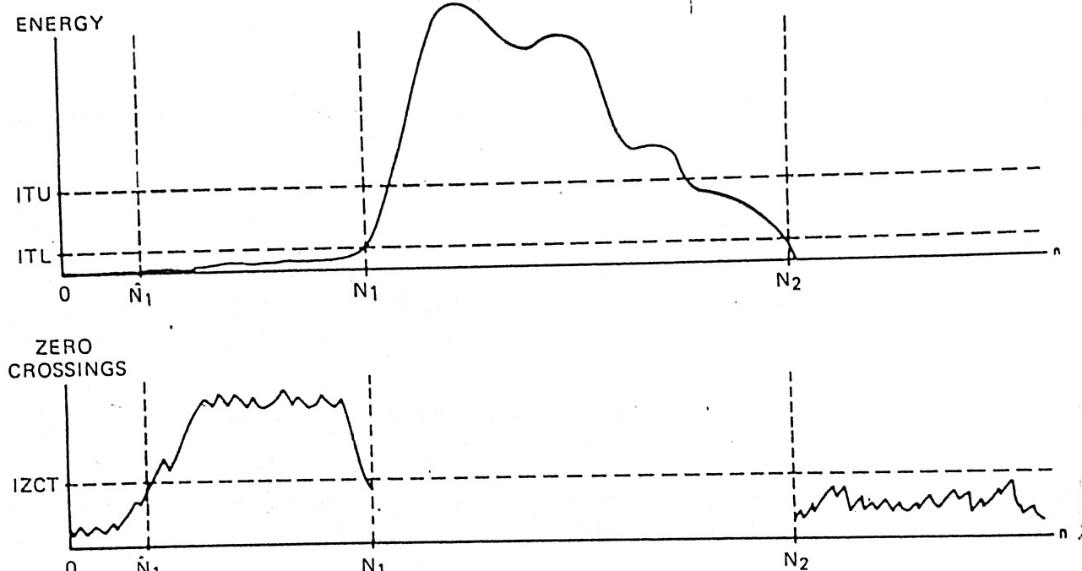
The Algorithm: Example
(Word begins with strong fricative)

Slide 18
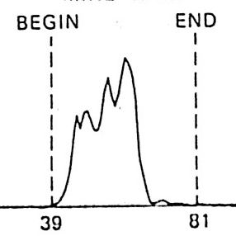
Algorithm: Examples
“Half”
Caught trailing /f/

Slide 19
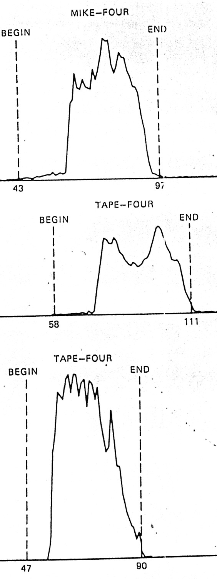
Algorithm: Examples
“Four”
(Notice how
different each
“four” is)

Slide 20
Evaluation: Part 1
54-word vocabulary
Read by 2 males, 2 females
No gross errors (off by more than 50 ms)
Some small errors
Losing weak fricatives
None affected recognition

Slide 21
Evaluation: Part 2
10 speakers
Count 0 to 9
No errors at all

Slide 22
Evaluation: Part 3
Your Project 1b…

