Slide 1
A Survey of Packet-Loss Recovery Techniques
Colin Perkins, Orion Hodson and Vicky Hardman
Department of Computer Science
University College London (UCL)
London, UK
IEEE Network Magazine
Sep/Oct, 1998

Slide 2
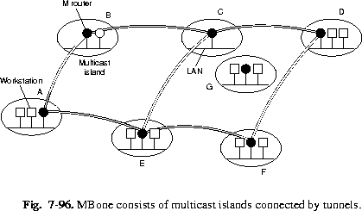
Overview
Development of IP Multicast
“Light-weight session”
Scale to 1000’s of participants
How to handle packet loss? (MLC: why doesn’t retransmission work?)
Repair techniques beyond retransmission

Slide 3
Overview
This paper:
Loss characteristics of Mbone
(MLC – dated, but not dissimilar from some P2P networks and ad-hoc wireless networks)
Techniques to repair loss in a ‘light-weight’ manner
Concentrate on audio
Recommendations
Other papers:
Fully-reliable (every bit must arrive), but not real-time
Real-time, but do not include receiver based approaches

Slide 4
Outline
Overview
Multicast Channel Characteristics
Sender Based Repair
Receiver Based Repair
Recommendations

Slide 5
IP Multicast Channel Characteristics
Group address
Client receives on address
Sender sends to address, without knowledge of clients
Loosely coupled connections
“Extension” to UDP
Not two-way
Makes it scalable
Allows clients to do local repair
Multicast router shares with unicast traffic
Can have high loss
Often MBone router 2nd rate

Slide 6
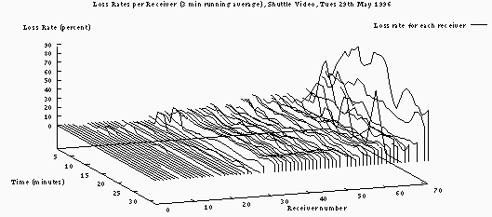
MBone Loss Characteristics
Some receivers near 0% loss rates
Most receivers in the 2-5% loss range
Some see 20-50% loss
Characteristics differ, so need local decisions

Slide 7
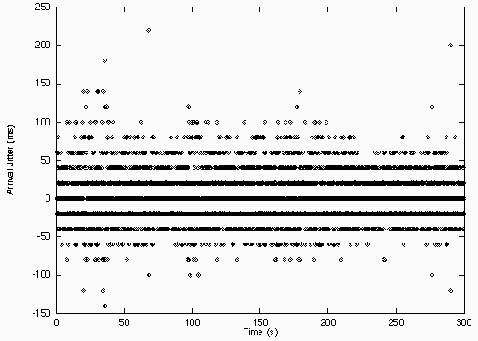
Mbone Jitter Characteristics
High jitter
If too late, will be discarded and look like loss (e.g. I-policy)
Interactive applications need low latency
Influences repair scheme

Slide 8
Media Repair Taxonomy
Media Repair
Sender Based
Receiver Based

Slide 9
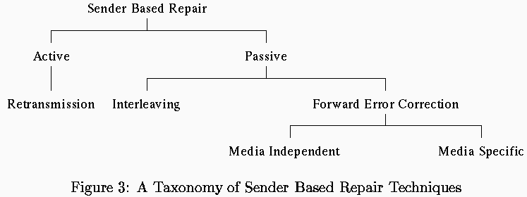
Sender Based Repair Taxonomy
Work from right to left
Unit of audio data vs. a packet
Unit may be composed of several packets
Or one packet may have several units of audio data

Slide 10
Forward Error Correction (FEC)
Add extra data to stream
Use extra data to recover lost packets
Two classes:
Media independent (not multimedia specific)
Media dependent (knowledge of audio or video)

Slide 11
Media Independent FEC
Given k data packets
Generate n-k check packets
Transmit n packets
Schemes originally for bits (like checksums in packet headers)
Applied to packets
So, for example i’th bit of check packet, checks i’th bit of each associated packet

Slide 12
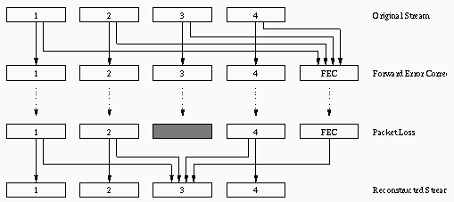
FEC Coding
e.g., XOR operation across all packets
Transmit 1 parity packet every n data packets
If 1 loss in n packets, can fully recover
e.g., Reed-Solomon treat as polynomial, add k packets redundancy
→ If k-1 loss in n packets, can fully recover

Slide 13
Media Independent FEC Advantages and Disadvantages
Advantages
Media independent
Audio, video, different compression schemes
Computation is small and easy to implement
Disadvantages
Add delay (must wait for all n packets)
Add to bitrate (causing more loss?)
Add decoder complexity

Slide 14
Sender Based Repair Taxonomy

Slide 15
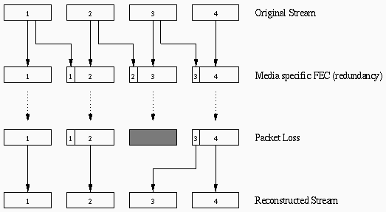
Media Specific FEC
Multiple copies of data
“Quality” of secondary frames?

Slide 16
Media Specific FEC Secondary Frame
Send packet energy and zero crossing rate
2 numbers, so small
Coarse, but effective for small loss
Better than interpolating across missing packets
Low bit-rate encoded version of primary
Lower number of sample bits audio sample, say
Full-version of secondary
Effective if primary is small (low bandwidth)

Slide 17
Media Specific FEC Discussion
Typical overhead 20-30% for low-quality
Media specific FEC can repair various amounts by trading off quality of repair
Contrast with media independent FEC has fixed number of bits for certain amount of full repair
Can have adaptive FEC
When speech changes and cannot interpolate
Add when increase in loss
Delay more than 1 packet when bursty loss

Slide 18
Media Specific FEC Advantages and Disadvantages
Advantages
Low latency
Only wait for one additional packet to repair
Or multiple if adapted to bursty losses
Can have less bandwidth than independent FEC
Disadvantages
Computation may be more difficult to implement
Still adds to bitrate
Adds decoder complexity
Typically lower quality (vs. other methods of repair)

Slide 19
Sender Based Repair Taxonomy

Slide 20
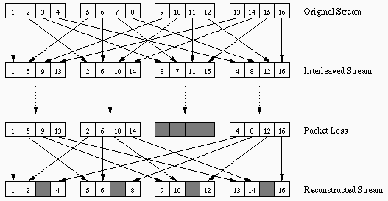
Interleaving
Doesn’t really repair, rather mitigates effects of loss
Many audio tools send 1 phoneme (40 ms of sound), so most of phoneme intact

Slide 21
Interleaving Advantages and Disadvantages
Advantages
Most audio compression schemes can do interleaving without additional complexity
No extra bitrate added
Disadvantages
Delay of interleaving factor in packets
Even when not repairing!
Gains to quality can be modest

Slide 22
Sender Based Repair Taxonomy

Slide 23
Retransmission
If delays less than 250 ms, can do retransmission
Effective for LAN or fast Internet connection
But wide-area wireless & inter-continetnal connection can be 200ms +
Scalable Reliable Multicast (SRM)
Hosts time-out based on distance from sender
To avoid implosion
Mcast repair request (and repair) to all
All hosts can reply (timers based on distance stop implosion)

Slide 24
Retransmission Discussion
In typical multicast session, can have every packet usually lost by some receiver
Will always retransmit at least once
FEC may save bandwidth
Typically, crossover point to FEC based on loss rate
Some participants may not be interactive
Use retransmission
Others use FEC

Slide 25
Retransmission Advantages and Disadvantages
Advantages
Well understood
Only add additional data ‘as needed’
Disadvantages
Potentially large delay
Not usually suitable for interactive applications
Large jitter (different for different receivers)
Implosion (setting timers difficult)

Slide 26
Media Repair Taxonomy
Media Repair
Sender Based
Receiver Based
Do not require assistance of Sender
Receiver recovers as best it can
Often called Error Concealment
Can work well for small loss ( up to 15%), small packets (4-40 ms)
Not substitute for sender-based
Rather use both
Receiver based can conceal what is left

Slide 27
Taxonomy of Error Concealment
When packet is lost, replace with fill-in

Slide 28
Splicing
Splice together stream on either side
Do not preserve timing
Advantages
Easy
Works ok for short packets of 4-16 ms
Disadvantages
Poor quality for losses above 3%
Can interfere with delay buffering

Slide 29
Silence Substitution
Fill gap left by lost packet with silence
Preserve timing
Advantages
Still Easy
Works well for low loss (< 2%)
Works ok for short packets of 4-16 ms
Disadvantages
Poor quality for higher losses (3%+)
Ineffective with 40 ms packets (typical)

Slide 30
Noise Substitution
Human psych says can repair if sound, not silence (phonemic restoration)
Replace lost packet with “white noise”
Like static on radio
Still preserve timing
Similar to silence substitution
Sender can send “comfort noise” so receiver gets white-noise volume right

Slide 31
Repetition
Replace missing packet with previous packet
Can “fade” if multiple repeats over time
Decrease signal amplitude to 0
Still pretty easy, but can work better than nothing
A step towards interpolation techniques (next)

Slide 32
Noise Substitution and Repetition
Advantages
Easy to implement
Works well for small loss (up to 5%)
Disadvantages
Still doesn’t work well for larger losses
Does not work well for larger packets

Slide 33
Taxonomy of Error Concealment
When packet is lost, reproduce packet based
on surrounding packets.

Slide 34
Interpolation Based Repair
Waveform substitution
Use waveform repetition from both sides of loss
Works better than repetition (that uses one side)
Pitch waveform replication
Use repetition during unvoiced speech and use additional pitch length during voiced speech
Performs marginally better than waveform
Time scale modifications
“Stretch” audio signal across gap
Generate new waveform that smoothly blends across loss
Computationally heavier, but performs marginally better than others

Slide 35
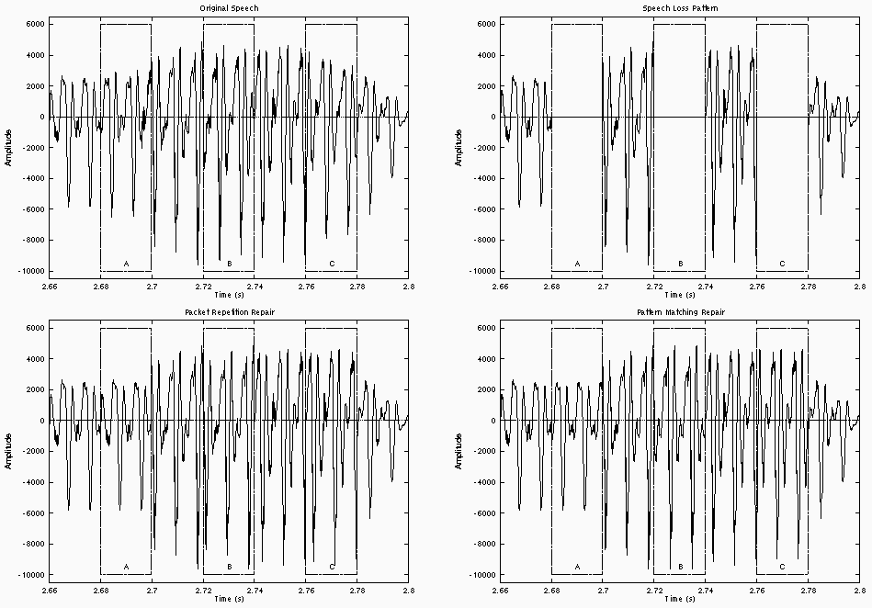
Original
Loss
Repetition
Wave Substitution
(Boundaries better)
(Both bad at C)

Slide 36
Taxonomy of Error Concealment
Use knowledge of audio compression to derive
codec parameters, using knowledge of code to regenerate

Slide 37
Regeneration Based Repair
Interpolation of transmitted state
State-based decoding can then interpret what state codec should be in
Reduces boundary-effects
Typically high processing
Model-Based recovery
Regenerate ‘speech’ to fit with speech on either side
Very complicated, often language dependent

Slide 38
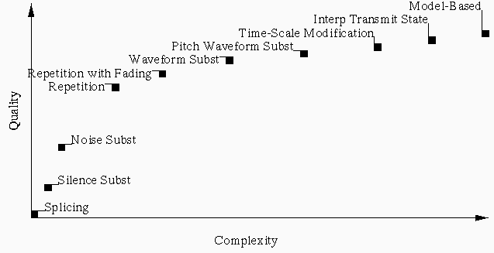
Summary of Receiver Based Repair
“Knee”
Quality increase decreases at high complexity
Repetition is at ‘knee’ in curve

Slide 39
Groupwork
Consider:
Interactive voice from Asia to U.S.
Multicast video of taped lecture
Multicast replicated database update
Interactive voice across city
Choose a repair technique and justify:
Interleaving
Retransmission
Media Specific FEC
Media Independent FEC

Slide 40
Recommendations: Non-Interactive Applications
Latency less important
Bitrate a concern (mcast has varied capacities)
→ Can use interleaving
→ Use repetition for concealment
Retransmission does not scale
Ok for unicast
Media independent FEC may be ok

Slide 41
Recommendations: Interactive Applications
Want to minimize delay
→ Interleaving delay is too large
→ Retransmission delay can be large
→ Media independent FEC usually large
(Or computationally expensive)
Can use media specific FEC
Delay is low
Approximate repair is ok
Can be tuned (via quality and repair placement) to suit network and user

