Slide 1
Sharp or Smooth? Comparing the Effects of Quantization vs. Frame Rate for Streamed Video
J. McCarthy, M. A. Sasse and D. Miras
ACM Conference on Human Factors in Computing Systems
Vienna, Austria, April 2004

Slide 2
Introduction (1 of 2)
Streaming sports (football) are popular Internet service
The NFL! … but they mean soccer
Key business for mobile services
Little known about quality levels required
Minimum for acceptable quality?
For given constraint, what is best?
Note, constraint may be bitrate capacity or power or …
Recent IBM QoS policy says:
“The priority for smooth video is higher than the priority for frame quality”
Yet, available evidence suggests sports are relatively insensitive to changes in frame rate

Slide 3
Introduction (2 of 2)
Discover functions relating physical quality to perceived quality
Graphs give service providers knowledge to manage resources
New methodology
Test sports on sports enthusiasts (may buy)
Gradually increase or decrease video perf within clip to determine acceptability edge
Investigate effects of frame rate and quality (quantization) on acceptability
Get subjective responses and eye movements
Examine palmtop and desktop

Slide 4
Outline
Introduction (done)
Background
Method
Study 1 (Desktop)
Results
Study 2 (Palmtop)
Results
Conclusions

Slide 5
Background – Perceived QoS
Typically, show short (~10 second) clip and measure with 5-point rating [11]
Problematic when network conditions vary over time
Problematic when content changes over time
Continuous quality evaluation using slider [3,4,8,14]
But can be intrusive for real-time tasks

Slide 6
Background – Physical QoS
Physical metrics impacting quality: resolution, frame rate, frame quality (quantization) [6]
For MPEG type compression, quantization of DCT coefficient dominates
Other metrics that impact quality: size of display, distance between observer and display
For service provider, primary factors they can control are frame rate and frame quality
Focus on those in this study

Slide 7
Background – Service Providers and Acceptability
Service providers need metric to relate physical quality to perceived quality
Neither MOS nor slider give good indication of acceptability (Ex: is MOS of 3 acceptable?)
Some researchers have used 5-point acceptability scale [5,9]
Draw upon this work for new metric:
Easy to understand
Less disruptive than continuous techniques
Can be used with variable video quality
Is more relevant to service providers

Slide 8
Background – Relevant Studies
Most related work shows sports insensitive to frame rate changes
Apteker et al. [2] study frame rates 5, 10, 15 fps and show acceptability of sports highlights little difference
Ghinea and Thomas [7] show information content same for 5, 15, 25 fps
Wang et al. [15] manipulate frame rate and quantization for 8 second video (American football)
“Quantization distortion is generally more objectionable than motion judder”
All run against intuition that higher motion needs higher frame rate

Slide 9
Outline
Introduction (done)
Background (done)
Method
Study 1 (Desktop)
Results
Study 2 (Palmtop)
Results
Conclusions

Slide 10
Method
Method of Limits (Fechner in [5]):
Gradually increase stimulus in steps until it is just detectible
Give subject binary (yes/no) to detect
Also run in reverse (decrease stimulus in steps)
Authors:
→ Variant of this: ask users if acceptable or not
Use 210 second clips, increase/decrease quality every 30 seconds (7 types)
But don’t tell users, only “varied in quality”

Slide 11
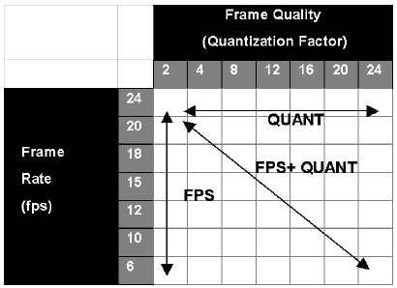
Quality Gradients
Three types
Temporal: Frame rate (fps)
Quality: Quantization
Both
Each has 7 levels
(30 seconds x 7 = 210 s)
User free to say “acceptable” or “unacceptable” as much as want

Slide 12
Eye Tracking
Measure where users looked using remote eye-tracking camera
Measure with EyeGaze from LC technologies [13]
Record where looking with EyeSpy (open source)
Help identify regions of interest → could, someday, make compression use info
More detail for area user looking at (ex: ball and person kicking)
Less detail for background (ex: pitch, fans)

Slide 13
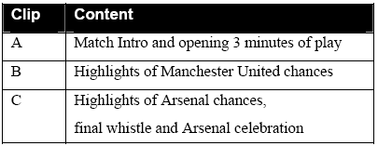
Source Material
Sourced from DVD of recent
match between Manchester
United and Arsenal
Three clips, include variety of camera angles and shots (including replays)
CIF (252x288) for study 1, QCIF (176x144) for study 2
H.263 encoded for quality gradients
Re-encode to MPEG so could use commercial (e.g., RealPlayer)
Audio for all clips is 64 kbps
Total of 18 clips for study 1, Total of 9 clips for study 2

Slide 14
Outline
Introduction (done)
Background (done)
Method (done)
Study 1 (Desktop)
Results
Study 2 (Palmtop)
Results
Conclusions

Slide 15
Study 1 – Small Screen on Desktop
41 participants (29 male, 12 female)
Average age 22
Paid 5 pounds (about $8)
Tried to recruit those who liked football (soccer) and watched regularly
59% one+ per week, 88% rooted for some team, 50% supported one team in clip
352x288 resolution on LCD with 1024x768
RealPlayer set to theater mode (rest is black)

Slide 16
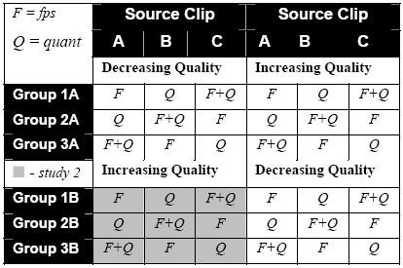
Study 1 – (Continued Design)
Each saw 6 clips: FPS, Quant, FPS+Quant
both increasing and decreasing gradients
Counter-balance with “Greco Latin” squares design (no sequences appear more than once row or column)
Participants briefed
first
Told Telecom
company wanted
acceptable region

Slide 17
Outline
Introduction (done)
Background (done)
Method (done)
Study 1 (Desktop) (done)
Results
Study 2 (Palmtop)
Results
Conclusions

Slide 18
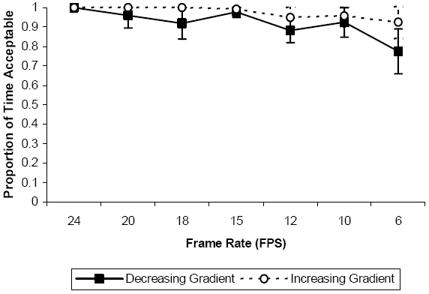
Perceived Quality and Frame Rate
Transform binary (yes/no) to ratio by calculating which portion of 30 seconds acceptable (Ex: unacceptable at 20s of the 30 would be 0.667)
95% conf
intervals
- ANOVA test says all different
- At 6 FPS, quality is acceptable 80% of the time

Slide 19
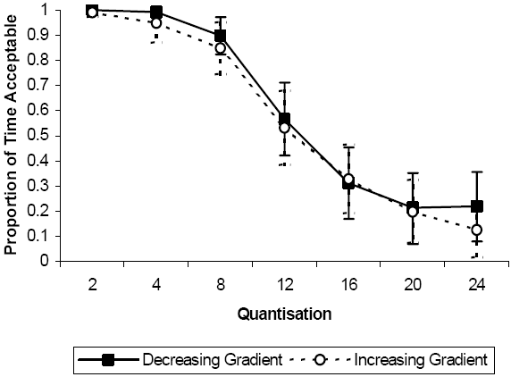
Perceived Quality and Quantization
95% conf
intervals
- Again, ANOVA test says difference
- Sharp drop after 8 quantization
- Interesting shape

Slide 20
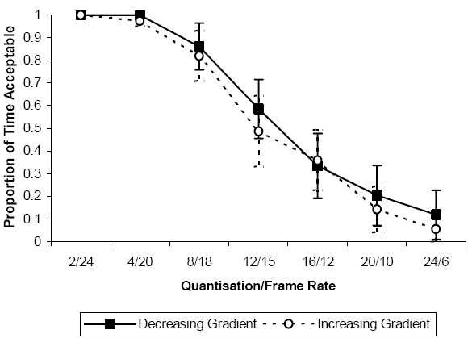
Quantization and Frame Rate
- ANOVA test says difference
- Similar to quantization alone
- Suggest quantization dominates

Slide 21
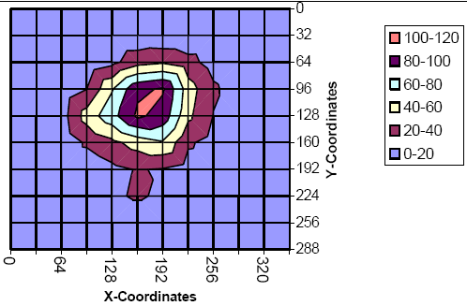
Eye Movements
Averaged over
all clips
Units? Maybe
sample every 250ms?
- Similar across all clips – focus is on center.
- May be because nature of video – action is in center.
- Could use this region of interest in compression
+ use more bits on area where gaze is focused

Slide 22
Outline
Introduction (done)
Background (done)
Method (done)
Study 1 (Desktop) (done)
Results (done)
Study 2 (Palmtop)
Results
Conclusions

Slide 23
Study 2 – Study on Palmtop
37 participants (31 male, 6 female)
Mean age 22
Paid 5 pounds (about $8)
Tried to recruit those who liked football (soccer) and watched regularly
65% one+ per week, 84% rooted for some team with 38% supporting one team in clip
(Me: not clear of participant overlap between studies)
176x144 resolution, iPAQ h2210
Additional clip to study critical values

Slide 24
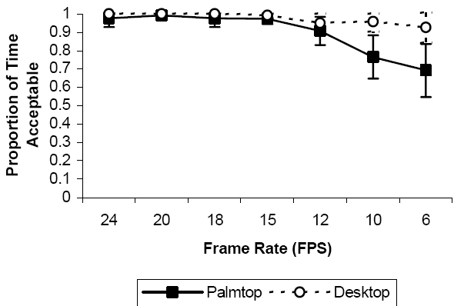
Perceived Quality and Frame Rate
- Low FPS less acceptable on palmtop than desktop
- Driven by one clip (B) with panning and action
- Still acceptable at least 50% of time at 6 FPS

Slide 25
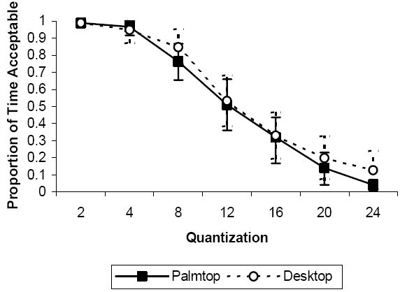
Perceived Quality and Quantization
- Similar for both
- Again, critical value at 8 quantization

Slide 26
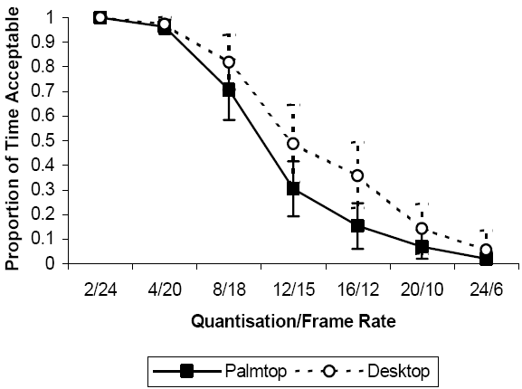
Quantization and Frame Rate
- Again, palmtop appears slightly more sensitive
- May be because of frame rate

Slide 27
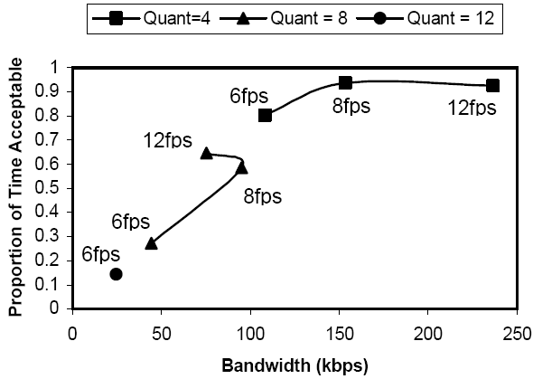
Critical Values, Acceptability and Bandwidth
- Study relationship with 4th clip
- Examine only critical values from previous study
- For low quality, drop in frame rate may compound?
- Me: quantization dominates for bandwidth
(was not comparing “apples to apples” before)

Slide 28
Qualitative Comments
When “unacceptable”, users give reasons:
84% said recognizing players was impossible
65% had problems following the ball
35% said close up shots fine, but distant camera shots very poor
21% cited jerky movement as one problem
Summary statement:
“I’d rather have jerky video and better quality pictures”

Slide 29
Conclusions
Limitations of approach
Additional degradations are not factored in (packet errors, changing capacity, etc.)
Substantive findings
Response curve relating perceived quality to physical quality
Population of users with clear interest (i.e., would be consumers and pay for service)
At 6 fps, 80% of the time video is acceptable
Challenges assumption that sports must be high frame rate
Methods of limits
Provides stable metric
Curves in line with ITU logistic with quality

Slide 30
Future Work?

Slide 31
Future Work
Screen size (inches) and resolution (pixels)
Mobile device/player could pick if difference
Other video content
Include measure of motion
Investigate using eye tracking data for compression
Need computationally cheap way to save bandwidth without impacting quality
Same bitrate for quality versus frame rate (versus resolution)

