Slide 1
MPEG: A Video Compression Standard for Multimedia Applications
Didier Le Gall
Communications of the ACM Volume 34, Number 4 Pages 46-58, 1991

Slide 2
Introduction
1980’s technology made possible full-motion video over networks
Television and Computer Video seen moving closer
(More recently, Sony and Microsoft are squaring off)
Needed a standard
Often, triggers needed volume production
Ala facsimile (fax)
Avoid de facto standard by industry
1988, Established the Motion Picture Experts Group (MPEG)
Worked towards MPEG-1
Primarily video but includes audio (MP3)
Dance of the
2 elephants

Slide 3
The Need for Video Compression
High-Definition Television (HDTV)
1920x1080
30 frames per second (full motion)
8 bits for each three primary colors (RGB)
→Total 1.5 Gb/sec!
Cable TV: each cable channel is 6 MHz
Max data rate of 19.2 Mb/sec
Reduced to 18 Mb/sec w/audio + control …
→Compression rate must be ~ 80:1!

Slide 4
Outline
Introduction (done)
MPEG Goals ←
MPEG Details
Performance and Such
Summary

Slide 5
Compatibility Goals
1990: CD-ROM and DAT key storage devices
1-2 Mbits/sec for 1x CD-ROM
Two types of application videos:
Asymmetric (encoded once, decoded many)
Video games, Video on Demand
Symmetric (encoded once, decoded once)
Video phone, video mail …
(Q: How do you think the two types might influence design?)
Video at about 1.5 Mbits/sec
Audio at about 64-192 kbits/channel

Slide 6
Requirements
Random Access, Reverse, Fast Forward, Search
At any point in the stream (within ½ second)
Can reduce quality somewhat during this task, if needed
Audio/Video Synchronization
Robustness to errors
Not catastrophic if some bits are lost
Lends itself to Internet streaming
Coding/Decoding delay under 150ms
For interactive applications
Ability to Edit
Modify/Replace frames

Slide 7
Relevant Standards
Joint picture Experts Group (JPEG)
Compress still images only
Expert Group on Visual Telephony (H.261)
Compress sequence of images
Over ISDN (64 kbits/sec)
Low-delay
Other high-bandwidth “H” standards:
H21 (34 Mbits/sec)
H22 (45 Mbits/sec)

Slide 8
Outline
Introduction (done)
MPEG Goals (done)
MPEG Details ←
Performance and Such
Summary

Slide 9
MPEG Compression
Compression through
Spatial
Temporal

Slide 10
Spatial Redundancy
Take advantage of similarity among most neighboring pixels

Slide 11
Spatial Redundancy Reduction
RGB to YUV
Less information required for YUV (humans less sensitive to chrominance)
Macro Blocks
Take groups of pixels (16x16)
Discrete Cosine Transformation (DCT)
Based on Fourier analysis where represent signal as sum of sine's and cosine’s
Concentrates on higher-frequency values
Represent pixels in blocks with fewer numbers
Quantization
Reduce data required for coefficients
Entropy coding
Compress

Slide 12
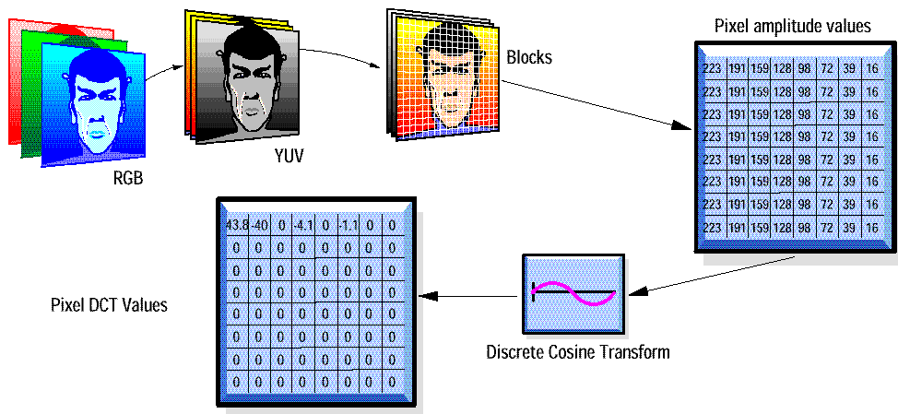
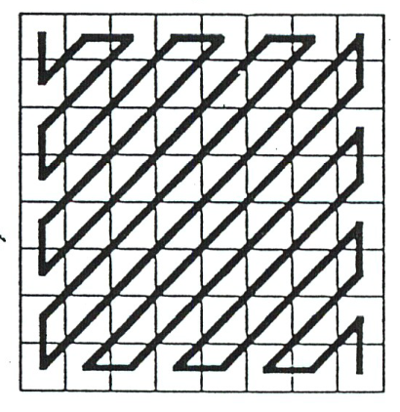
Spatial Redundancy Reduction
“Intra-Frame
Encoded”
Quantization
major reduction
controls ‘quality’
Zig-Zag Scan,
Run-length coding

Slide 13
Groupwork
When may spatial redundancy reduction be ineffective? What kinds of images/movies?

Slide 14
Groupwork
When may spatial redundancy reduction be ineffective?
High-resolution images and displays
May appear ‘coarse’
A varied image or ‘busy’ scene
Many colors, few adjacent
Any complex scene

Slide 15
Loss of Resolution
Original (63 kb)
Low (7kb)
Very Low (4 kb)

Slide 16
Temporal Redundancy
Take advantage of similarity between successive frames
F 950
F 951
F 952

Slide 17
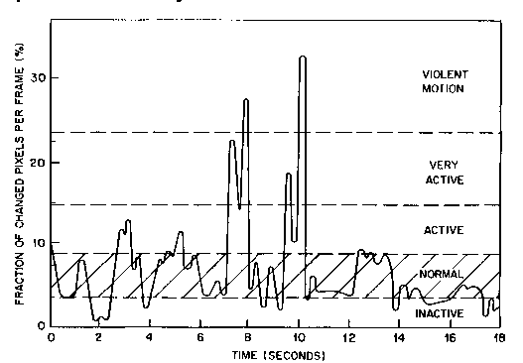
Temporal Activity
“Talking Head”

Slide 18
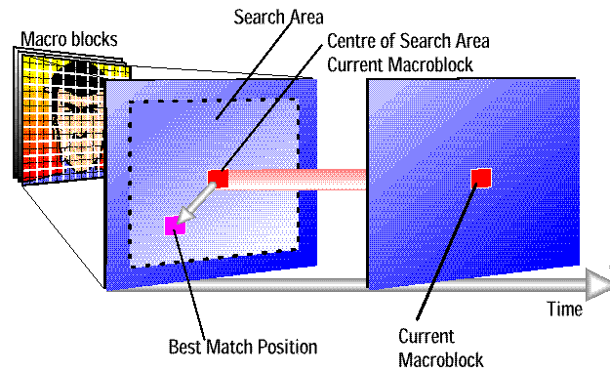
Temporal Redundancy Reduction

Slide 19
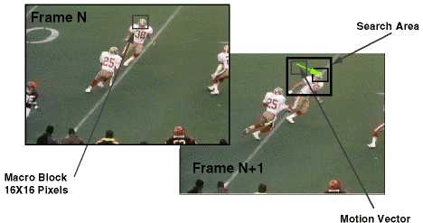
Temporal Redundancy Reduction

Slide 20
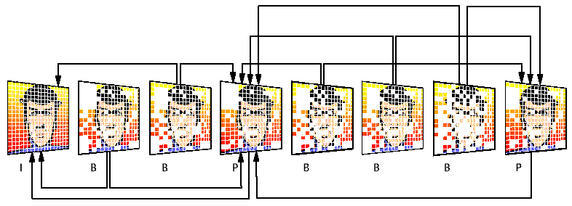
Temporal Redundancy Reduction
I frames are independently encoded
P frames are based on previous I, P frames
Can send motion vector plus changes
B frames are based on previous and following I and P frames
In case something is uncovered

Slide 21
Group of Pictures (GOP)
Starts with an I-frame
Ends with frame right before next I-frame
“Open” ends in B-frame, “Closed” in P-frame
(What is the difference?)
MPEG Encoding a parameter, but ‘typical’:
I B B P B B P B B
I B B P B B P B B P B B
Why not have all P and B frames after initial I?

Slide 22
Groupwork
When may temporal redundancy reduction be ineffective?

Slide 23
Groupwork
When may temporal redundancy reduction be ineffective?
Many scene changes
High motion

Slide 24
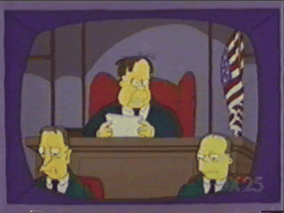
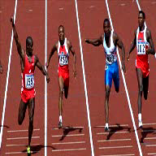
Non-Temporal Redundancy
Many scene changes vs. Few scene changes
“Standard” Movies
Akiyo
Coast guard
Hall

Slide 25
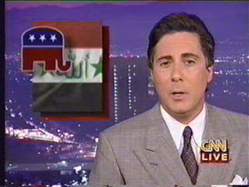
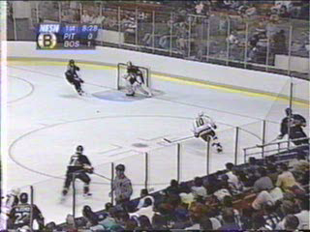
Non-Temporal Redundancy
Sometimes high motion
“Standard” Movies
Foreman

Slide 26
Possible MPEG Parameters

Slide 27
Possible Compression Performance (YMMV)
Type Size Compression
---------------------
I 18 KB 7:1
P 6 KB 20:1
B 2.5 KB 50:1
Avg 4.8 KB 27:1
---------------------
Note, results are variable bit Rate (VBR), even if frame rate is constant

Slide 28
MPEG Today (1 of 2)
MPEG video compression widely used
Digital television set-top boxes
HDTV decoders
DVD players
Video conferencing
Internet video
...
Principles are basis for other compression algorithms
e.g., H.264

Slide 29
MPEG Today (2 of 2)
MPEG-2
Super-set of MPEG-1
Rates up to 10 Mbps (720x486)
Can do HDTV (no MPEG-3)
MPEG-4
Around Objects, not Frames
Lower bandwidth (and can be higher – bigger range)
Has some built-in repair (header redundancy)
MPEG-7
Allows content-description (ease of searching)
MP3
For audio
MPEG Layer-3

