Slide 1
A Credit-based Home Access Point (CHAP) to Improve Application Performance on IEEE 802.11 Networks
Choong-Soo Lee, Mark Claypool and Robert Kinicki
In Proceedings of the First ACM Multimedia Systems Conference (MMSys), Scottsdale, Arizona, USA, February 2010
In Proceedings of the ACM Multimedia Conference, Florence, Italy, October 25-29, 2010

Slide 2
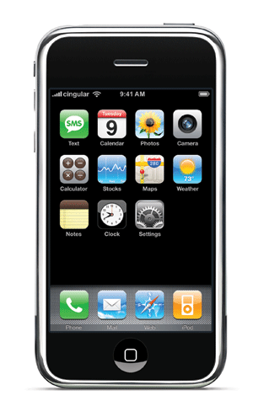
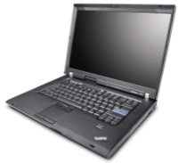
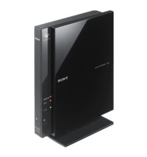
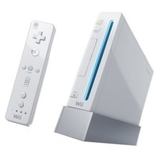
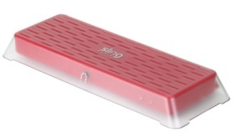
Introduction
Wide deployment of broadband access at home
Wireless Access Point to connect devices at home over the shared Internet connection
Diverse networked devices
Diverse applications and their needs

Slide 3
Challenge and Possible Approaches
How to manage throughput, delay and loss with a diversity of applications and their needs
Possible Approaches:
Applications can claim quality requirements.
Changes to the end-hosts, applications and protocols
Middle boxes can figure out quality requirements.
Port/signature-based classification
Both approaches require:
Pre-determined treatment for traffic classes
Careful configuration

Slide 4
Outline
Introduction (done)
Credit-based Home Access Point (CHAP)
Performance Evaluation
Conclusion

Slide 5
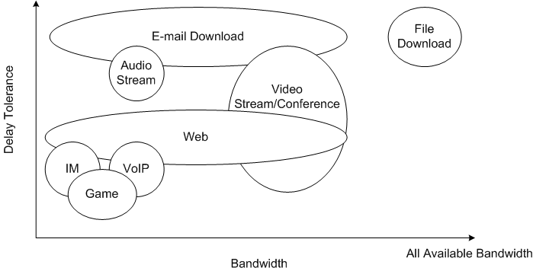
Summary of Network Traffic Characteristics
High
Medium
Low
Low
Medium
High

Slide 6
Credit-based Scheduling
Use of credit as priority
Map application traffic characteristics to credit
Delay Tolerance
Credit
Bandwidth

Slide 7
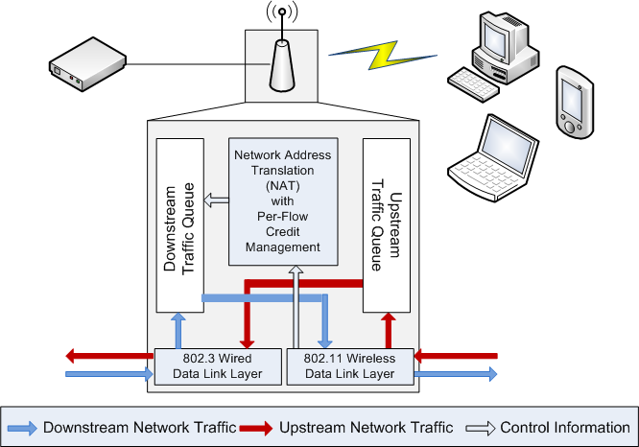
Credit-based Home Access Point (CHAP)
Credits in time
Wireless Transmission Time
P

Slide 8
How CHAP Works
Credits
Delay sensitive
Delay insensitive
N₁
Cost of each transmission = 5 bars
S
The delay insensitive flow runs out of credits.
→ Increase credits of all active flows by:
1. halving the current credits
2. increasing by boost parameter (15 bars)
Wireless
Access Point
N₂

Slide 9
How CHAP Works
Credits
Delay sensitive
Delay insensitive
N₁
S
Cost of each transmission to N₁ = 5 bars
Cost of each transmission to N₂ = 5 bars
10
Wireless
Access Point
N₂

Slide 10
Outline
Introduction (done)
Credit-based Home Access Point (CHAP) (done)
Performance Evaluation
Simulation
Implementation
Conclusion and Future Work

Slide 11
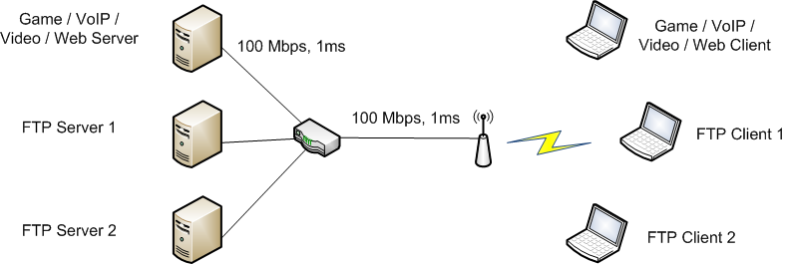
Simulation Setup
Network Simulator (NS-2)
Single channel, IEEE 802.11g Infrastructure Network
Shadowing propagation model
DropTail / CHAP / Strict Priority Queue (SPQ)

Slide 12
Simulation Flow Schedule
Application
under test
FTP 1
FTP 2
30
90
150
210
270
330
Time (s)

Slide 13
FTP Scenario - Throughputs

Slide 14
Game Scenario – G-Model MOS

Slide 15
Summary of Performance
Scn. | App (Unit) | DropTail | CHAP | SPQ | % Impr.
Game | Game (MOS) | 3.67 | 4.27 | 4.27 | +16%
 | FTPs (Mbps) | 26.42 | 26.60 | 26.00 | +1%
VoIP | VoIP (MOS) | 4.37 | 4.42 | 4.42 | +1%
 | FTPs (Mbps) | 26.18 | 26.34 | 26.17 | +1%
Video | Video (fps) | 9.97 | 30.00 | 30.00 | +201%
 | FTPs (Mbps) | 23.03 | 23.12 | 22.95 | +0%
Web | Web (ms) | 109.52 | 39.70 | 33.96 | +64%
 | FTPs (Mbps) | 26.59 | 26.73 | 26.54 | +1%

Slide 16
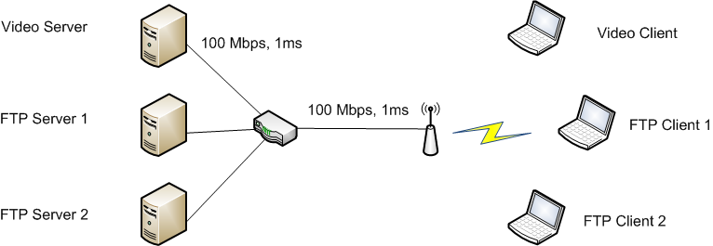
Varying Wireless Conditions via Distance (Video)
Simulation runs with varying distances
d = 1m ~ 30m
d

Slide 17
Results: Varying Wireless Conditions via Distance (Video)
CHAP provides higher throughput than FIFO and SPQ
CHAP provides video application quality higher than FIFO and
close to SPQ, while providing higher FTP throughput than FIFO and SPQ
when video application is placed further away from AP.

Slide 18
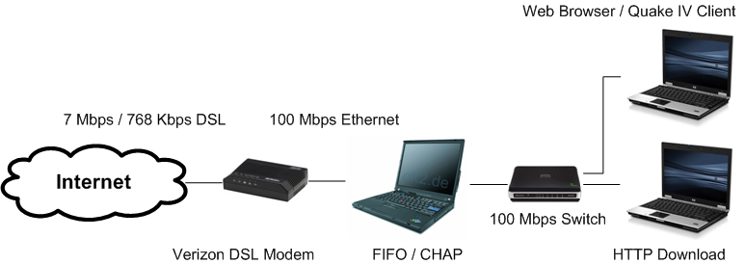
Case Study Setup
Broadband: Verizon 7Mbps/768Kbps DSL Line
Linux bridge provides bottleneck
Extra 2ms delay → about 5 Mbps
350 packet queue limit
Boost parameter of 25 ms for CHAP
Case Studies
Web Browsing: Firefox 3.6
Online Game: Quake IV
Moving around
Shooting a shotgun

Slide 19
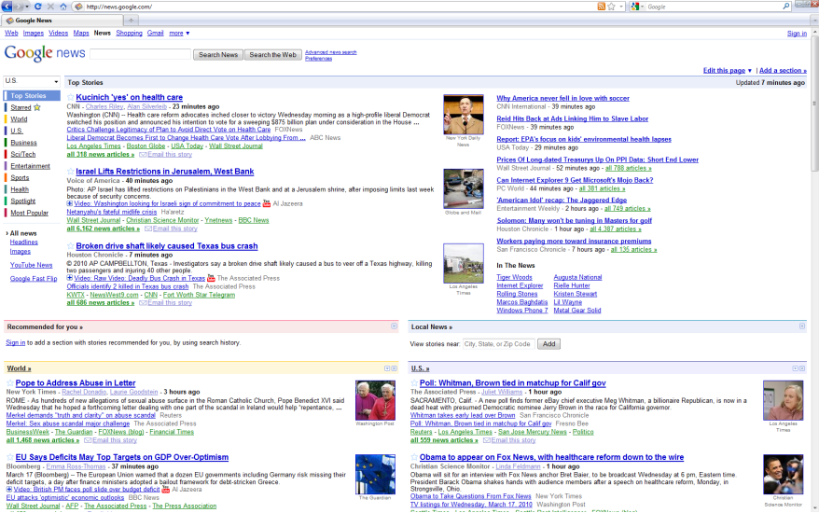
Websites Tested
Yahoo
CNN
Google News
Wall Street Journal

Slide 20
Webpage Load Times
CHAP provides Webpage load times similar to FIFO in absence of
file download, and provides much faster webpage load times than FIFO
with file download.

Slide 21
Quake IV Servers
Worcester, MA
(qstat to get IP address, geolocate IP address on Google map)

Slide 22
Quake IV Server Ping Times
Playable
Threshold
425 ms
CHAP provides server ping times similar to FIFO in absence of
file download, and provides much smaller server ping times than FIFO
in presence of file download.

Slide 23
Quake IV – Moving Around
http://perform.wpi.edu/chap/
FIFO – Quake IV alone
(62 – 125 ms)
FIFO – Quake IV + Debian ISO Download
(477 – 546 ms)
CHAP – Quake IV + Debian ISO Download
(62 – 94 ms)
CHAP allows the player to move around freely as if there is no concurrent
file download while FIFO prevents the player from moving due to the large
roundtrip time to the server.

Slide 24
Outline
Introduction (done)
Credit-based Home Access Point (CHAP) (done)
Performance Evaluation (done)
Conclusion and Future Work

Slide 25
Conclusion
Credit-based Home Access Point (CHAP) improves quality of delay sensitive applications.
FTP performance preservation
CHAP improves performance over DropTail and provides performance close to SPQ.
Minimal configuration
No explicit classification
No pre-determined treatment
CHAP adjusts to wireless network configuration automatically.
Overall performance improvement over DropTail and SPQ

Slide 26
Future Work?

Slide 27
Future Work
More evaluation of CHAP
Formal analysis of CHAP algorithm for setting the increment
Prototype implementation using a Linux-based access point

