Slide 1
ABE: Providing a Low Delay within Best Effort
P. Hurley, M. Kara, J. Le Boudec, and P. Thiran
ICA, Swiss Federal Institute of Technology, Lausanne, Switzerland
Sprint ATL, California
Department of Computer Science, University of Leeds, UK
IEEE Network Magazine
May/June 2001

Slide 2
Introduction
Multimedia applications can perform well over a wide-range of loss (with repair)
Delay often the major impediment for interactive multimedia applications
Internet is “best-effort” with one QoS of traffic for all
DiffServ requires monitoring of classes
Want to keep it simple, but add support for delay sensitive multimedia traffic
→ Alternative Best Effort (ABE)

Slide 3
Outline
Introduction (done)
The ABE Service (next)
Implementation
Simulation Results
Related Work
Conclusions

Slide 4
Outline
Introduction (done)
The ABE Service
Definition (next)
Green does not hurt blue
Router requirements
Inter-working and Migration
Implementation
Simulation Results
Related Work
Conclusions

Slide 5
Definition
ABE packets are either green or blue
(Neutral colors, green for “go”)
Application chooses to make packets green
Default is blue (most applications)
Green packets get low, bounded delay
Green does not hurt blue
Blue has same or better throughput even in presence of green traffic
All ABE packets in same best-effort class
Traditional congestion control
All blue get more throughput than all green

Slide 6
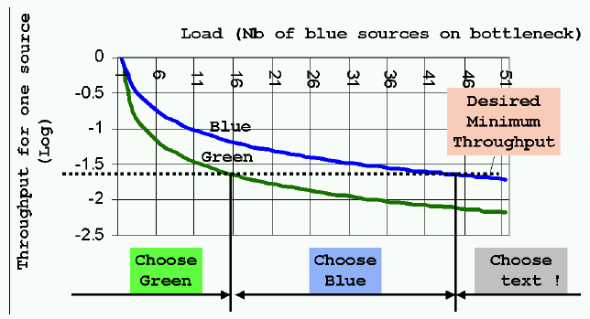
Possible Packet Coloring Strategy
Assume: utility(rate, delay) = 0 if rate < min
utility(rate, delay) = linear with delay if rate > min

Slide 7
Discussion
Interactive applications send mix of blue and green
“Probe” packets to determine region
Traditional applications send all blue
Care more about throughput
Note, says nothing about TCP-friendly
Still same problem as with best-effort
Green makes it no worse since doesn’t hurt blue
Backbones have low delay, so ABE likely in peripheral/edge routers
Delay bound offered depends upon hops
Assume 2-6 low-speed hops
Delay 100-150 msec total, maybe 50 for network
Per-hop delay about 5-20 msec

Slide 8
Outline
Introduction (done)
The ABE Service
Definition (done)
Green does not hurt blue (next)
Router requirements
Inter-working and Migration
Implementation
Simulation Results
Related Work
Conclusions

Slide 9
Green Does Not Hurt Blue
When there is green traffic in addition to traditional blue traffic, must have
Local transparency to blue
Throughput transparency to blue

Slide 10
Local Transparency to Blue
Consider a traditional router that treats all packets equal (no ABE)
ABE router should have same delay as traditional router
If blue not dropped with traditional router, then not dropped with ABE router
If TCP friendly:
[11, Kurose SIGCOMM ‘98] – well-used model
If reduce R, what might happen to throughput for green?
→ Need throughput transparency

Slide 11
Throughput Transparency to Blue
If green flow is TCP friendly, should get less or equal throughput as blue flows
Hard to implement exactly since hard to measure
Hard to measure TCP friendly, even!
Consider it to be a loose requirement
Implement by making sure green has higher loss ratio

Slide 12
Outline
Introduction (done)
The ABE Service
Definition (done)
Green does not hurt blue (done)
Router requirements (next)
Inter-working and Migration
Implementation
Simulation Results
Related Work
Conclusions

Slide 13
Router Requirements
Provide low, bounded delay to green
Provide local transparency to blue
Provide throughput transparency to blue
Preserve packet sequence within blue and green
Note, may be out of order across colors
Keep green packet loss as low as possible
Make green attractive as possible

Slide 14
Outline
Introduction (done)
The ABE Service
Definition (done)
Green does not hurt blue (done)
Router requirements (done)
Inter-working and Migration (next)
Implementation
Simulation Results
Related Work
Conclusions

Slide 15
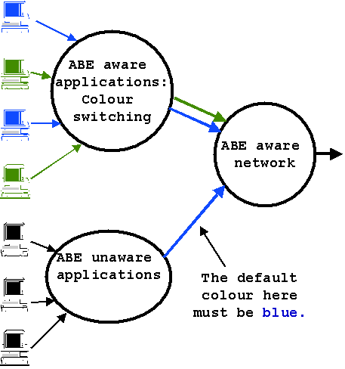
Interworking and Migration
- Can add one
router at a time
- Let customers
switch to gradually
- Should not
impact other
routers

Slide 16
Outline
Introduction (done)
The ABE Service (done)
Implementation (next)
Duplicate Scheduling with Deadlines
Properties of (DSD)
Simulation Results
Related Work
Conclusions

Slide 17
Implementation
Could try modified FCFS:
For blue, enqueue normally
For green, drop if delay > max
(What is problem with only doing this?)
Instead, use separate queues
But still work conserving
Deadlines associated with each packet
Dequeue color that has earlier deadline
If both, use control function for fairness
→ Duplicate Scheduling with Deadlines (DSD)

Slide 18
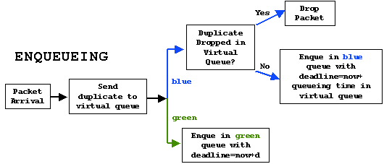
DSD Overview

Slide 19
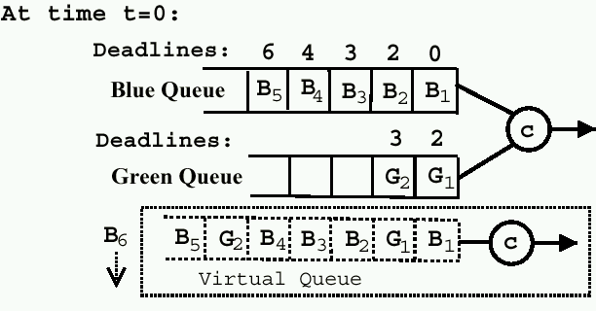
DSD Example (1 of 2)
Buff = 7
Max d = 3
Serve: B1, G1, B2, B3, B4
Drop: G2 (deadline missed), B6 (buffer full)

Slide 20
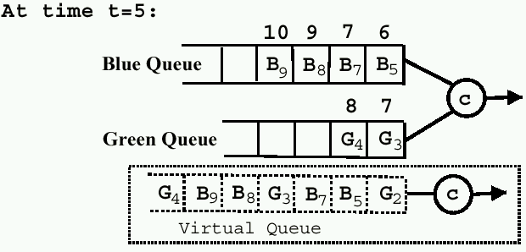
DSD Example (2 of 2)
Buff = 7
Max d = 3
Serve: G3, B5, B7, G4, B8 and B9

Slide 21
DSD Modifications
Only enqueue green packet if length of green queue + blue packets with deadline less than d
(would not have enqueued G2, in example)
If either can be served, if [0,1] < g then pick green else blue
g=1 favor green, g=0 favor blue
(g=1 in example)
Can also use active queue management (AQM, say RED) for congestion monitoring

Slide 22
Properties of DSD
Buffer always less than Buff because of virtual queue
All blue packets served by deadlines, so same as or earlier than best-effort
All green packets served before d, else dropped

Slide 23
Outline
Introduction (done)
The ABE Service (done)
Implementation (done)
Simulation Results (next)
Related Work
Conclusions

Slide 24
Simulation
Done in NS-2
Show green does not hurt blue
Show green benefits from low delay
Show loss rates for both types
Compare to reference condition, flat best-effort FCFS (droptail) router

Slide 25
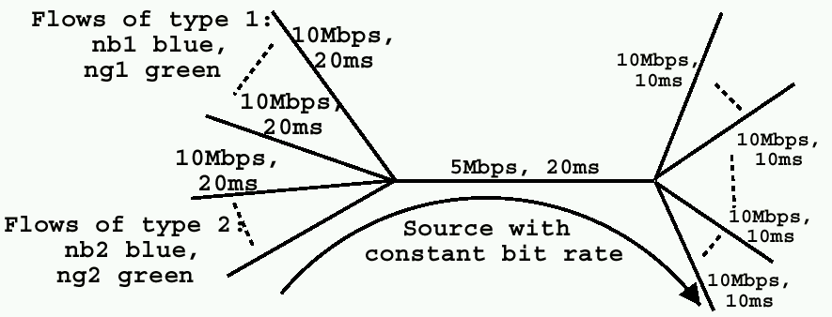
Simulation Setup
Typo: 50 ms delay
(why two different RTTs?)
Blue are TCP-Reno, green are TCP-Friendly (RAP)
Some simulations have one additional green source
that is unresponsive CBR
Packet size 1000 bytes
Delay max = 0.04 seconds
Simulations run for 300 seconds

Slide 26
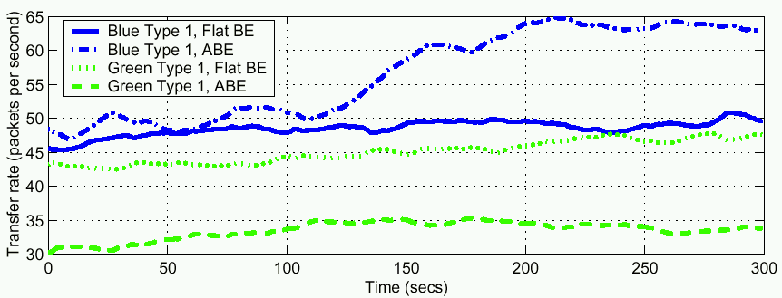
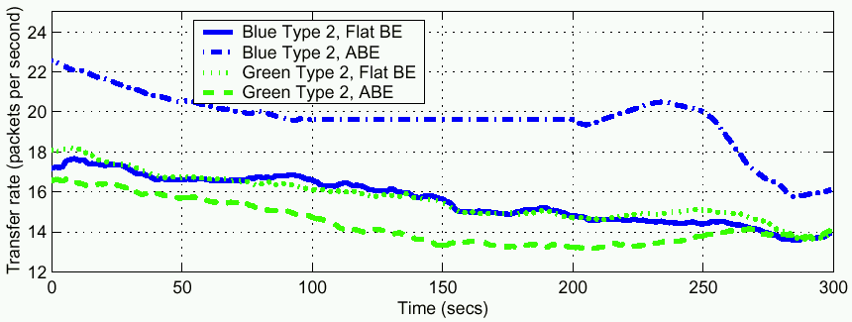
Throughput - Equal
10 blue, 10 green
all TCP-friendly

Slide 27
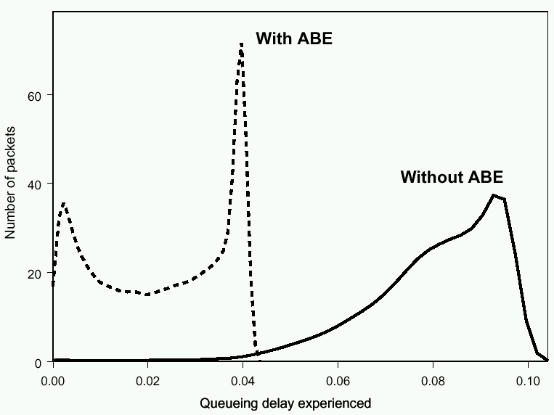
Green Queuing Delay - Equal
Loss: (ABE, BE)
green: (4.97%, 3.3%)
blue: (2.5%, 3.2%)

Slide 28
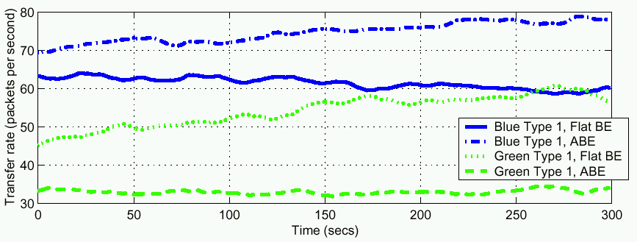
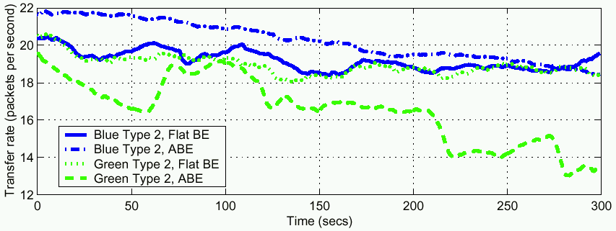
Throughput - Unequal
10 blue, 6 green
all TCP-friendly

Slide 29
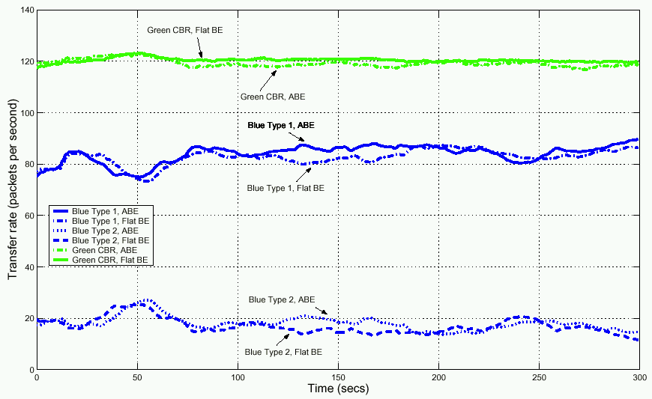
Throughput – CBR
10 blue, 1 green
CBR

Slide 30
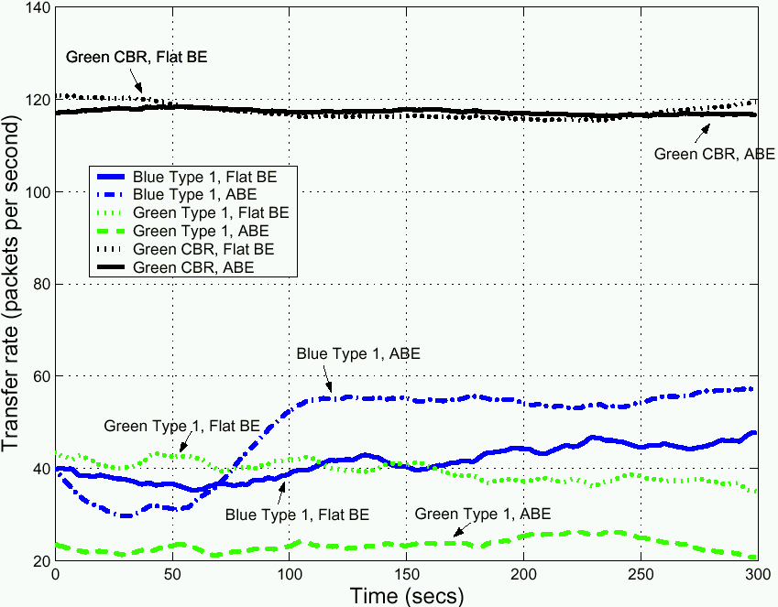
Throughput – CBR + Friendly
10 blue, 10 green
TCP-friendly, 1
green CBR

Slide 31
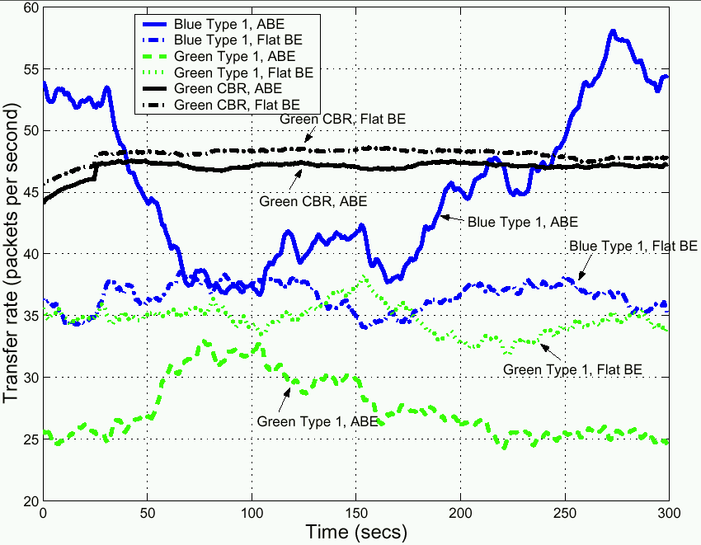
Throughput – Mixed Green + Blue
- 10 blue, 10 green
TCP-friendly, 1
green CBR
- Green does 80%
green and 20%
blue

Slide 32
Outline
Introduction (done)
The ABE Service (done)
Implementation (done)
Simulation Results (done)
Related Work (next)
Conclusions

Slide 33
Related Work
IntServ [21, 22]
Admission control plus reservation
Per-flow accounting and charging
Doesn’t scale
May perform on edge only
DiffServ
Aggregates (classes) of flows
Scales better
(Next chunk of related work)

Slide 34
Related Work
DiffServ low delay service
Crowcroft et al. (also gets more throughput) [23]
EF provides low delay and low loss [25]
SIMA has level for how ‘real-time’ traffic is [26]
DiffServ low delay class
Dovrolis et al. [27]
AF – Assured Forwarding [30]
All require changes to existing price structures. Incremental deployment difficult.

Slide 35
Conclusion
Alternate Best Effort (ABE)
Supports low delay
No reservation or signaling required
Choice of green or blue up to application
One ABE implementation presented (DSD)
Simulation and implementation suggest:
Green benefits from lower delay
Blue not harmed
Over range of network and traffic conditions

Slide 36
Future Work?

Slide 37
Future Work
Applications that use green
Adaptively
PQ benefits of ABE to multimedia apps
Implementation overhead of ABE
More colors for more MM applications:
dark green, light green, neon green …
More colors for more blue applications
Web, Email, Telnet, File Transfer

