Slide 1

Tuning Skype Redundancy Control Algorithm for User Satisfaction
Te-Yuan Huang, Kuan-Ta Chen, Polly Huang
Proceedings of the IEEE Infocom Conference
Rio de Janiero, Brazil, April 2009

Slide 2
Motivation
  Voice traffic is sensitive to network impairment
Why is VoIP sending rate important?
  Most important factors for user satisfaction [5]:
    Sending rate and its variation
    High and stable voice quality
    (MLC: note, their measure is “call survival rate”. Based on empirical measurement of net traffic.)
Why is adapting sending rate difficult?
  Aggressively? → cause congestion, worse for all
  Conservatively? → quality lower than users want
Notes:
Voice traffic is sensitive to network impairment.
Previous work shows that most important factors on user satisfaction are sending rate and its variation.
This indicates that what users generally want is high and stable voice quality.
To date, it is still not clear to the community about how to adapt voice sending rate to network conditions. The difficulty is that we can not send voice traffic aggressively nor conservatively.
If we send it aggressively, we might inject too much voice data and cause the network congested. The congestion would cause packet loss, increase jitter, and eventually degrade the voice quality at the receiver side. On the other hand, if we send it conservatively, then the voice quality might not be perceptible either.
------
Set Highest Sending rate? Probably not a good idea, cause it might cause congestion, starve its best effort counterpart and eventually hurt the voice traffic itself.
However, the voice data delivered might not be perceptible if each voice call is limited to the rate of an average TCP flow.

Slide 3

Goals
Skype – one of most popular VoIP apps
  2008, had 338 millions users [footnote 1]
Q1: How does Skype adapt voice traffic?
Q2: Is Skype mechanism good enough?
Q3: How can Skype’s policy be improved?
  (Look to apply to VoIP in general)
Notes:
Dig into Skype, one of most popular VoIP
Like to know how Skype adapts its voice traffic.
Furthermore, like to examine Skype’s mechanism.
And finally, how can Skype’s mechanism be improved, lessons learned from this case study, and apply it to general VoIP development.

Slide 4


Related Work
Skype’s voice traffic is governed by [4]:
  Bit rate
  Framing time (aka sample rate)
  Redundant data
PC-PSTN calls (Public Switched Telephone Network)
  G.729 – constant bit rate, framing time
PC-PC calls
  iSAC – likely implemented by 3rd party, so bitrate and framing time fixed
Only redundant data is controlled by Skype
Notes:
In infocom 2008, Bonfiglio et al found Skype’s voice traffic is governed by 3 factors: Bit rate, framing time, and redundancy ratio.
Skype supports two kinds of voice calls: PC-PSTN calls and PC-PC calls.
For PC-PSTN calls, Skype uses G.729 as the audio codec for SkypeOut (PC-PSTN) calls;
G.729 is constant bit rate and constant framing time.
Thus the rate variation in SkypeOut calls is the result of adapting redundancy to network conditions.
For PC-to-PC calls, iSAC is used in most of the calls.
Through little experiments, found that the bit rate and framing time adaptation in calls using iSAC, is likely implemented by the codec, not by Skype.

Slide 5
Outline
Motivation (done)
Related Work (done)
How does Skype adapt redundancy? (next)
Is Skype’s mechanism good enough?
How can Skype do better?
Conclusion

Slide 6
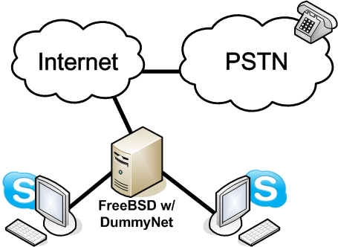
Experiment Setup
Voice Input : American English Speech Samples from Open Speech Repository [20]
PC-PSTN (G.729)
PC-PC (iSAC)
Only UDP sessions via tcpdump
60 seconds after starting
Loss increased by 1% every 180 seconds
Notes:
Setup a FreeBSD box to act as a bridge to connect
Two Skype clients on PC-PC calls (iSAC)
Skype client to PSTN network (G.729)
use Dummynet to control the network conditions, such as network loss rate
To simulate natural conversations, speech samples from open speech repository as voice input
Skype can transmit its voice packets by either UDP or TCP (tries UDP, but falls back to TCP if cannot connect).
But since TCP guarantees in-order and reliable transmission, there is no need for Skype to add redundancy to TCP flows.
Thus, in this work, use only UDP.

Slide 7
Observation
10%
G.729 (PC-PSTN)
  Constant bit rate
  Constant framing time
9%
8%
7%
6%
5%
4%
3%
2%
1%
0%
0%
As network loss rate ↑, number of packets with doubled payload size also ↑
Notes:
PC-PSTN calls with codec G.729.
y-axis is payload size in bytes, and x-axis the time in seconds.
When loss rate is 0%, payload size remains around 30 bytes.
Loss rate increases, more packets with a payload size around 60 byes.
Skype implements policy to mitigate impact of network loss rate by retransmitting past voice blocks into same message.
When loss rate reaches to 10%, most packets payload of 60 bytes.
When loss rate goes back to 0%, payload size goes back to 30 bytes.

Slide 8
Redundancy Ratio
Definition
  Fraction of packets that carry redundant voice data
4
3
2
1
Redundancy Ratio = 2/4 = 0.5
Notes:
“Redundancy ratio” – fraction of packets that carry redundant voice data.
For example, the second and the third packets are piggybacking the previous packet, thus the redundancy ratio is 2/4, that is 0.5.

Slide 9
Estimate Redundancy Ratio of G.729
10%
G.729 (PC-PSTN)
  Constant bit rate
  Constant framing time
9%
8%
7%
6%
5%
4%
3%
2%
1%
0%
0%
Set Threshold at 40 bytes
Notes:
Derive redundancy ratio from previous result, use simple threshold method:
+ threshold set at 40 bytes
to determine whether or not a packet contains a piggybacked voice block

Slide 10
Identify Redundancy Ratio (1 of 2)
Redundancy Ratio of G.729 (PC-PSTN Calls)
steady above 0.9
with 95% conf intervals
dramatic increase
gradual increase
Notes:
Average redundancy ratio of SkypeOut and 95% confidence intervals.
y-axis is redundancy ratio, x-axis is loss rate from 0% to 10%
Redundancy ratio increases gradually when loss rate is between 1% and 2%
Increases dramatically between 2% and 4%
Stays higher than 0.9 when the loss rate is higher than 4%

Slide 11
Identify Redundancy Ratio (2 of 2)
Redundancy Ratio of iSAC (PC-PC Calls)
with 95% conf intervals
Notes:
Average redundancy ratio of PC-PC calls and 95% confidence intervals.
Similar way to adjusting G.729.
This suggests that Skype adjusts redundancy ratio the same regardless of codec used.

Slide 12
Outline
Motivation (done)
Related Work (done)
How does Skype adapt redundancy? (done)
Is Skype’s mechanism good enough? (next)
How can Skype do better?
Conclusion

Slide 13
Skype’s Redundancy Control Algorithm
Broadly, three factors that may affect VoIP quality
  Available bitrate
  Codec
  Burstiness of network loss
Adapt to network loss rate?
  → Based on [4], switches rates before packet loss reaches 1% so changing bitrate doesn’t affect redundancy algorithm
Adapt to other factors?
  Codec
  Network loss burstiness
Notes:
Investigate whether Skype considers other factors when it adjusts redundancy ratio.
Three factors that may affect VoIP quality
Available bandwidth
Codec
Burstiness of network loss
How Skype adapts to changing bandwidth has been discussed in Bonfiglio’s paper in INFOCOM last year. They have found that when reducing the bandwidth, the codec successfully switches to a lower bit rate before the packet loss rate is high enough to trigger the redundancy control algorithm. Thus, the bandwidth setting does not affect Skype’s redundancy control decision.
Other two factors this paper.

Slide 14
Effect of Codec
G.729
iSAC
Skype’s mechanism does not take difference of codec into consideration
Notes:
y-axis is the redundancy ratio from 0 to 1, x-axis is the loss rate from 0% to 10%.
Average redundancy ratio of G.729 and iSAC together.
Red dashed line average redundancy ratio of iSAC calls.
Black solid line average redundancy ratio.
95% confidence interval of two curves collide with each other. Suggests Skype applies same redundancy control algorithm for different codecs

Slide 15
Effect of Network Loss Burstiness
G.729 (PC-PSTN, but iSAC similar)
BR=2
BR=1
Burst ratio (defined by ITU-T [12]):
average length of consecutive loss /
average length random loss
e.g., BR = 1 means uniform random
BR=1.5
Skype’s mechanism does not take level of burstiness into consideration
Notes:
In order to quantify the level of burstiness, introduce burst ratio defined by ITU-T.
Burst ratio is average length of consecutive loss / burst length under random loss.
BR=1 loss pattern is roughly equal to uniformly random loss
Use Gilbert model [8] to induce bursty loss (two states, received and loss)
Black solid line is average redundancy ratio, when Burst Ratio is equal to 1.
Red dash line is for Burst ratio 1.5, and the green dotted line is for burst ratio 2.
95% confidence intervals overlap with each other.
(Similar result for iSAC)
This strongly suggests that Skype’s redundancy control policy ignores effect of network loss burstiness.

Slide 16
Outline
Motivation (done)
Related Work (done)
How does Skype adapt redundancy? (done)
Is Skype’s mechanism good enough? (done)
How can Skype do better? (next)
Conclusion

Slide 17
Optimal Redundancy Control Policy
Redundancy purpose → to maintain voice quality under loss rates
  Adapt to different loss rates
What’s the optimal policy?
  Minimum amount of redundancy data needed to sustain same audio quality under different network conditions
Develop an emulator to derive
  Manipulate voice frames generated from encoder to emulate different network conditions
  Grade voice quality of degraded audio clips after transmitting under given network conditions
(details next)
Notes:
Purpose of piggybacking redundant information is Skype would like to maintain certain voice quality under different network loss rates
Define optimal policy as minimum amount of redundancy data needed to sustain a certain level of audio quality under different network conditions.
Develop a simulator to understand the resulting audio quality of different redundancy ratio under a range of network conditions

Slide 18
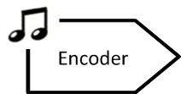
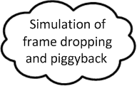
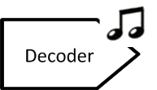



Emulation Flow
Voice Input : American English Speech Samples from Open Speech Repository
Encode audio clip into voice frames: G.711 and G.729
  Can’t use iSAC since closed
Simulate network loss with Gilbert model
Determine if piggybacking based on ratio (simple duplicate)
Decode into voice frames
Use PESQ [14] to compare original to degraded → MOS
Repeat for range of redundancy ratios
Consider minimum redundancy ratio to sustain given MOS
→ optimal redundancy ratio
Notes:
Encode an audio clip into voice frames by using encoders provided by the Intel IPP (public codecs, use G.711 and G.729 – can’t use iSAC)
Simulate network loss and the level of loss burstiness with Gilbert model
Determine if frame should be piggybacked by desired redundancy ratio
Use corresponding decoder to decode resulting stream of voice frames
Finally, use PESQ [14] to quantify quality of degraded audio clip by comparing it to original clip
Repeat for range of redundancy ratios
Consider minimum redundancy ratio to sustain a given voice quality as the optimal redundancy ratio
For example, if desired PESQ score is 3.5, then under each network loss rate, redundancy ratio achieves exactly 3.5 is considered the optimal redundancy ratio

Slide 19
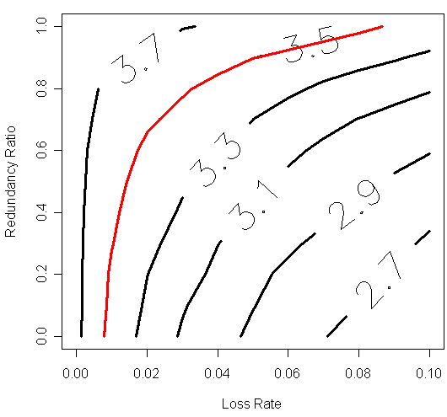
Optimal Redundancy Ratio – G.729
Combinations of redundancy for loss that gives MOS
(Fig 7a: G.711 is somewhat different than G.729 – needs more redundancy)
Notes:
Desired MOS becomes “curve” in space – combinations of redundancy based on loss that results in given MOS
Generally, G.711 is different than G.729.
E.x. MOS 3.3 - Loss rate2% needs 0.5 redundancy for G.711, only 0.2 for G.729

Slide 20
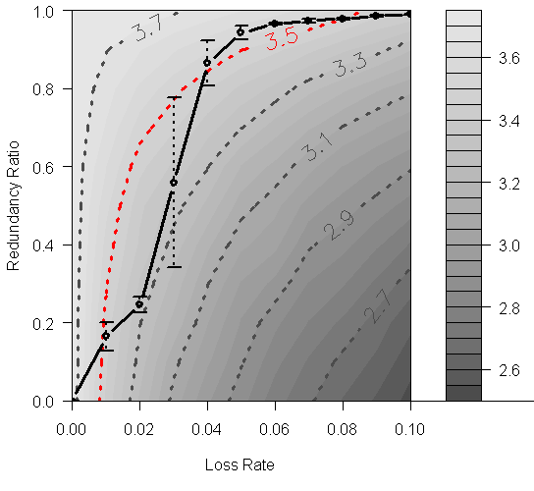
Skype versus Optimal – G.729
Assume desired MOS 3.5
Higher for very low loss and very high loss
Lower for mid-range loss
Optimal can better balance
Skype
Burst Ratio = 1
Notes:
Sype’s redundancy control policy together with optimal one
Skype’s policy is pretty close to optimal
But fails to maintain a consistent voice quality.
For example, Skype achieves audio quality better than 3.5 when loss rate lower than 1% or higher than 4%
When the loss rate is between 1% and 4%, quality level is much lower than MOS 3.5
Inconsistency may result in frustration for users or over-utilization of bandwidth
Optimal better balances bandwidth utilization and voice quality

Slide 21
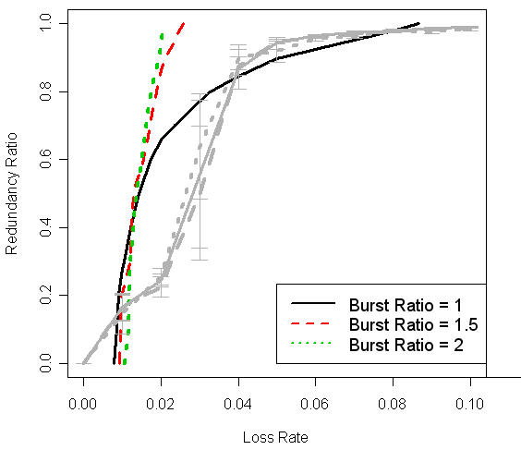
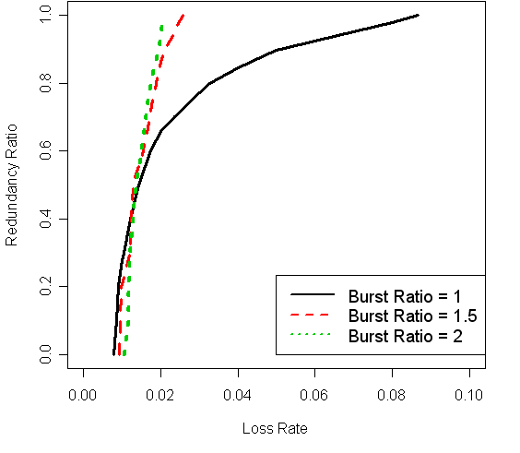
Optimal Redundancy for Burst Ratio
BR=1.5
BR=2
Under bursty loss, need more aggressive redundancy ratio
BR=1
Skype
Skype does not adapt to loss burstiness
G.729, MOS=3.5
Notes:
G.729 to sustain voice quality at MOS 3.5 under different burst ratios
Redundancy ratio should be increased more aggressively to maintain same audio quality under higher burst ratio

Slide 22
Modeling Optimal Redundancy Ratio
Based on targeted voice quality
  e.g., MOS 3.5
Take codec and burstiness into consideration
Polynomial regression
Example: optimal policy for G.729, targeted MOS=3.5
R² as high as 0.98
Notes:
Derive optimal policy by polynomial regression for each target PESQ quality, considering codec and burstiness.

Slide 23
Conclusion
Explored how Skype adapts redundancy for voice traffic → redundancy ratio
Propose general model for optimal redundancy ratio policy
  Consistent user satisfaction
  Extensible to general VoIP software
Skype’s policy does not factor in codec and loss patterns
  But should!
  → Skype not optimal for some ranges of loss, even more so for bursty loss
Notes:
To conclude, in this work, observed how Skype adapts its redundancy levels to network loss rate.
Show that Skype’s rate adaptation mechanism is not really geared for best user satisfaction
Proposed a general model for various codecs to tune the redundancy for consistent user satisfaction.
Methodology can be extended by Skype developers to facilitate tuning of different proprietary codecs, such as iSAC.

Slide 24
Future Work?

Slide 25
Future Work
Kinds of redundancy
  Not just piggybacking
Video
Other VoIP

