Slide 1
Speak with Forward error correction: Implementation and Evaluation
Brian White
CS529
Notes:
My Name is Brian
I am a part-time student and will be finishing my masters work this summer
For project3, I focused on improvements to the Speak application in the presence of packet loss.
In particular, I looked at a media specific FEC implementation
I also looked at PESQ as a format for evaluation.

Slide 2
PESQ: What is it?
Perceptual Evaluation of Speech Technology (ITU-T P.862)
Standard methodology for analysis of voice quality
  “Full Reference” Test – original vs. degrade
  Produces a mean opinion score (MOS)
  Temporal alignment
  Sample by sample comparison
ITU provides a reference implementation
Notes:
So what is PESQ?
An automated method for evaluating an audio algorithm (transmission, compression, or filter) by quantifying the quality of a recording and translating it to a mean opinion score.
It applies a variety of well known concepts to compare two audio files (an original and a degraded version) to arrive at a quality score.
There are temporal and frequency comparisons and well as smoothness.
So why is PESQ valuable?
It provides a cheaper/faster way to evaluate the quality of an algorithm. Each release doesn’t necessarily have to go out and commission a huge user study to be sure the algorithm is functional and up to standards.
PESQ requires a number of different voice types to be tested, typically 2 male and 2 female voices in each language of interest.
PESQ does not attempt to predict the MOS of any particular experiment. Individual experiments have cultural and situational contexts that color the results. However there should be a rough correlation between PESQ score and subjective results. The P.862.x series of standards provides a robust methodology for making a direct comparison between objective and subjective results.
PESQ values range from 1 to 5
When we look at the results we’ll see that PESQ doesn’t quite line up with my evaluation, but they follow the same general trend.

Slide 3
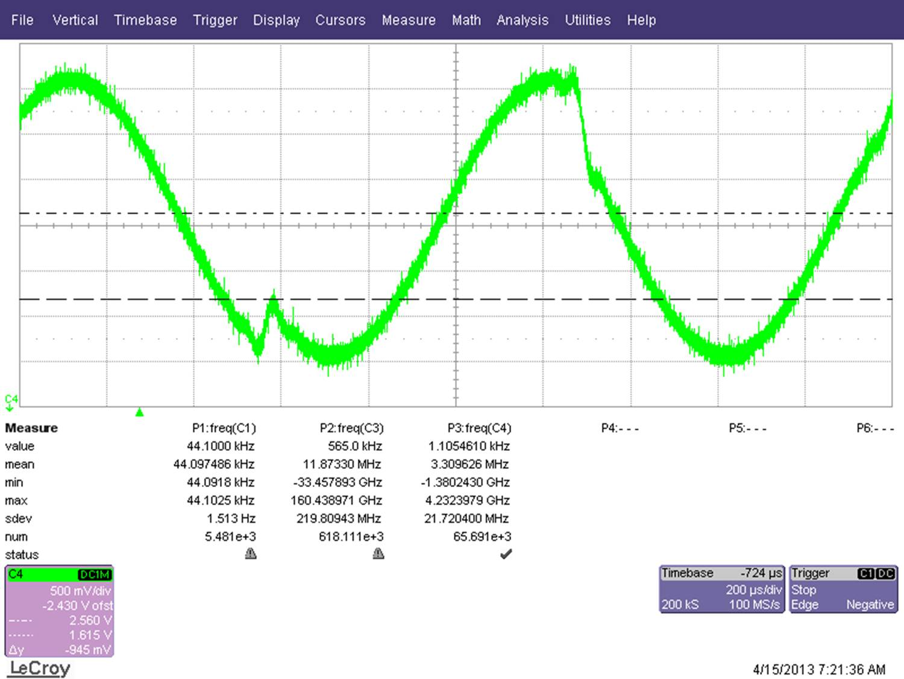
What Does PESQ Detect?
Notes:
PESQ attempts to line up the samples in time and compare A to B, but it will also detect audio discontinuities.
This scope capture isn’t from the Speak application, but it is a reasonable example of a frame error. Almost a whole
It detects noise
Missing samples
Temporal shifts
Pitch shifts

Slide 4
Speak FEC implementation
Media Specific Forward Error Correction
  Include fully redundant data in next packet
  Sequence Number
  Primary Audio
  Secondary Audio
N
A[N-1]
A[N]
N+1
A[N]
A[N+1]
Notes:
My modifications to Speak implement a media specific FEC.
-- The FEC data is directly related to the content that is recorded.
-- In fact, I’ve taken the relatively simple approach of including a fully redundant playload
-- Speak records 30MS frames of audio and transmit the new audio as well as a copy of the previous frame.
-- In order to implement FEC some amount of buffering is required. I took the approach of pre-buffering several frames of audio (3-10), but did not attempt to rebuffer, so once the buffer was exausted the application fell back to inserting zeros if it had no data. At this point FEC was no longer operational.
-- Since I wanted to study FEC at high loss rates, I simply increased the amount of data that was pre-buffered. I ended up with 15 which is too much for
Primary audio is in orange
Secondary (FEC) audio is in Yellow
The sequence number is in gray.

Slide 5
Speak FEC implementation
Handling packet loss (packet N)
N-1
A[N-2]
A[N-1]
N
A[N-1]
A[N]
N+1
A[N]
A[N+1]
A[N-1]
A[N]
A[N+1]
Notes:
If no packet is available a zero’ed packet is played.

Slide 6
Evaluation
Subjective evaluation with 5 test subjects
22 seconds audio played through a Speak application channel.
With and Without FEC
Various error rates (0%,5%,7%,10%,12%,15%)
The audio of each session was recorded and run through PESQ
3 Questions on quality
  Overall quality
  Impression vs. landline
  Impression vs. cellphone
Notes:
The subjects listened to a pre-recorded audio sample and were asked to pay attention to the audio quality and understandability.
For each test, the subject was asked to rate the overall quality and quality versus other common communication mediums.

Slide 7
So how well does FEC perform?
Notes:
FEC performs really well for moderate loss (up to 7%)
Beyond 7%, burst errors start to become an issue (2 or 3 consecutive dropped packets), this makes the audio sound a little more metallic and whole words star to be missed.
But still the quality is around 3.3 which is pretty good.
Side note:
In testing my FEC implementation, I noticed that my virtual machine was quite bad at delivering loop-back packets on time.
The addition of buffer smoothed the arrival rate out and also contributed to higher satisfaction with this implementation of Speak vs. project 2.
So what does this graph show.
Vertical axis is mean opinion score, which is the average over 5 test subjects.
Horizontal axis is the percentage of loss introduced into the transmission
The two trend lines show FEC and non-FEC implementations

Slide 8
Comparison to Landline phone
Notes:
Similar to the previous graph, this shows two trendlines (FEC and non-FEC)
Test subjects were asked to compare audio heard from Speak to there impression of a recent landline telephone call.
Origin in the middle.
A score of 0 in this chart means that the perception was on par with the landline conversation.

Slide 9
PESQ Evaluation
Notes:
Mean opinion score from PESQ roughly follows the trend of the subjective results
A few aberrations
-- Gives a perfect score to the initial 0% loss case. This could be mitigated by using a higher quality original for the comparison
-- Something strange happening between 7 and 10% loss. I think this would smooth out over more trials and follow the general slope
Both trends roughly track.
-- Same basic decline for non-FEC
-- Same steady state for FEC enabled

Slide 10
Conclusion
FEC is valuable for networks that expect moderate loss
To fully work, an adaptive buffering scheme should be adopted
Work with speech detection
Future work to evaluate FEC implementation in a two-way conversation test.
Expand on informal evaluation of PESQ as a testing methodology. Are there cases were PESQ diverges from subjective results?

