Slide 1
Killing Zombies with Rate Controlled Adaptive Intra Refresh over Wireless HDMI by Nicholas Jamba

Slide 2
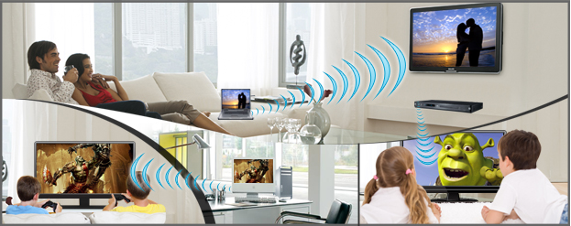
Any Content Any Room Any Device

Slide 3
Wireless HDMI for Consoles Gaming
Many Displays One Source Conundrum
Bluetooth game controllers allow freedom to play on another display.
H.264 compression makes it feasible to wirelessly stream HDMI to Display
Zero latency
Robust error resiliency
Low cost but support for 1080p60 video

Slide 4
Outline
Wireless HDMI Background
Wireless low latency techniques
Error resiliency techniques
Experimental Design
Future Work

Slide 6
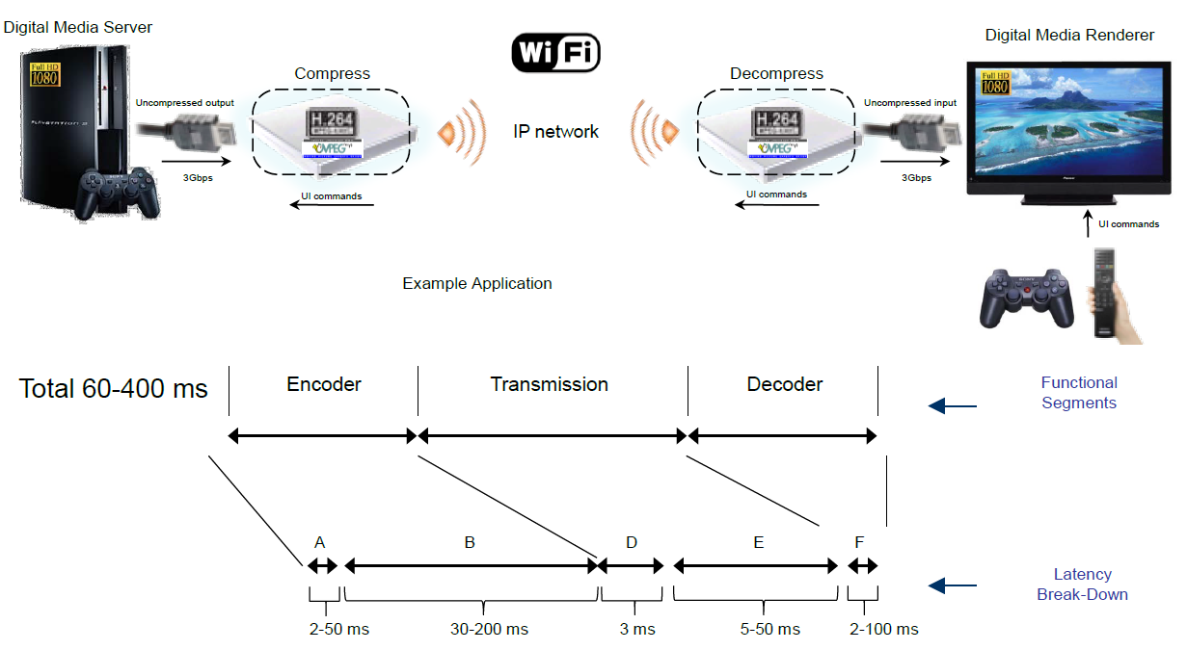

Slide 7
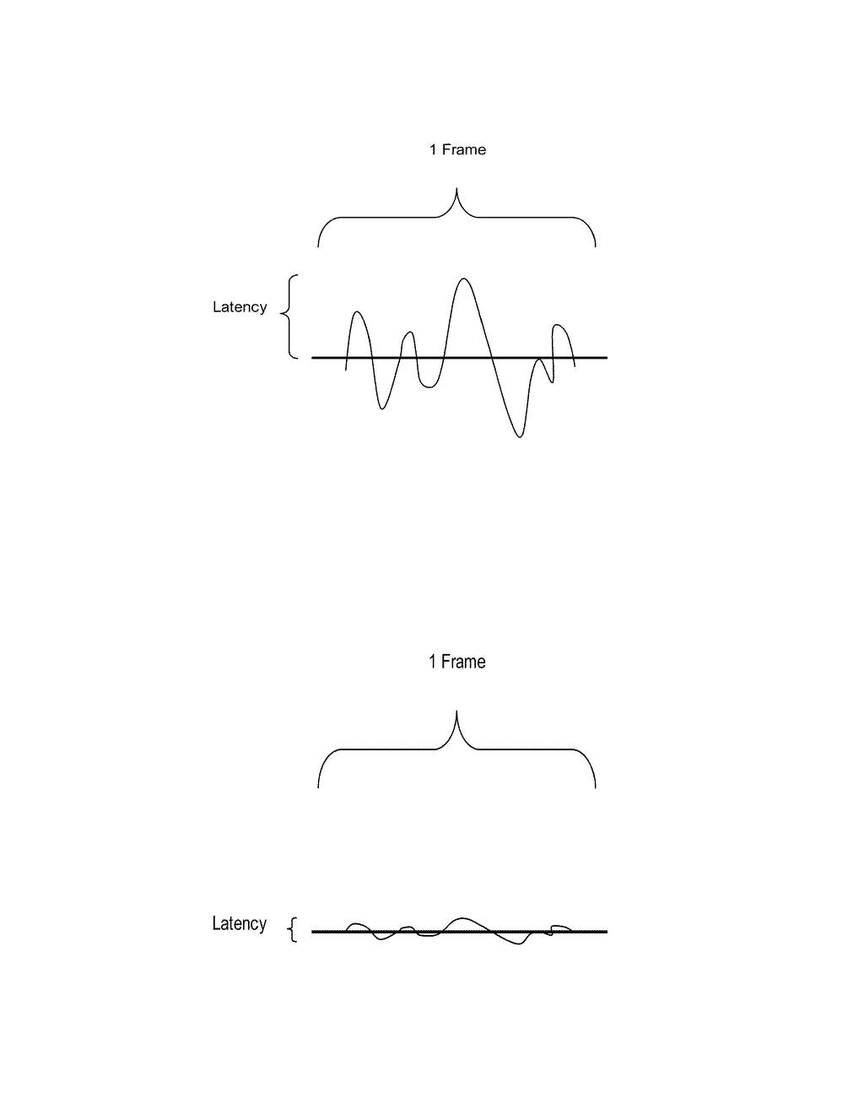
Wireless Connections are very error prone
Most recovery techniques from packet loss causes higher bitrates.
Variable bitrates can cause latency
Latency of 100ms or more in games is noticeable

Slide 8
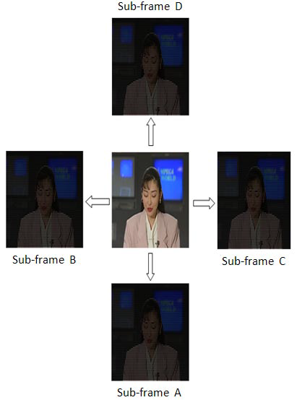
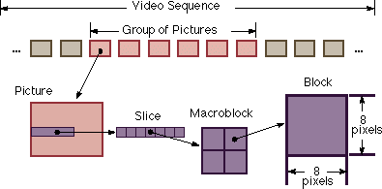
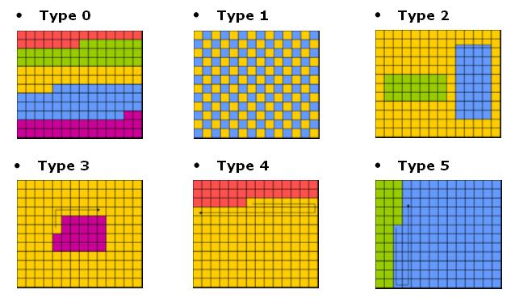

Slide 9
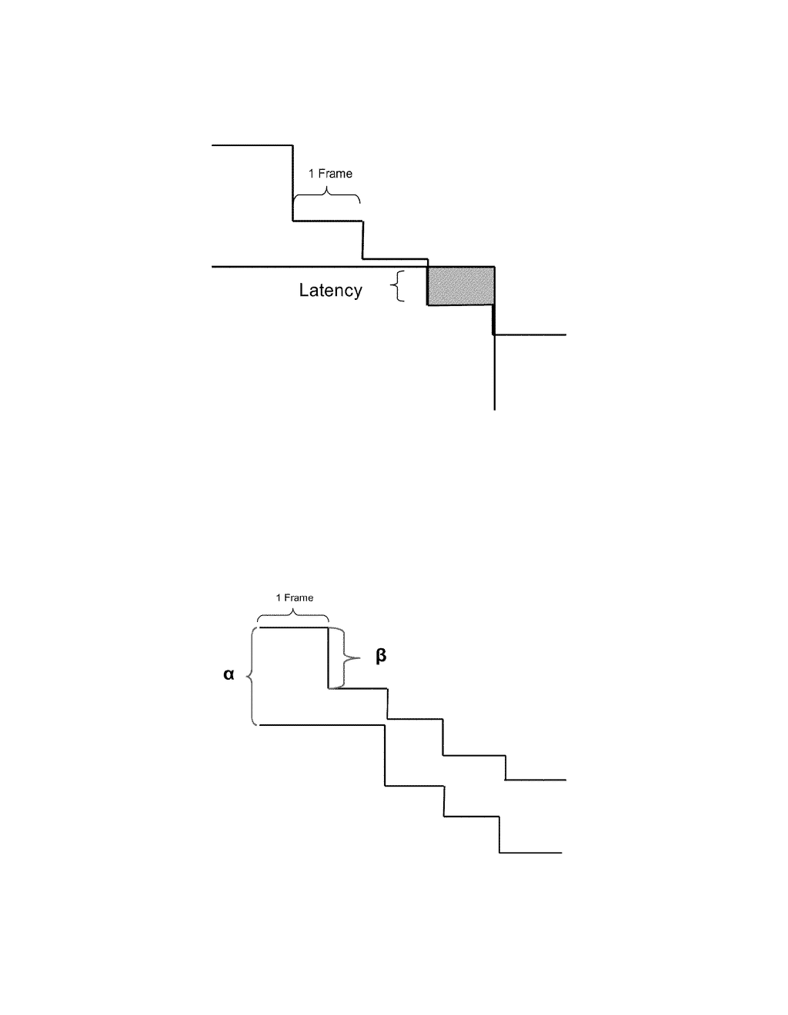
current video bit rate (cur_VBR)
current channel bit rate (cur_CBR)
current headroom factor cur_α, and setting a current video bit rate (cur_VBR) for encoding the multimedia stream such that the cur_CBR-cur_VBR≧cur_α
monitor a new channel bit rate (new_CBR), determining a channel bit rate reduction β, wherein β=cur_CBR-new_CBR, a
cur_CBR
cur_VBR

Slide 10
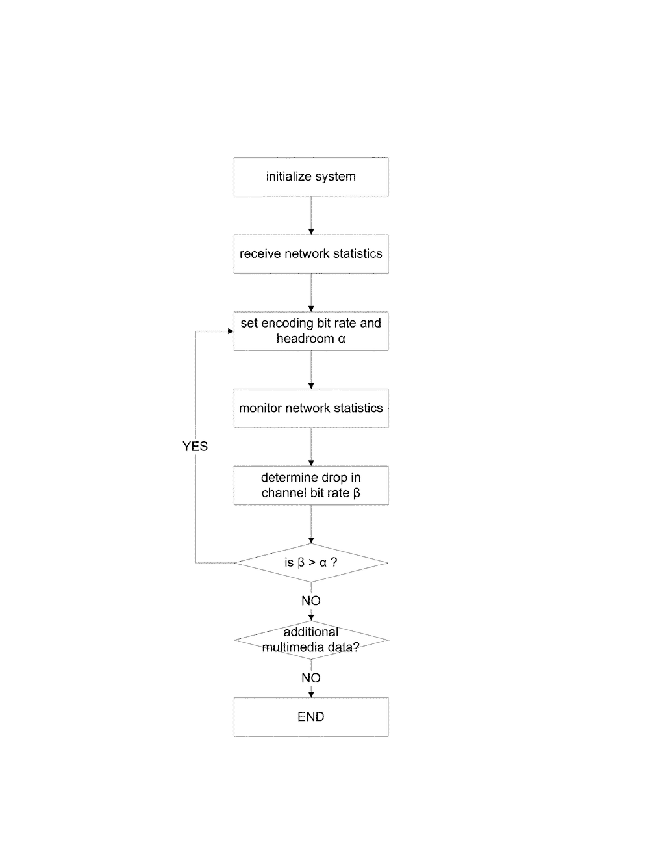

Slide 11
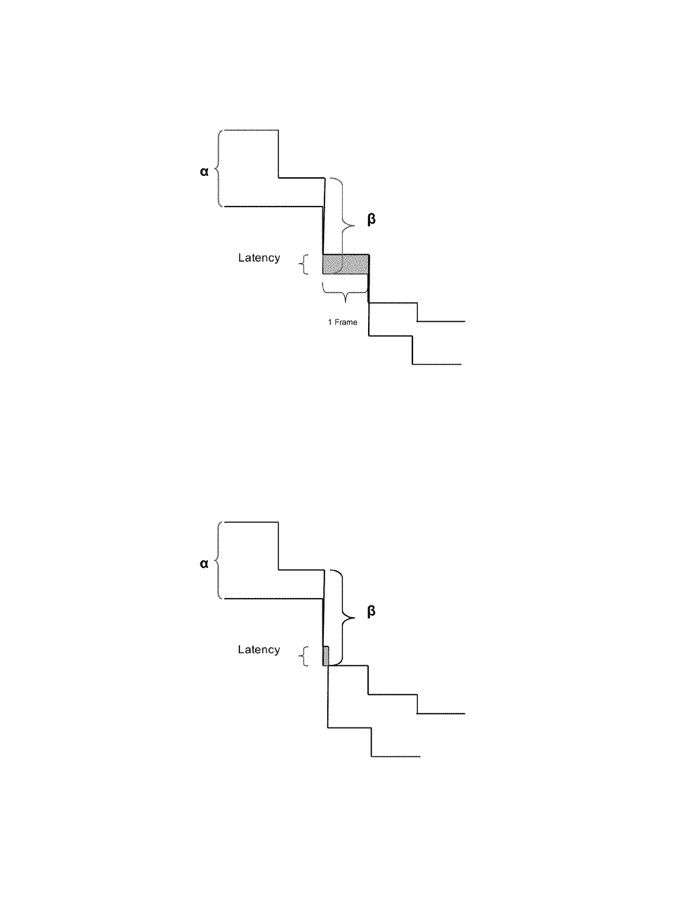
rate control scheme adjusts the encoded video data rate at the frame level
When the drop in channel bit rate β exceeds the headroom α, latency is introduced for a period of at least one frame, until the encoded video data rate can be adjusted
cur_CBR
cur_VBR
The encoded video bit rate is adjusted at the sub-frame level, allowing for a much more rapid adaptation to the changing channel conditions
latency is introduced only for a portion of the frame following the reduction in the channel bit rate

Slide 12
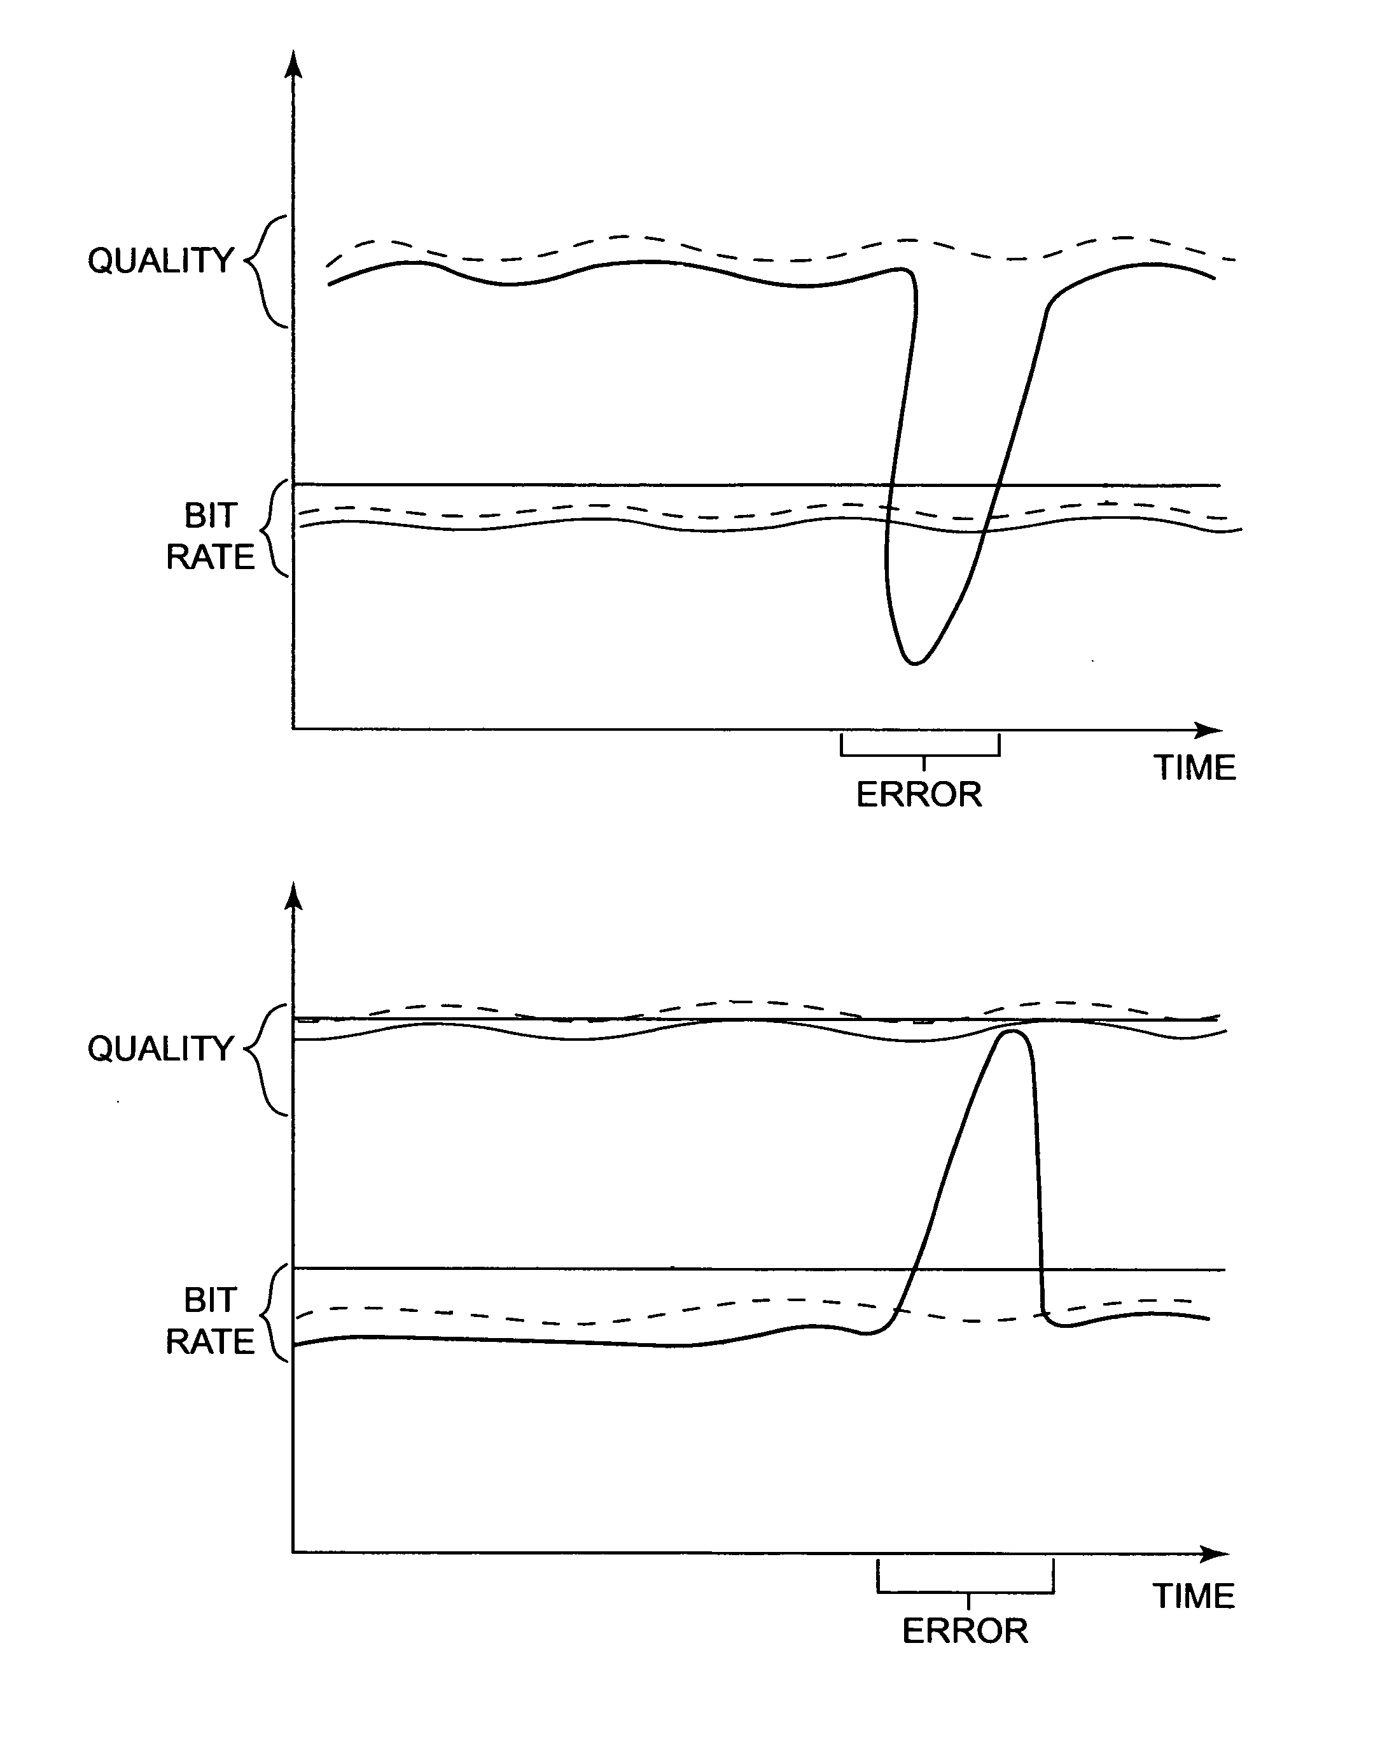
Errors cause a loss of video quality or a fluctuation in bit rate.

Slide 13
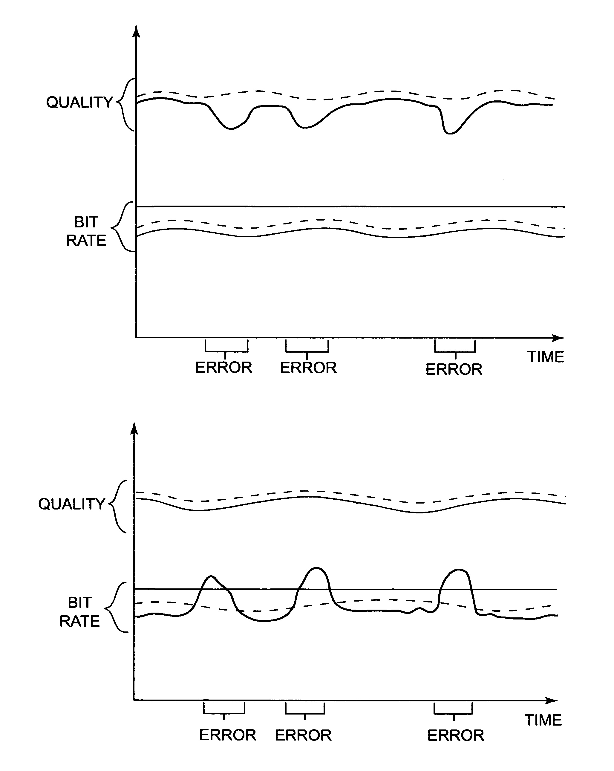
Slice Processing lowers the fluctuations

Slide 14
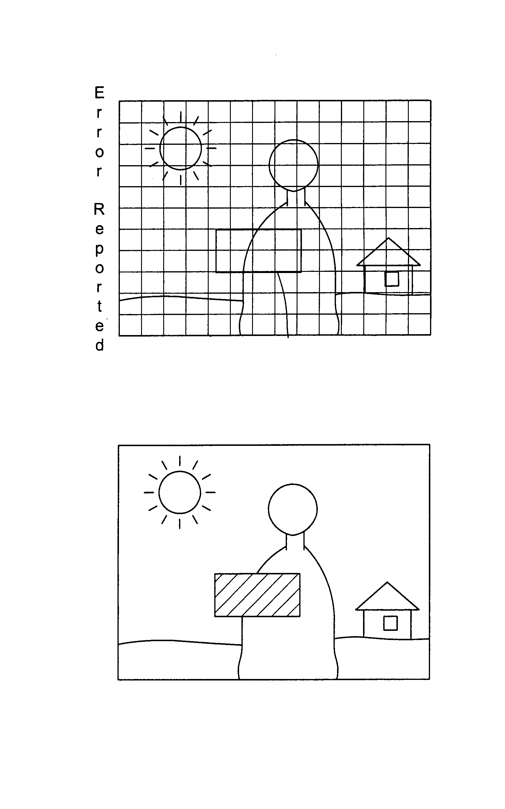
On demand Intra refresh only refreshes the areas that have errors reported

Slide 15
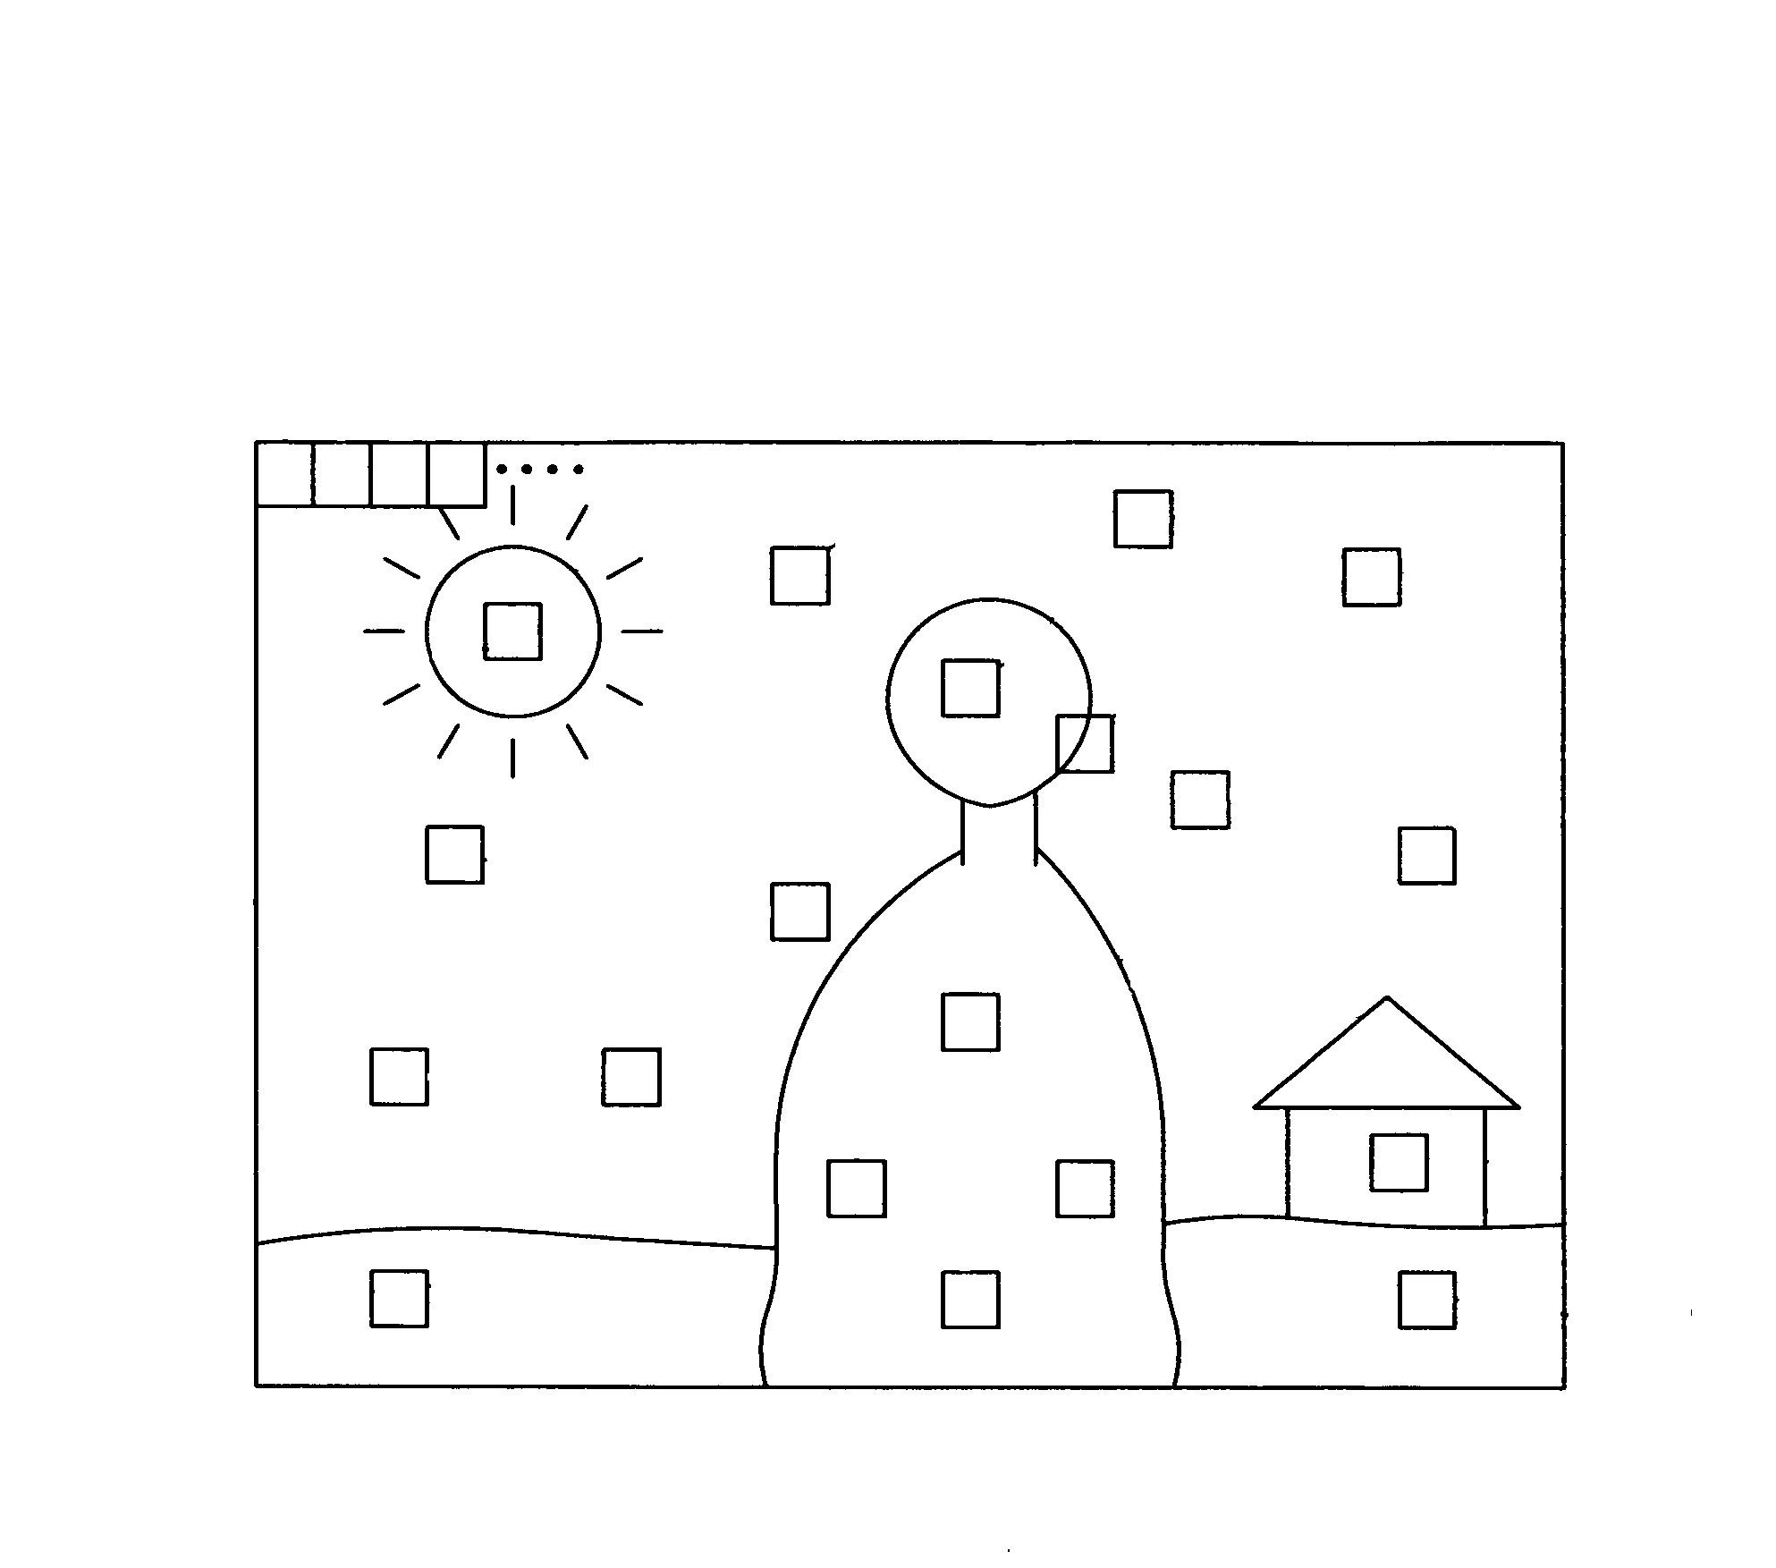
Random Intra-fresh when error rate high

Slide 16
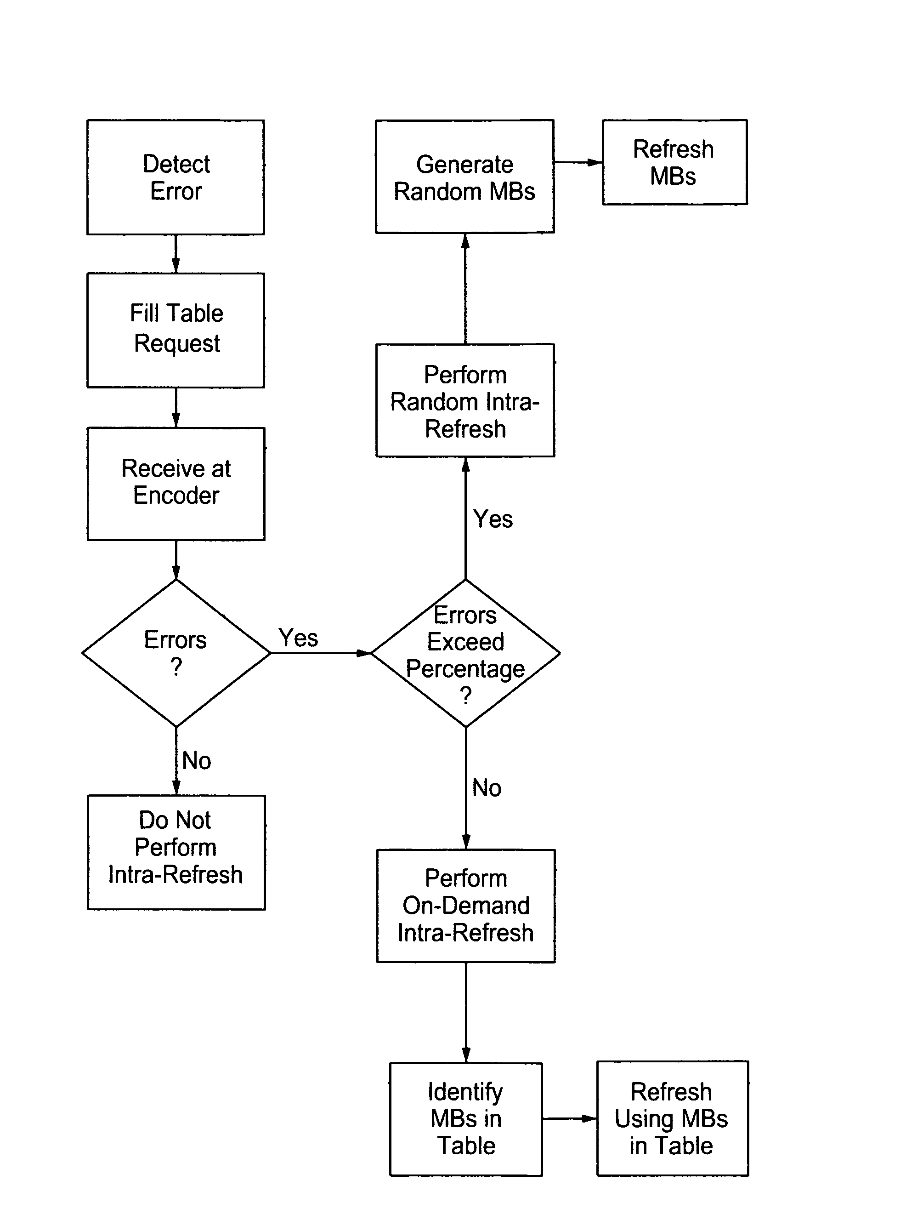

Slide 18
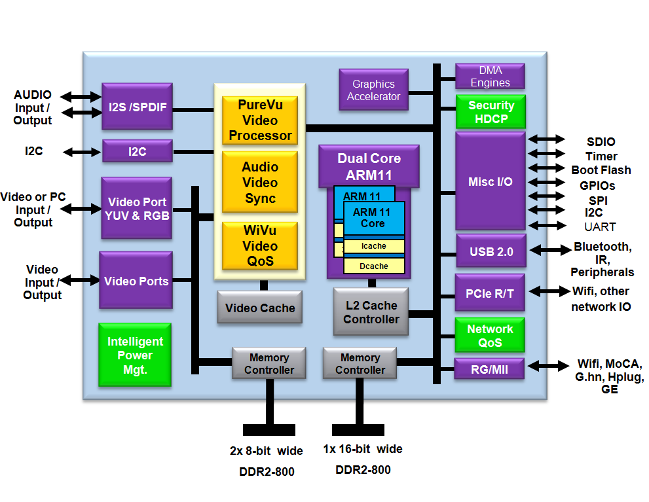

Slide 20
Experimental Design
Source will be Playstation 3
Output will be Sharp Aquos 60 inch TV
Players will be sitting 12 feet away from TV
Playing Call of Duty Zombies FPS game for 10 minutes at 4 different settings
Get 1-5 sliding scale metrics for Video Quality and Lag and user comments for each

Slide 21
Experimental Design cont..
Actiontech box has 2 modes video mode and game mode. Video mode has better quality with more latency.
Source transmitter 5 feet from receiver in game mode
Source transmitter 5 feet from receiver in video mode
Source transmitter 30 feet away in same room game mode
Source transmitter 15 feet away in different room with one wall in between game mode

Slide 22
Results
Yet to be determined but some preliminary…
Just got the device 2 days ago
Source transmitter 5 feet from receiver in video mode no latency issues, video quality good, but every 20 minutes on average loses data signal reset needed
Source transmitter 30 feet away in same room game mode no latency issues when working see adjustment of video quality every so often. but losses signal every 5 minutes on average.

Slide 23
Future Work
Test with computer RTS game {Starcraft, LOL}
Test other wireless networking boxes
Nyrius ARIES NAVS500 5.8 GHZ Wireless
IOGEAR GW3DHDKIT 5.8 GHZ Unliscened
Test with software version on Wireless Display Adapters Deliver Enhanced and Optimized Functionality for the Latest Android 4.2 Release
Samsung AllShare Cast Wireless Hub

