Slide 1
Evaluating Performance of a Video Streaming Application using vlcj CS529 Project 3 April 18th, 2013
Mark Hawthorne
mhawthorne@wpi.edu

Slide 2
Agenda
Project Problem & Goals
Motivation & Importance
Solution
Background & Definitions
Implementation
Experimental Design
Results
Conclusions & Future Work

Slide 3
Project Problem & Goals
Develop a Video Streaming Application
Goals
Allow for broadcasting multiple streams
Allow for multiple clients to view the same broadcast
Allow for clients to view multiple broadcasts simultaneously
Explore multicast streaming
Leverage existing libraries

Slide 4
Motivation & Importance
Video streaming is become more and more ubiquitous
Desktop Applications - Skype
Webpages - YouTube, Netflix
Devices - Smartphones, Game Consoles
Developers need to be able to leverage existing libraries for video streaming
Ex - HTML5 supports video playback

Slide 5
Solution
Choose a video streaming library
Develop server and client applications
Written in Java using Swing for GUIs
Provide user controls and video playback
Provide data recording of test metrics
Evaluate performance of streaming
Vary network protocols and video quality
Focus on metrics provided by the library
Minimal user feedback

Slide 6
Background & Definitions
VideoLAN Client (VLC) Media Player
Open source, light-weight, minimalist
Supports most audio and video codecs
vlcj
Library of VLC Java bindings
Caprica Software Limited
Java Native Access (JNA)
Simplified version of JNI
Java Native Interface (JNI)
Allows Java programs to call methods written in other languages (C/C++, Assembly)

Slide 7
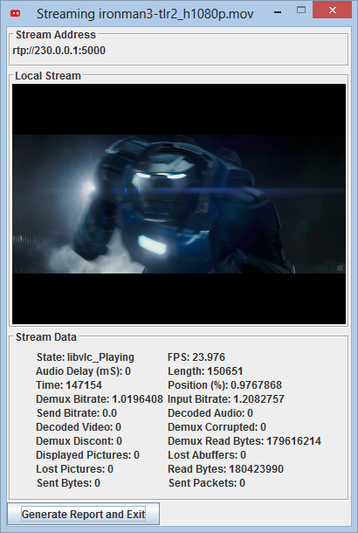
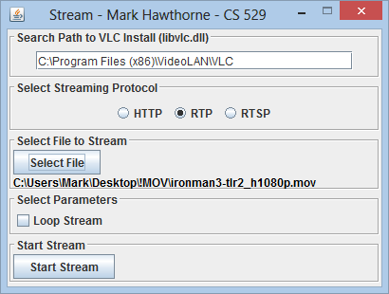
Implementation - Server

Slide 8
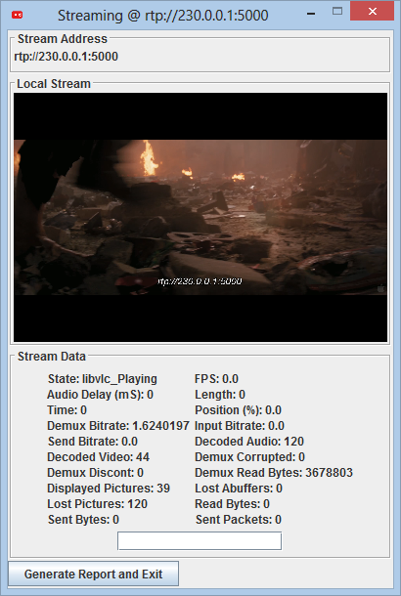
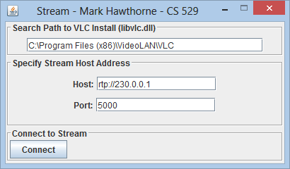
Implementation - Client

Slide 9
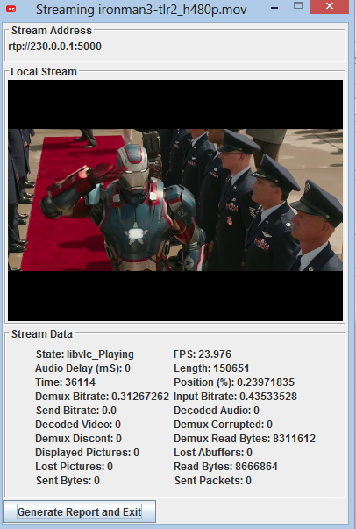
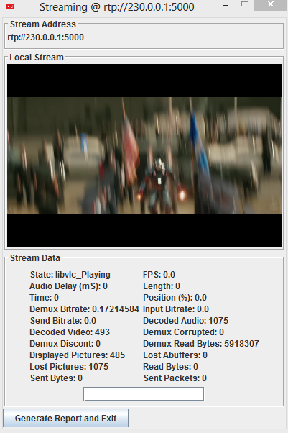
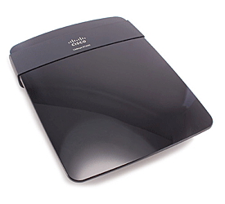
Experimental Design
HTTP, RTP, RTSP
1
2
(Ethernet LAN)

Slide 10
Results – Quality Measures
Frame rate consistent
Audio stayed synchronized
No delay jitter
Some cases of graphical artifacts
Typically at beginning of stream
Likely before the buffer is maintained
RTSP had noticeable struggles here
Noticeable 2-3 second delay between server and client
Not ideal for interactive streaming use

Slide 11
Results – Hypothesis A
A: If the protocol is changed, performance will be maintained.
1080p
720p
480p
320p

Slide 12
Results – Hypothesis B
B: If higher resolution video is used, there will be a decrease in performance

Slide 13
Conclusions & Future Work
VLC is a robust media player
vlcj is an easy to use library to leverage the capabilities of VLC
Documentation could use some work
Updates to VLC may break functionality
Future Work
Impact of delay for interactive use
Portability to devices other than PC
Manipulation of network conditions via netbox

Slide 14
Questions?

