Slide 1
Streaming Music with Media Specific FEC
Frank Carnevale

Slide 2
Outline
Outline
Introduction
Background
Implementation
Experiments
Results
Conclusions
Future Work

Slide 3
Introduction
Online radio station
  Stream to client at regular rate
Experiments
  Subjective ratings
  Vary loss
  Vary frame size
Why not TCP retransmissions?

Slide 4
Background
Silence
Repetition
Forward Error Correction
  Media Independent
    Check packets
  Media Specific
    Piggyback extra data
    Might use copy, energy, etc...

Slide 5
Media-Specific FEC
Stream
1
2
3
FEC
1
1
2
2
3

Slide 6
FEC Recovery
FEC Stream
1
2
3
Loss Recovery
1
2
3

Slide 7
Implementation
Streaming
  8000 sample/sec
  1 byte per sample
Buffering
  Small playout buffer
  Only as fast as needed
Adjustable frame size / loss rate
  40ms, 160ms, 240ms frames
  10%, 20%, 30% loss

Slide 8
FEC
Piggybacked Frame Quality
  Originally identical
  Compressed to 1/4 size
Recovery
  Rebuild full frame
  Can only recover last frame lost

Slide 9
Experiments
Users
  Me and a friend
  1 to 10 scale
Music
  Use project 1
  Re-recording of Led Zeppelin's 'The Ocean'
Baseline
Silence / Repetition
FEC

Slide 10
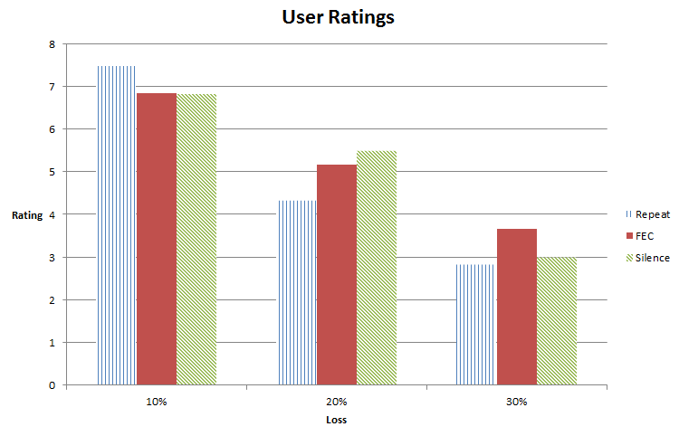
Results

Slide 11
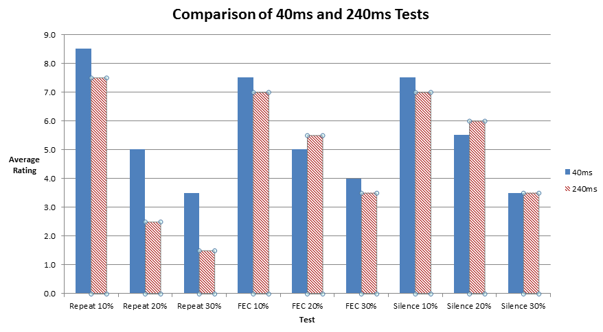
Results

Slide 12
Conclusions
Nothing significant
  FEC seemed to perform best at 30% loss
  Silence worked surprisingly well
Confounding Variables
  Re-recorded music
  Chance of consecutive loss
Future Work
  Dig deeper into the effect of frame size
  More users

