Slide 1
Project 1 Speech Detection
Due: Friday, February 1st, 11:59pm

Slide 2
Outline
Motivation
Problem Statement
Details
Hints
Grading
Turn in

Slide 3
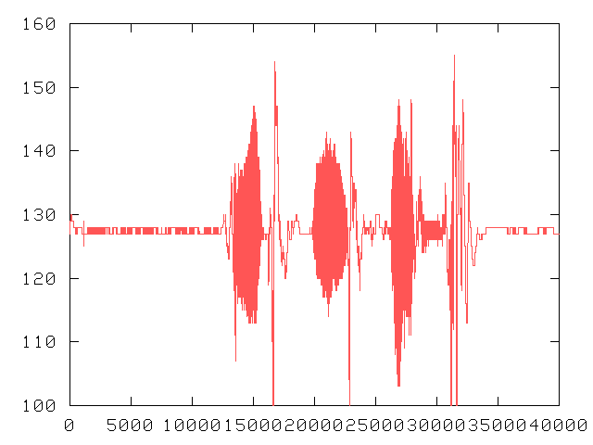
Motivation
Speech recognition needs to detect word boundaries in raw audio data
“Silence
Is
Golden”

Slide 4
Motivation
Recognizing silence can reduce:
Network bandwidth
Processing load
Easy in sound proof room, with digitized tape
Measure energy level in digitized voice
What about elsewhere?

Slide 5
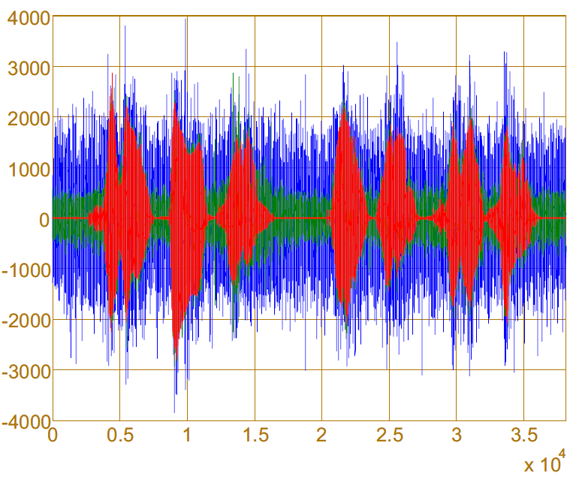
Speech in the Presence of Noise
Clean SNR = 5 dB SNR = -5 dB
Speech corrupted by additive background noise at decreasing SNRs.
Notes:
J. Ramírez, J. M. Górriz, J. C. Segura, “Voice Activity Detection. Fundamentals and Speech Recognition System Robustness”. Robust Speech Recognition and Understanding. pp. 1-22, Ed.: M. Grimm and K. Kroschel, I-TECH Education and Publishing, 2007. ISBN: 978-3-902613-08-0

Slide 6
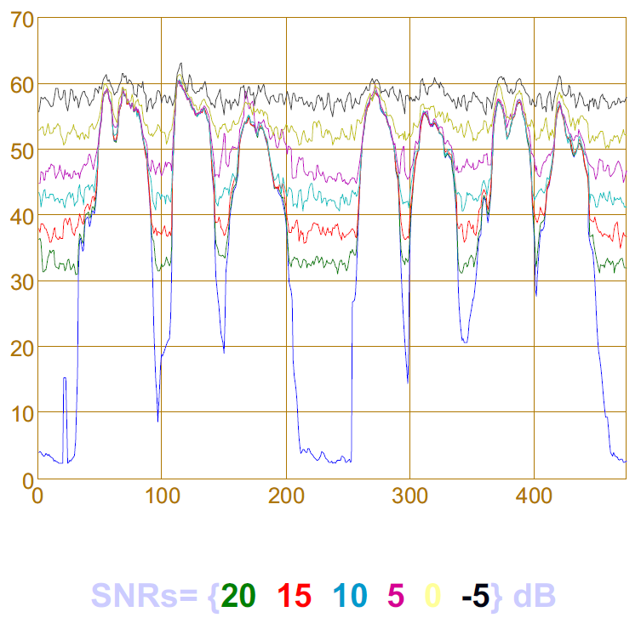
Speech in the Presence of Noise
Energy (dB)
Notes:
J. Ramírez, J. M. Górriz, J. C. Segura, “Voice Activity Detection. Fundamentals and Speech Recognition System Robustness”. Robust Speech Recognition and Understanding. pp. 1-22, Ed.: M. Grimm and K. Kroschel, I-TECH Education and Publishing, 2007. ISBN: 978-3-902613-08-0

Slide 7
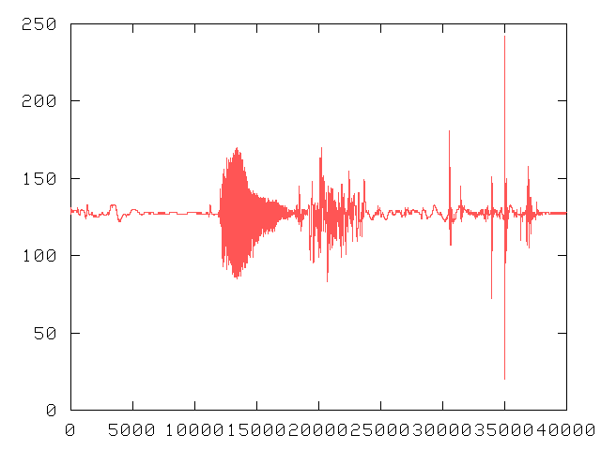
Research Problem
Noisy computer room has loud background noise, making some edges difficult
“Five”

Slide 8
Research Problem
Computer audio often for interactive applications
Voice commands
Teleconferencing (Voice over IP or VoIP)
→Needs to be done in ‘real-time’

Slide 9
Project
Implementation in Linux or Windows (or Cygwin)
Implement end-point algorithm by Rabiner and Sambur [RS75]
(Paper for class, next)
Embed in “record” utility – data from microphone
Build “play” utility for testing – data to speakers
Basis for VoIP
(Project 2)

Slide 10
Details - Record
Voice-quality:
8000 samples/second
8 bits per sample
One channel
Record sound, write files:
sound.data: audio data (between 0 and 255) → can graph
sound.raw: raw audio data with all sound → can play
speech.raw: raw audio data without silence → can play
energy.data: energy, one row per frame → can graph
zero.data: zero crossings, one row per frame → can graph
Other features allowed

Slide 11
Details - Play
Plays sound file
Repeat until file empty
E.g.
play sound.raw
play speech.raw
Other features allowed

Slide 12
Sound in Windows
Microsoft Visual C++
See Web page for hints
Use sound device → WAVEFORMATEX struct:
wFormatTag: set to WAVE_FORMAT_PCM
nChannels, nSamplesPerSec, wBitsPerSample: set to voice quality audio settings
nBlockAlign: set to number of channels times number of bytes per sample
nAvgBytesPerSec: set to number of samples per second times the nBlockAlign value
cbSize: set this to zero

Slide 13
Sound in Windows
waveInOpen()
a device handle (HWAVEIN)
device number (may be 1, depends upon PC)
WAVEFORMATEX variable
a callback function
→gets invoked when sound device has a sample of audio

Slide 14
Sound in Windows
Sound device needs buffers to fill
Type LPWAVEHDR
lpData: for raw data samples
dwBufferLength: set to nBlockAlign times length (in bytes) of sound chunk you want
waveInAddBuffer() to give buffer to sound device
Give it device
Buffer (LPWAVEHDR)
Size of variable
When callback invoked, buffer (lpData) has raw data to analyze
Must give it another via waveInAddBuffer() again

Slide 15
Sound in Windows
Useful header files:
#include <windows.h>
#include <stdio.h>
#include <stdlib.h>
#include <mmsystem.h>
#include <winbase.h>
#include <memory.h>
#include <string.h>
#include <signal.h>
extern "C"
Useful data types:
HWAVEOUT
writing audio device
HWAVEIN
reading audio device
WAVEFORMATEX
sound format structure
LPWAVEHDR
buffer
MMRESULT
Return type from wave system calls
Online documentation from Visual C++ for more information (Visual Studio → Help →Samples)

Slide 16
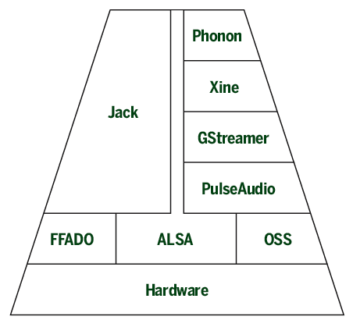
Sound in Linux
Two primary methods: Open Sound System (OSS) or Advanced Linux Sound Architecture (ALSA)
ALSA part of kernel, v2.4+
Phonon, Xine, Gstreamer, PulseAudio, Jack, even OSS all interface with it
OSS “legacy” but broader than Linux
How it works: Linux audio explained

Slide 17
Linux – OSS
Can do in Windows! → Cygwin
Unix-like environment and command-line interface for Microsoft Windows (http://www.cygwin.com/)
Audio device just like file (POSIX):
/dev/dsp
open("/dev/dsp", O_RDWR)
Recording and Playing by:
read() to record
write() to play

Slide 18
OSS – Sound Parameters
Use ioctl() to change sound card parameters
To change sample size to 8 bits:
fd = open("/dev/dsp", O_RDWR);
arg = 8;
ioctl(fd, SOUND_PCM_WRITE_BITS, &arg);
Remember to error check all system calls!

Slide 19
OSS – Sound Parameters
The parameters you will be interested in are:
SOUND_PCM_WRITE_BITS
number of bits per sample
SOUND_PCM_WRITE_CHANNELS
mono or stereo
SOUND_PCM_WRITE_RATE
sample/playback rate

Slide 20
OSS Compatibility Mode
Has not been in the Linux kernel since v2.4
But there is OSS compatibility mode
Try: aoss name_of_program_using_oss
E.g. aoss record
Or have snd_pcm_oss kernel module loaded

Slide 21
Linux – ALSA
Samples at given time for all channels is called a frame.
If stream is non-interleaved, each channel is stored in separate buffer.
If stream is interleaved, the samples are mixed together in single buffer.
A period contains multiple samples (frames).
Only needed audio include is:
#include <alsa/asoundlib.h>
When compiling, -lasound needed to link in libasound library.

Slide 22
ALSA – Open Device
Open with snd_pcm_open()
snd_pcm_t *handle;
/* open playback device (e.g. speakers default) */
snd_pcm_open(&handle, "default", SND_PCM_STREAM_PLAYBACK, 0);
/* open record device (e.g. microphone default) */
snd_pcm_open(&handle, "default", SND_PCM_STREAM_CAPTURE, 0);
When done, close with snd_pcm_close()

Slide 23
ALSA – Write/Read
Done by snd_pcm_writei() and snd_pcm_read(), respectively:
/* write to audio device */
snd_pcm_writei(handle, buffer, frames);
/* read from audio device */
snd_pcm_readi(handle, buffer, frames);
[Tra04] J. Tranter. Introduction to Sound Programming with ALSA, Linux Journal, Issue #126, October, 2004.

Slide 24
Program Template (Linux)
open sound device
set sound device parameters
record silence
set algorithm parameters
while(1)
record sound
compute algorithm stuff
detect speech
write data to file
write sound to file
if speech, write speech to file

Slide 25
Questions
When done, brief answers (in answers.txt)
What might happen to the speech detection algorithm in a situation where the background noise changes a lot over the audio session?
What are some cases where you might want the silence to remain in a recorded audio stream?
Accurate detecting the beginning of speech might be easier with a large sample size (i.e. capturing more of the audio before computing energy and zero crossings). Why might this be a bad idea for some audio applications?
Do you think the algorithm is language (e.g. English versus Spanish) specific? Why or why not?

Slide 26
Hand In
Online turnin (see Web page)
Turn in:
Code
Makefile/Project file
Answers
Via email

Slide 27
Grading
25% basic recording of sound
25% basic playback of sound
20% speech detection
10% adjustment of thresholds
10% proper file output (sound, speech, data)
10% answers to questions
Rubric on Webpage

