Slide 1
Large-Scale Machine Learning at Twitter
Jimmy Lin and Alek Kolcz
Twitter, Inc.
Presented by: Yishuang Geng and Kexin Liu

Slide 2
Outline
•Is twitter big data?
•How can machine learning help twitter?
•Existing challenges?
•Existing literature of large-scale learning
•Overview of machine learning
•Twitter analytic stack
•Extending pig
•Scalable machine learning
•Sentiment analysis application

Slide 3
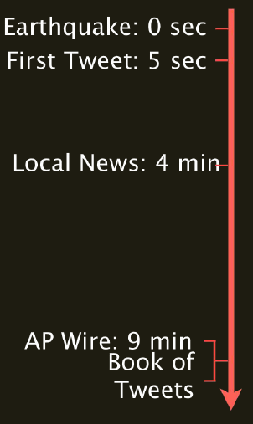

Slide 4
The Scale of Twitter
•Twitter has more than 140 million active users
•340 million Tweets are sent per day
•50 million people log into Twitter every day
•Over 400 million monthly unique visitors to twitter.com
Large scale infrastructure of information delivery
•Users interact via web-ui, sms, and various apps
•Over 55% of our active users are mobile users
•Real-time redistribution of content
•Plus search and other services living on top of it
–E.g., 2.3B search queries/day (26K/sec)

Slide 5
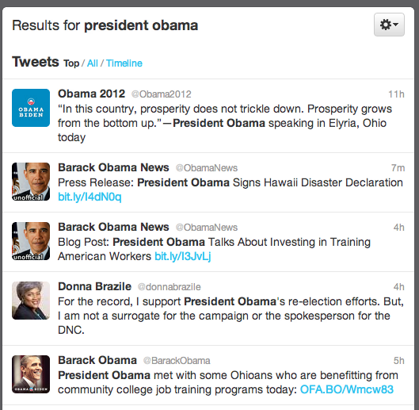
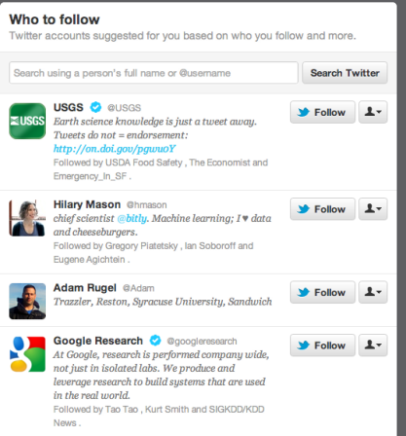
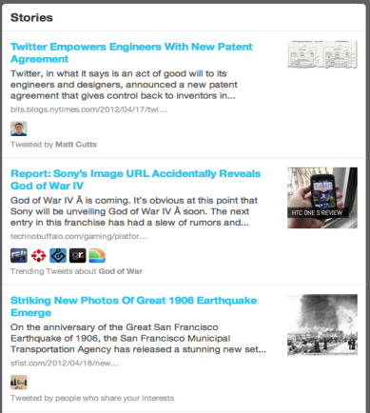
Support for user interaction
•Search
–Relevance ranking
•User recommendation
– WTF or Who To Follow
•Content recommendation
–Relevant news, media, trends
(other) problems we are trying to solve
•Trending topics
•Language detection
•Anti-spam
•Revenue optimization
•User interest modeling
•Growth optimization

Slide 7
Literature
•Traditionally, the machine learning community has assumed sequential algorithms on data fit in memory (which is no longer realistic)
•Few publication on machine learning work-flow and tool integration with data management platform
Google – adversarial advertisement detection
Predictive analytic into traditional RDBMSes
Facebook – business intelligence tasks
LinkedIn – Hadoop based offline data processing
But they are not for machine learning specificly.
Spark
ScalOps
But they result in end-to-end pipeline.

Slide 8
Contribution
•Provided an overview of Twitter’s analytic stack
•Describe pig extension that allow seamless integration of machine learning capability into production platform
•Identify stochastic gradient descent and ensemble methods as being particularly amenable to large-scale machine learning
Note that,
No fundamental contributions to machine learning

Slide 10
Database
Application
log
Other
sources
Oink:
Aggregation query
Standard business intelligence tasks
Ad hoc query
One-off business request
Prototypes of new function
Experiment by analytic group
Real-time
processes
Batch
processes
Hadoop
cluster
Serialization
Protocol buffer
/Thrift
HDFS

Slide 11
Maximizing the use of Hadoop
•We cannot afford too many diverse computing environments
•Most of analytics job are run using Hadoop cluster
–Hence, that’s where the data live
–It is natural to structure ML computation so that it takes advantage of the cluster and is performed close to the data
Seamless scaling to large datasets
Integration into production workflows

Slide 12
Core libraries:
Core Java library
Basic abstractions similar to existing packages (weka, mallet, mahout)
Lightweight wrapper
Expose functionalities in Pig

Slide 13
Training models:
Storage function

Slide 14
Shuffling data:

Slide 15
Using models:

Slide 16
Scalable Machine learning
Techniques for large-scale machine learning
Stochastic gradient descent
Ensemble method

Slide 17
Stochastic gradient descent
Gradient Descent
Compute the gradient in the loss function by optimizing value in dataset. This method will do the iteration for all the data in order to one a gradient value.
Inefficient and everything in the dataset must be considered.

Slide 18
Stochastic gradient descent
Approximating gradient depends on the value of gradient for one instance.
Solve the iteration problem and it does not need to go over the whole dataset again and again.
Stream the dataset through a single reduce even with limited memory resource.
But when a huge dataset stream goes through a single node in cluster, it will cause network congestion problem.
Solution ?

Slide 19
Ensemble Methods
Classifier ensembles: high performance learner
Performance: very well
Some rely mostly on randomization
-Each learner is trained over a subset of features and/or instances of the data
Ensembles of linear classifiers
Ensembles of decision trees (random forest)

Slide 20
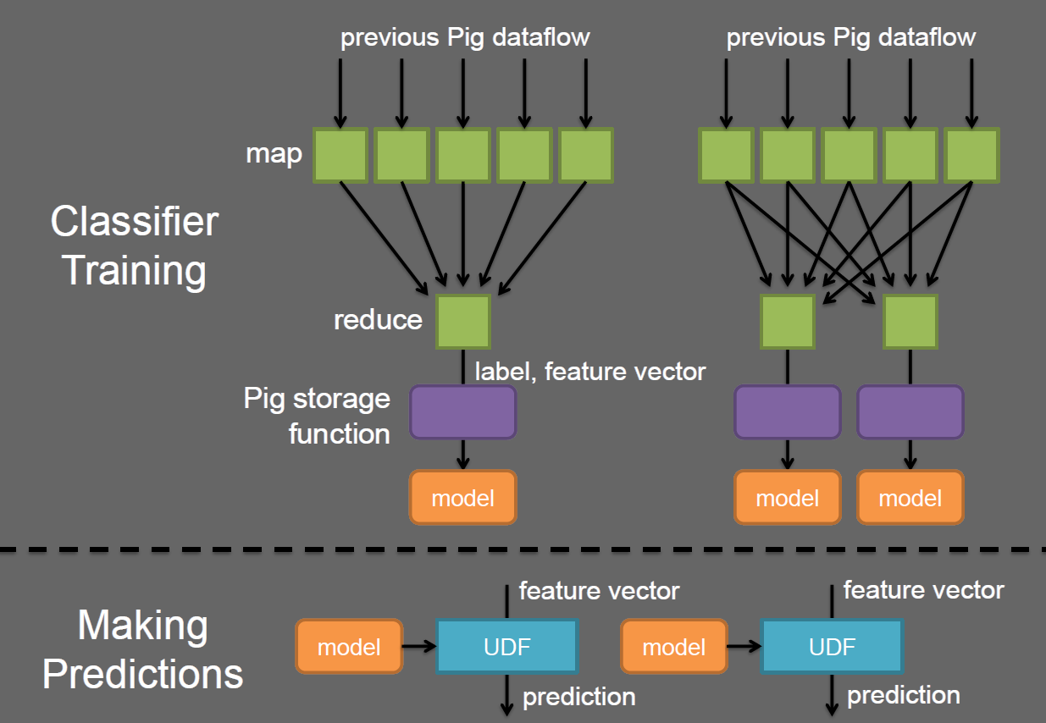
Ensemble Methods

Slide 21
Example: Sentiment Analysis
Emotion Trick ☺ ☹
Test dataset: 1 million English tweets, minimum 20 letters-long
Training data: 1 million, 10 million and 100 million English training examples
Preparation: training and test sets contains equal number of positive and negative examples, removed all emoticons.

Slide 22
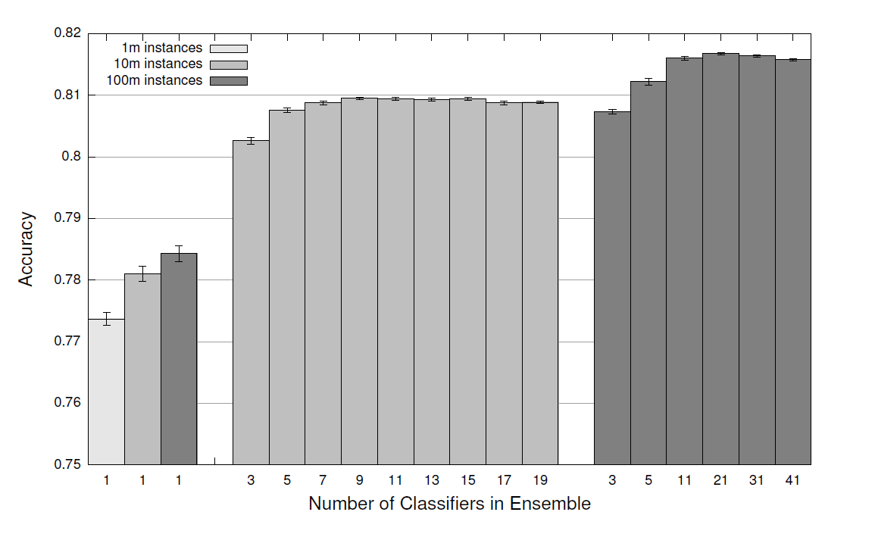

Slide 23
Twitter: STORM
Distributed and Fault-Tolerant Real-Time Computation
Nathan Marz
Twitter, Inc.
Presented by: James Forkey

Slide 24
Key Concepts of Storm: Tuples
•Ordered list of elements

Slide 25
Key Concepts of Storm: Streams
•Unbound sequence of tuples

Slide 26
Key Concepts of Storm: Spouts
•Source of streams

Slide 27
Key Concepts of Storm: Spouts
•Source of streams

Slide 28
Key Concepts of Storm: Spouts
•Source of streams
Spouts can talk with:
•Queues
•Web logs
•API calls
•Event data

Slide 29
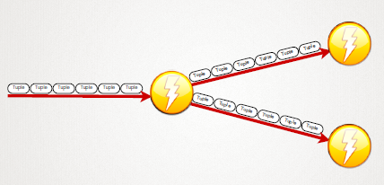
Key Concepts of Storm: Bolts
•Process tuples and create new streams
Bolts can:
•Apply functions / transforms
•Filter
•Aggregation
•Stream joining or splitting
•Access DBs, APIs, etc

Slide 30
Key Concepts of Storm: Topologies
•A directed graph of spouts and bolts

Slide 31
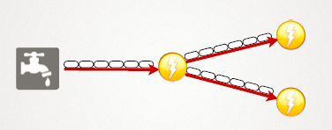
Key Concepts of Storm: Topologies
•A directed graph of spouts and bolts

Slide 32
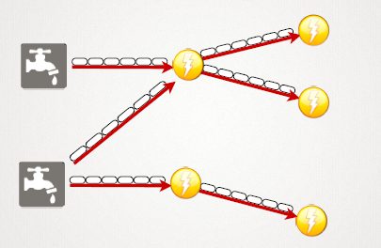
Key Concepts of Storm: Topologies
•A directed graph of spouts and bolts

Slide 33
Key Concepts of Storm: Tasks
•Processes which execute streams or bolts
Spout
[“sentence”]
SplitSentence Bolt
[“word”]
WordCount Bolt
[“word”, “count”]

Slide 34
Grouping
•Fields Grouping
•Groups tuples by specific named fields and routes
• (Very similar to Hadoops partitioning behavior)
•Shuffle Grouping
•tuples are randomly distributed across all of the tasks running the bolt

Slide 35
Grouping
•Fields Grouping
•Groups tuples by specific named fields and routes
• (Very similar to Hadoops partitioning behavior)
•Shuffle Grouping
•tuples are randomly distributed across all of the tasks running the bolt

Slide 36
Key Concept of Storm: Distributed RPC for communication

Slide 37
Many thanks!
Questions?

