Slide 1
Asymptotic Growth of T(n)
Plots taken from Cormen, Leiserson, Rivest, & Stein’s Texbook
here f(n) = T(n)
asymptotic tight bound g(n) asymptotic upper bound g(n) asymptotic lower bound g(n)
(“Big-Theta”) (“Big-Oh”) (“Big-Omega”)

Slide 2
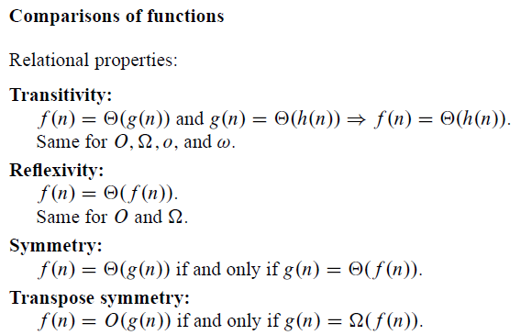
Big-Theta, Big-Oh and Big-Omega
Properties
Taken from Cormen, Leiserson, Rivest, & Stein’s Texbook

