Slide 1
Dynamic Programming
(Longest Common Subsequence)

Slide 2
Subsequence
String Z is a subsequence of string X if Z’s characters appear in X following the same left-to-right order
X = < A, B, C, T, D, G, N, A, B >
Z = < B, D, A >

Slide 3
Longest Common Subsequence (LCS)
String Z is a common subsequence of strings X and Y if Z’s characters appear in both X & Y following the same left-to-right order
X = < A, B, C, T, B, D, A, B >
Y = < B, D, C, A, B, A >
< B, C, A > is a common subsequence of both X and Y.
< B, C, B, A > or < B, C, A, B > is the Longest Common Subsequence (LCS) of X and Y.
LCS is used to measure the similarity between two strings X and Y. The longer the LCS , the more similar X and Y

Slide 4

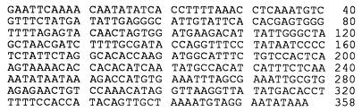
LCS Problem Definition
We are given two sequences
  X = <x₁,x₂,...,x_{m}>, and
  Y = <y₁,y₂,...,y_{n}>
We need to find the LCS between X and Y
Very common in DNA sequences

Slide 5
Characterization of LCS

Slide 6
Characterization of LCS (Cont’d)

Slide 7
Recursive Nature of LCS
Implications of Theorem 15.1

Slide 8
Recursive Equation
Input X = <x₁, x₂, …., x_{m}>
Y = <y₁, y₂, ………, y_{n}>
Assume C[i, j] is the LCS for the first i positions in X with the first j positions in Y
  C[i,j] = LCS(<x₁, x₂, …., x_{i}>, <y₁, y₂, ………, y_{j}>)
Our goal is to compute C[m,n]

Slide 9
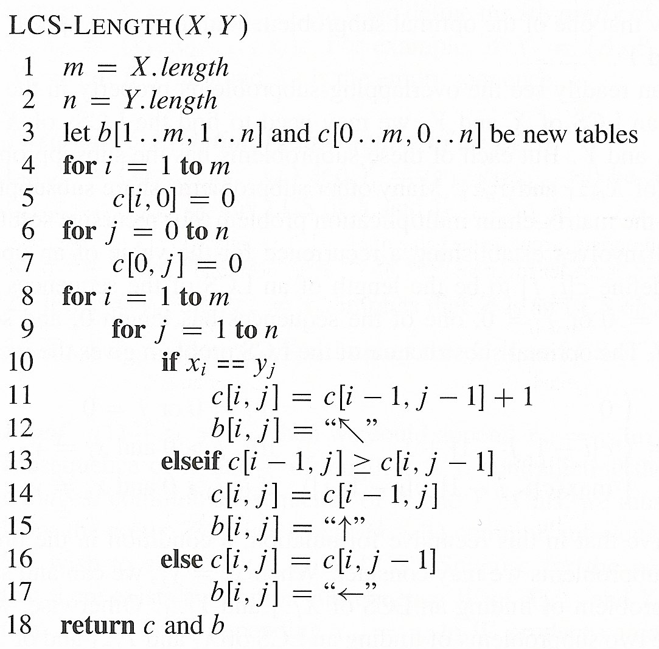
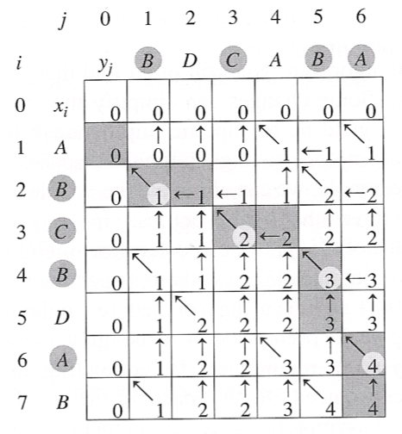
Dynamic Programming for LCS
Initialization step

Slide 10
Dynamic Programming for LCS
If matching, go diagonal

Slide 11
Dynamic Programming for LCS
Else select the larger of top or left

Slide 12
Dynamic Programming for LCS
Note that array c ➔ keeps track of the cost,
Array b ➔ keeps track of the parent (to backtrack)

Slide 13
Summary of the Main Strategies

