Slide 1
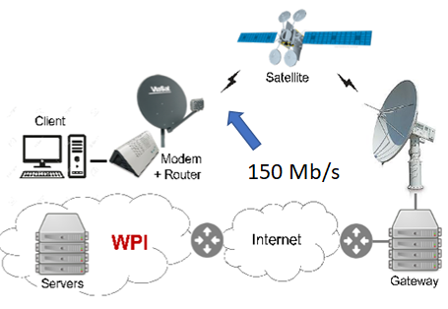
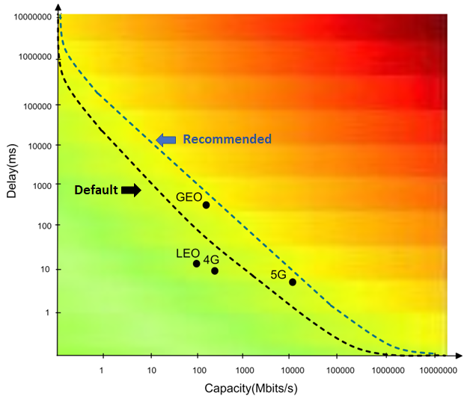
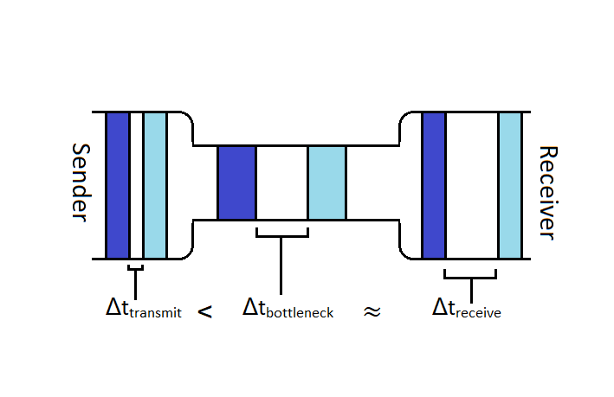
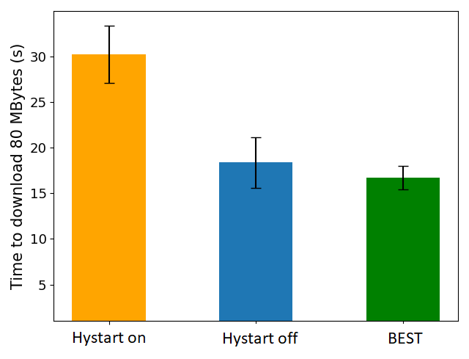
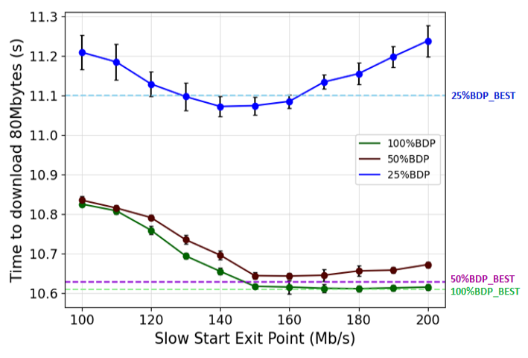
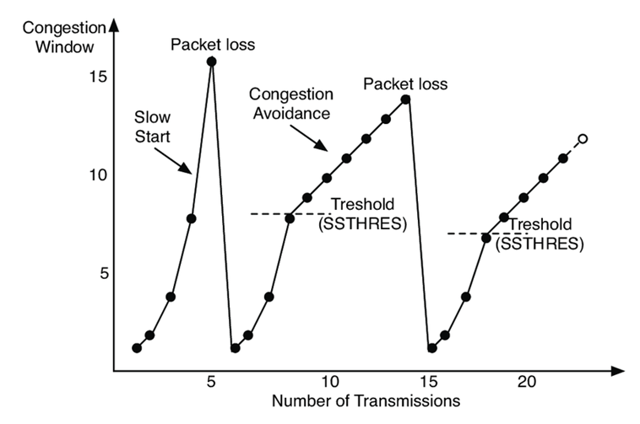
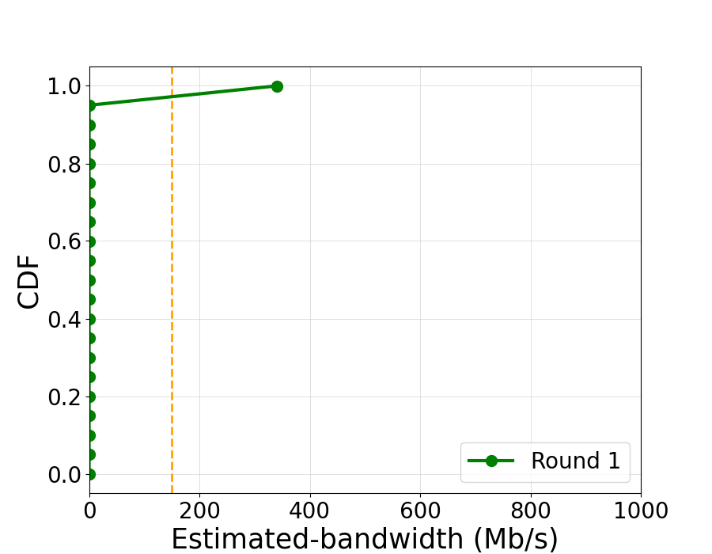
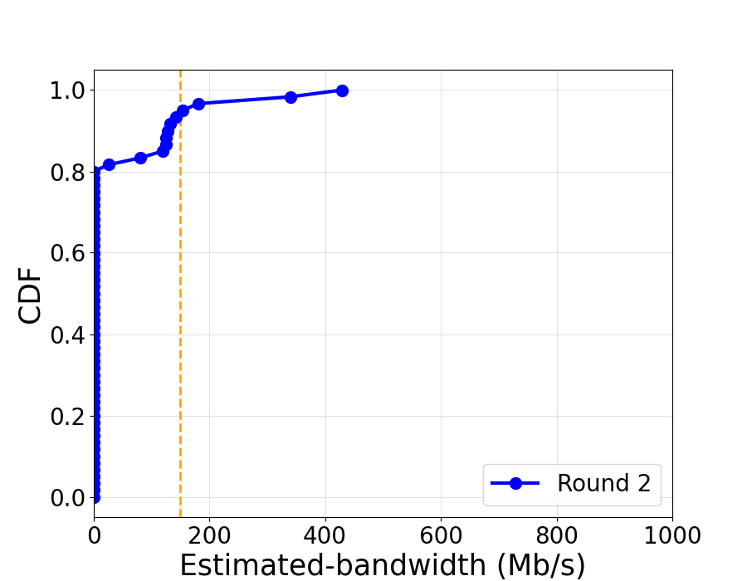
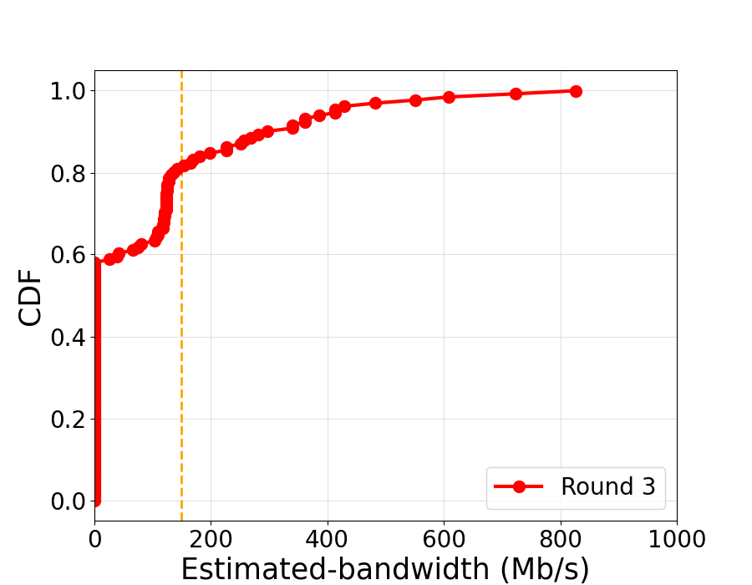
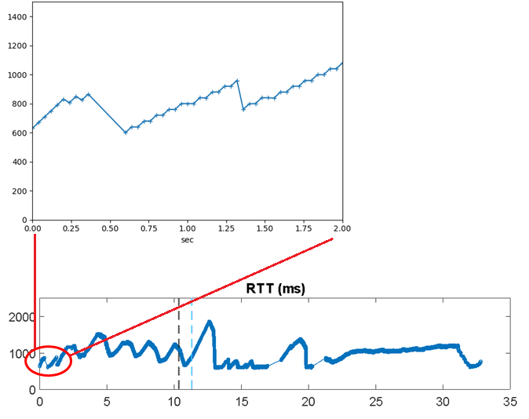
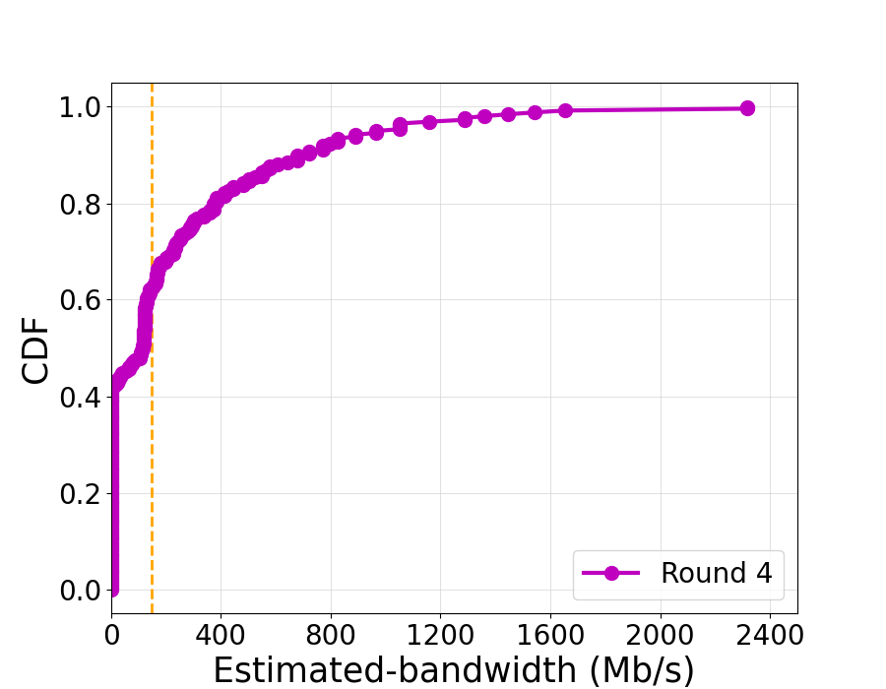
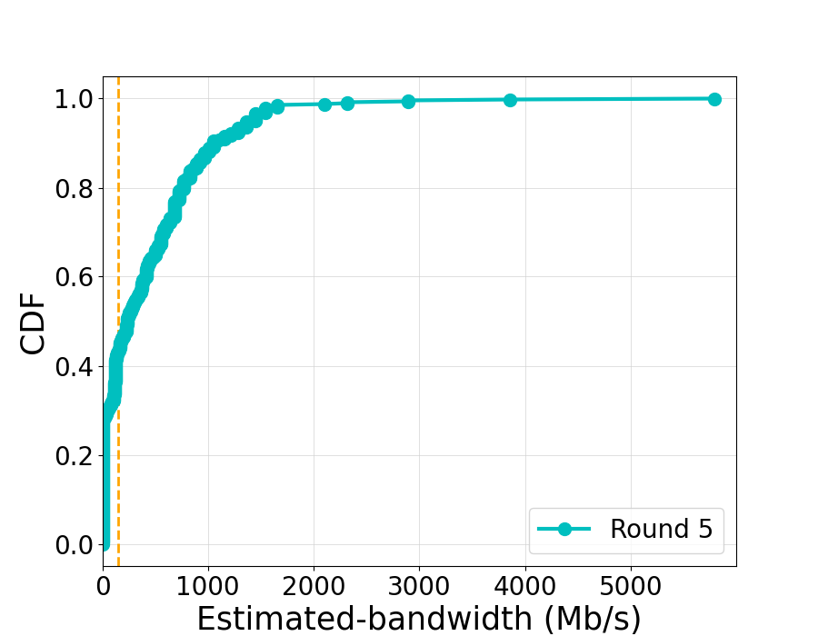
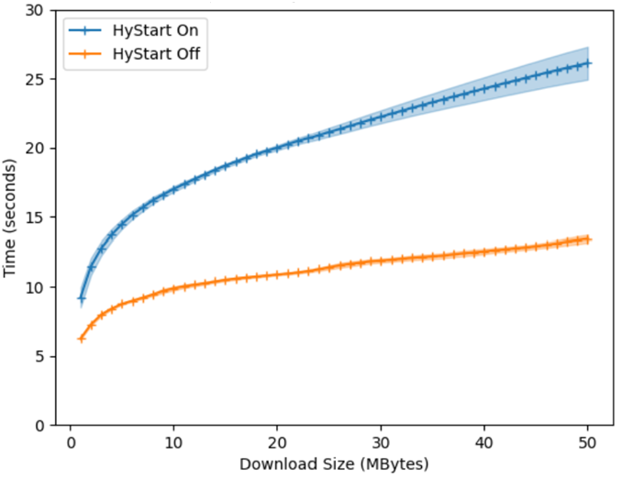
Fixing TCP Slow Start for Slow Fat Links
Maryam Ataei Kachooei
Advisor: Prof. Mark Claypool
Department of Computer Science
Abstract
Approach
Evaluate
Satellite networks are an essential part of modern network infrastructures. The critical challenge of these networks is to overcome the inherent high latencies that are detrimental to TCP throughputs. We improve TCP performance by using bandwidth estimation to more quickly increase throughput for links with high latency. We evaluate the proposed slow start algorithm over a commercial geostationary satellite link. Our preliminary results indicate that our proposed slow start adjustments improve start-up performance over satellite links, outperforming the measured alternatives.
Use Viasat testbed
Several bulk downloads using Iperf3
Compare BEST, HyStart on, and off
Client
Satellite
Modem
+ Router
WPI
Internet
Servers
Gateway
Geo Satellite Measurement Testbed
BDP limitations for the default(6291456) and
Recommended(26214400) maximum Linux buffer sizes
Illustration of packet temporal spacing through a bottleneck link
Result
The shortest download times and about half the packet losses of HyStart
Number of packet loss:
HyStart on = 88
HyStart off = 9111
BEST = 4328
Introduction
Making change on TCP in Linux kernel
Use information of log file
Packet pairs for each RTT
Estimate bandwidth
Find the median of estimated bandwidths for each RTT
Determine threshold to set BDP
Host A
Established
Host B
Slow
Fat
SEQ = n
Links
ACK = n+N
Time to download 80 MB
Data
High Delay
ack-pair Δt
SEQ=n+N
Data
Data
High Bandwidth
150 ms
SEQ=n+2N
bytes acked
Near the optimal exit points for different queue sizes
Data
ACK
150 ms
SEQ=n+3N
ACK
ACK
ACK=n+4N
Can we avoid this?
Disconnected
Performance of BEST for different queue sizes
bandwidth = bytes acked / ack-pair Δt
Conclusion
Sender window
Congestion window
Receiver window
HyStart on: Exit too early, underutilization
HyStart off: Exit too late, Overshooting, Packet loss
BEST: Shorter download times for 80 MByte objects than HyStart on or HyStart off with more substantial improvements for smaller bottleneck queue sizes
Exit closer to here?
Future Work
Accommodate LEO link characteristic
Evaluation in more networks and system configuration
Consider other approaches including sending-delivery rate method and Ack Space method
Time to download objects
of different sizes
RTT and throughput with HyStart on
Estimated bandwidth for each RTT (rounds 1 to 5)

