Slide 1

A First Look at the Network Turbulence for Google Stadia Cloud-based Game Streaming
An engineering school near Boston, Massachusetts
in the USA.
Xiaokun Xu
PhD student of Computer Science
Worcester Polytechnic Institute
xxu11@wpi.edu
Mark Claypool
Professor of Computer Science
Worcester Polytechnic Institute
claypool@wpi.edu

Slide 2

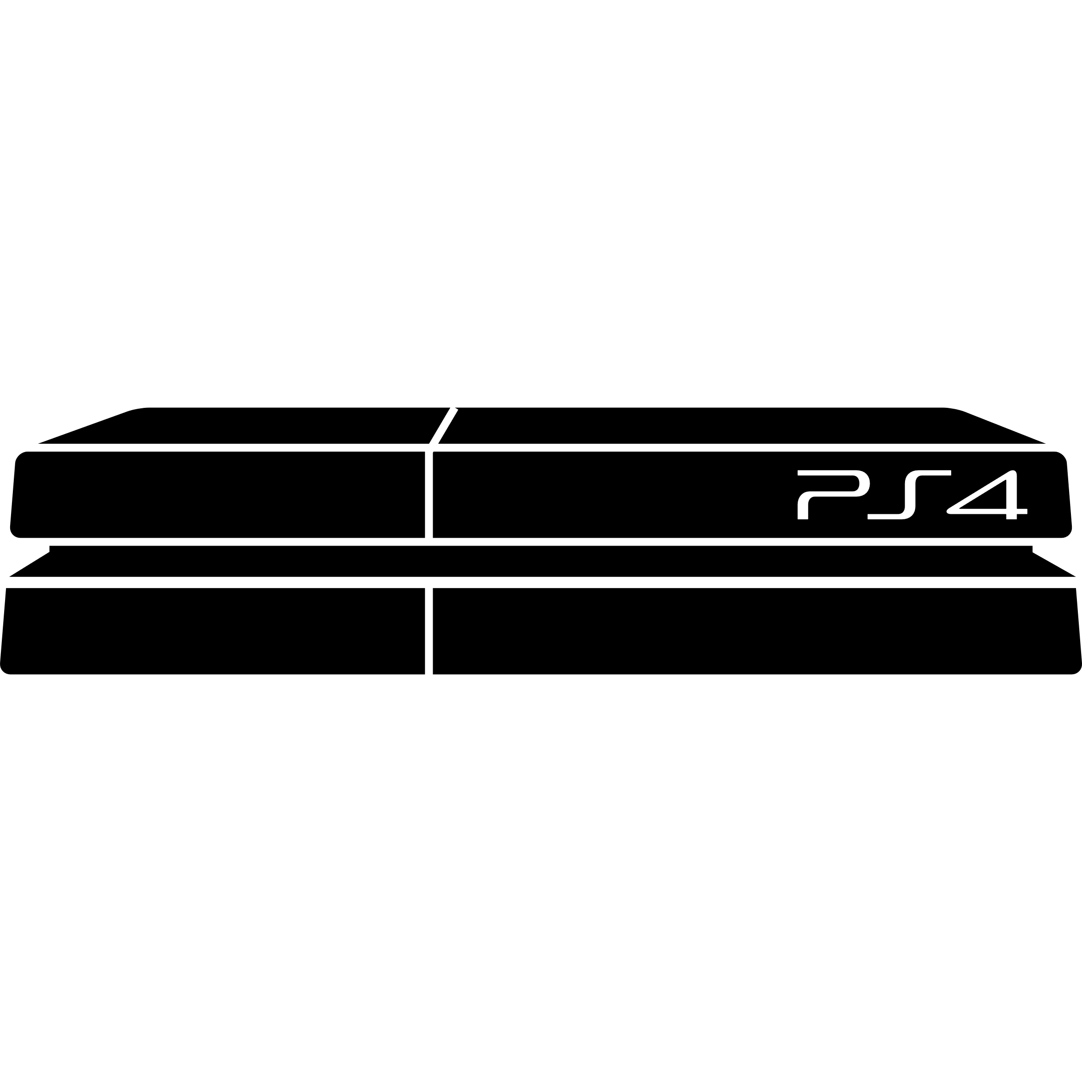


1. Introduction
Growth of cloud-based game market
Cloud-based game streaming vs traditional games
\
~==-
/
____
/___o\
Traditional
console
Client
Player input
Game frames
\
~==-
/
____
/___o\
\
~==-
/
____
/___o\
\
~==-
/
.**
**.**
*.*
server
\
~==-
/
____
/___o\
server
Cloud-based
Player input
server
Thin Client
Cloud Servers

Slide 3
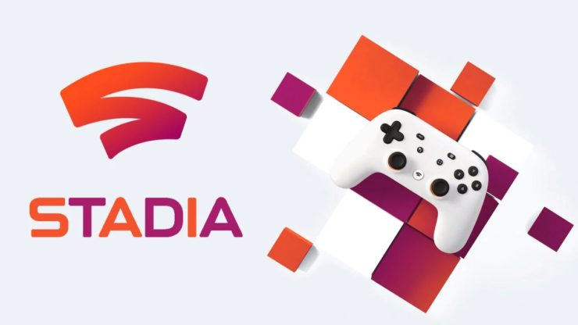
1. Introduction
Understanding network load for cloud-based game services is important
  Understanding load will help plan for network Quality of Service
  Many traditional network games have been characterized and modeled
  Studies of some early cloud-based game systems
Google Stadia was not measured yet.
The goals of this paper:
1. A first look at the network traffic for Google Stadia
2. comparisons to traditional games and video and earlier services.
3. analysis of the results.

Slide 4
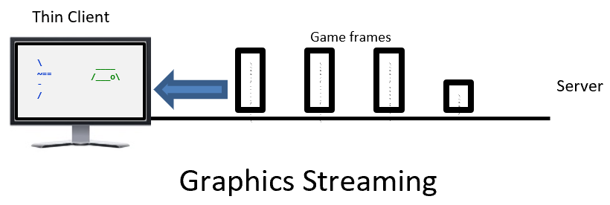
2. Methodology
To measure the network turbulence of Stadia, we:
Selected Stadia games
Setup measurement testbeds
Gathered network traces
Analyzed the data
Gather network traces via middleware
Selected games

Slide 5
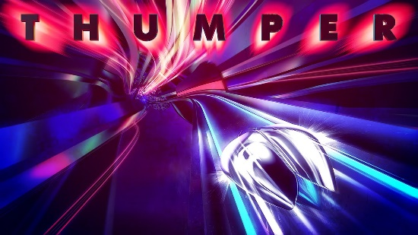





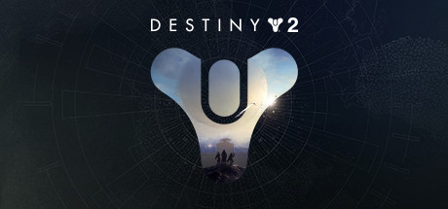



2. Methodology-Game selection

Slide 6
2. Methodology-Testbeds
Testbed 1 is located Sunnyvale, CA, USA
Testbed 2 is located Shrewsbury, MA, USA

Slide 7
2. Methodology-Experiments
The Wireshark traces are trimmed to 3 minutes of the core gameplay (i.e., loading, menus, etc. are not included – just gameplay).
Game | D2, DS, FS, HN, LC, OD, PR, SS, TH, or TR
Capacity | 10, 20, 30, Mb/s, or no restriction
Added Latency | 0, 10, 20, or 30 milliseconds
Induced Packet Loss | 0, 1, 2 or 20 percent
Iterations | 3 runs per game session, per condition
Table: Experiment parameters

Slide 8
3. Analysis
We analyze the data in three ways:
Bitrates, packet sizes and inter-packet times
The effects of capacity constraints, packet losses and added delays
Comparisons with other game and video systems

Slide 9
3. Analysis - Overview
Downstream game bitrates:
FS is highest for mean, 2x higher than the lowest mean of DS
The max bitrates are similar for most games

Slide 10
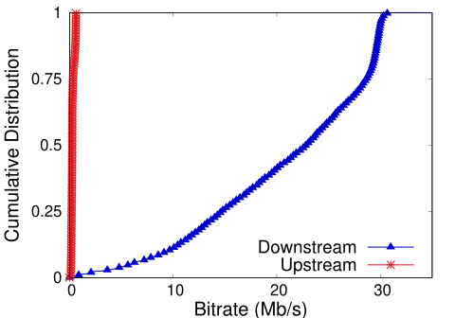
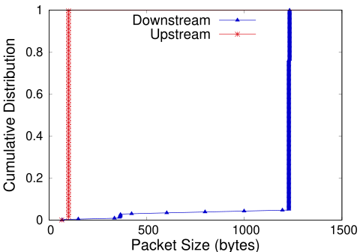
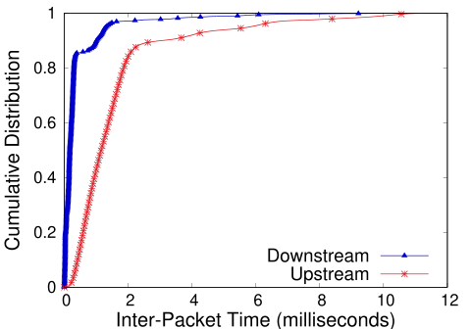
3. Analysis - Bitrate
3. Analysis – Packet Size
3. Analysis – Inter-packet Time
Bitrates: Downstream bitrates 50x higher than upstream
Packet Sizes: Downstream 1232 bytes or 1228 bytes, upstream 100 bytes
Inter-Packet Time: Downstream as small as 0.2ms, Up stream as high as 2ms

Slide 11
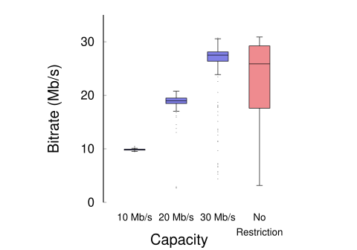
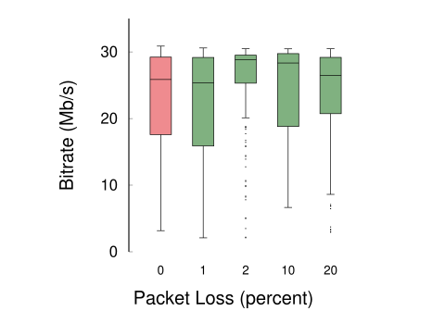
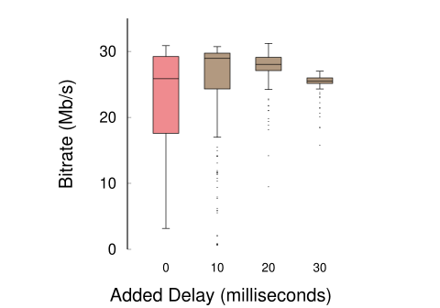
3. Analysis –Restricted Capacity
3. Analysis –Packet Loss
3. Analysis –Added Delay
Restricted Capacity: lowers the maximum bitrate, but smooths out
the bitrate variance
Packet Loss: bitrate mean and variance not visually correlating with loss.
Added Delay: delays above 30 milliseconds were noticeable

Slide 12
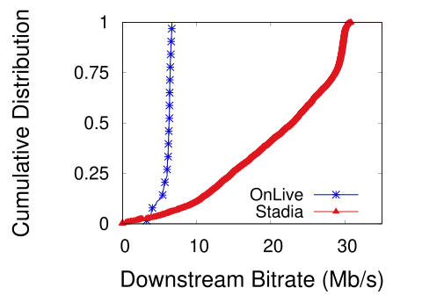
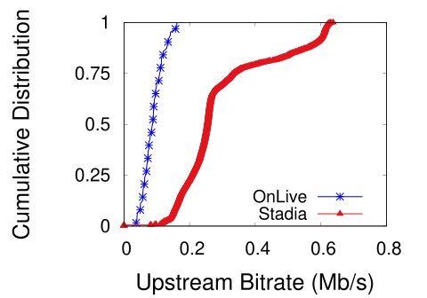
3. Analysis -Comparison
Stadia downstream 3.5x higher than Onlive
Stadia upstream 4x higher than Onlive

Slide 13


3. Analysis -Comparison
Game | Bitrate (Mb/s) |  | Pkt Sz (B) |  | Int-Pkt (ms)
 | Down | Up | Down | Up | Down | Up
Trad. (PC) | 0.039 | 0.015 | 91 | 74 | 15 | 15
Cloud (OnLive) | 6.2 | 0.12 | 1203 | 130 | 0.7 | 8
Cloud (Stadia) | 25.8 | 0.53 | 1228 | 100 | 0.18 | 1
Stadia 350x greater bitrate, 15x larger packets, 250x more frequent packets than traditional games
VS

Slide 14
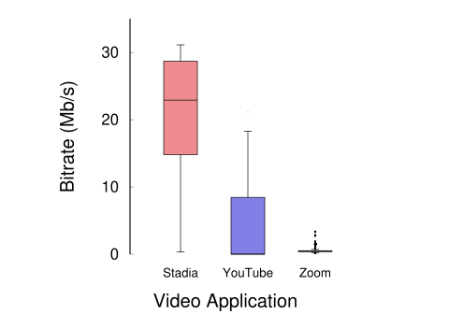


3. Analysis -Comparison
Stadia bitrate 5x higher than YouTube
Zoom has the lowest bitrate of 1.3 Mb/s

Slide 15
Conclusion
Stadia has far more downstream turbulence than upstream (50x)
Stadia does not respond to most packet losses
Stadia’s bitrates are significantly higher than other streaming video services, and are far higher than traditional network games (5x early cloud-based game streaming, and 350x traditional games)

Slide 16
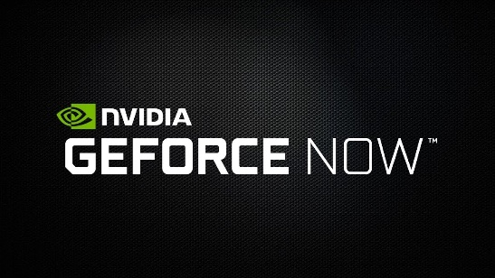
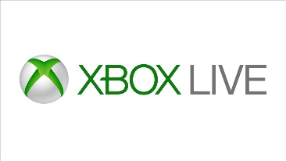
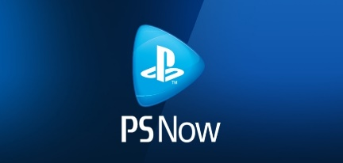
Future work
Automating input
    use scripts to automatically run the games
    Allow us to perform repeated tests over a long time period for comparison
Other cloud-base game systems
    Network traffic of other systems such as Nvidia GeForce Now, Sony PlayStation Now and Microsoft XCloud
congestion control analysis

Slide 17
Thank you！
Xiaokun Xu
PhD student of Computer Science
Worcester Polytechnic Institute
xxu11@wpi.edu
Mark Claypool
Professor of Computer Science
Worcester Polytechnic Institute
claypool@wpi.edu

