Slide 1
Implementation of the SEARCH Slow Start Algorithm in the Linux Kernel
NetDev 0x18
San Clara, CA, July 2024
Jae Chung
Feng Li
Benjamin Peters
Maryam Ataei
Mark Claypool
Joshua Chung

Slide 2
Outline
Motivation and Problem Statement
SEARCH Algorithm
SEARCH Parameter Analysis
Performance Evaluation
Conclusion and Future work

Slide 3
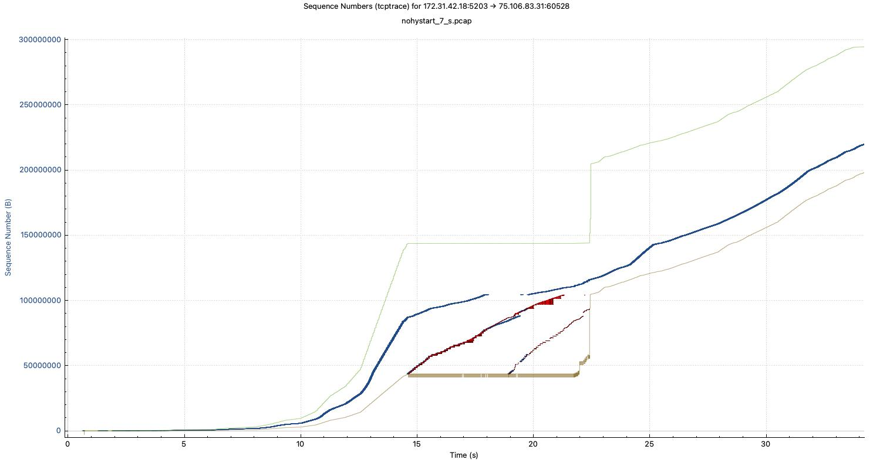
Why Slow Start Important?
Case Study: TCP CUBIC on Broadband GEO Satellite (Capacity: 144Mbps, Duplex Propagation Latency = 600ms)
Time Sequence Graph of a TCP CUBIC w/o HyStart at the sender (bulk transfer)
Slow Start
Recovery
Congestion Avoidance
Receive window
Transmitted Segments
Acks (in sequence)
Duplicated Acks
Notes:
Late slow start exit caused buffer bloat and large bursts of packet drops
TCP session spent more than 7 seconds on the recovery, then entered congestion avoidance mode
Goodput is degraded during this time by the large retransmissions

Slide 4
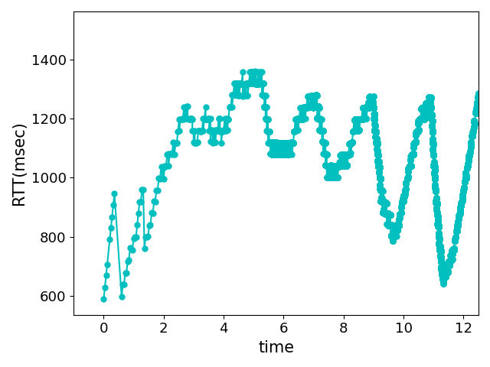
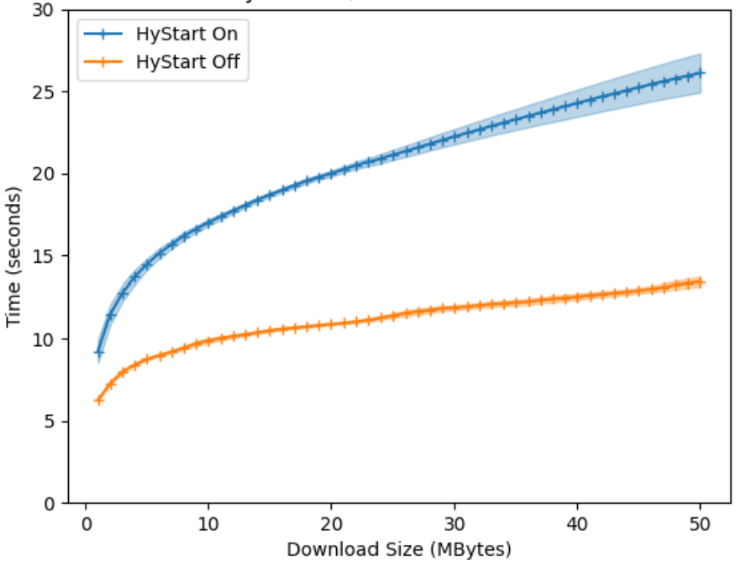
Why Slow Start Important ?
TCP Overview
Case Study: TCP CUBIC on Broadband GEO Satellite (Capacity: 144Mbps, Base-RTT = 600ms)
Large RTT variations confused TCP CUBIC HyStart (Linux Default) and caused early slow start exit
The early exit resulted in bandwidth underutilization and impacted object delivery time
Maryam Ataei Kachooei, Pinhan Zhao, Feng Li, Jae Won Chung, and Mark Claypool. Fixing TCP Slow Start for Slow Fat Links, In Proceedings of the 0x16 NetDev Conference, Lisbon, Portugal, October 2022

Slide 5
Mission Statement
Enhance TCP slow start to avoid premature exits and bound the exit delay to avoid buffer bloat

Slide 6
Outline
Motivation and Problem Statement
SEARCH Algorithm
SEARCH Parameter Analysis
Performance Evaluation
Conclusion and Future work

Slide 7
Slow start Exit At Right CHokepoint (SEARCH)
8a
sent bytes
delivered bytes
4a
capacity
4a
capacity
2a
2a
a
a
t₁
t₂
t₃
t₄
t₅
t₁
t₂
t₃
t₄
Time
Time
Notes:
Describe the inherent functionality of TCP which is the reference of SEARCH algorithm idea. (Typically, data is received by the receiver in the first half of the RTT and is acknowledged, by receiving ack packet in the sender side in the latter half. Therefore, in anormal circumstance, the data sent equals the data acknowledged in the subsequent RTT.)
So, when we are under capacity, you can see how many bytes is sent, is received in the next RTT. But what happen when we reach the link capacity? sender can send more, but the receiver cannot receive.
So, by using this difference between current delivered bytes and corresponding sent bytes in one RTT ago, we can define when we reach the capacity.

Slide 8
Slow start Exit At Right CHokepoint (SEARCH)
8a
8a
sent bytes
delivered bytes
4a
capacity
4a
capacity
2a
2a
a
a
t₁
t₂
t₃
t₄
t₅
t₁
t₂
t₃
t₄
Time
Time
estimated sent = 2 × prev delv
if (normalized diff $≥$ predefined threshold):
exit safely from slow start
diff = estimated sent – curr delv
normalized diff = diff / estimated sent
Notes:
In SEARCH algorithm to decrease memory usage. We decided to only use the delivered bytes. Therefore, we need to expect the send byte in the previous RTT.
As, we mentioned before, sender by receiving each ack packet, increase the cwnd by one and so the cwnd is doubled per each RTT. So, for estimating the sent byte in previous RTT, we can double the previous delivered bytes. Then to find the time of reaching capacity, we need to compare it with current delivered byte.

Slide 9
SEARCH Behavior
TCP Default
TCP with SEARCH
cwnd
Drop
cwnd
Drop
SEARCH
exit
Capacity
Norm >= Threshold
Time
Time
Notes:
TCP default: Does not pay attention to capacity, increase cwnd and send data until drop packet happen, then exit slow start and stop doubling.
SEARCH: Continuously calculate the difference between the estimated sent bytes and the delivered bytes, when notice reaching capacity by comparing normalized difference with the determined threshold, exit from slow start, stop doubling cwnd, and increase cwnd conservatively.

Slide 10
Challenges
RTT
Variation of RTTs
RTT increase may not be caused by congestion on forward link.
Attributable to uplink acknowledgments on backward link.
Limited memory on server
Memory allocated per flow
Unable to store history for each received ACK
window
Bin
Bin
Bin
Notes:
To stabilize the RTT, employ a sliding window that covers a significantly larger data than a single RTT.
Storing per-packet information can be resource-intensive, leading to storage challenges. To optimize data storage, we introduce the concept of "bins." Within each window, we divide the widow into several smaller time periods or bins. We aggregate delivered byte data within these bins. These aggregated values provide a more efficient way to approximate the behavior of the entire window without the need for detailed per-packet storage. Instead of sliding the window on a per-packet basis, we slide the window at the bin level, reducing storage demands while maintaining accurate monitoring and control of network performance.

Slide 11
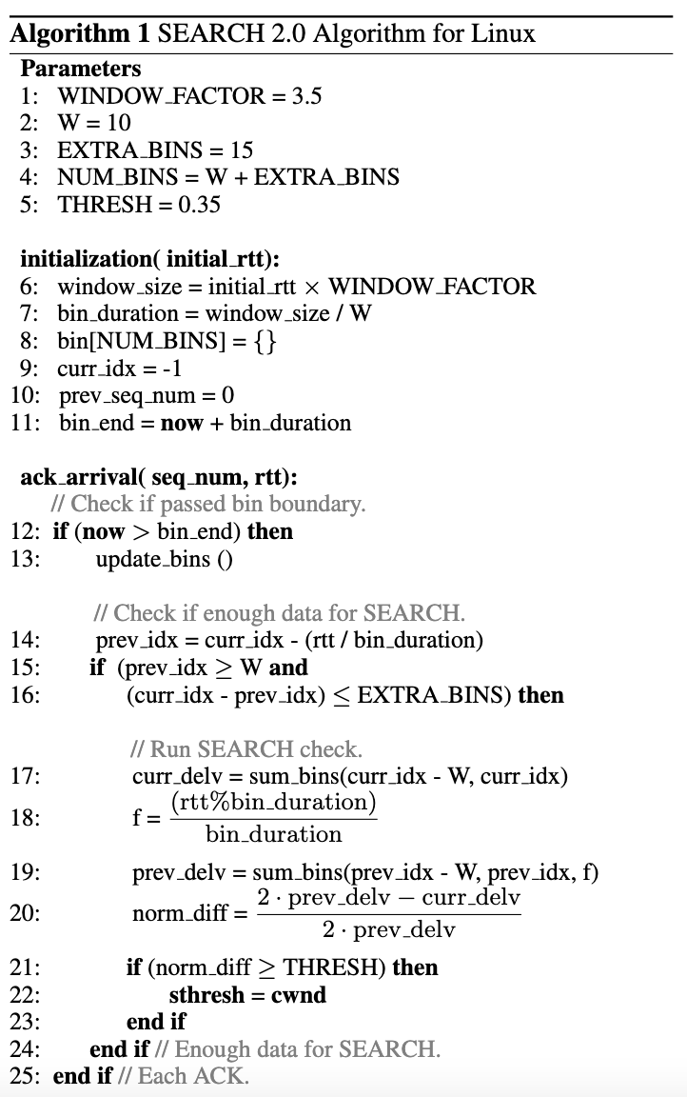
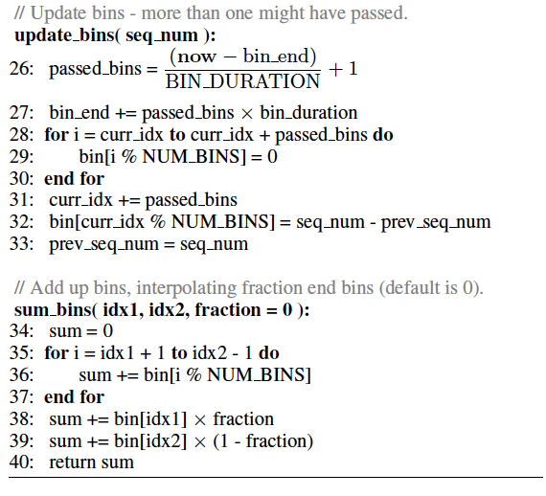
SEARCH Algorithm 2.0
Window size
Number of Bins
Threshold
Notes:
Pseudocode for the SEARCH algorithm
Define some default variables.
Like window size that it sets as a multiple of the RTT to maintain a window of bytes. This helps in minimizing the impact of RTT fluctuations.
Then we divided window to bins to reduce memory usage and we need to define the number of bins per each window.
We need to establish a threshold to determine when to exit the slow start phase effectively.
Initialize the bins
In each bin boundary, if we have enough data, calculate the delivered window(curr_delv) and estimate the sent window (prev_delv).
If normalized difference greater than the predefined threshold, exit slow start and set ssthresh to the current cwnd.
As I mentioned at the first, we have some parameters with default values. Therefore, we need to define the ideal values for them to be effective in all networks.

Slide 12
Window Size – Parameter Selection (I)
Windows Size Selection Consideration
Large enough to encapsulate meaningful link variation
Small enough to respond quickly when reaching link capacity
Select window size with FFT
Convert measured RTT from Time domain to frequency domain
Choosing 3.5 as default, which is a balanced results for
GEO (3.33), LEO (3.33), WiFi (3.75) and LTE (2.8)

Slide 13
Number of Bins – Parameter Selection (II)
Bins are introduced to reduce computational and memory load.
Impractical to track every ACK.
More bins provide more fidelity to actual delivered bytes total, reduce SEARCH convergence time. But more memory consumption.
Through numbers cases analysis [KCC24], we choose 10 bins which
Nearly identical performance as with more bins
Minimize ”early exits” when closing to the maximum link capacity.

Slide 14
Threshold – Parameter Selection (III)
Exit threshold demines when the difference between current delivered bytes and delivered bytes during previous RTT is large enough to exit from slow start.
Based on analysis [KCC24], normalized difference would in range [0, 0.5).
Choose 0.35 as default value after tons of evaluation and analysis.
Detect congestion point in less 2 RTTs.

Slide 15
Outline
Motivation and Problem Statement
SEARCH Algorithm
SEARCH Parameter Analysis
Performance Evaluation
Evaluation w/ GEO by example
Evaluation w/ Wifi
Conclusion and Future work

Slide 16
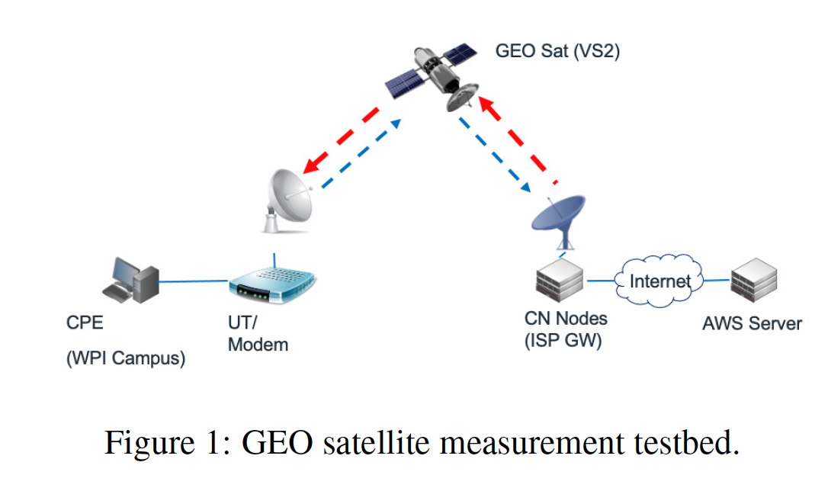
GEO TestBed
AWS Server EC2 Instance w/ 32 GB RAM, Ubuntu 22.04 w/ 5.13.12 customized kernel for SEARCH support.
CPE (Client) PC w/ 32GB RAM, Intel i7 – 5820 CPU, w/ Ubuntu 20.04 w/ 5.4.0 kernel.
ISP Gateway supports up to 36MB buffer per flow with AQM capability.
PEP are bypassed in this study.

Slide 17
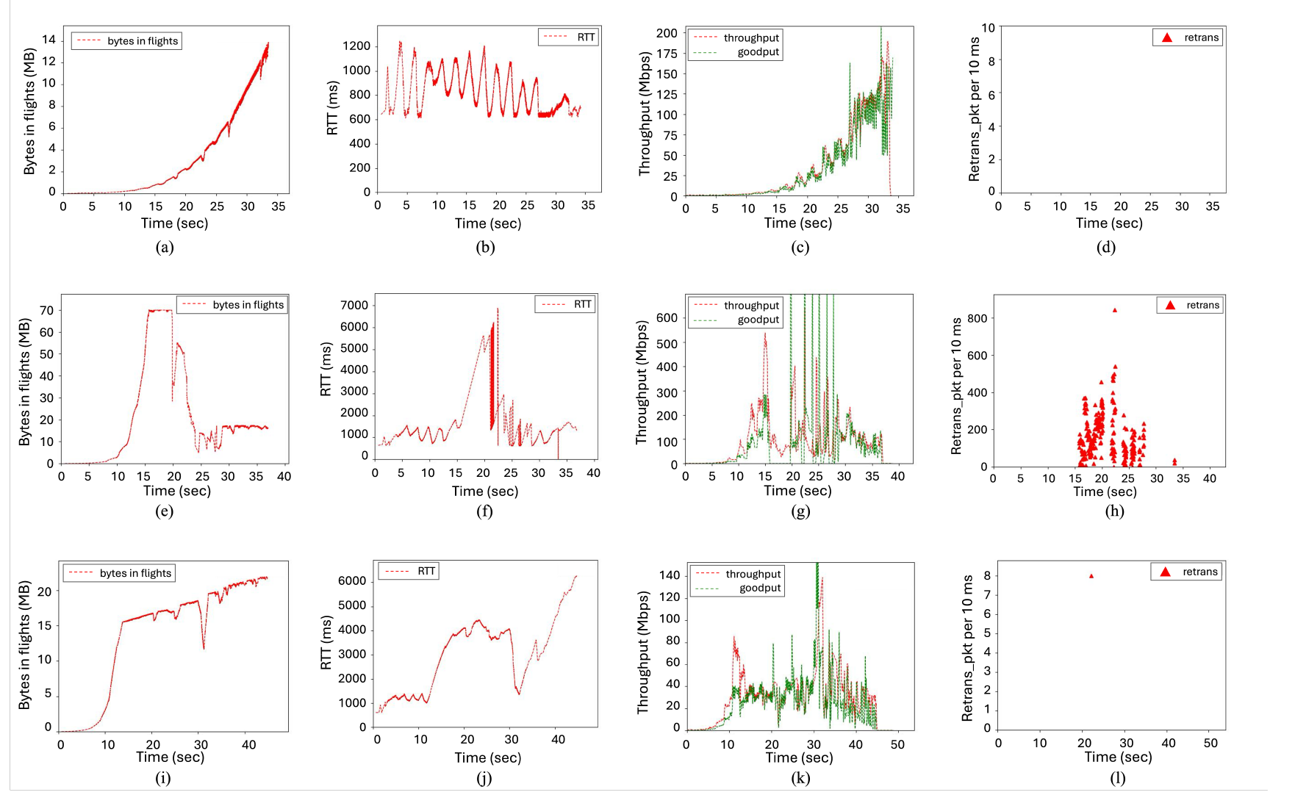
GEO Case Study by Examples
CUBIC w/ Hystart
CUBIC w/o Hystart
CUBIC w/ SEARCH

Slide 18
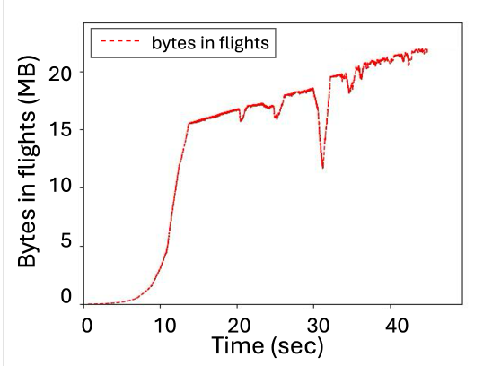
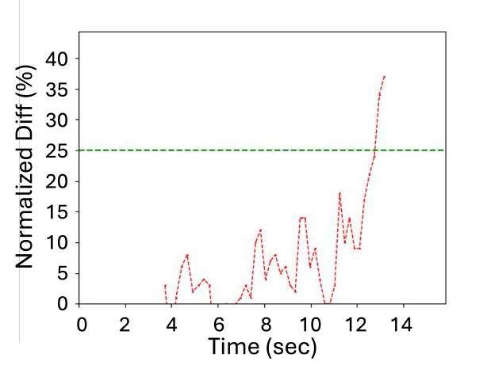
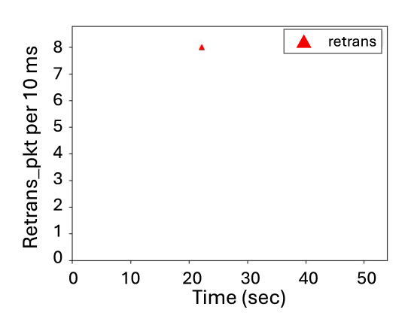
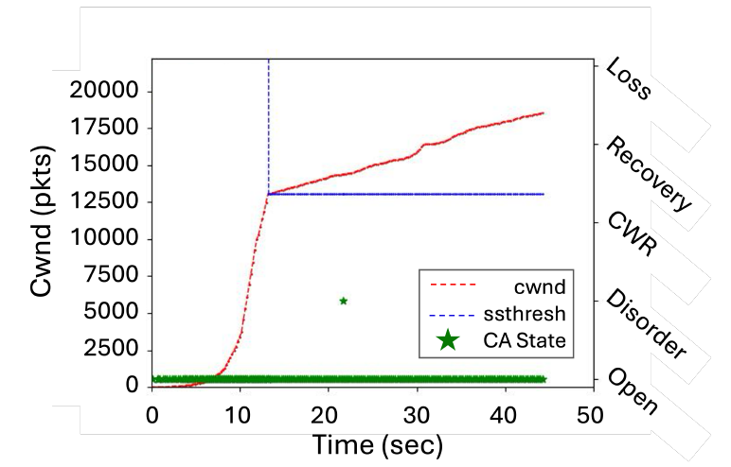
GEO Case Study by Examples
Threshold

Slide 19
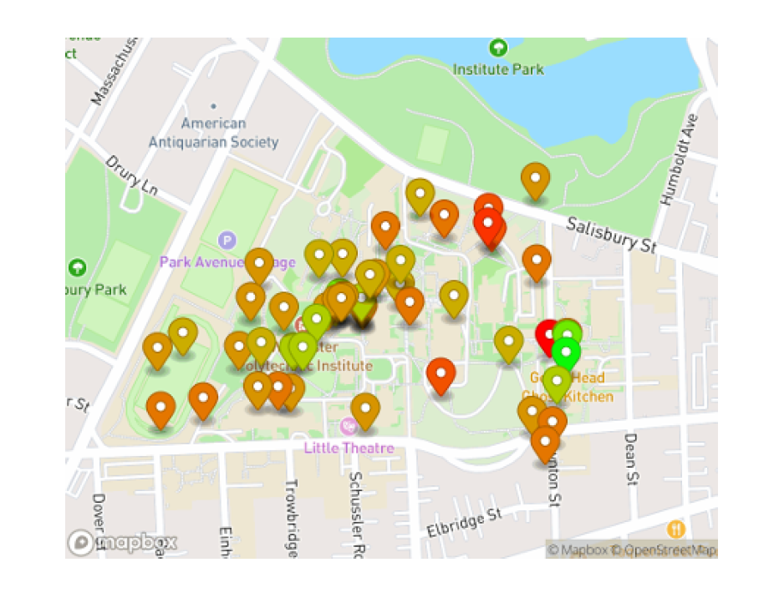
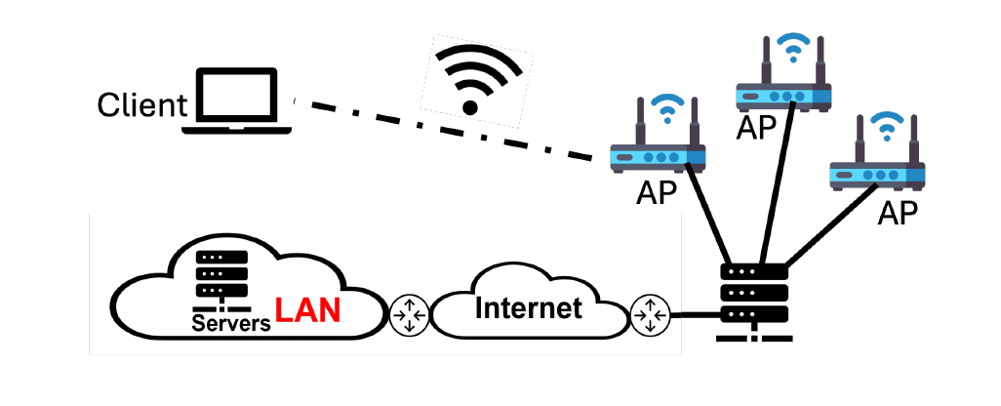
Wifi TestBed
Wired server connected to campus network
Intel i5-8500 CPU, 8GB RAM, mint 20.3 Linux kernel 5.10.79 w/ SEARCH module.
Client laptop Intel Core Ultra 7 CPU, w/ 16GB RAM, ubuntu 22.04 w/ 6.8.0 kernel.
Each iteration has a 3 second long iperf3 session with four CCA configurations:
CUBIC w/HyStart, CUBIC w/o HyStart , BBRv1, and SEARCH
Repeat 200 times in 24 hours.

Slide 20
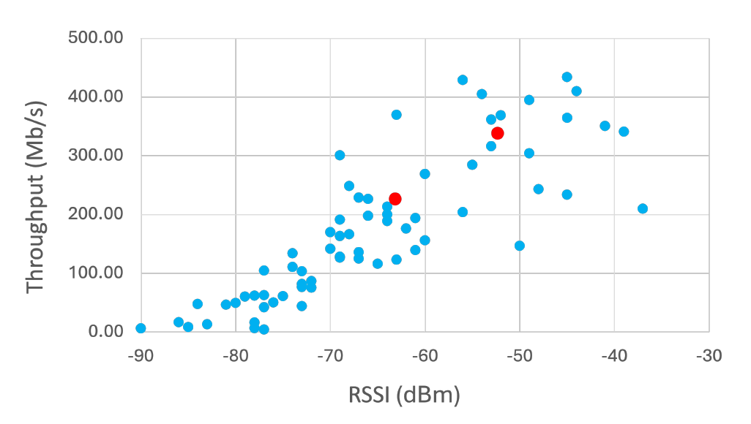
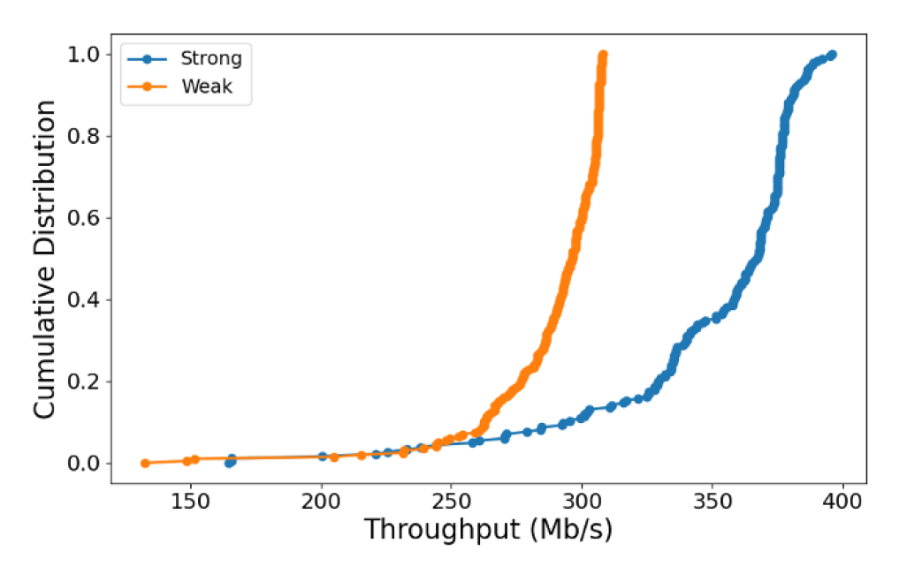
WIFI Throughput and RSSI
* Throughput measured w/ Default TCP settings
General strong correlation between higher RSSI and higher throughput.
Other factors may cause inconsistence such as shared nature of campus APs.
Two red dots are manually examined locations.
Median throughput CDFs at strong and weak locations
Median throughput at strong location is higher than weak locations.

Slide 21
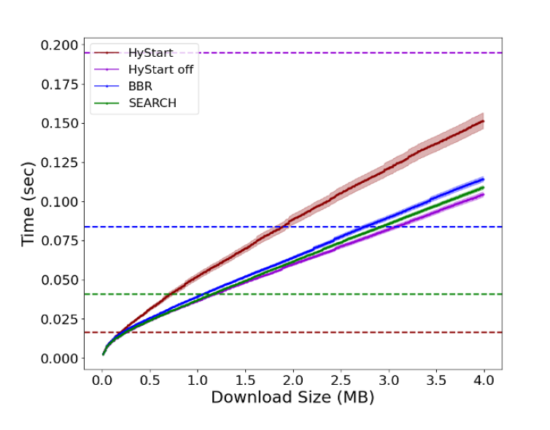
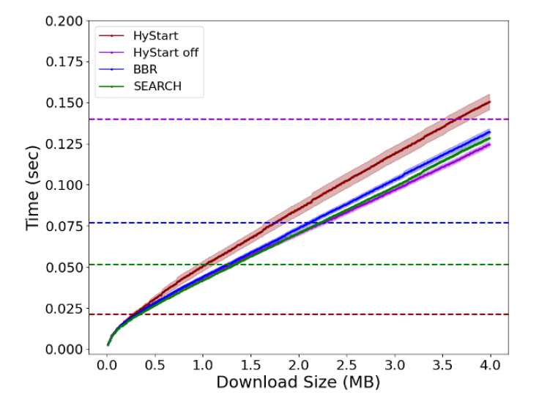
Time to Download
Weak
Strong
* Horizontal lines indicates the slow start exit time for each CCAs matching their respective color

Slide 22
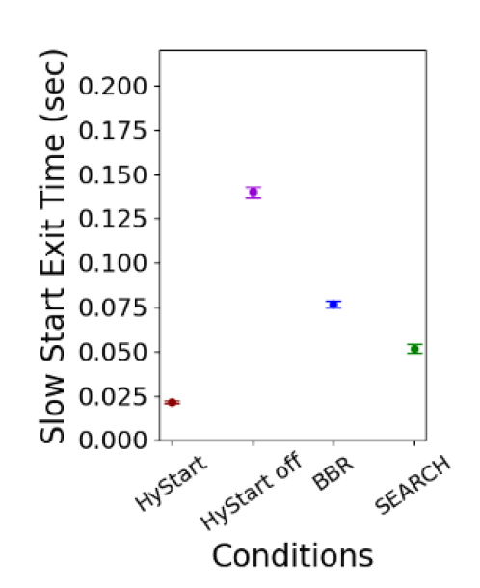
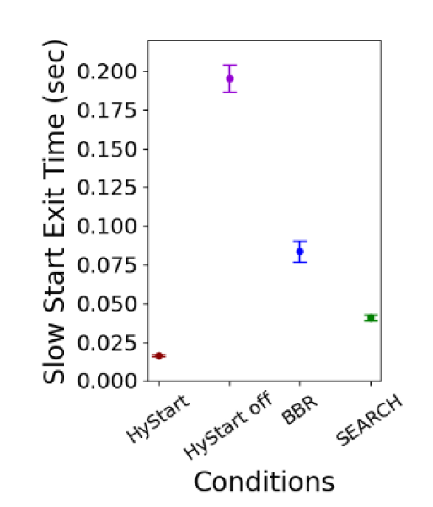
Slow Start Exit Time
Strong
Weak

Slide 23
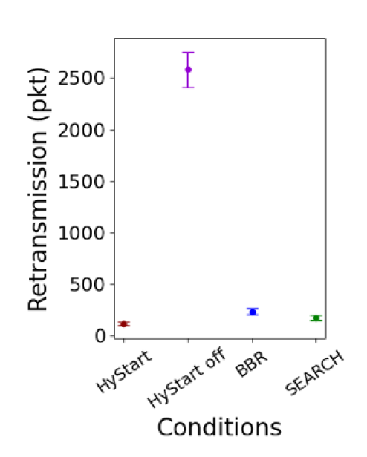
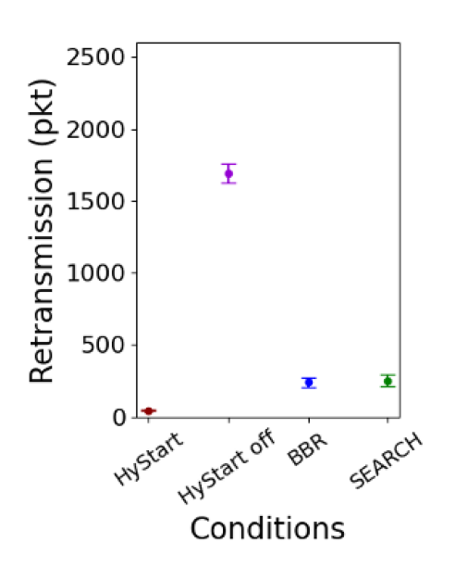
Retransmission
Strong
Weak

Slide 24
Evaluation
Working in Progress
Project Page https://search-ss.wpi.edu
Linux Kernel Module Implementations
5.13.x series kernel
https://github.com/Project-Faster/tcp_ss_search.git (main branch)
6.10rc2 based (net-next-6.10rc2 branch)
https://github.com/Project-Faster/tcp_ss_search/tree/net-next-6.10rc2
QUIC implementation H2O/Quicly
https://github.com/Project-Faster/quicly/tree/generic-slowstart (generic-slowstart branch)
IETF 120 CCWG Draft0
https://datatracker.ietf.org/doc/draft-chung-ccwg-search/
July 24, 2024, IETF 120 CCWG group meeting.

Slide 25
Future works
TCP Overview
Future iteration of the SEARCH algorithm will focus on
Refining slow start exit strategy to precisely match congestion condition.
Upstream TCP SEARCH into Linux mainstream and integrate it into open source QUIC.
https://github.com/Project-Faster/tcp_ss_search.git
More evaluations with search
Over other link type (LTE, LEO, 5G/mmWave, Data Center, etc)
Varied network condition.
Incorporate with BBR’s probing phase

Slide 26
Conclusions
TCP Overview
HyStart does not work in wireless environments (GEO, LTE, WIFI) and causes premature slow start exits.
Need a fix in near future
SEARCH achieves its design goals
Effectively exits Slow Start after reach maximum capacity,
Minimizing packet loss and improving network efficiency.
Reach comparable maximum throughput as TCP w/o Hystart with fewer retransmissions.

Slide 27
References
TCP Overview
[KCC24] Kachooei, M. A.; Chung, J.; Cronin, A.; Chung, J.; Li, F.; Peters, B.; and Claypool, M. 2024. Improving TCP Slow Start Performance in Wireless Networks with SEARCH. In Proceedings of the IEEE World of Wireless, Mobile and Multimedia Networks (WoWMoM).
[KCL23] Kachooei, M. A.; Chung, J.; Li, F.; Peters, B.; and Claypool, M. 2023. SEARCH: Robust TCP Slow Start Performance over Satellite Networks. In Proceedings of the IEEE 48th Conference on Local Computer Networks (LCN), 1–4.
[RFC9406] Huang, Y., and Olson, M. a. 2023. HyStart++: Modified Slow Start for TCP. RFC 9406, RFC Editor.

Slide 28
Thank you for your attention!

Slide 29
Static Memory Footprint Analysis
TCP Overview
Structure | Size
struct sock | 736 bytes
struct tcp_sock | 2192 bytes
Module | Size (bytes) | Overhead (%) | Additional Details
CUBIC | 72 | 2.5 | 60 bytes + ack_sample struct: 12 bytes
HyStart | 18 |  | Part of CUBIC's 72 bytes
SEARCH2.0 | 121 | 4.1 | Exclude shared cubic fields
BBR (v1.0) | 156 | 5.3 | 100 bytes + rate_sample struct: 56 bytes
* Based on 5.10.79 kernel

