Slide 1

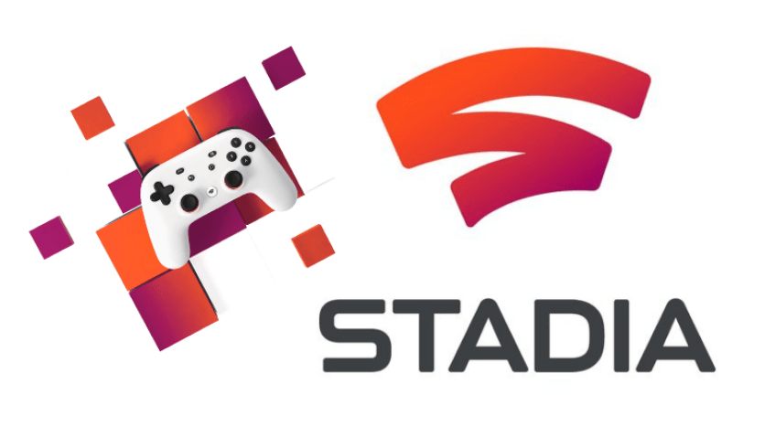

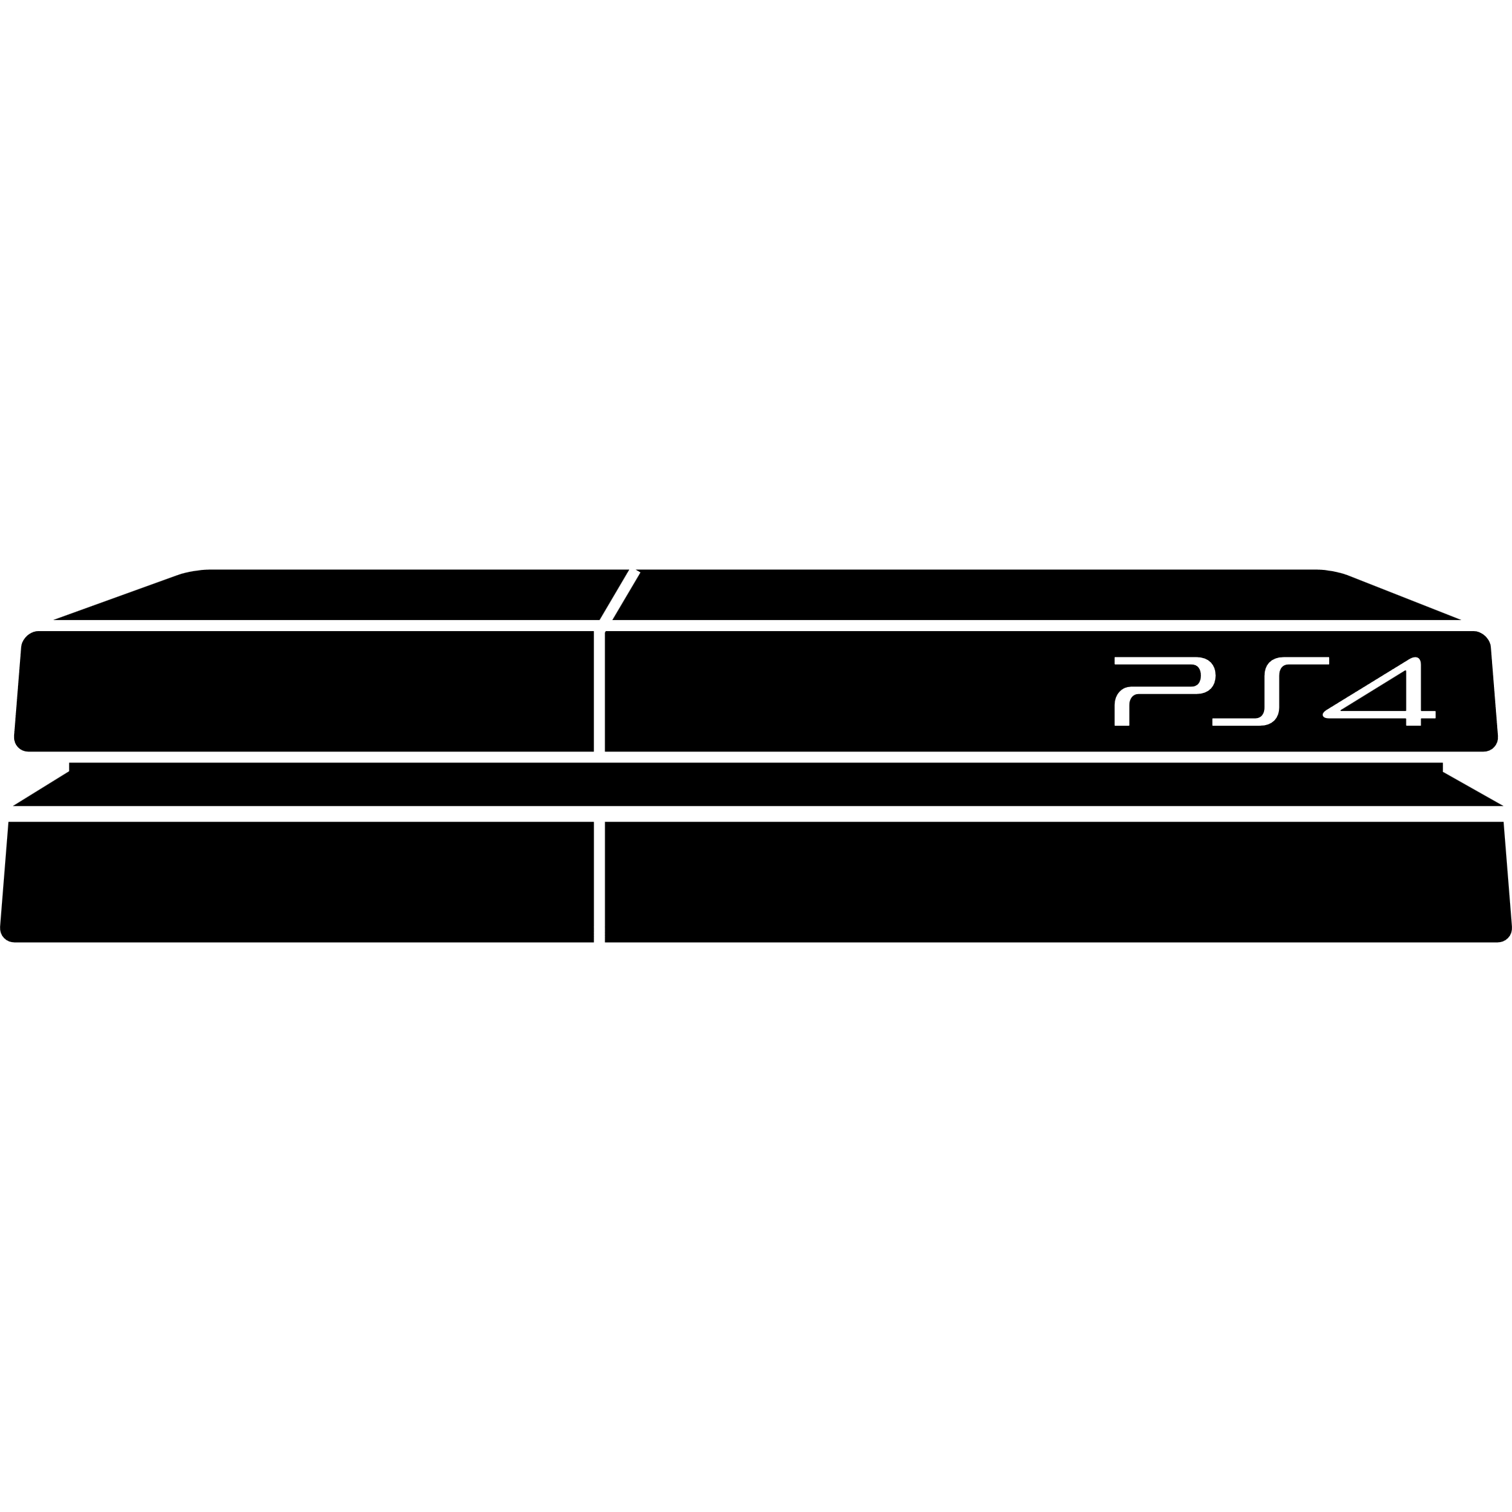



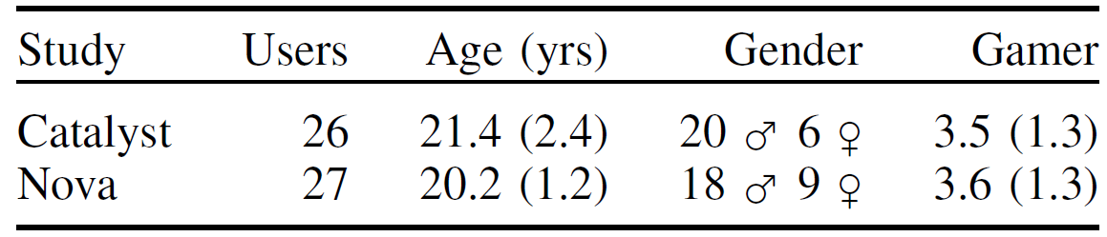

Compensating for Latency in Cloud-based Game Streaming using Attribute Scaling
Xiaokun Xu, Michael Bosik, Adam Desveaux, Alejandra Garza, Alex Hunt, Cameron Person, James Plante, Joseph Swetz, Nina Taurich, Brian Clark, Doris Hung, Philip Lamoureux
Advisor: Professor Mark Claypool
Abstract
Cloud-based game streaming has the disadvantage of added latency from the thin client to the cloud-based server and back, decreasing player performance and degrading their experience. Attribute scaling can make the game easier, potentially exactly counteracting the difficulty added by the latency. We incorporate attribute scaling models into two different games, deploy them on a commercial cloud-based game streaming system and evaluate their efficacy by measuring impact on player performance and Quality of Experience (QoE).
Workflow
Results
Develop games and attribute scaling
Performance
Introduction
(a) Catalyst
\
~==-
/
____
/___o\
Catalyst – attribute scaling by adjusting hitbox size
Nova – attribute scaling by adjusting window duration
Traditional
console
For Catalyst, the hitbox scaling factor (s) is:
$$s=\frac{a+0.09l+0.1d−73}{20}$$
where l is the latency (in milliseconds) and d is the difficulty (the speed of the opponent avatar, in cm/s).
For Nova, the time window scaling factor (s) is:
$$s=\frac{a+0.1l−12d+73}{10}$$
where l is the latency (in milliseconds) and d is the difficulty (the cooldown between notes spawning, in seconds). [1]
Client
Player input
Game frames
\
~==-
/
____
/___o\
\
~==-
/
____
/___o\
\
~==-
/
____
/___o\
\
~==-
/
.**
**.**
*.*
server
server
Cloud-based
Player input
server
(b) Nova
Thin Client
Cloud Servers
QoE
For both Catalyst and Nova, participant QoE decreased with added latency both with and without latency compensation.
User Study
Screener
Select qualified participants
Yes
Consent
Conclusion
No
Setup
Set machines, in campus lab
Unqualified
Pre-Play
Demographics
Reaction Time test
Attribute scaling latency compensation can keep player performance high despite network latency with additional tuning work needed for QoE.
Play
Scripts for auto-run
Latency control
game log
Methodology
3.5 minutes
Repeat Play with different latency and for 60 minutes for each participant
Future Work
QOE
QOE Survey
Build attribute scaling into a game engine (e.g., UE4) to scale select game object attributes automatically.
Explore any other way to improve the QoE, e.g., Buffer policy algorithms
Understand the connection of QoE and the presence of competing network traffics
Understand the latency and gaming [2]
Closing
Collect data and pay participants gift card or credits
Participant demographics
(a) Catalyst – a first person, capture-the-flag shooter game
(b) Nova – a first person, target selection rhythm game
[1] Carlson et al. "Towards Usable Attribute Scaling for Latency Compensation in Cloud-based Games", GameSys 2021.
[2] Xu et al. "The Effects of Network Latency on Counter-strike: Global Offensive Players", QoMEX 2022.
Deploy the games to Google Stadia

