Slide 1
Motion and Scene Complexity for Streaming Video Games
Mark Claypool
Computer Science Department
Worcester Polytechnic Institute
Worcester, Massachusetts, USA
http://www.cs.wpi.edu/~claypool/papers/game-motion/

Slide 2




Introduction
Growth:
  Networks – high bandwidth to the home
  Thin clients – Remote Desktop, Google Desktop
  Online games
Opportunity:
  Heavyweight, “fat” server hosting game
  Stream game as interactive video over network
  Played on a lightweight, thin client
Motivation:
  Rendering game that requires data and specialized hardware not at client
    Sony Remote Play, and OnLive
  Augmented reality - physical world enhanced by thin, wearable computers (i.e. head-mounted displays)
  Ease of implementation and maintenance

Slide 3
Application Streams vs. Game Streams
Typical thin client applications:
  Relatively casual interaction
    i.e. typing or mouse clicking
  Infrequent display updates
    i.e. character updates or scrolling text
Computer games:
  Intense interaction
    i.e. avatar movement and shooting
  Frequently changing displays
    i.e. 360 degree panning

Slide 4
Games as Streaming Video
High bandwidth – push limits of graphics
  Need efficient compression
Adapting traditional video to network ➔ motion and scene complexity crucial to maximize quality
  High motion needs quality scaling
  Low motion needs temporal scaling
  Getting it “right” improves perceived quality by as much as 50%
To stream games as video, need:
  Standard measures of motion and scene complexity
  Streaming game videos as benchmarks
  Understanding how current thin tech is limited

Slide 5
Outline
Introduction (done)
Motion and Scene Complexity (next)
Game Perspectives
Methodology
Analysis
Conclusions

Slide 6
Motion
9 Videos varying motion/scene complexity
Divide frame into 16 blocks
User rated amount of motion (0, ¼, ½, ¾, 1)
Results:
  MPEG vector [12]: 0.51
  PMES [9]: 0.70
  Interpolated macroblocks [13]: 0.63
Our measure:
  Percentage of Forward/backward or Intracoded Macroblocks (PFIM) 0.95

Slide 7
Scene Complexity
Same 9 Videos varying motion/scene complexity
Divide frame into 16 blocks
User rated complexity (0, ¼, ½, ¾, 1)
Our measure:
  Intracoded Block Size (IBS) 0.68

Slide 8
Outline
Introduction (done)
Motion and Scene Complexity (done)
Game Perspectives (next)
Methodology
Analysis
Conclusions

Slide 9
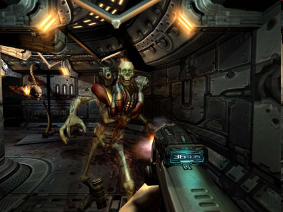

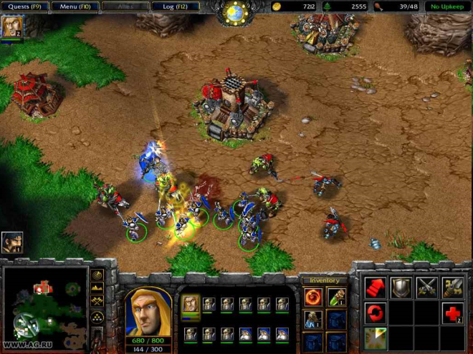
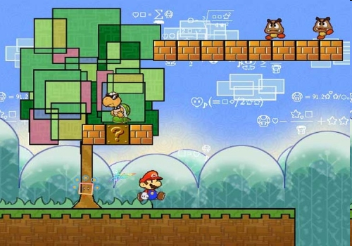
Game Perspectives
First Person Linear
Third Person Linear
Omnipresent
Third Person Isometric

Slide 10
Outline
Introduction (done)
Motion and Scene Complexity (done)
Game Perspectives (done)
Methodology (next)
Analysis
Conclusions

Slide 11
Methodology
Select Games
Record Traces
Select Videos
Analyze Data
Evaluate Thin Clients

Slide 12
Select Games

Slide 13
Capture Game Videos
FRAPS (Direct X or OpenGL), 30 f/s
PC Intel P4, 4.0 GHz, 512 MB RAM, nVidia Geforce 6800GT 256
  After: MPEG compress using Berkeley MPEG Tools
Resolution: 800x600 pixels
Length: 30 seconds

Slide 14
Select Videos
Widely used by multimedia community
Range of motion and scene complexity
Each 10 seconds long

Slide 15
Outline
Introduction (done)
Motion and Scene Complexity (done)
Game Perspectives (done)
Methodology (done)
Analysis
  Motion and Scene Complexity (next)
  Thin Clients
Conclusions

Slide 16
Motion and Scene Complexity
MOTION
Games from .2 to .95
  First highest → panning
  Third iso → lowest (except side scroll)
  Omin → all medium
Videos all .7 to ~1
SCENE COMPLEXITY
Games vary considerably across all genres
  First least (may value responsiveness)
  Omni most (lots of detail for game play)
  Third medium
Videos vary low to high but a bit less than highest omni

Slide 17
Motion and Scene Complexity - Summary

Slide 18
Outline
Introduction (done)
Motion and Scene Complexity (done)
Game Perspectives (done)
Methodology (done)
Analysis
  Motion and Scene Complexity (done)
  Thin Clients (next)
Conclusions

Slide 19
Thin Client Evaluation
Brief look at performance issues with current thin-client technology
  Microsoft’s Terminal Services (RDP)
  NoMachine’s NX client (for Windows)
  Specialized technology future work
Win XP laptop, Intel M 2.26 GhZ, 2GB RAM, nVideo GeForce GO 6400 w/64 MB
Wireless, 802.11g
Use VideoLAN VLC media player
  Reports frame statistic
Wireshark
  Network traces

Slide 20
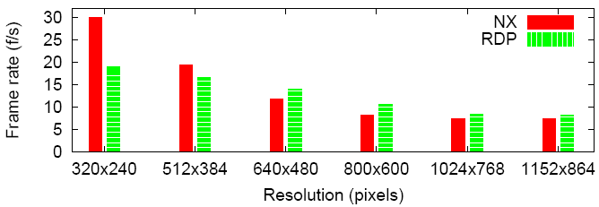
First Person, Various Resolutions
Resolution increases
  FR drop (need 15 f/s), bitrate increase
NX slightly better, much lower bitrate

Slide 21
Different Perspectives
(800x600)
Some correlation with motion
  Higher motion (First), lower FR
Less correlation with scene
  Ominpresent similar to 3rd

Slide 22
Contributions
Novel metrics of motion and scene complexity
  IBS and PFIM
29 game videos → public benchmark
  .avi and .mpg
  Scripts for PFIM and IBS
Preliminary evaluation of thin clients

Slide 23
Conclusions
Video encoding characteristics (IBS and PFIM) capture perceived motion and scene complexity
Motion and scene complexity vary considerably across games
  Perspective impacts both
  First person higher motion, while third iso least
Motion and scene complexity for games different than for video
  Games have broader range, and omni more complex
Streaming video games possible, but only for low motion and low resolution
  Bitrates higher than most residential broadband, but ok for LAN

Slide 24
Future Work
Game-specific thin clients
  Sony Remote Play
  Onlive
Latency

Slide 25
Motion and Scene Complexity for Streaming Video Games
Mark Claypool
Computer Science Department
Worcester Polytechnic Institute
Worcester, Massachusetts, USA
http://www.cs.wpi.edu/~claypool/papers/game-motion/

