Slide 1

Exerwalls – an Exercise Alternative to Paywalls in Mobile Games
Anthony Gallo
Philipp Baumann
Emmanuel Agu
Mark Claypool
In Proceedings of the International Academic Conference on Meaningful Play, East Lansing, Michigan, USA, October 20-22, 2016.

Slide 2
Introduction
Physical inactivity increases risk of diseases
  Diabetes, cardiovascular, cancers, obesity [CDC, 2015]
  Leasing cause of death in US [Mokdad, et al. 2000]
Physical guidelines 150 minutes exercise/day
  But most kids get far less, preferring “online” entertainment [Rideout, Foehr, and Roberts, 2010]
Approach → integrate exercise into online apps
  Inspiration: Bitwalking [Imbesi and Bahar, 2016] and Pokémon Go [The Pokémon Company, 2016]

Slide 3
Paywalls (1 of 2)
Paywall – in-game mechanism to restrict content until paid (time, money or effort)
(Dungeon Keeper, Mythic Entertainment, 2013)
Many examples: card games Hearthstone and Heroes of Warcraft (Blizzard, 2014), puzzle games such as Candy Crush (King, 2012), strategy games such as Game of War – Fire Age (Machine Zone, 2013), and classic games Monopoly (Hasbro, 2015).
Notes:
Example pictured - Player can either pay or wait predetermined amount of time to continue play.

Slide 4
Paywalls (2 of 2)
Paywall types [Doe, 2015]
  Classic paywall – purchase game content
  Pressure-wall – integrate with friends, so social pressure urges payment for content
  Patience-wall – wait for time for content
  Ad-wall – watch advertisement for content
Our idea: new kind of paywall → Exerwall

Slide 5
Exerwalls
Provide additional choice for player
exercise to unlock content
Control for player since exercise rate a choice
  Reduce player frustration
  Promote self-accomplishment, keep players engaged
Does not replace paying, instead replacing waiting
This paper → evaluate exerwall potential

Slide 6
Methodology
Survey user opinions on exerwalls and patience-walls
Develop mobile game with exerwalls for user study
Conduct user study to evaluate efficacy of exerwalls
Analyze results of user study
Notes:
Methodology servers as an outline for the rest of the talk

Slide 7
Methodology
Survey user opinions on exerwalls and patience-walls
Develop mobile game with exerwalls for user study
Conduct user study to evaluate efficacy of exerwalls
Analyze results of user study

Slide 8
Survey (1 of 2)
Goal: Assess opinions of paywalls and explore exerwall options
Example questions:
  How likely are you to spend money on mobile game?
  Have you played games that include paywalls?
  If you encountered a paywall preventing play that costs X dollars, how long would you be willing to wait instead to continue without paying?
  If you encountered a paywall preventing play that costs X dollars, how long would you be willing to walk instead to continue without paying?

Slide 9
Survey (2 of 2)
Place online via Qualtrics
Sent to WPI mailing lists (primarily students)
Respondents
56 subjects
93% students, 7% staff
68% male, 28% female, 4% unspecified
Ages 18 to 51, median 20
51% in CS, rest in Eng.
31% exercising less than 4 hours per week
Many only exercise is walking to/from classes
25% of students paid attention to exercise

Slide 10
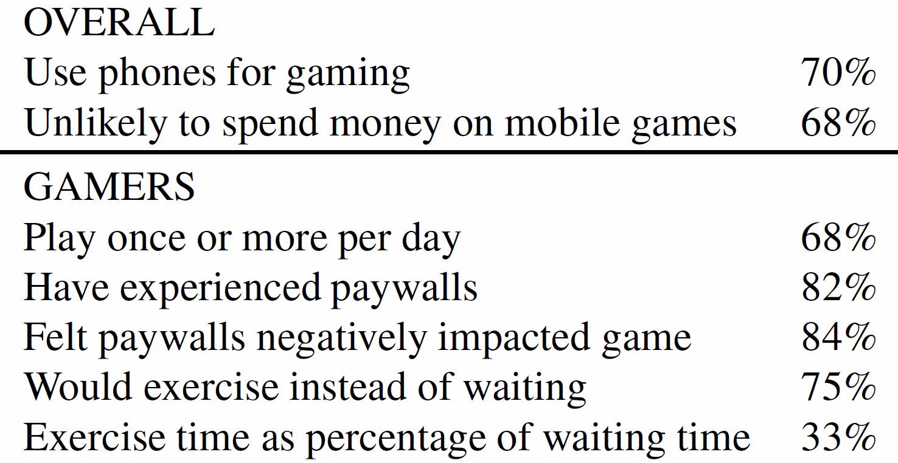
Survey Summary Results

Slide 11
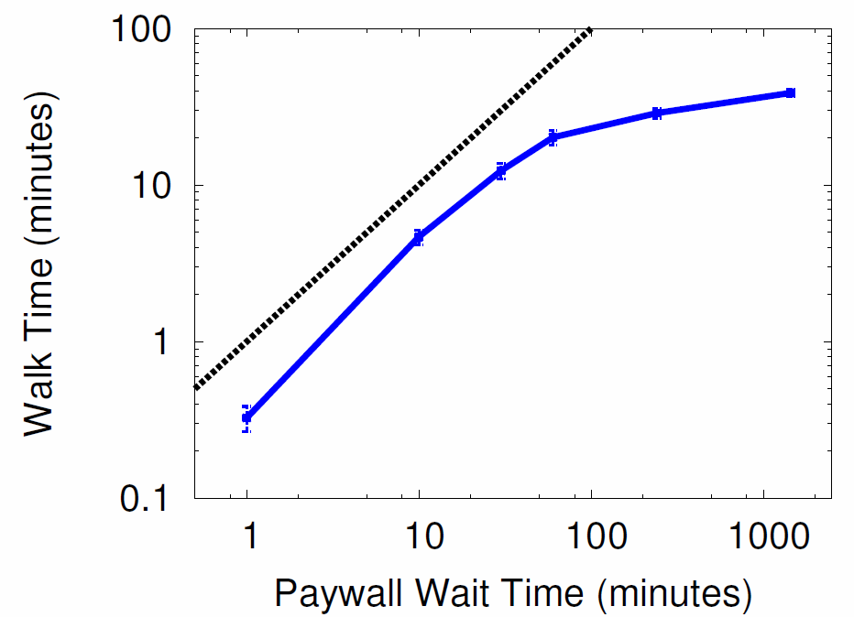
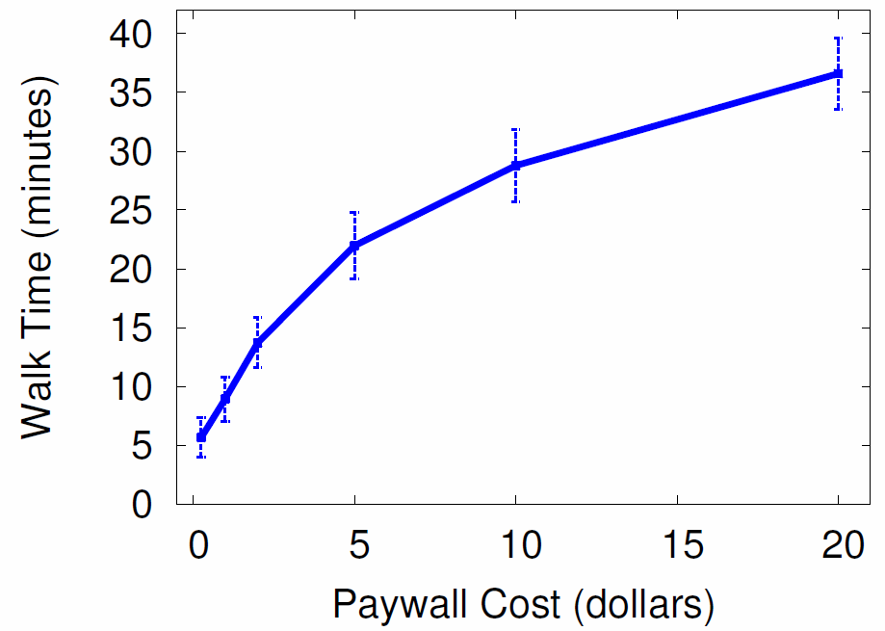
Receptiveness to Exerwalls
For up to about an hour, players willing to walk 1/3rd the wait
Game vendors can use to pick exercise versus monetary gain
Amount of time player is willing to walk to continue playing instead of waiting to continue playing.
Amount of time player is willing to walk to continue playing instead of paying to continue playing.
Notes:
LEFT depicts in more detail the length of time players would walk to continue playing a game rather than wait through a paywall. The horizontal axis is the time a paywall would require the player to wait to continue playing and the vertical axis is the time the player could choose to walk, instead. Note both axes are shown in logscale for readability. Each point is the mean response of all subjects with the bars showing the standard error of the mean. The dashed diagonal line shows the point where walking time would equal waiting time. In general, the walk values are positive in that players are more willing to exercise by walking rather than waiting. For up to about an hour, players are willing to walk on average about one-third the waiting time.
RIGHT depicts the amount of time players would walk to avoid paying for a paywall. The horizontal axis is the cost to bypass a paywall to continue playing and the vertical axis is the time the player would choose to walk, instead. Each point is the mean response with the bars showing the standard error of the mean. In general, there is a logarithmic progression with the time players are willing to walk with the increase in paywall cost. Game vendors seeking to deploy exerwalls in place of traditional paywalls may use this information to determine levels of exercise that are equivalent to various amounts of monetary gain.

Slide 12
Methodology
Survey user opinions on exerwalls and patience-walls
Develop mobile game with exerwalls for user study
Conduct user study to evaluate efficacy of exerwalls
Analyze results of user study

Slide 13
Game for Study
Need game to place exerwall, control duration, compare to waiting
Developed in Android, using Libgdx
Use procedural content generation for art
Conduct focus group for development focus
  (Details in paper)
→ Concentrate on making game fun given developer resources (2 students, 6 months)

Slide 14
Laser Planets
Player builds team of planets – shoot laser beams to battle other planets – win battles for galactic domination!

Slide 15
Explore Stars

Slide 16
Select Planets to Commence Battle

Slide 17
Battle with Lasers

Slide 18
Battle Boss for Glory

Slide 19
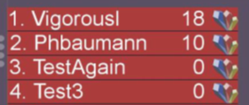
Shop, Manage, Compete
Leader Board

Slide 20
Exerwalls in Laser Planets
(Also in “Explore” screen for fuel)
Random paywall options: Force Walk, Force Wait or Choice

Slide 21
Methodology
Survey user opinions on exerwalls and patience-walls
Develop mobile game with exerwalls for user study
Conduct user study to evaluate efficacy of exerwalls
Analyze results of user study

Slide 22
User Study Procedure
Solicit users via WPI email
  Incentives: raffle for two $25 gift cards, $50 for top score
Pre-survey for demographics, exercise habits, phone use IRB consent
Users download game via APK
  Brief game tutorial
Asked to play at least once per day
Results
One week, April 2016
21 Users
16 male, 5 female
Ages 18 to 31, median 21
All in CS and Engineering
Details in report
[Baumann and Gallo, 2016]

Slide 23
Methodology
Survey user opinions on exerwalls and patience-walls
Develop mobile game with exerwalls for user study
Conduct user study to evaluate efficacy of exerwalls
Analyze results of user study

Slide 24
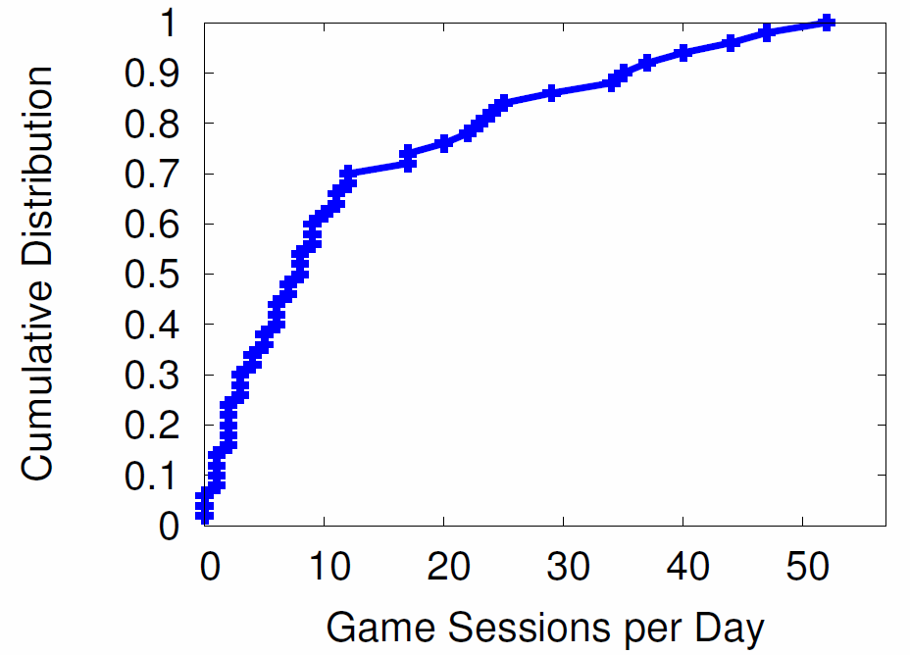
Game Sessions per Day
Game sessions:
Total 1289 total
Median 8 / day
Mean 12.9 / day
Median length 3 minutes
Users engaged
Notes:
Cumulative distribution function (CDF) of mean number of game sessions users played Laser Planets per day. Median user was engaged, playing about 9 sessions per day (mean is 12.9). Only about 5% of the users played less than once a day, while about a quarter played over 15 times per day.

Slide 25
Steps Per Day
Steps:
Median 5000 / day
Mean 5102 / day
10% more than 10,000 / day
10% less than 500 / day

Slide 26
When Choice, Walk or Wait? (1 of 2)
Walking viable choice for users versus waiting
Notes:
Percentage of time (the y-axis) users made the choice (the x-axis). From the graph, the percentages for each choice are similar. This suggests that the new exercise option (in our case, walking) may sometimes be utilized by users in favor of waiting.

Slide 27
When Choice, Walk or Wait? (2 of 2)
Walking viable choice for most users versus waiting, but some won’t walk
Notes:
CDF of the user choices when presented with the choice option. The x-axis is the number of times users made a particular choice (walk or wait) and the y-axis is the cumulative distribution. There are two trendlines shown, one for each choice. From the graph, there is an equal distribution of choices across users, with the exception of the wait option favored quite heavily for 3 users. This reinforces the efficacy of an exercise option for a paywall for most users, suggested by Figure 15, but does indicate some users may still overwhelmingly choose a wait option.

Slide 28
Average Steps per Day
Slight increase in steps per day over week
Notes:
Trend in the mean number of steps taken over the course of the user study. The x-axis is the day of the user study (the study lasted a little over a week) and the y-axis is the mean number of steps. Each point is the mean number of steps across all users for that day with the bars showing the standard error of the mean. The dashed line is a trend line, the least squares line fit of the mean values. From the graph, there is considerable variation in the mean values, but a noticeable upward trend – the slope is +102 steps/day – suggesting slightly more steps per day at the end of the study than at the beginning.

Slide 29
When Walk, More Steps?
Increase in number of steps when exerwall
Notes:
Combined analysis of the paywall presented and/or chosen (walk or wait) with the average number of steps taken. This analysis examines the average number of steps taken by each user for 20 minutes after presented with a paywall. The time window of 20 minutes is used since that is the longest patience-wall waiting time. The horizontal axis shows four cases, the two on the left when there is a choice (walk or wait) and the two on the right when there is no choice. The y-axis is the average number of steps taken. The horizontal dashed line shows the overall average number of steps over 20 minutes for reference. From the figure,
when the exerwall has the user walk, whether through choice or not, the user takes more steps than a patience-wall option of wait. Although not definitive, this suggests the exerwall may have encouraged users to exercise more.

Slide 30
Conclusion
Current paywalls limited (pay or wait) and frustrating (decreasing user base)
Exerwalls provide player-controlled option – exercise to unlock content
  Potential to increase user base and revenue
Survey (54 people) shows ¾ gamers would use instead of waiting
User study (21 people) suggest exerwalls in Laser Planets encourage walking

Slide 31
Future Work
Exerwall impact
  Additional studies with more users, broader demographics, longer period of time (years – behavior change)
Exerwall placement
  Frequency and duration
Exerwall revenue
  Impact on in-app purchases

Slide 32
Exerwalls – an Exercise Alternative to Paywalls in Mobile Games
Anthony Gallo
Philipp Baumann
Emmanuel Agu
Mark Claypool
In Proceedings of the International Academic Conference on Meaningful Play, East Lansing, Michigan, USA, October 20-22, 2016.

