Slide 1
Exergame Enjoyment Questionnaire (EEQ): An Instrument for Measuring Exergame Enjoyment
Alexander Fitzgerald, Sam Huang, Kyle Sposato, Dongjie Wang, Mark Claypool, Emmanuel Agu

Slide 2
Outline (12 slides)
The Problem (1)
Project Goal in context of larger vision: RecSys (1)
Related Work (1)
Methodology
Exergame selection process (1)
EEQ Synthesis (1)
Focus groups to refine EEQ (1)
EEQ Testing (1)
Results (4)
Conclusion and Future work (1)

Slide 3
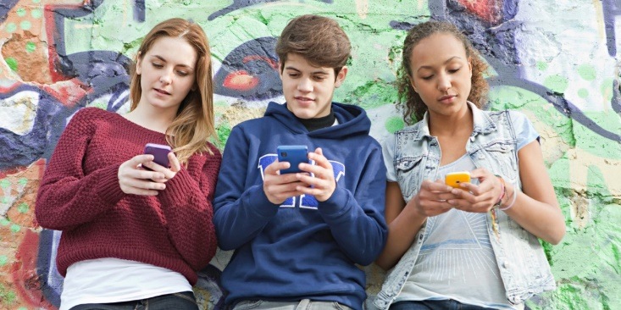
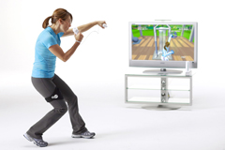
The General Problem
Physical inactivity is on the rise [25]
Can lead to obesity
Increases risk of many ailments
Is leading cause of death in U.S. [6]
Many young adults get insufficient exercise
Use electronic media (Internet, smartphone, social media, games)
Definition: Exergames gamify physical activity
Exergames may help increase physical activity in young people
Demonstrated efficacy in improving health (aerobic fitness, etc)

Slide 4
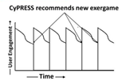
The Specific Problem
Exergame engagement starts high, but drops quickly [24]
95% of new exergamers stopped playing within 3 months
85% of new players stopped after one day!
Enjoyment of physical activity is important determinant of physical activity levels especially in young people
Defn: exergame enjoyment is “A feeling of pleasure that results from playing a videogame that provides physical activity”
Our Cypress vision: an exergame
recommender system [26]
Monitors user enjoyment of smartphone
exergames (machine learning)
Whenever waning user enjoyment is detected,
recommends new game
First step: Create questionnaire/instrument to measure exergame enjoyment → this paper’s goal!

Slide 5
Related Work
Exergame = Physical Activity + Gamification
Physical Activity Enjoyment Questionnaires
Physical Activity Enjoyment Scale (PACES) [17]
Video/computer game enjoyment questionnaires
Game Enjoyment Questionnaire (GEQ) [14, 16]
Immersive Experience Questionnaire (IEQ) [15]
No exergame enjoyment questionnaires exist!!
We propose Exergame Enjoyment Questionnaire (EEQ)
Research, synthesis and testing

Slide 6
Methodology for EEQ Creation
Synthesize EEQ
Questions about physical activity enjoyment from PACES
Questions about gamification enjoyment from GEQ, IEQ
Original questions not covered by existing questionnaires
about intrinsically rewarding activities, control and exercise
Refine EEQ using focus groups
Validate EEQ in user studies
Use EEQ to evaluate new exergames

Slide 7
Step 1: Exergame Selection
Create and test EEQ using exergames that were representative, popular and interesting to young people
Searched Android and iPhone app stores → 80 exergames
Excluded games that were 1) not free 2) buggy 3) minimal physical activity 4) unpopular 5) minimal gamification
Game | Description
Fitocracy | Personal workout trainer, achievements for workouts, uses social media.
Geocaching | Users walk to locations on real world map to explore Geocaches.
Ingress | Users walk to locations on real world map in a “capture-the-flag” style game.
Just Dance Now! | Users dance to music with on screen dance instructions.
Nike+ Running | Distance/step counter with achievements and goals.
Pokémon GO | Users walk to locations on real world map to catch Pokémon.
Resources Game | Users walk around in a real-world map collecting “resources”.
S Health | Personal workout trainer, achievements and goals for workouts.
Shape Up Battle Run | Racing game that requires user to walk, jog, or run with achievements and goals.
SpekTrek Light | Users walk or run in a real-world map and catch in-game “ghosts”.
TableZombies Augmented Reality | Augmented reality game that requires user to walk in order to move around within game.
Turf Wars | Users control territories on real-world map and walk/run based on in-game events.
Walkr: Fitness Space Adventure | Users walk to explore in-game map and earn achievements and unlocks.
Zombies, Run! | Walking/running game with challenges and achievements.
Short-listed
14 exergames

Slide 8
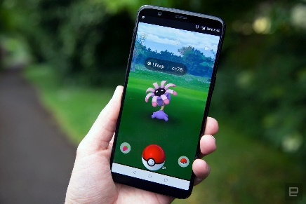
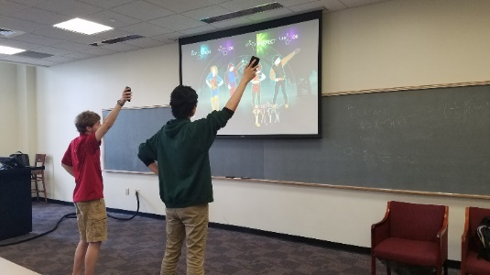
Step 1: Exergame Selection (Contd)
Further evaluated 14 shortlisted exergames using criteria
Game aspects: interesting gamication elements (e.g. fantasy, goal achievement, competition)
Exercise aspects: adequate physical exertion
Testing difficulty: easy to play, to facilitate large study
Gameplay difficulty: Easy to learn especially for first-timers
Popularity: which is a measure of user interest in playing
Exergames selected:
Pokemon Go: treasure hunt game, players catch Pokemons
Just Dance: Players dance to song while following game directions

Slide 9
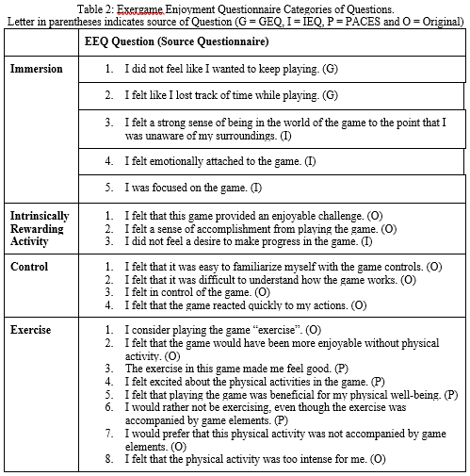
EEQ Synthesis
EEQ questions to measure engagement (From GEQ):
Absorption
Flow
Presence
Immersion
EEQ measures PA enjoyment (from PACES):
Immersion
Intrinsically rewarding activity
Control
Exercise
Additional/original questions:
Rewarding activity, control, exercise

Slide 10
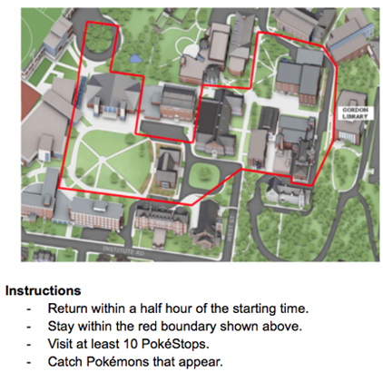
Focus Groups to Refine EEQ
Five-step IRB-approved study:
Sign informed consent
Administer-prequestionnaire (demographics, exergame background)
Play exergame (Pokemon Go or Just Dance)
Administer EEQ
Discuss EEQ and exergames in groups, repeated, revised EEQ till saturation. Focus group questions:
How do you feel about the game?
Would you play this game again?
What do you think about the physical activity in this game?
While playing, did you reach any goals, achievements or accomplishments?
Was there anything you did not like about the game?
Did anything interrupt your gameplay?
Did you have any problems while taking the questionnaire?

Slide 11
EEQ Testing/Validation
Goal: Generate quantitative evidence on whether EEQ captured user enjoyment accurately
Steps:
Users play exergame
Users respond to EEQ about exergame
Users discuss exergame experience in free-form discussions
Analyze user EEQ responses vs. free-form discussions
Pick out key phrases + code user responses
Quantify level of agreement between free from responses vs. EEQ
Results:
23 Just Dance Now participants, 15 Pokemon Go participants

Slide 12
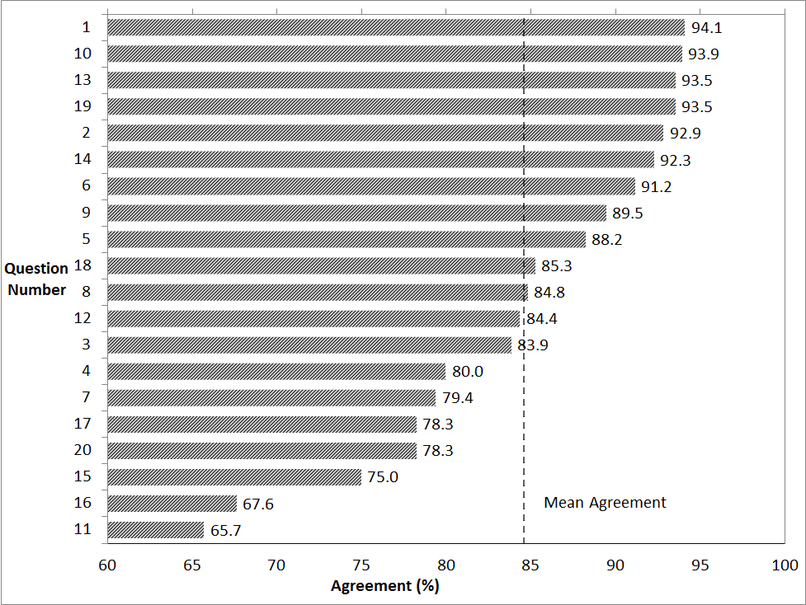
Results: Testing/Validation
Free-form discussion responses mostly agreed with EEQ responses

Slide 13
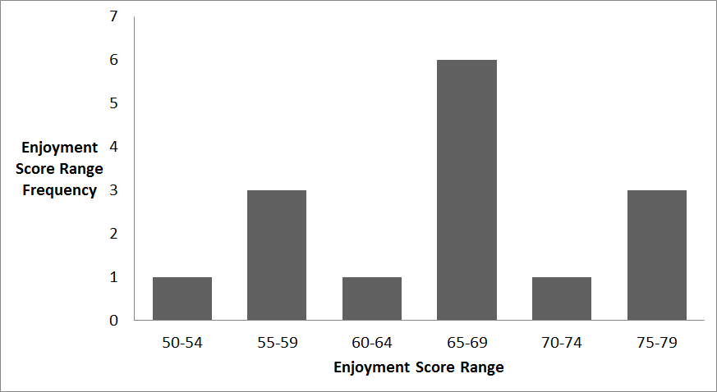
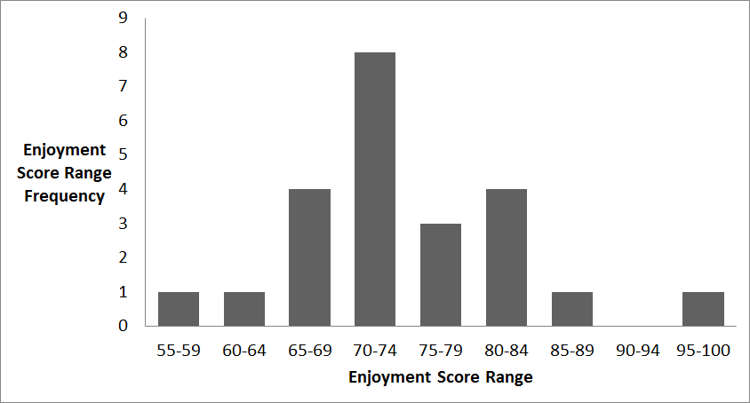
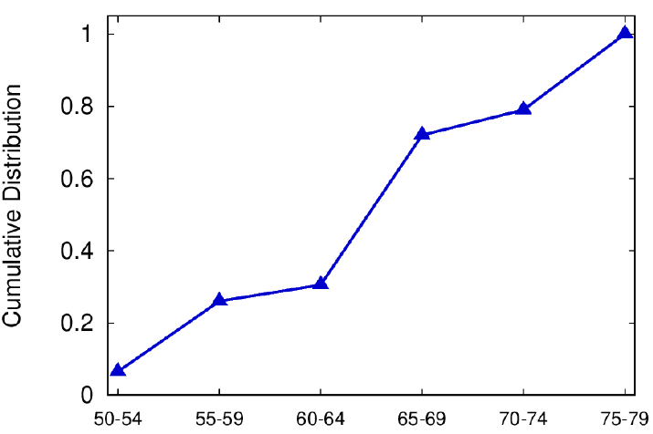
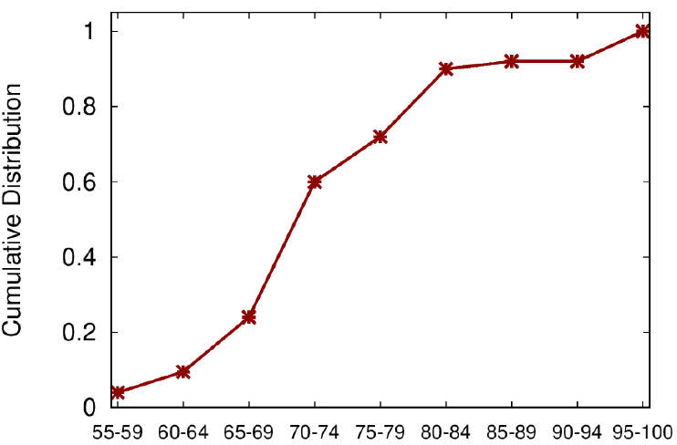
EEQ Score Distribution
Pokemon Go
Just Dance

Slide 14
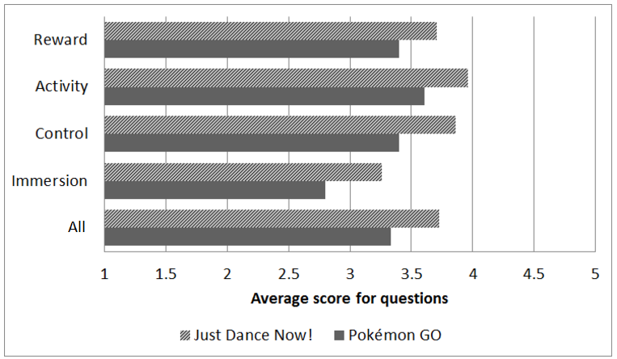
Comparison of EEQ Scores
Overall users found Just Dance more enjoyable than Pokemon Go

Slide 15
Discussion
High agreement: EEQ had high agreement (~85%) per questions with coded verbal responses
Just Dance more enjoyable: Highest EEQ scores were from Just Dance participants
Larger sample size needed: While total no. participants (38) was reasonable, more participants needed per-game (23 Just Dance, 15 Pokemon Go)
Prior exergame experience: Players who had previously played an exergame may have given lower EEQ scores
Playing alone vs. together: Players who played Pokemon Go alone enjoyed game more than those who played with others (0.73 alone vs 0.79)

Slide 16
Conclusion and Future Work
Enjoyment of physical activity is important determinant of physical activity levels
No existing questionnaire to measure exergame enjoyment
Present research to synthesize, test and validate the Exergame Enjoyment Questionnaire (EEQ) to measure exergame enjoyment
Players responses to the EEQ had a high (~85%) agreement with their coded verbal responses after playing 2 exergames
While promising, larger sample size is needed to confirm our findings
Also future work is to use in Cypress – recommender system for exergames

Slide 17
Extra Slides

Slide 18
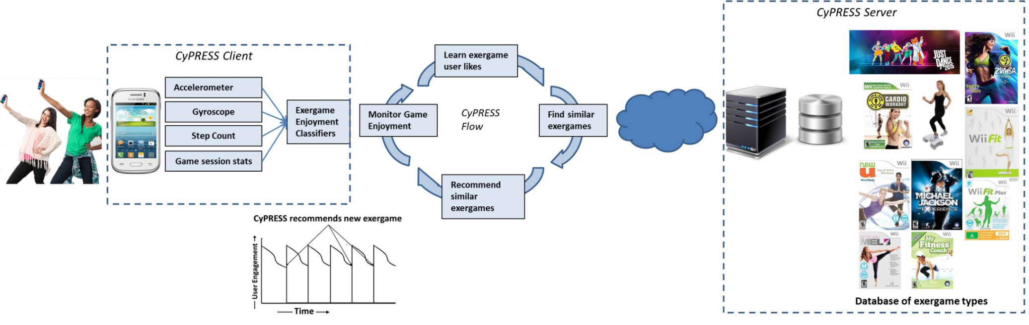
Cypress Objectives
Discovers games enjoyed by gamers by:
Actively monitoring player behaviors that indicate game enjoyment
Learns the specific types of games enjoyed by each player
Recommends similar games when players get bored/tired of their current game

Slide 19
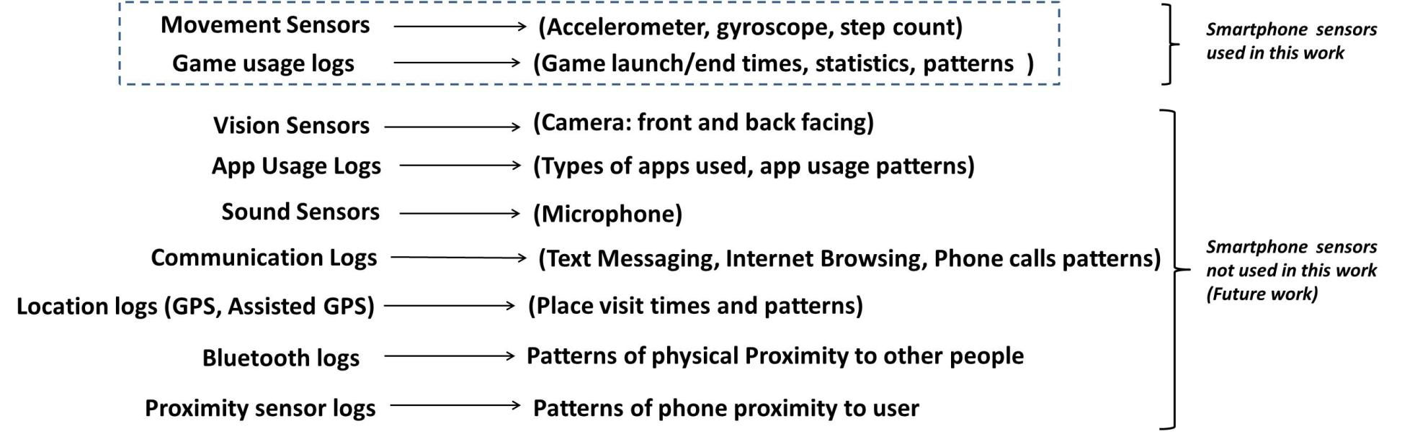
CyPRESS Overview
We initially focus on Smartphone-based Exergames
Game enjoyment inferred from player behaviors such as
Excitement when playing (smartphone accelerometer, gyroscope)
Game replay frequency (session statistics)
Increased step count (indicates user engagement especially useful for pedometer games)
Initially focus on movement sensors and game logs

