Slide 1

On Models for Game Input with Delay – Moving Target Selection with a Mouse
Mark Claypool
Notes:
Mark Claypool. On Models for Game Input with Delay - Moving Target Selection with a Mouse, In Proceedings of the IEEE International Symposium on Multimedia (ISM), (Invited Paper), San Jose, California, USA, December 11-13, 2016. Online at: http://www.cs.wpi.edu/~claypool/papers/delay-action-ism/

Slide 2
Introduction
Real-time games sensitive to delay
  Even 10s of milliseconds of delay impacts player performance and quality of experience (QoE)
Mitigate with delay compensation (e.g., time warp, player prediction, dead reckoning …)
  But when to apply (what player actions)?
  And how effective?
Need research to better understand effects of delay on games
[Claypool, 2006]
[Bernier, 2001]

Slide 3
Introduction
Real-time games sensitive to delay
  Even 10s of milliseconds of delay impacts player performance and quality of experience (QoE)
Mitigate with delay compensation (e.g., time warp, player prediction, dead reckoning …)
  But how effective?
  And when needed (what player actions)?
Need research to better understand effects of delay on games
[Claypool, 2006]
[Bernier, 2001]

Slide 4
Introduction
Real-time games sensitive to delay
  Even 10s of milliseconds of delay impacts player performance and quality of experience (QoE)
Mitigate with delay compensation (e.g., time warp, player prediction, dead reckoning …)
  But how effective?
  And when needed (what player actions)?
Need research to better understand effects of delay on games
[Claypool, 2006]
[Bernier, 2001]

Slide 5
Research in Games and Delay
Effect of delay on games?

Slide 6
Research in Games and Delay
Game Genres
[Armitage, 2003]
[Beigbeder, 2004]
UT
Warcraft
EverQuest
[Chen, 2006]
Research
[Claypool, 2005]
Quake
Effect of delay on games?
[Amin, 2013]

Slide 7
Research in Games and Delay
Game Genres
UT
Warcraft
EverQuest
Research
Quake
Effect of delay on games?
[Hajri, 2011]
[MacKenzie, 1992]
[Raeen, 2011]
Research
Target Selection
[Fitts’ Law]
Target Selection w/Delay
Moving Target Selection
[Hoffman, 2012]
[Brady, 2015]
Input Types

Slide 8
Research in Games and Delay
Game Genres
UT
Warcraft
EverQuest
Research
Quake
Effect of delay on games?
[Hajri, 2011]
[MacKenzie, 1992]
[Raeen, 2011]
Research
Target Selection
[Fitts’ Law]
Target Selection w/Delay
Moving Target Selection
[Hoffman, 2012]
[Brady, 2015]
Input Types

Slide 9
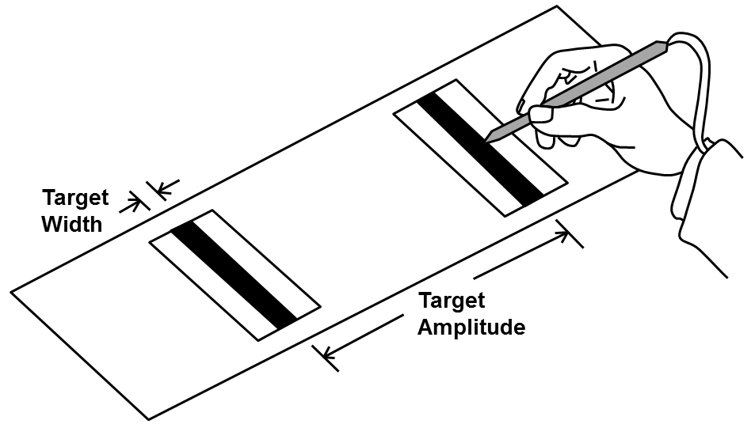
Fitts’ Law
[Fitts, 1954]
Time to select target
http://www.yorku.ca/mack/hci1992-f1.jpg

Slide 10
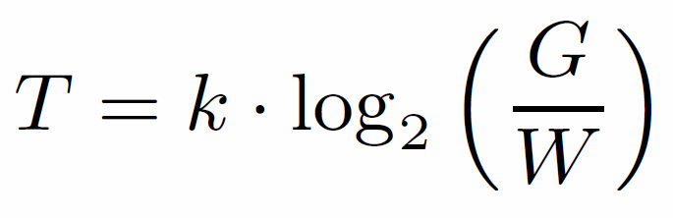
Fitts’ Law
[Fitts, 1954]
Time to select target

Slide 11
Fitts’ Law
[Fitts, 1954]
Gap distance
Width
Time to select target
Constant (determined empirically)
Index of difficulty
Robust under many conditions: limbs (hands, feet, lips, head-mounted sight, eye gaze), input devices (mouse, stylus), environments (e.g., underwater), and users (young, old, special needs, impaired).

Slide 12
Fitts’ Law
[Fitts, 1954]
Gap distance
Width
Time to select target
Constant (determined empirically)
Index of difficulty
Robust under many conditions: limbs (hands, feet, lips, head-mounted sight, eye gaze), input devices (mouse, stylus), environments (e.g., underwater), and users (young, old, special needs, impaired).

Slide 13
Limitations of Fitts’ Law
One dimension → 2 dimensions
  Change “effective width”
  Target shape mostly irrelevant
Stationary target → moving target
  Add speed to index of difficulty
  Time linear or exponential with speed
No added delay → transmission delay
  Time linear with delay
Missing? → 2d, moving target, with delay
Problem statement: Measure and model effects of delay on moving target selection with mouse
[MacKenzie, 1992]
[Jacacinski, 1980]
[Hoffman, 1991]
[Hoffman, 2012]
[Brady, 2015]

Slide 14
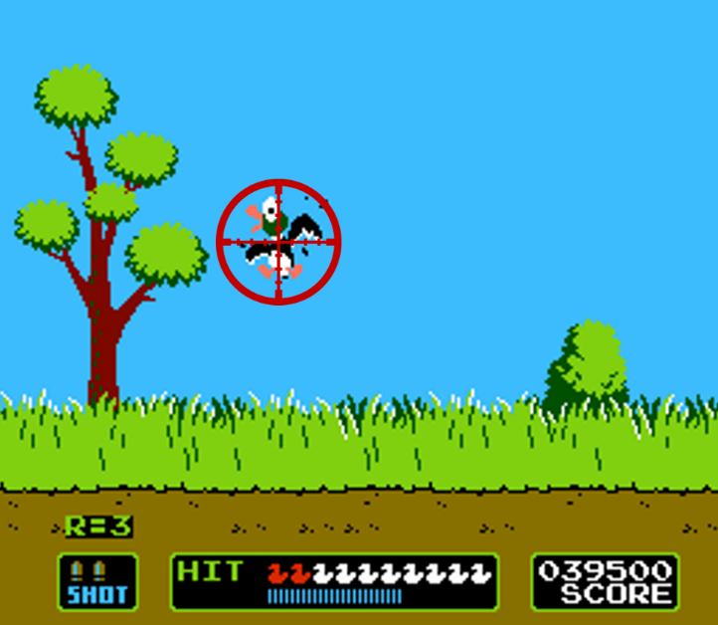
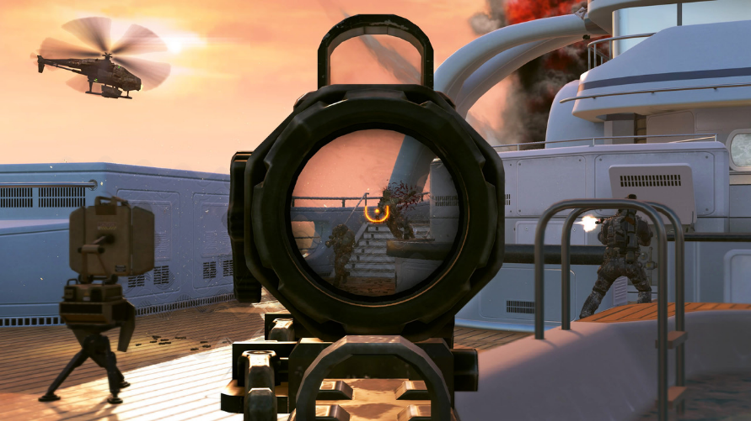
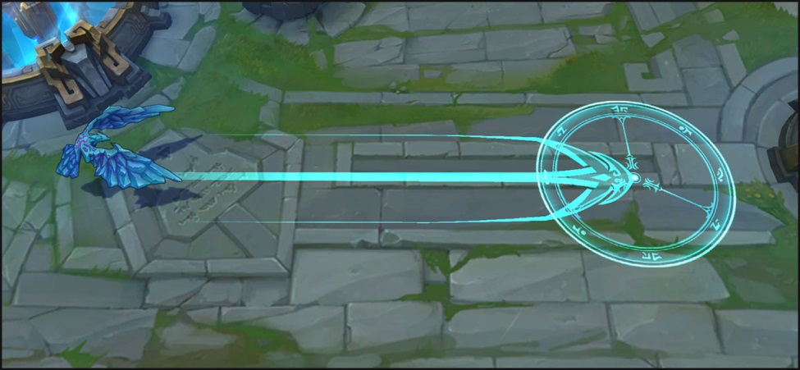
Why Moving Target Selection with Mouse?
[Call of Duty, Activision, 2003]
[Duck Hunt, Nintendo, 1984]
[League of Legends, Riot Games, 2009]

Slide 15
Outline
Introduction (done)
Methodology (next)
Results
Conclusion

Slide 16
Methodology
Develop game
  Focus player action on target selection
  Enables controlled delay
Conduct user study
Analyze results
  Graphs
  Model

Slide 17
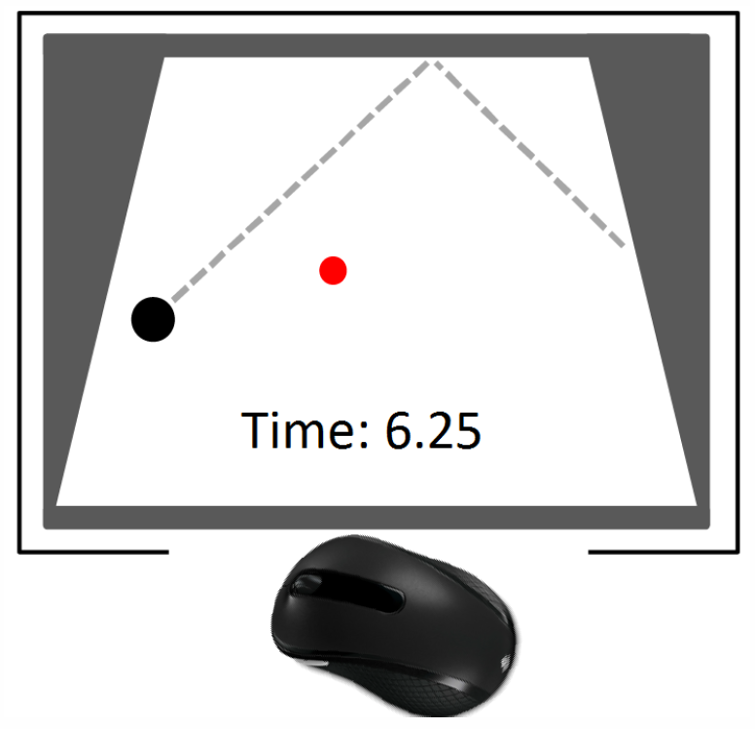
Puck Hunt
The Game of Moving Target Selection
Time to select puck with mouse

Slide 18
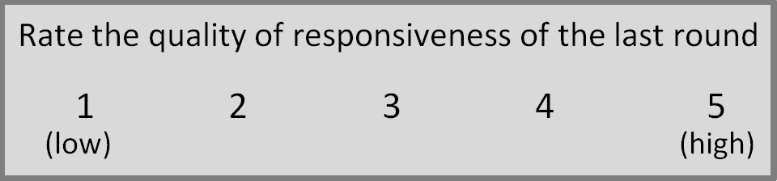
Puck Hunt
The Game of Moving Target Selection
Time to select puck with mouse
5 iterations
1 QoE for each combo

Slide 19
User Study
32 users
Ages 18-26 (mean 21 years)
23 Male, 8 female, 1 unspecified
Mean self-rating (1-5) as gamer is 3.6
Play 6+ hours of games per week

Slide 20
Outline
Introduction (done)
Methodology (done)
Results (next)
  Selection time measurement
  Selection time model
  Additional analysis
Conclusion

Slide 21
Selection Time versus Delay – Measurement
Exponential with delay
Low delays, speed doesn’t matter
High delays, speed makes it even harder

Slide 22
Selection Time versus Speed – Measurement
Somewhat non-linear at high delay

Slide 23
Selection Time versus Delay – Model
Time to select target
Exponential with delay
Exponential with speed
speed-delay interaction term

Slide 24
Selection Time versus Delay – Model
R² 0.97
F-stat 328
p < 2.2 × 10⁻¹⁶

Slide 25
Selection Time versus Delay – By Skill
Delay affects all skill levels
Low skill most impacted, high skill least impacted

Slide 26
Mouse Clicks versus Delay
Users “miss” more at high speeds
May want combined model for gamer performance

Slide 27
Comparison with Commercial Games
[Beigbeder, 2004]
Trends for Puck Hunt similar
Suggests results hold for other games

Slide 28
Quality of Experience
Linear/logarithmic decrease
Independent of speed

Slide 29
Conclusion
Need to better understand delay on game actions/input
  Delay compensation and game design that is resilient to delay
We measure and model target selection with a delayed mouse
Game and user study (30+ users) with delays from 100-500 ms and 3 target speeds
Increase in selection time even for low delays (under 200 ms)
Sharp increase in selection time for higher delays (300+ ms)
Even sharper increase in selection time for fast targets (450 px/s)
QoE sensitive to even slight delays (100 ms)
Model with exponential terms for speed, delay and combined term fits well

Slide 30
Conclusion
Need to better understand delay on game actions/input
  Delay compensation and game design that is resilient to delay
We measure and model target selection with a delayed mouse
Game and user study (30+ users) with delays from 100-500 ms and 3 target speeds
Increase in selection time even for low delays (under 200 ms)
Sharp increase in selection time for higher delays (300+ ms)
Even sharper increase in selection time for fast targets (450 px/s)
Model with exponential terms for speed, delay and combined term fits well
QoE sensitive to even slight delays (100 ms)

Slide 31
Future Work
Other input (e.g., thumbstick, buttons)
Other game actions (e.g., avatar movement)
Other model components (e.g., player skill)
Other perspectives (e.g., first person)

Slide 32


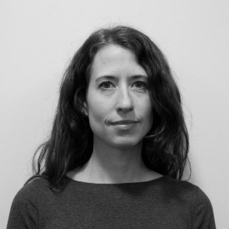
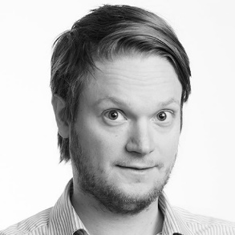
Acknowledgements
Marco Duran and Matthew Thompson
  Measuring base delay
  Conducting user study
Ragnhild Eg and Kjetil Raaen
  Initial Puck Hunt version
  Experimental design

Slide 33
On Models for Game Input with Delay – Moving Target Selection with a Mouse
Mark Claypool
Notes:
Mark Claypool. On Models for Game Input with Delay - Moving Target Selection with a Mouse, In Proceedings of the IEEE International Symposium on Multimedia (ISM), (Invited Paper), San Jose, California, USA, December 11-13, 2016. Online at: http://www.cs.wpi.edu/~claypool/papers/delay-action-ism/

