Slide 1
The Effects of Network Latency on Competitive First-Person Shooter Game Players
Atsuo Kuwahara
James Scovell
Jamie Sherman
Shengmei Liu
Mark Claypool
Worcester Polytechnic Institute
Intel Corporation
Notes:
Hi my name is Shengmei. My advisor is Prof Mark Claypool, and my research area focus on latency and gaming.
Today I’ll present the results regarding the effects of local latencies on competitive first person shooter game players.

Slide 2
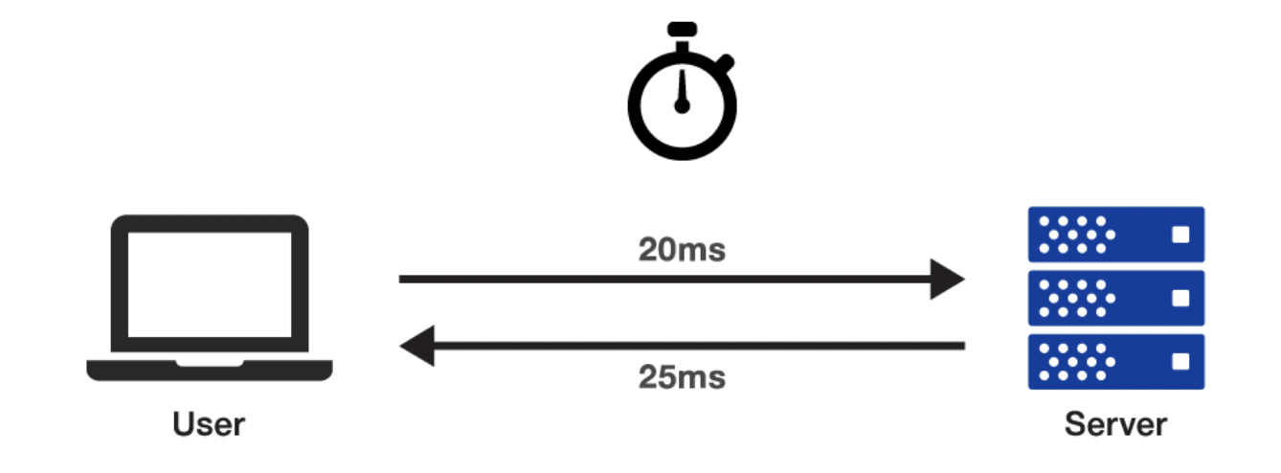
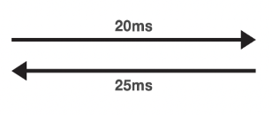
Motivation
Upgrade
20 ms
40 ms
25 ms
50 ms
Performance
🤨
😃
Quality of Experience
Mouse
Display
Local latency
Notes:
It’s a common knowledge that decrease in latency helps game players, and local latency is an important type of latency. It’s the time between mouse clicking and rendering on the screen.
Now if we upgrade the system to a high end gaming system, there would be shorter local latency. The question is how much does the upgrade help competitive fps players?
Talking about affecting gamers, the 1st aspect would be performance. This would affect your ranking in the game.
We have two matrix for performance, and they are weapon accuracy and in-game score.
We also want to know how would lower local latency helps players feeling, and player feeling is represented by the quality of experience.

Slide 3
Related work
Armitage et al.:
Latency tolerance for Quake 3 is about 150~180 ms.
Dick et al.:
UT2003 players suffer with latency and jitter as low as 100 ms
Fritsch:
Players of the role-playing game Everquest2 can tolerate hundreds of milliseconds of network latency
Sheldon et al.:
Some aspects of play in the real-time strategy
game Warcraft 3 are not affected by up to a second of network latency
Ok…
but why?
Low latency < 100 ms
Competitive gamers
Latency compensation
Notes:
While beneficial, these works typically studied higher
latencies than those in our paper ,and higher than usually
experienced by competitive game players, and do not identify
nor isolate the game’s latency compensation techniques as
does our work

Slide 4
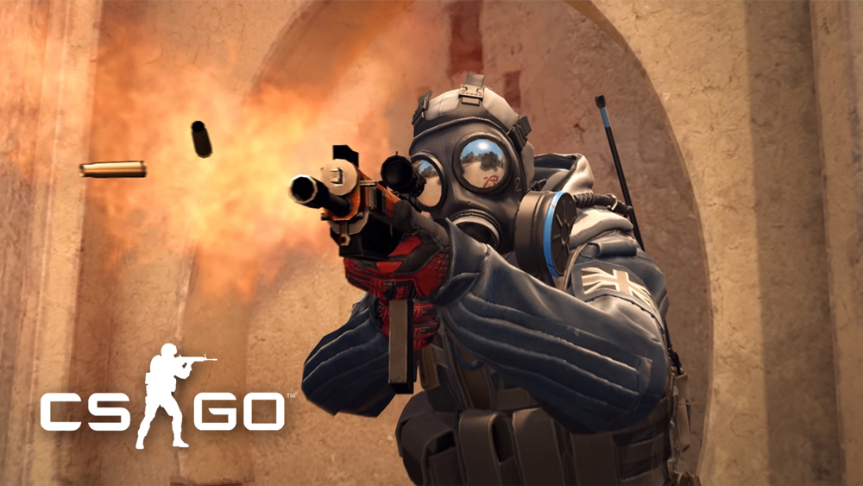
User Study
Game customization
Deathmatch FFA
Single player with 20 bots
3.5 mins per round
Client-server architecture
Network latency
Shuffled total network latency (25, 50, 100, 150 ms)
Shuffled latency compensation on and off
Questionnaires (Demographic, In-game surveys)
<1
25
50
100
150
0
100
200
300
(ms)
Good
Internet Connection
Moderate
Internet connection
Other
Notes:
A total number of 43 users were recruited for the local latency study, and All the users are experienced gamers with over 100 hours in the game.
Different types of system would cause different local latencies. The latency for gaming system are mainly in a range of 0 -100 ms. Normal PCs are like 100-200 ms. Consoles and TVs would have latencies even higher.
The base local latency of the gaming system used in both of the studies was measured at 25 ms. For the local latency study,
There are 5 shuffled total latency for the rounds, and they are 25 50 75 100 and 125 ms.
For the network latency study, A total number of 25 users were recruited, and All the users are also experienced gamers with over 100 hours in the game
Normally speaking, network latency from 0 to 100 indicates a good internet connection, moderate internet connection may have latency between 100 and 200 ms. And bad internet connections would cause even higher network latency.
The base round trip time for the LAN in the study was less than 1 ms.
There are 4 shuffled total latency values for the rounds, and they are 25, 50, 100, 150 ms.

Slide 5
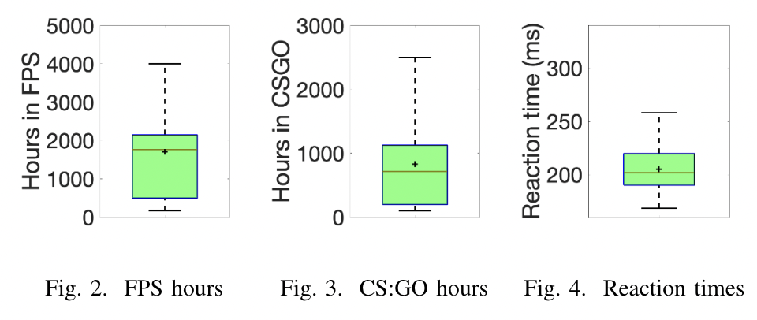
Demographics
25 Users (> 100 hrs in CSGO)
Age: 20.8 (3.0)
Gender: all males
More information
FPS hours
CSGO hours
Reaction time
Notes:
A total number of 43 users were recruited for the local latency study, and All the users are experienced gamers with over 100 hours in the game.
Different types of system would cause different local latencies. The latency for gaming system are mainly in a range of 0 -100 ms. Normal PCs are like 100-200 ms. Consoles and TVs would have latencies even higher.
The base local latency of the gaming system used in both of the studies was measured at 25 ms. For the local latency study,
There are 5 shuffled total latency for the rounds, and they are 25 50 75 100 and 125 ms.
For the network latency study, A total number of 25 users were recruited, and All the users are also experienced gamers with over 100 hours in the game
Normally speaking, network latency from 0 to 100 indicates a good internet connection, moderate internet connection may have latency between 100 and 200 ms. And bad internet connections would cause even higher network latency.
The base round trip time for the LAN in the study was less than 1 ms.
There are 4 shuffled total latency values for the rounds, and they are 25, 50, 100, 150 ms.

Slide 6
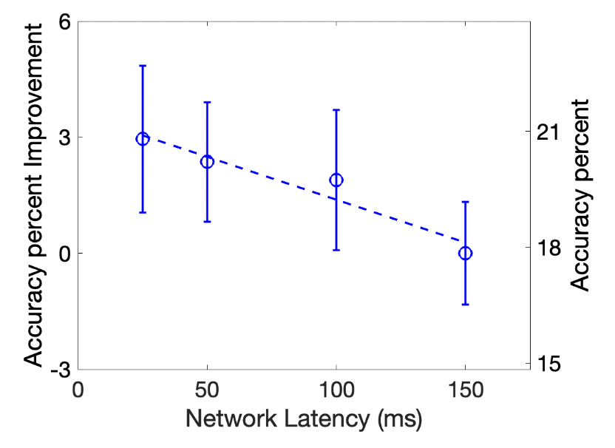
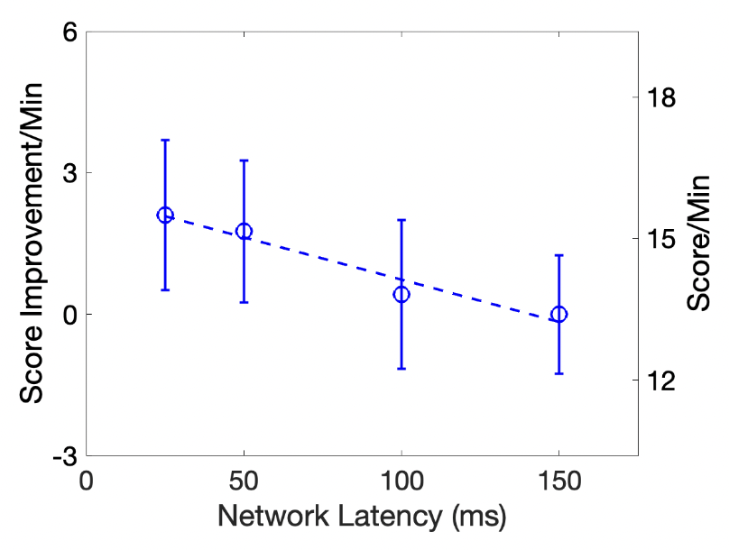
Results (Player Performance)
Decrease in latency by 100 ms improves overall accuracy percent by 2.
Decrease in latency by 100 ms improves score by 2 points per minute.
Notes:
Here are some of our results.
The graph on the left denotes accuracy versus latency. The x-axis is latency in milliseconds, and the y-axis on the right is accuracy and the y-axis on the left is the accuracy improvement compared to 125 ms condition. The rectangles are the mean values bounded by 95% confidence interval. The dashed line denotes the linear regression for the mean values. The regression fits the data well wit the R^2 high at 0.95 and a significant p value. We can learn that Accuracy degrades linearly with local latency within low range,
and A decrease in local latency by 100 ms improves accuracy percent by 8.
The graph on the right is for score. The
axes and points are as in the left graph, but the data is the score instead of accuracy. The linear regression fits the data well with R^2 high at 0.98 and a very low p value. We can learn that Score also degrades linearly with local latency within low range,
and A decrease in local latency by 100 ms improves score by 12 points. For reference, 12 points means 6 more kills in CSGO.
Based on the two graphs, we get the conclusion that player performance degrades linearly with local latency.

Slide 7
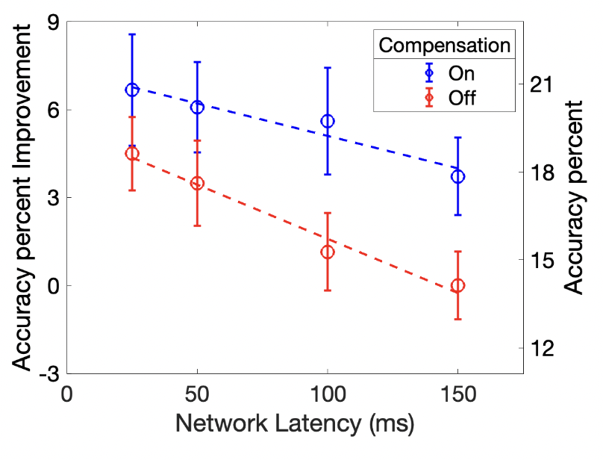
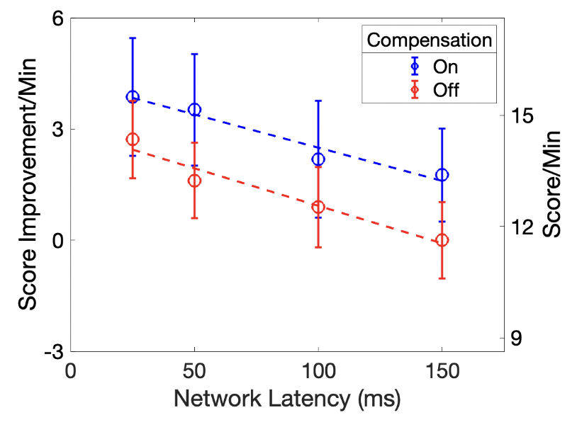
Results (Latency Compensation)
Accuracy degrades slightly faster with network
latency for compensation off than for compensation on.
Latency compensation improves accuracy by about 19 percent
Latency compensation improves score by about 1.5
points per minute.
Notes:
Here are some of our results.
The graph on the left denotes accuracy versus latency. The x-axis is latency in milliseconds, and the y-axis on the right is accuracy and the y-axis on the left is the accuracy improvement compared to 125 ms condition. The rectangles are the mean values bounded by 95% confidence interval. The dashed line denotes the linear regression for the mean values. The regression fits the data well wit the R^2 high at 0.95 and a significant p value. We can learn that Accuracy degrades linearly with local latency within low range,
and A decrease in local latency by 100 ms improves accuracy percent by 8.
The graph on the right is for score. The
axes and points are as in the left graph, but the data is the score instead of accuracy. The linear regression fits the data well with R^2 high at 0.98 and a very low p value. We can learn that Score also degrades linearly with local latency within low range,
and A decrease in local latency by 100 ms improves score by 12 points. For reference, 12 points means 6 more kills in CSGO.
Based on the two graphs, we get the conclusion that player performance degrades linearly with local latency.

Slide 8
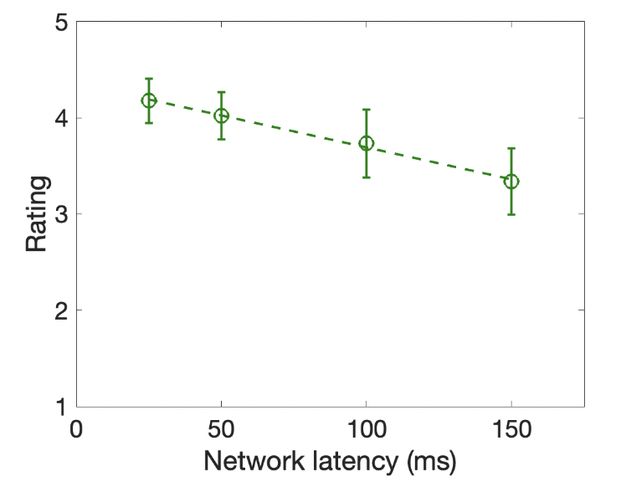
Results (Quality of Experience)
Decrease in latency by 100 ms improves QoE by 0.7 on a 5-point scale.
Notes:
For an overall measure of QoE, we compute the mean ratings by weighting all questions equally. In this graph, the x axis is local latency, and the y axis is rating. The linear regression fits the mean values well with R^2 high at 0.96 and a significant p value. Same as performance, QoE also degrades linearly with local latency.
A decrease in latency by 100 ms improves QoE by 1.5 out of 5

Slide 9
Future Work
More games
…..
More weapons
…..
More skills
…..
0
100
200
300
Higher latencies
(ms)
…..
Good
Moderate
Other
Notes:
Our work here focus on the impact of low range of latencies on experienced CSGO gamers. Future work can extend to more games,
more types of weapons,
and more skill groups of players.
A comparision of network latency and local latency in a higher range would be interesting as well. + variation

Slide 10
The Effects of Network Latency on Competitive First-Person Shooter Game Players
Atsuo Kuwahara
James Scovell
Jamie Sherman
Shengmei Liu
Mark Claypool
Worcester Polytechnic Institute
Intel Corporation
Notes:
Hi my name is Shengmei. My advisor is Prof Mark Claypool, and my research area focus on latency and gaming.
Today I’ll present the results regarding the effects of local latencies on competitive first person shooter game players.

