Slide 1
The Effects of Latency and Game Device on Moving Target Selection
An MS Thesis Presentation
-Aritra Kundu (akundu@wpi.edu)
Advisors:
Prof Mark Claypool – Worcester Polytechnic Institute
Prof Ragnhild Eg – Kristiana University College
Reader:
Prof Charles Roberts - Worcester Polytechnic Institute
Notes:
This PowerPoint Template includes a series of slide masters with predefined layouts and color schemes for formatting slides
Slide Masters are displayed when you right click on a slide and select Layout from menu

Slide 2
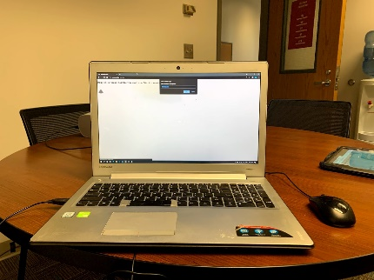
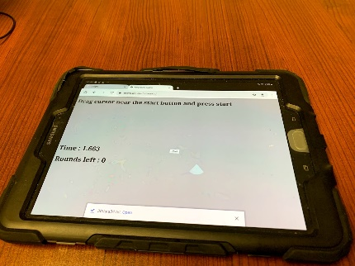
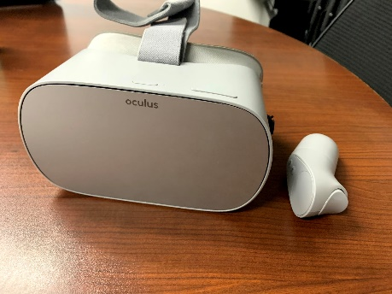
Introduction
Multiple platforms and devices for gaming.
Different interaction techniques.
“Does the device matter for task performance?”

Slide 3



Introduction - Latency
“What are the effects of latency on different gaming devices with different interaction techniques?”

Slide 4
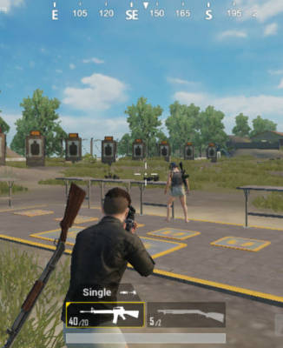
Introduction- Moving Target Selection
Most computer games today provide several player actions.
We isolate player action to study affects of latency.
Assess latency
on moving target selection for different devices.
.

Slide 5
Introduction - Motivation
RQ1-Does performance differ according to device?
RQ2-Does performance differ according to latency?
RQ3-Does performance differ according to task difficulty?

Slide 6
Outline Of Talk
Background And Related Work
Methodology
Analysis
Discussion
Conclusion And Future Work

Slide 7
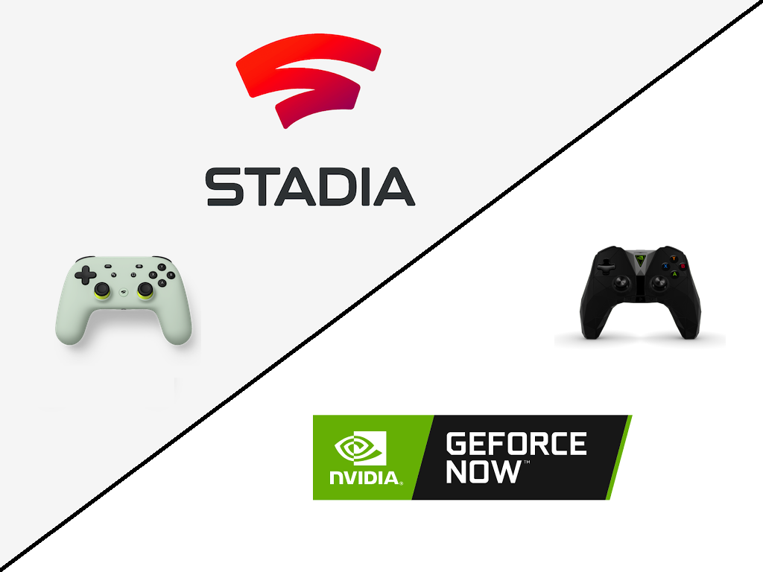
Background – Latency and Game Architectures.
Latency In Games
  Mainly two sources : network latency and local latency.
Game Architectures
  Traditional games are client heavy
  Cloud gaming streams output as
  video to the client.

Slide 8
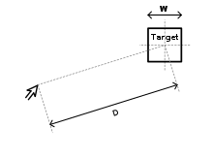
Background – Target Selection
Target Selection:
  Fundamental isolated action of selecting a moving target with a pointing device.
  Challenging tasks and performed frequently in gaming.
  Pioneering work done by Fitts’ with later models taking factors such as delay into consideration.

Slide 9
Related Work
Claypool et al.[1] modelled target selection by developing a game with latency with added motion parameter of turn angle, time between target turns.
Gutwin et al.[2] built a custom game that emulated classic pointing and interception tasks and tested on users using a touchscreen, mouse, gamepad, drawing tablet.
Raaen et al.[3] introduced an exploratory setup which they use in a systematic empirical investigation of latency in VR and also do a qualitative study on subjective experience

Slide 10
Outline Of Talk
Background And Related Work
Methodology
Analysis
Discussion
Conclusion And Future Work

Slide 11

Methodology
Steps:
Select Devices
Select Devices
Build App
Design Study
Analyze Results

Slide 12
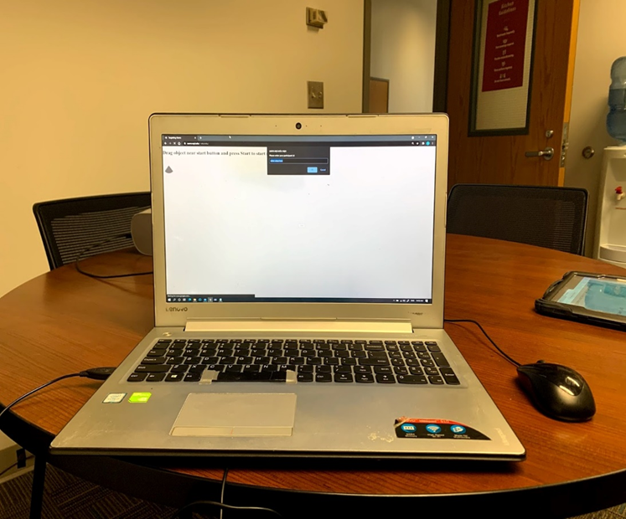
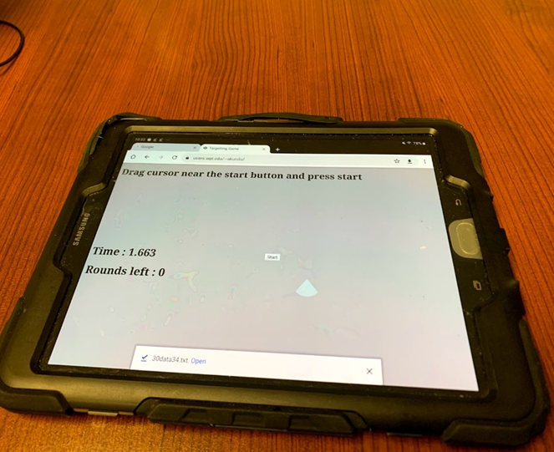

Methodology – Select Devices
  Devices
    PC
    Provides mouse and keyboard for input.
    Tablet
    Provides human touch as input
    Virtual Reality
    Provides controller as input.

Slide 13

Game Design – Build Application

Slide 14


Game Design – Build Application
Game design
  Pointer
    Changes color when clicked to give visual feedback on experienced delay according to input.
    Triangle shape with top tip of triangle as co-ordinates.

Slide 15
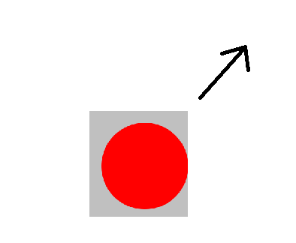
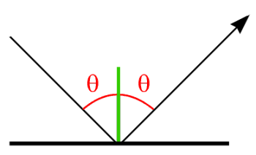
Game Design – Build Application
Game design
  Target
    circle shape which is red in color.
    Moves with constant velocity along a straight line and then bounces in a direction of equal angle.

Slide 16
Game Design – Build Application
Game design
  Delay
    All player action was delayed such as dragging and clicking to simulate local latency or latency as in a cloud environment
Game rounds:
Game allows to vary speed, latency and target size.
User was asked quality of experience question once for each setting.
How was the previous game session? (Enter a number [1-5])", "1.Bad 2.Poor 3.Fair 4.Good 5.Excellent”)

Slide 17
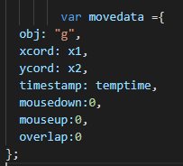
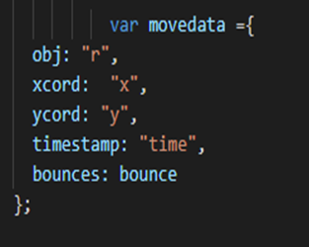
Game Design – Build Application
Data
  Data was stored in JSON format and downloaded to the devices. Metrics stored include x,y coordinates , selection time, number of clicks, qoe scores, target bounces, overlap condition.

Slide 18
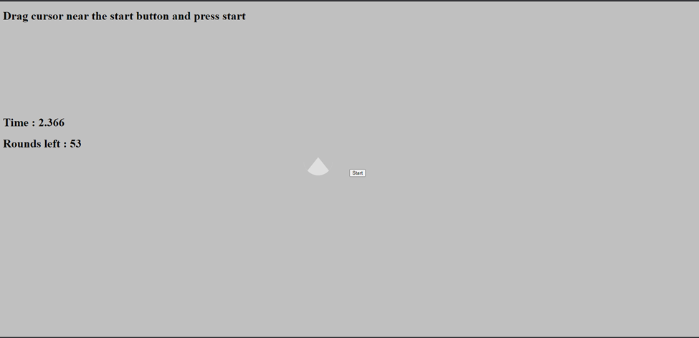
Game Design- Demo
https://users.wpi.edu/~akundu/

Slide 19
Game Design – Design Study
 | Low | Medium | High
Added Latency | 0ms | 75ms | 150ms
Total Latency Experienced | 69ms | 144ms | 219ms
Size | 50px | 60px | 70px
Speed | 0 px/second | 400 px/second | 500 px/second

Slide 20
Methodology –Design Study
Participants were recruited through mailing lists at WPI. Majority of participants were undergraduate students.

Slide 21
Outline Of Talk
Background And Related Work
Methodology
Analysis
Discussion
Conclusion And Future Work

Slide 22
Analysis-Demographic Information
N | Age | Gender | Gamer
30 | 20.7 (2.89) | 19 (M) 10 (F) 1? | 3.6 (1.21)

Slide 23
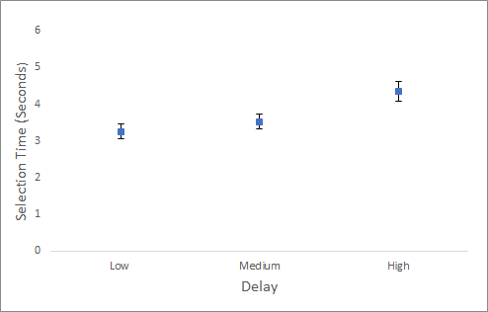
Analysis – Selection Time- Delay
High delays have highest, followed by medium , followed by low delays.

Slide 24
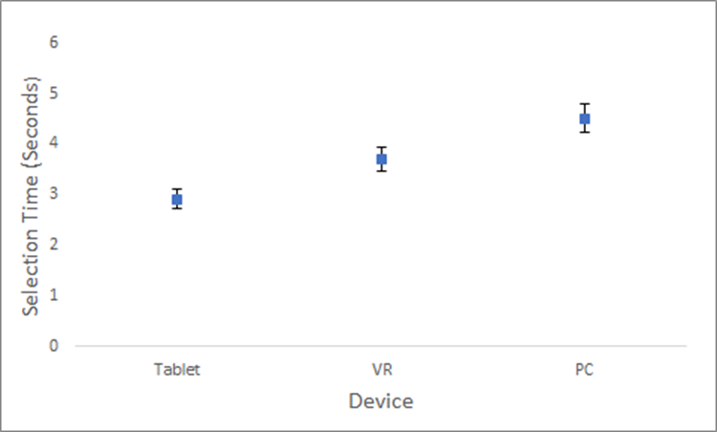
Analysis -Selection Time- Device
PC has highest selection times followed by VR, followed by tablet

Slide 25
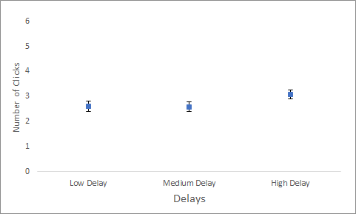
Analysis – Clicks – Delay
Low and medium delays have similar clicks, high delays have more clicks.

Slide 26
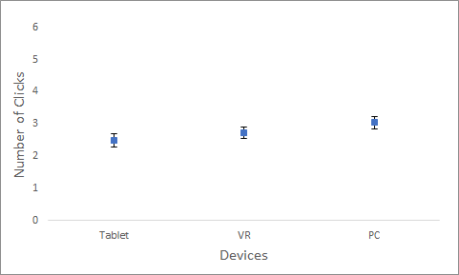
Analysis – Clicks- Device
PC has most number of clicks followed by VR followed by Tablet.

Slide 27
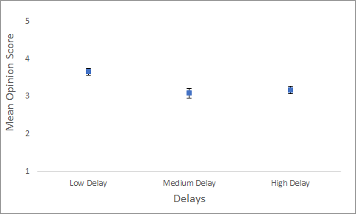
Analysis – QoE - Delay
User Experience: 1(low)-5(high).
Low Delay has higher score.

Slide 28
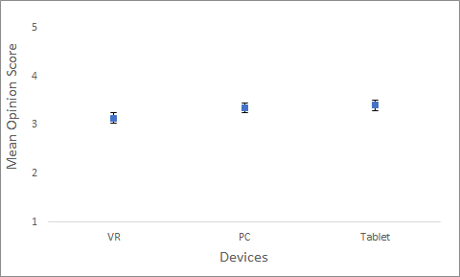
Analysis – QoE - Device
Tablet has highest rating followed by PC, followed by VR.

Slide 29
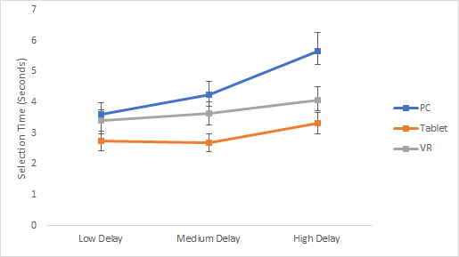
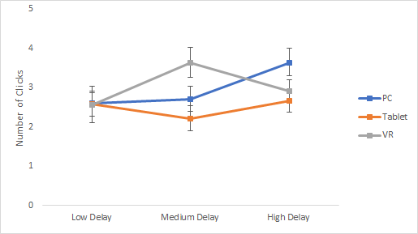
Analysis - Interaction Analysis
PC higher than VR
which is higher than Tablet
No clear relationship for clicks.

Slide 30
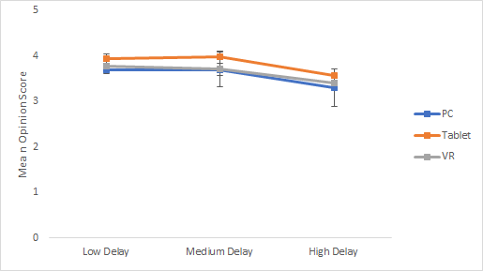
Analysis - Interaction Analysis
QOE score decrease for
High delay for all devices.
Tablet has highest scores
Followed by VR,
Followed by PC.

Slide 31
Analysis - Analysis Of Devices
After each device was finished, users were asked to rate the devices from 1(low) -5(high).
Device | Interaction Experience | Ease of Use of Device | Feeling of Control | Immersiveness of Device
PC | 3.26 | 3.59 | 3.1 | 2.4
Tablet | 3.9 | 3.9 | 3.6 | 2.83
VR | 3.76 | 3.6 | 3.53 | 3.9

Slide 32
Outline Of Talk
Background And Related Work
Methodology
Analysis
Discussion
Conclusion And Future Work

Slide 33
Discussion
RQ1-How does player performance differ according to device?
  The PC with the mouse has the highest selection times and tablet had lowest selection times.
  The tablet has the fewest number of clicks followed by VR. PC with mouse has the highest number of clicks. Maybe this could be because of interaction of the input and the surfaces.
RQ2-How does player performance differ according to latency?
  We see that as latency increases selection time increases.
  We see the number of clicks is similar for low and medium delays but is higher for high delays. Maybe people are more sensitive to high delays.

Slide 34
Discussions
RQ3-How does player performance differ according to task difficulty?
  Task difficulty varied with target speed (slow, medium and fast) and target size (large, medium and small).
  As task difficulty increases, selection times increase.
  Number of clicks is similar for large and medium size targets but is higher for large size targets.
.

Slide 35
Conclusion
  A custom application was built to study the isolated action of moving target selection to understand effects of latency.
  We had the same setup for each device. We tested our application and obtained data from 30 recruited participants.
  Analysis of data shows PC with mouse has highest clicks and selection times followed by VR and Tablet has lowest selection times and clicks. Higher delays and task difficulties have higher selection times and clicks.

Slide 36
Future Work
Similar experiments with more devices.
Broader demographic and gamer experiences for recruitment.
Similar studies for different gaming actions.

Slide 37
Thank You. Questions?

Slide 38
References
1. Game Input with Delay - Moving Target Selection Parameters. M. Claypool, A. Cockburn, C. Gutwin. 2019. In Proceedings of the 10th ACM Multimedia Systems Conference (MMSys), Amherst, MA, USA
2. Effects of Local Latency on Game Pointing Devices and Game Pointing Tasks. C. Gutwin, M. Long. Glasgow, Scotland : 2019. In Proceedings of the ACM SIGCHI Conference on Human Factors in Computing Systems (CHI).
3. Playing with delay: An Interactive VR Demonstration. K. Raaen, R. Eg, I. Kjellmo. New York, : 19. Association for Computing Machinery, 2019. Proceedings of the 11th ACM Workshop on Immersive Mixed and Virtual Environment Systems MMVE '19. pp. 19–21

