Slide 1


Improving TCP Slow Start Performance in Wireless Networks with SEARCH
Maryam Ataei Kachooei
Advisor: Professor Mark Claypool
Reader: Professor Shubbhi Taneja
Master of Science in Computer Science
December 16, 2024

Slide 2






Outline
Motivation and Goal
Related Works
SEARCH Algorithm
  Version 1
  Version 2
SEARCH Parameter Analysis
Performance Evaluation
Conclusion and Future Work

Slide 3
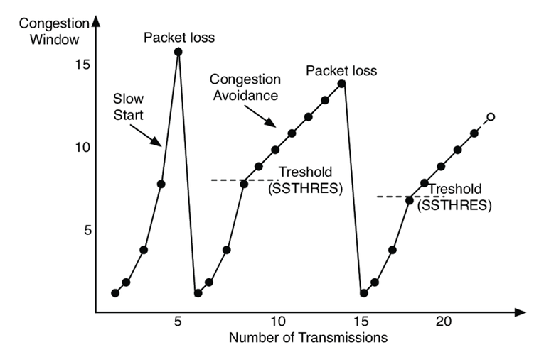
Internet Congestion Control Overview
TCP congestion window during slow start, doubling for each RTT
Packet loss happen Exit slow start
Hystart is designed to exit TCP slow start before overshooting link throughput to avoid packet loss
Hystart is on as Linux default

Slide 4
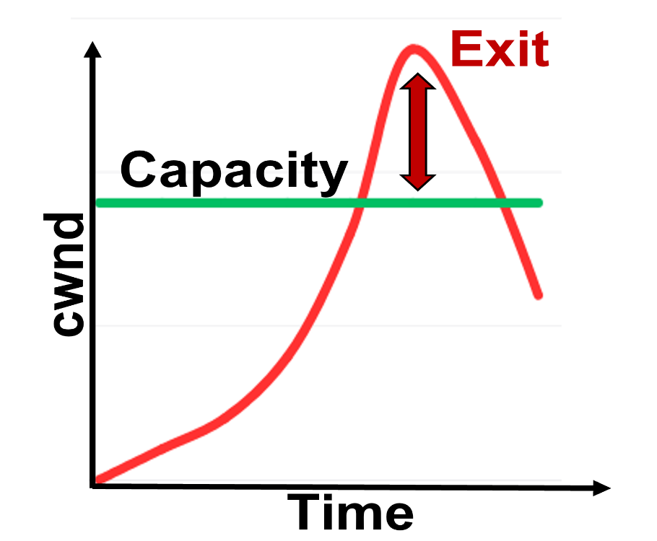
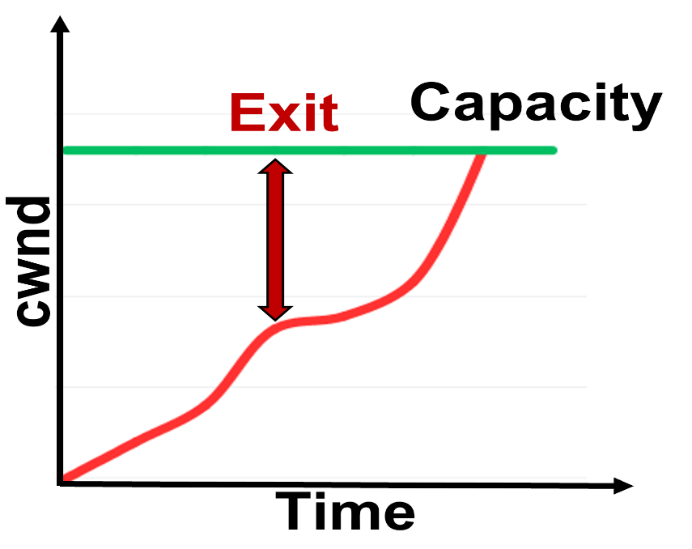

Motivation and Goal
Over high BDP networks:
Enabled Hystart
(default TCP)
Enter congestion avoidance too early resulting in underutilization of bandwidth
Increase transfer time for application data
Premature Exit

Slide 5

Motivation and Goal
Over high BDP networks:
Enabled Hystart
(default TCP)
Disabled Hystart
Throughput overshooting
Packet loss
Premature Exit
Late Exit

Slide 6
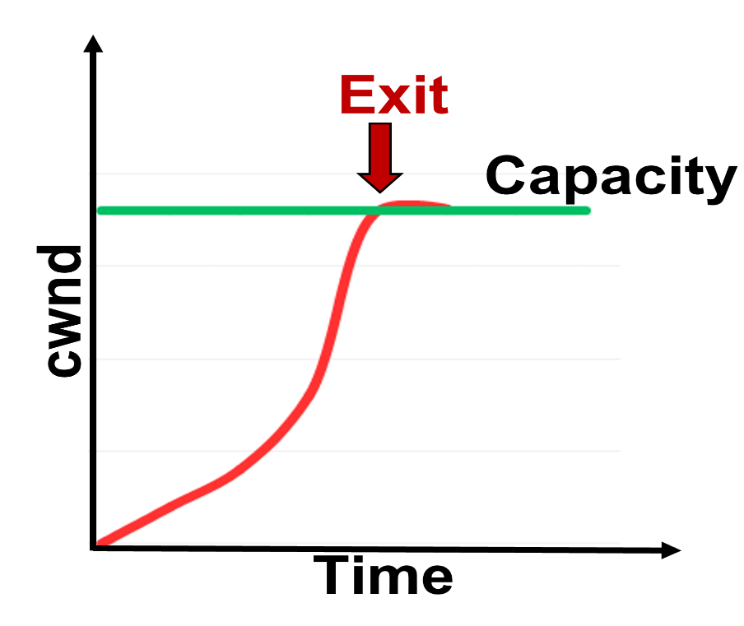
Motivation and Goal
Over high BDP networks:
Enabled Hystart
(default TCP)
Disabled Hystart
Goal
Premature Exit
Late Exit
Exit at Choke point

Slide 7
Outline
Motivation and Goal
Related Works
SEARCH Algorithm
  Version 1
  Version 2
SEARCH Parameter Analysis
Performance Evaluation
Conclusion and Future Work

Slide 8
Related Works: TCP Slow Start
HyStart++ (Huang & Olson)
  Gradual congestion window growth (Limited Slow Start phase).
  Limitations: Premature exits in some scenarios.
  SEARCH Advantage: Exits precisely at capacity using delivered bytes.
Personalized FAST TCP (Ye et al.)
  Improves performance using queuing delay ratio.
  Limitations: Struggles in dynamic environments.
  SEARCH Advantage: Exits slow start based on capacity, not queuing delay.
ABCSS (Kasoro et al.)
  Combines byte counting with slow start.
  Limitations: Congestion in high BDP networks.
  SEARCH Advantage: Normalizes delivery rates over multiple RTTs.

Slide 9
Related Works: TCP in High BDP Networks
Fast Bandwidth Estimation (Li et al.)
  Refines ACK intervals for bandwidth estimation.
  Limitations: Struggles in changing environments.
  SEARCH Advantage: Adapts dynamically with delivered bytes.
S-CUBIC (Guo et al.)
  Uses prior flow data for bandwidth estimation.
  Limitations: Inaccurate in dynamic environments.
  SEARCH Advantage: Smooths delivery rates across RTTs.
BEST Algorithm (Kachooei et al.)
  Bandwidth estimation via packet-pair measurements.
  Limitations: Challenges in variable bandwidth/RTT.
  SEARCH Advantage: Reliable slow start exits in fluctuating networks.

Slide 10
Outline
Motivation and Goal
Related Works
SEARCH Algorithm
  Version 1
  Version 2
SEARCH Parameter Analysis
Performance Evaluation
Conclusion and Future Work

Slide 11
SEARCH Idea
Slow start Exit At Right Chokepoint (SEARCH)
8a
sent bytes
delivered bytes
4a
capacity
4a
capacity
2a
2a
a
a
t₁
t₂
t₃
t₄
t₅
t₁
t₂
t₃
t₄
Round-trip time
Round-trip time

Slide 12
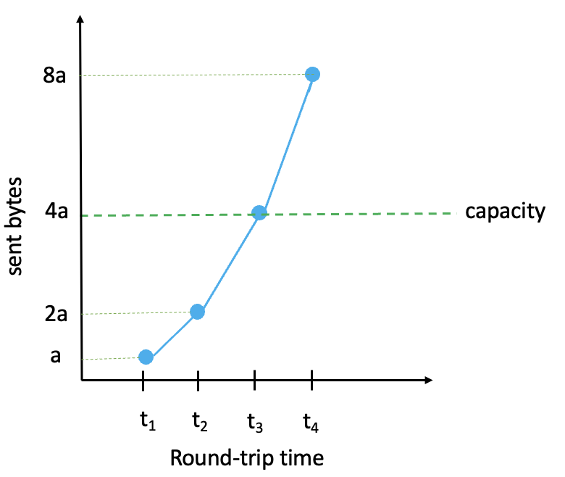
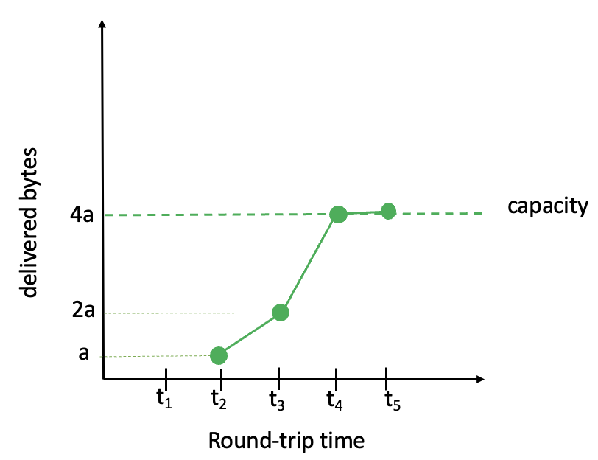
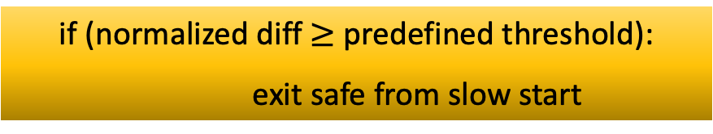
SEARCH Version 1
curr delv byte
diff = sent byte – curr delv byte
sent byte
normalized diff = diff / sent byte
if (normalized diff $≥$ predefined threshold):
exit safe from slow start

Slide 13
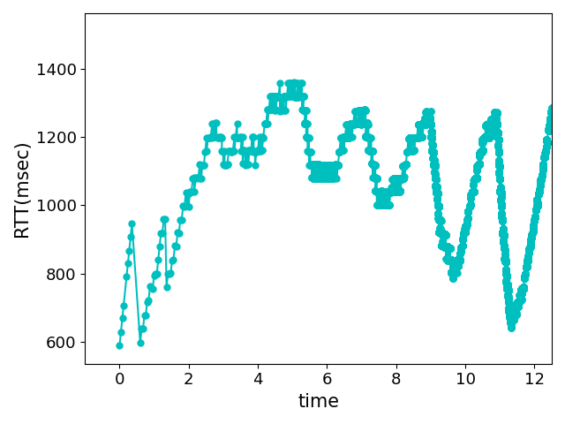
Challenges
RTT
Variable RTTs (est. bytes sent an RTT ago?)
Not caused only by congestion on the forward link
Attributable to uplink acknowledgments on backward link
Limited memory on server
Memory allocated per flow
Unable to store history for each received ACK
window
Bin
Bin
Bin

Slide 14

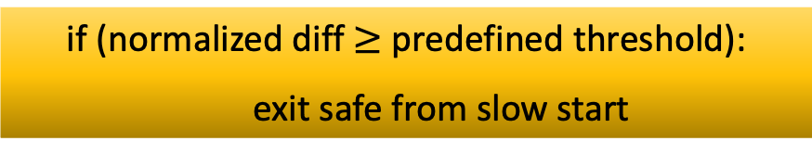
SEARCH Version 2
8a
8a
estimated sent = 2 × prev delv
sent bytes
curr delv
delivered bytes
4a
capacity
4a
diff = estimated sent – curr delv
2a
2a
a
a
normalized diff = diff / estimated sent
t₁
t₂
t₃
t₄
t₅
t₆
t₁
t₂
t₃
t₄
t₅
Round-trip time
Round-trip time
if (normalized diff $≥$ predefined threshold):
exit safe from slow start

Slide 15
Outline
Motivation and Goal
Related Works
SEARCH Algorithm
  Version 1
  Version 2
SEARCH Parameter Analysis
Performance Evaluation
Conclusion and Future Work

Slide 16
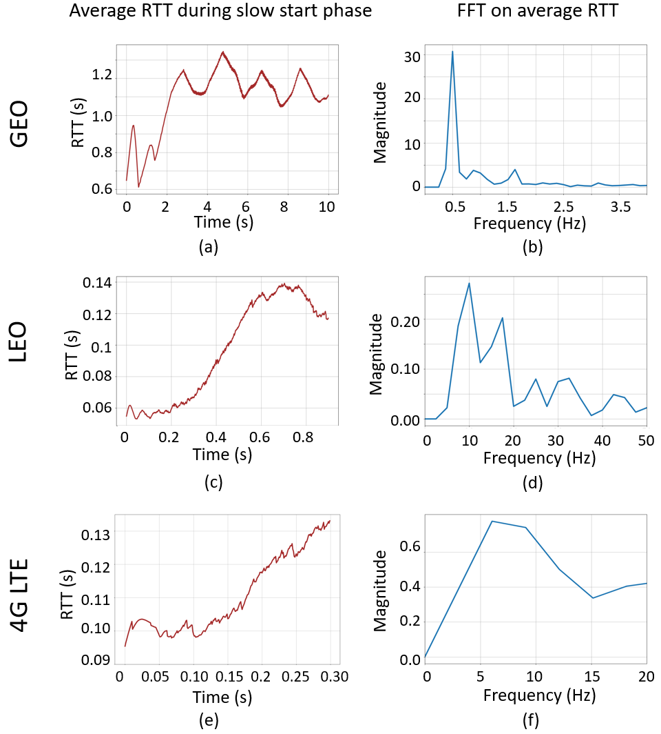
Window Size Parameters
Calculate Window Size from RTT Frequency Characteristics by FFT analysis:
  Periodic cycle = 1/ Primary peak in FFT
  Window size = Periodic cycle / initial_rtt
Viasat: initial_rtt = 600 ms primary pick = 0.5 Hz
Window size = 2 / 0.6 ≈ 3.33 RTTs
Starlink: initial_rtt = 30 ms primary peak = 10 Hz
Window size = 0.1 / 0.03 ≈ 3.33 RTTs
LTE: initial_rtt = 60 ms primary peak = 6 Hz
Window size = 0.17 / 0.06 ≈ 2.8 RTTs
Default window size = 3.5 × initial RTT

Slide 17
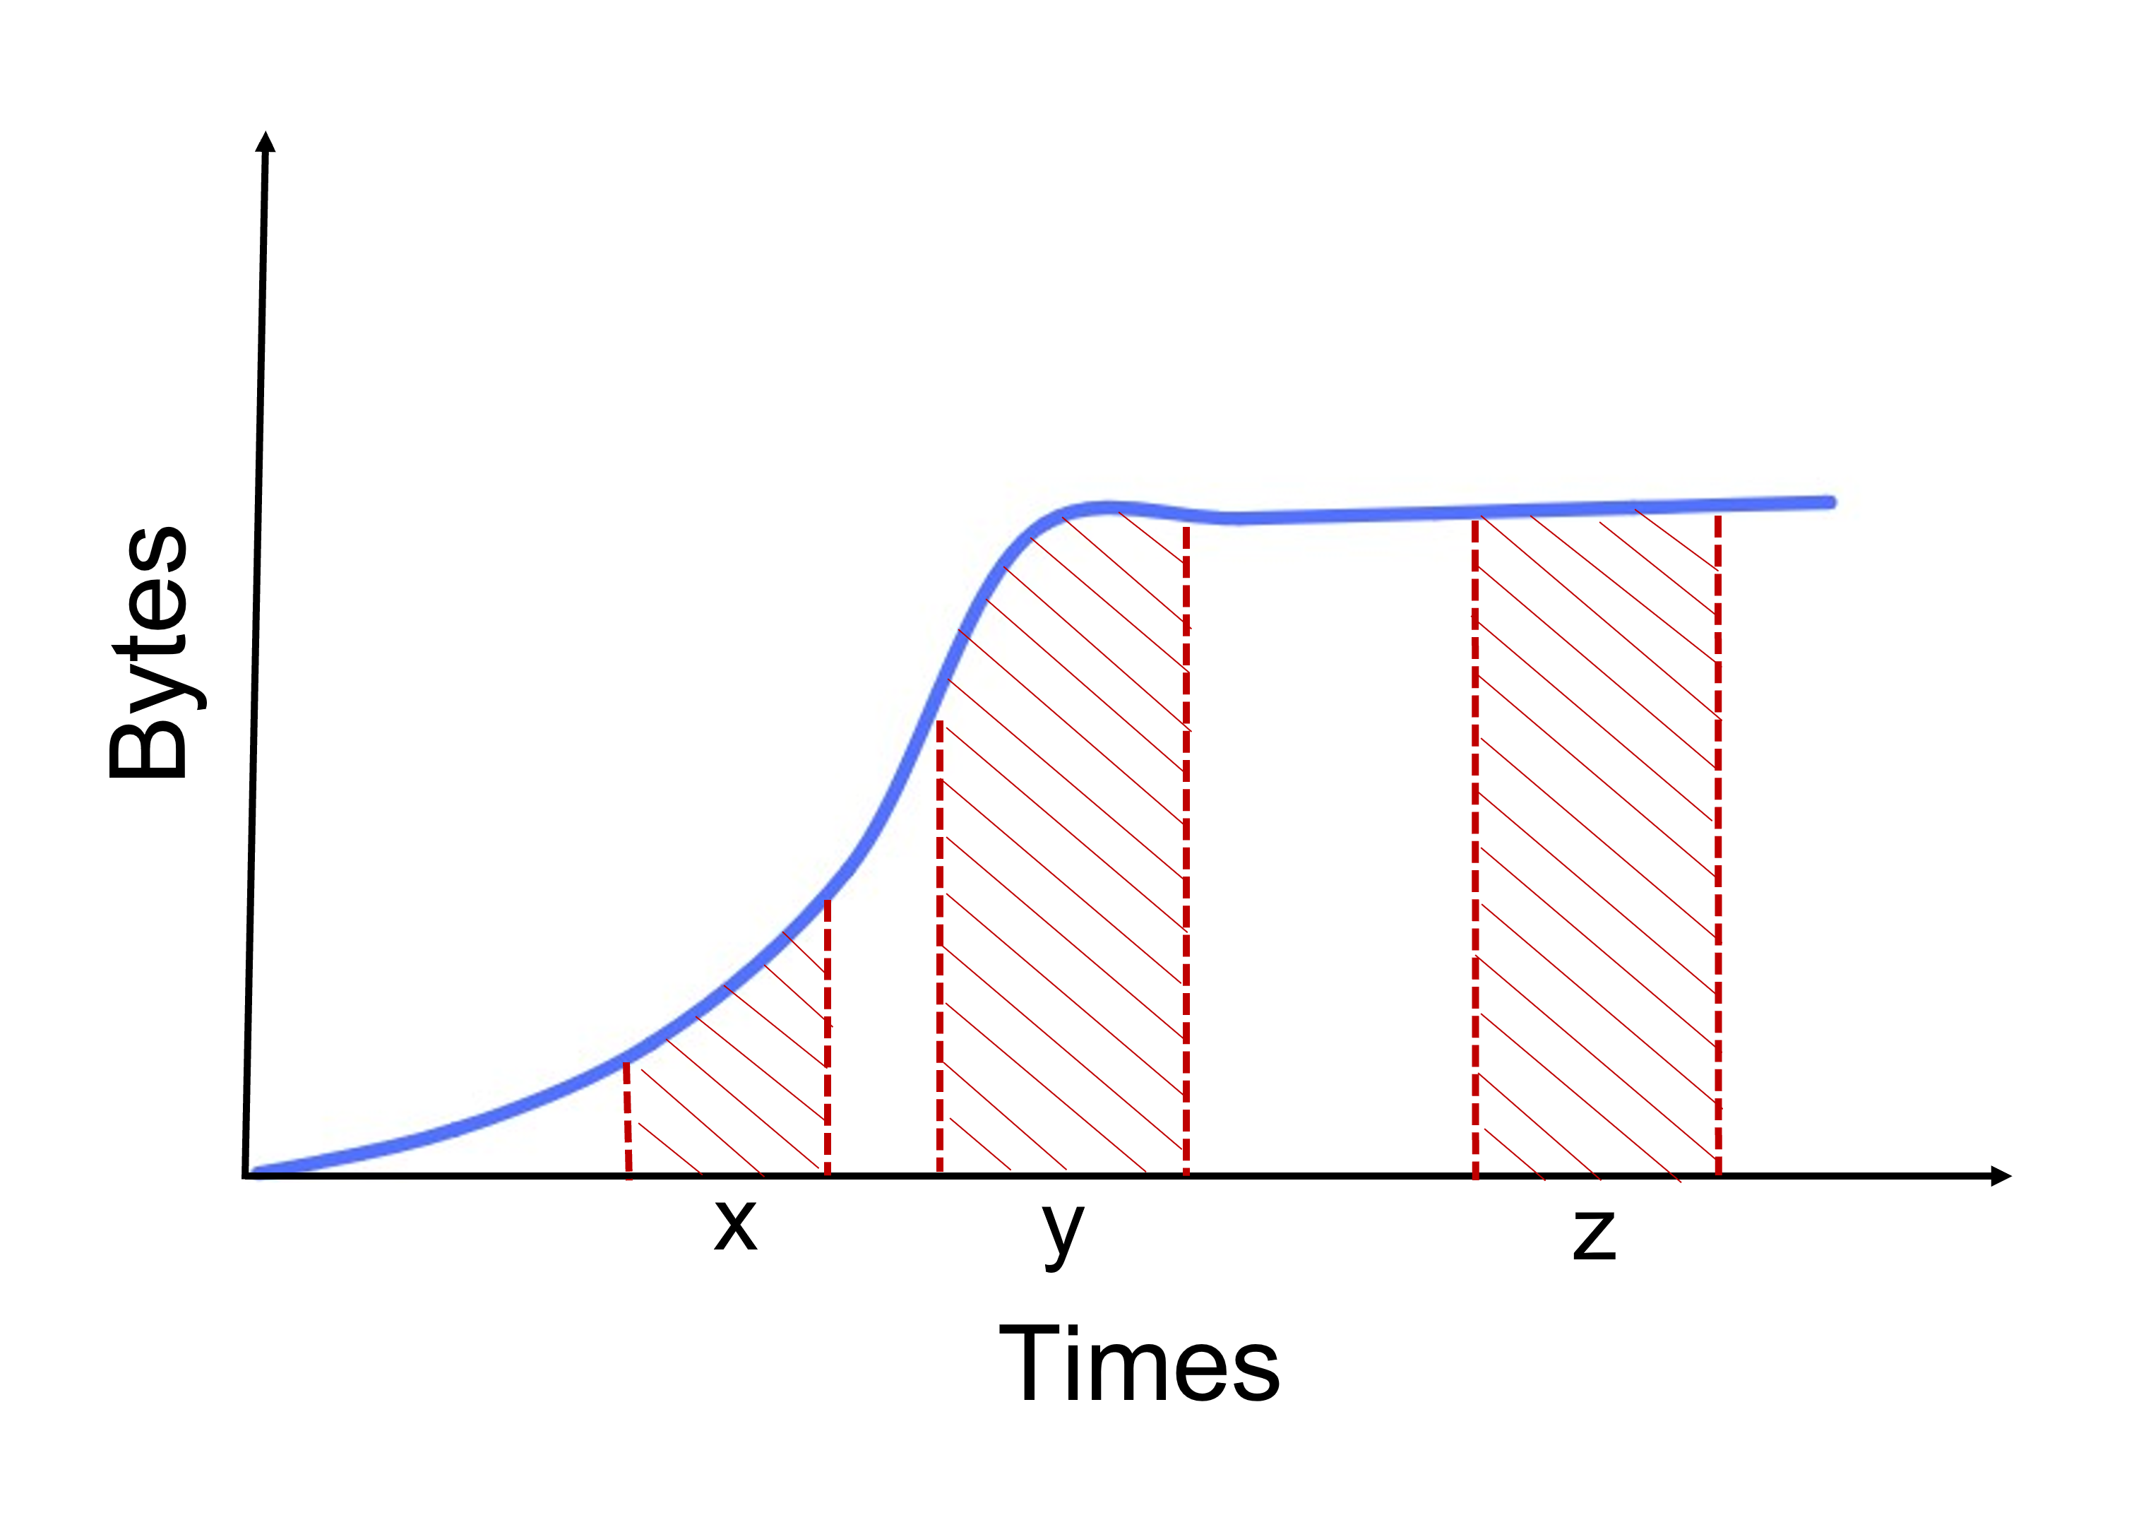
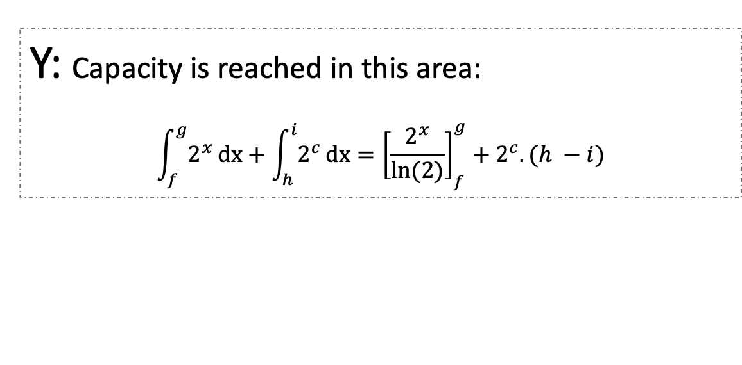
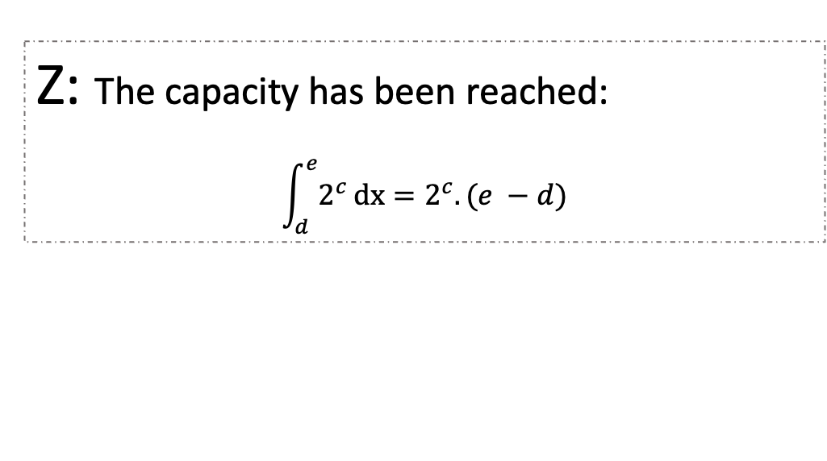
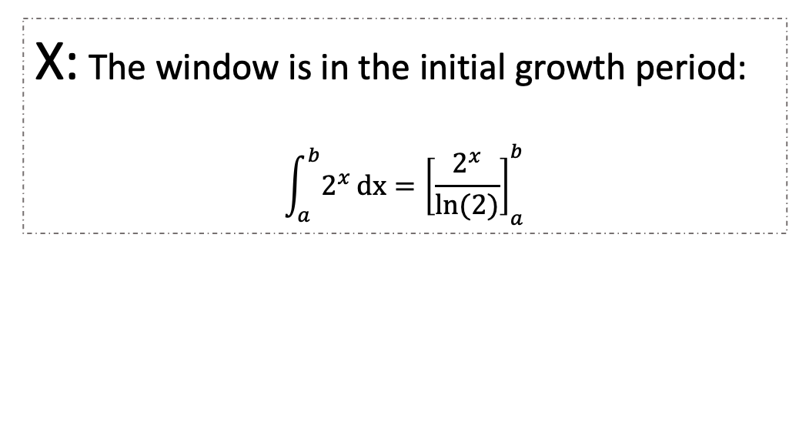
Threshold
X: The window is in the initial growth period:
$$\int_{a}^{b}{2^{x}}dx={\left[\frac{2^{x}}{ln⁡(2)}\right]}_{a}^{b}$$
Y: Capacity is reached in this area:
$$\int_{f}^{g}{2^{x}}dx+\int_{h}^{i}{2^{c}}dx={\left[\frac{2^{x}}{ln⁡(2)}\right]}_{f}^{g}+2^{c}. (h −i)$$
Z: The capacity has been reached:
$$\int_{d}^{e}{2^{c}}dx=2^{c}. (e −d)$$

Slide 18
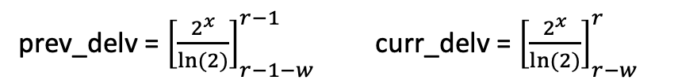
Threshold
X: r < c (where r is the round, c is the capacity round):
2^{x}, 2^{x+1}, …, 2^{r-1}, 2^{r} ….
W
prev_delv = ${\left[\frac{2^{x}}{ln⁡(2)}\right]}_{r−1−w}^{r−1}$ curr_delv = ${\left[\frac{2^{x}}{ln⁡(2)}\right]}_{r−w}^{r}$
r
C after window
Y: (r –w) < c < r:
2^{x}, 2^{x+1}, …, 2^{c}, 2^{c} …
w
prev_delv = ${\left[\frac{2^{x}}{ln⁡(2)}\right]}_{r−1−w}^{c}+2^{c}. ((r −1−c)$ curr_delv = ${\left[\frac{2^{x}}{ln⁡(2)}\right]}_{r−w}^{c}+2^{c}. ((r−c)$
r
C
within window
Z: c < (r – w) :
…. 2^{c}, 2^{c}, …, 2^{c}, 2^{c}
w
prev_delv = $2^{c}. ((r −1) −(r−1−w))$ curr_delv = $2^{c}. (r−(r−w))$
r
C before window

Slide 19
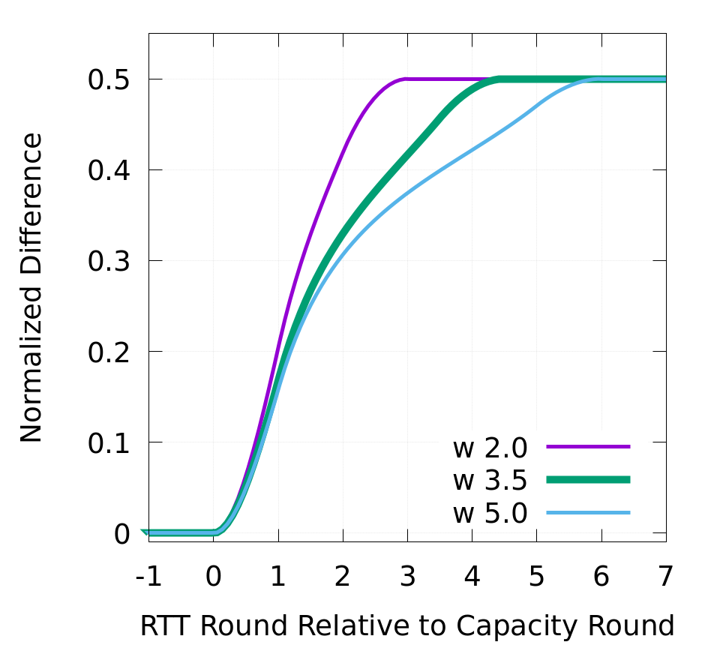
Threshold
X
Y
Z
Default threshold= 0.35

Slide 20


Number of Bins
number of bins = window bins + extra bins
Curr delv
RTT
prev delv

Slide 21
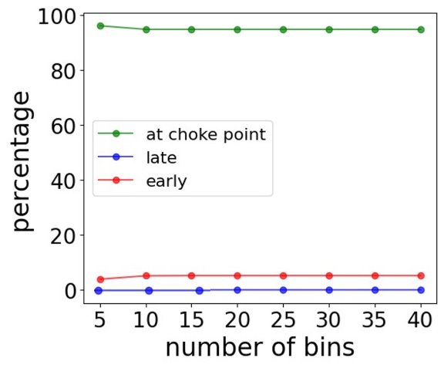
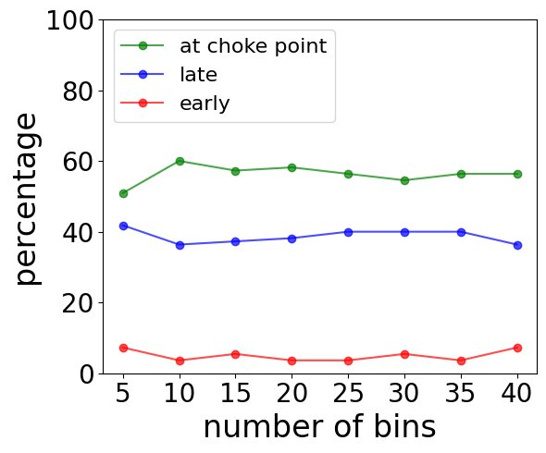
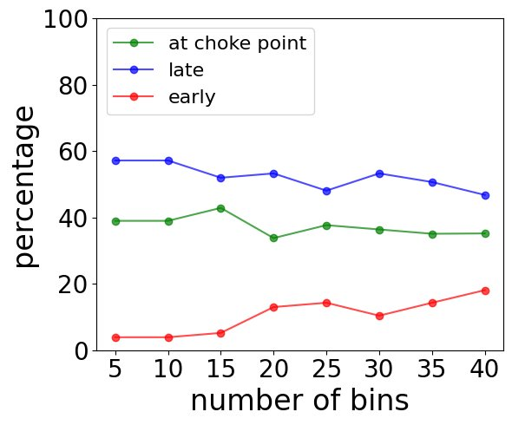
Number of Bins: Window Bins
Viasat
Starlink
4G LTE
Window Bins = 10

Slide 22
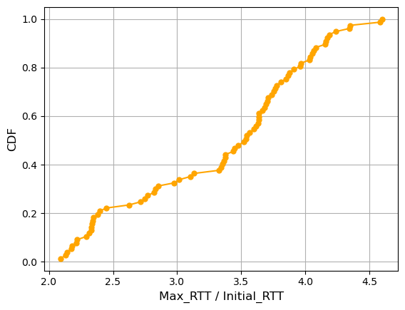
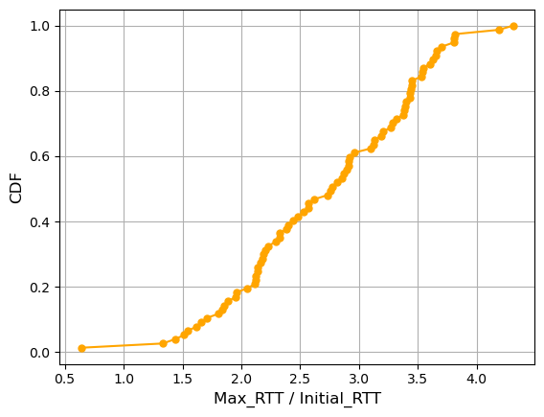
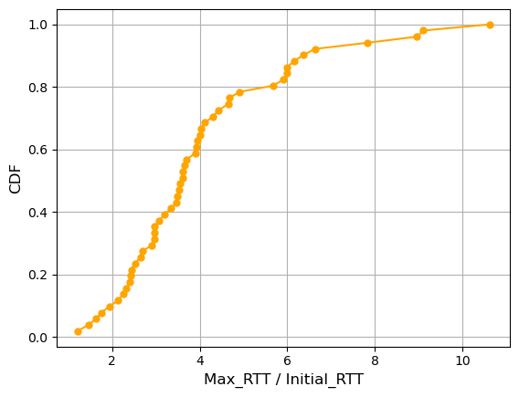
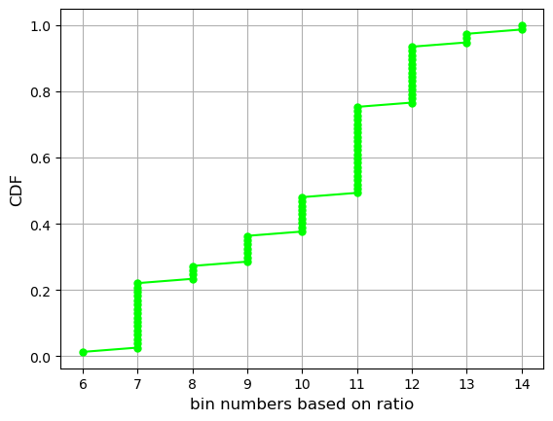
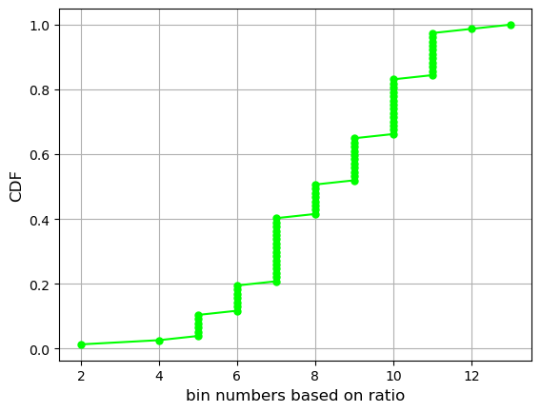
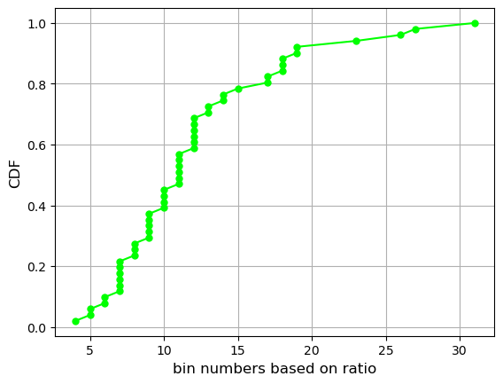
Number of Bins: Extra Bins
Viasat
Starlink
LTE
bin duration = window size / window bins = (3.5 × initial_RTT) / 10
(max_RTT / initial_RTT)
Extra Bins = max_RTT / bin duration = (max_RTT / initial_RTT) × 10 / 3.5

Slide 23
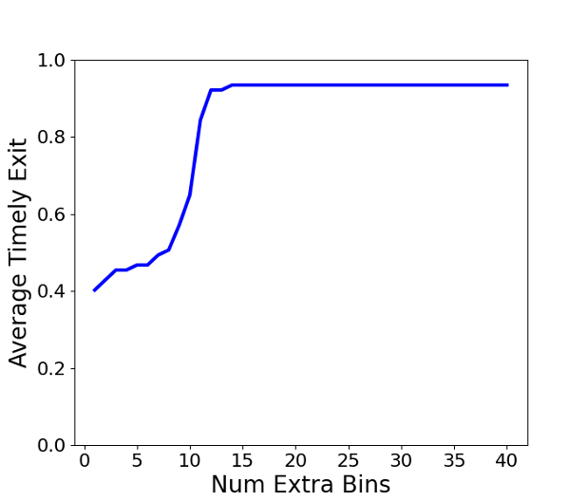
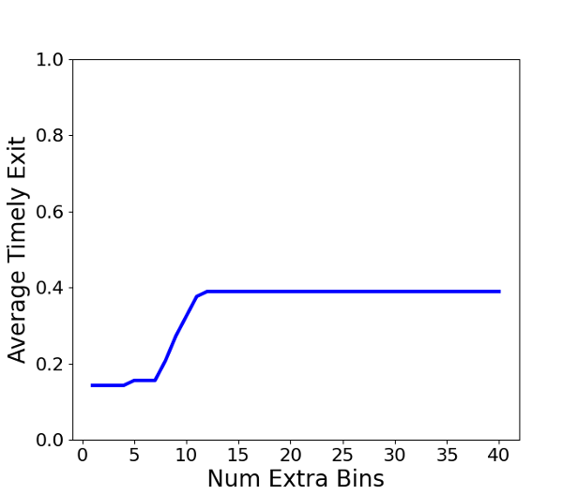
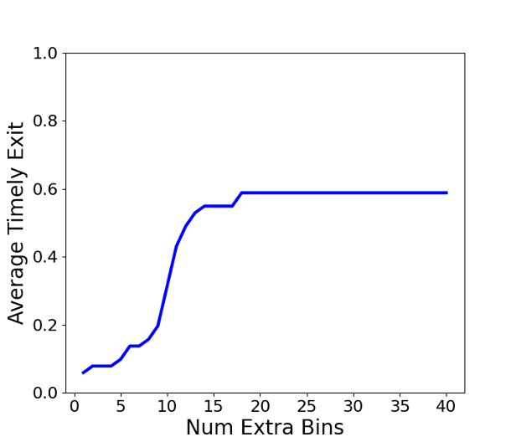
Number of Bins: Extra Bins
Viasat
Starlink
LTE
Extra Bins = 15
Default number of bins = window bins + extra bins = 25

Slide 24
Outline
Motivation and Goal
Related Works
SEARCH Algorithm
  Version 1
  Version 2
SEARCH Parameter Analysis
Performance Evaluation
Conclusion and Future Work

Slide 25
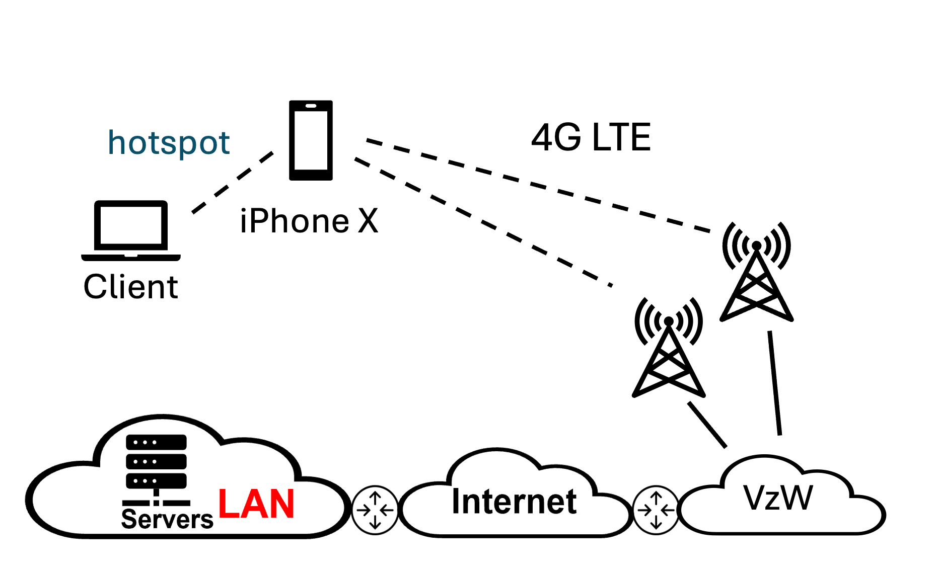
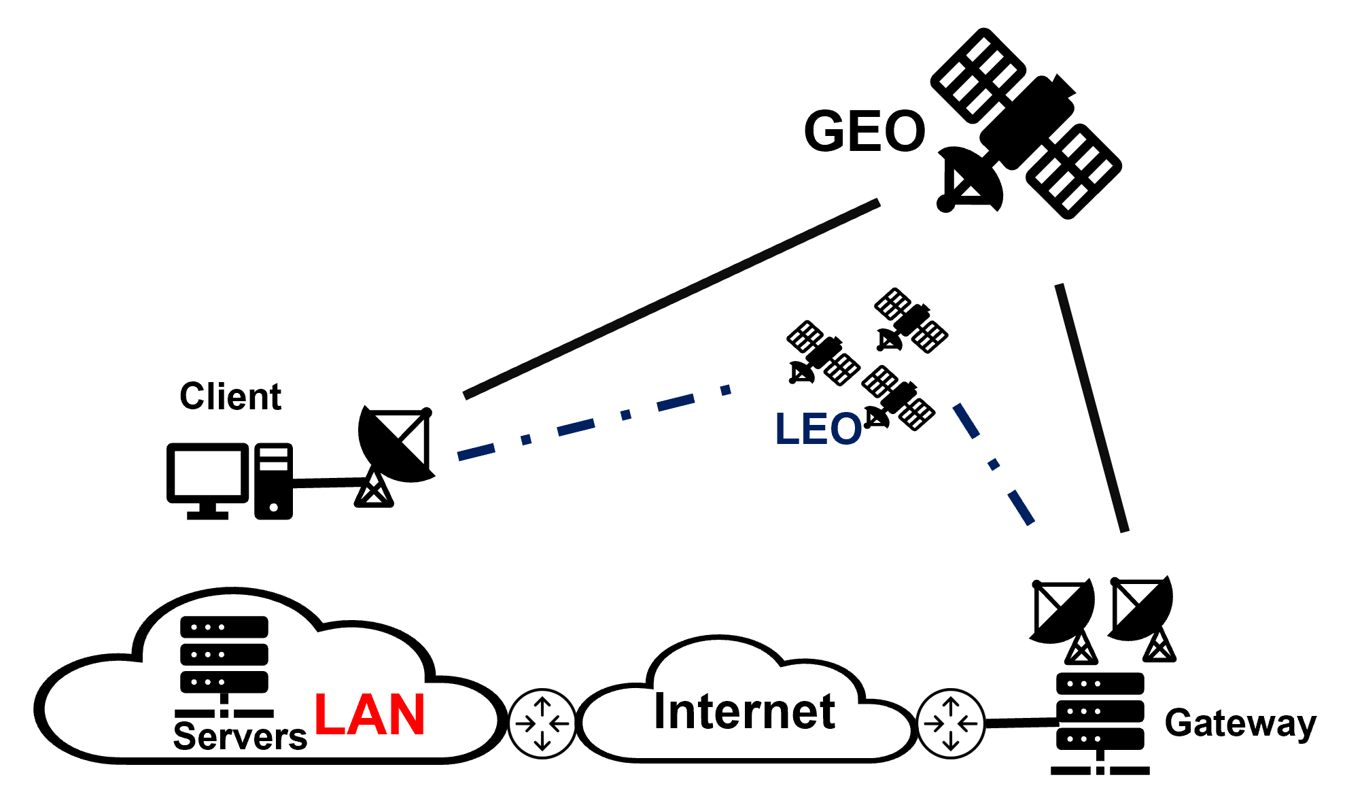
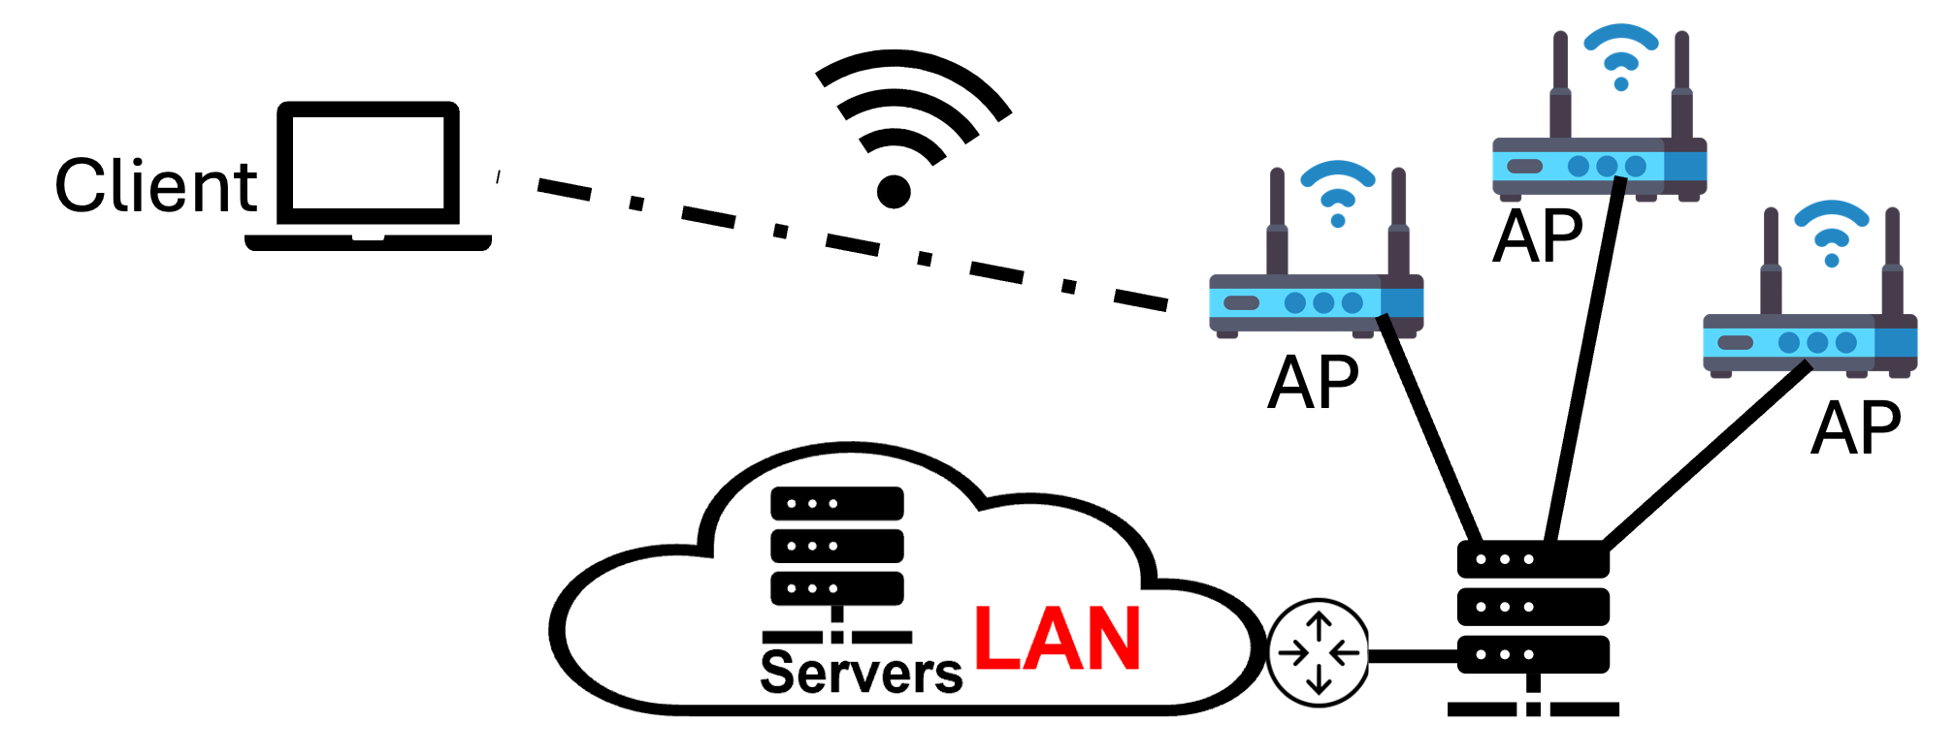
Testbed
Satellites
4G LTE
WiFi

Slide 26
Evaluation : Case Studies

Slide 27
Result
Network | Runs | Timely (%) | HyStart Timely (%)
GEO | 77 | 96.1 | 0
LEO | 77 | 96.1 | 0
4G LTE | 55 | 96.4 | 0
WiFi (strong) | 200 | 95.2 | 89.2
WiFi (weak) | 200 | 99.0 | 95.2

Slide 28
Outline
Motivation and Goal
Related Works
SEARCH Algorithm
  Version 1
  Version 2
SEARCH Parameter Analysis
Performance Evaluation
Conclusion and Future Work

Slide 29
Conclusion
Challenges with TCP Slow Start:
  HyStart exits too early → underutilized capacity.
  Disabling HyStart → overshooting and packet loss.
SEARCH Solution:
  Exits slow start at capacity, avoiding packet loss.
  Tracks delivered bytes and smooths RTT fluctuations.
Results:
  Effective across GEO, LEO, 4G LTE, and WiFi networks.
  Reduced download times and minimized packet loss.
Impact:
  Improved bandwidth utilization and congestion management.
  Adaptable for diverse real-world network conditions.

Slide 30
Future Work
Expand Application of SEARCH:
  Test SEARCH on 5G and Ethernet networks to broaden applicability.
  Integrate SEARCH into FreeBSD for broader adoption and testing
Handle Non-Congestion Flows:
  Improve robustness for irregular traffic patterns.
  Improve performance during extended low or no data periods.
Dynamic Window Adjustment:
  Adapt congestion window size in variable conditions.

Slide 31

Thank you for your attention!

Slide 32
Appendix

Slide 33
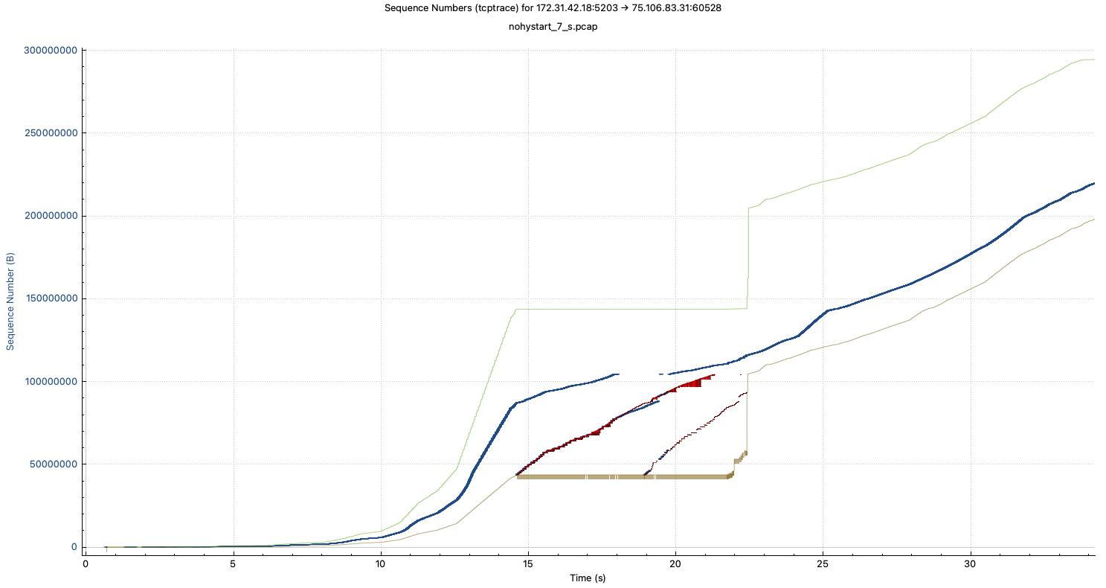
Big Deal About TCP Slow Start Performance
Case Study: TCP CUBIC on Broadband GEO Satellite (Capacity: 144Mbps, Base-RTT = 600ms)
Late slow start exit caused buffer bloat and large bursts of packet drops
TCP session spent more than 7 seconds on the recovery, then entered congestion avoidance mode
Goodput is degraded during this time by the large retransmissions
Time Sequence Graph of a TCP CUBIC (HyStart Off) at the sender (bulk transfer)
Slow Start
Recovery
Congestion Avoidance
Receive window
Transmitted Segments
Acks (in sequence)
Duplicated Acks
Notes:
Key Points to Highlight:
Context:
This slide examines the behavior of TCP CUBIC on a broadband GEO satellite with a high capacity of 144 Mbps and a large Base-RTT of 600 ms.
The focus is on the slow start phase and its impact on performance.
Problems with Late Slow Start Exit:
Buffer Bloat: Late exit leads to excessive buffering, causing delays.
Packet Drops: This buffering eventually results in large bursts of packet loss.
Inefficient Recovery: The TCP session spends significant time (over 7 seconds) recovering from these losses before entering congestion avoidance.
Performance Degradation:
The goodput (useful throughput) is significantly degraded during this recovery period due to retransmissions.
Visual Explanation (Graph):
Slow Start Phase: The orange arrow indicates this phase, showing rapid growth in the transmission rate.
Recovery Phase: Marked by retransmissions and duplicate acknowledgments (red section in the graph).
Congestion Avoidance Phase: Steady increase in throughput as TCP stabilizes (blue section).
Takeaway Message:
The inefficiencies in exiting slow start lead to a prolonged recovery period, ultimately reducing the overall performance in networks with high bandwidth-delay products, such as GEO satellite links.

Slide 34
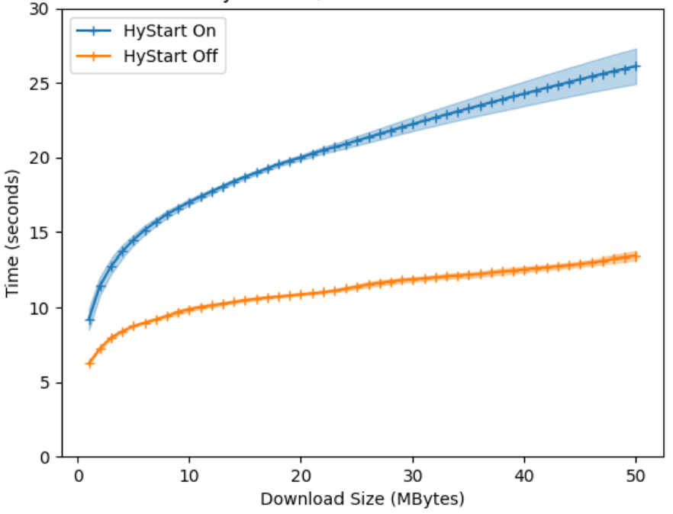
Big Deal About TCP Slow Start Performance
Case Study: TCP CUBIC on Broadband GEO Satellite (Capacity: 144Mbps, Base-RTT = 600ms)
Large RTT variations confused TCP CUBIC HyStart (Linux Default) and caused early slow start exit
The early exit resulted in bandwidth underutilization and impacted object delivery time
Maryam Ataei Kachooei, Pinhan Zhao, Feng Li, Jae Won Chung, and Mark Claypool. Fixing TCP Slow Start for Slow Fat Links, In Proceedings of the 0x16 NetDev Conference, Lisbon, Portugal, October 2022
(seconds)

Slide 35
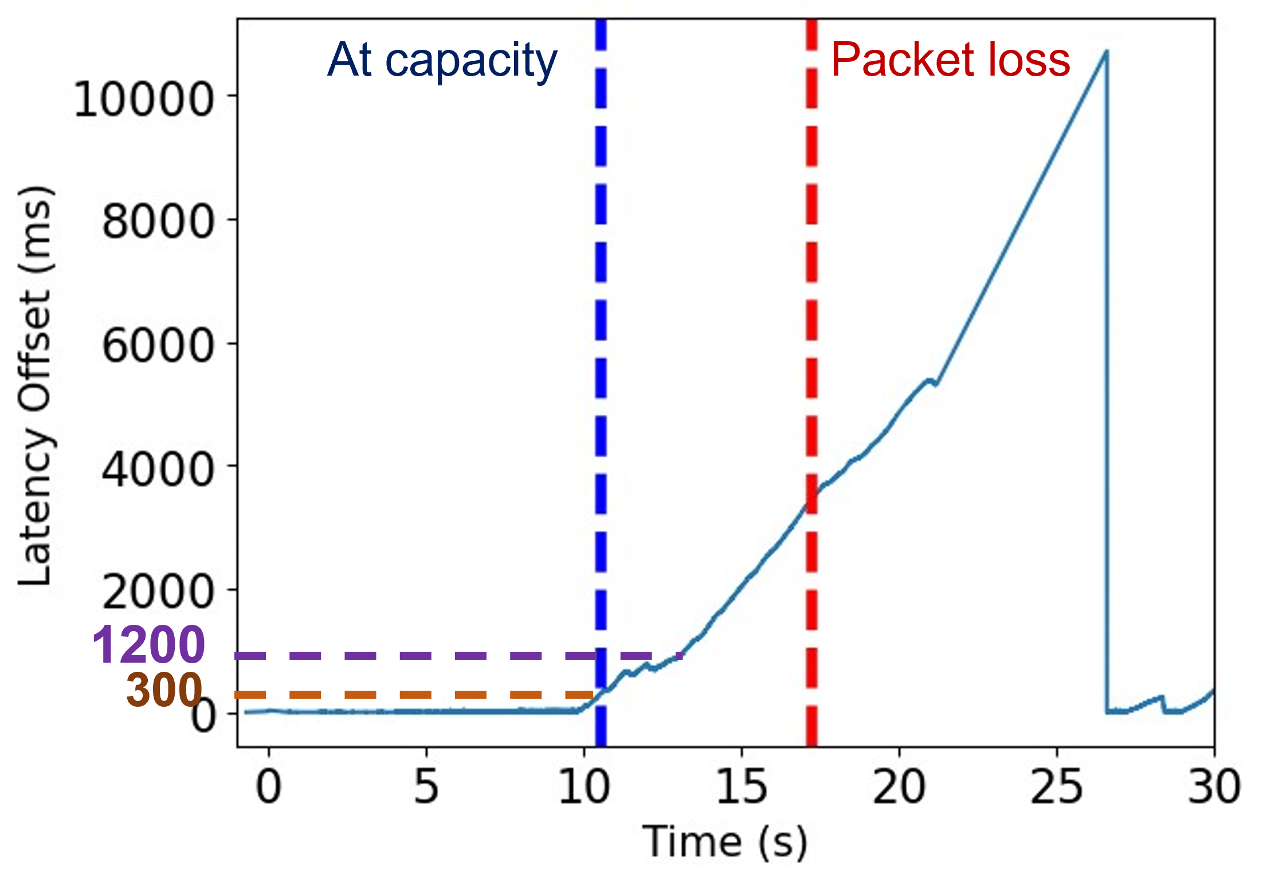
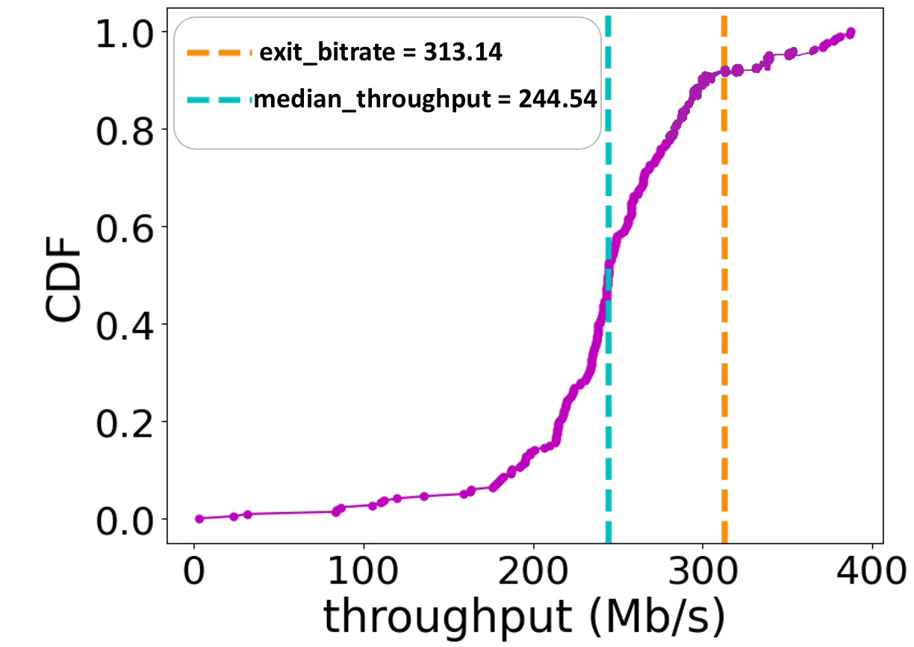
Determine At Capacity Point
High Delay:
Monitor Latency Offset:​
  Record one-way latency offset on the client using Wireshark.​
  Low offset initially; increases with saturation.​
Identify 'At Capacity' Point:​
  Step 1: Determine when latency offset surpasses twice the minimum RTT.​
  Step 2: Trace backward to when latency offset falls below one-half the minimum RTT.​
Low Delay:
Compare slow start exit bit rate to the median throughput:
  slow start exit bit rate = congestion window / RTT at the moment of slow start exit.
  Reach link capacity : If slow start exit bit rate >= median throughout

Slide 36
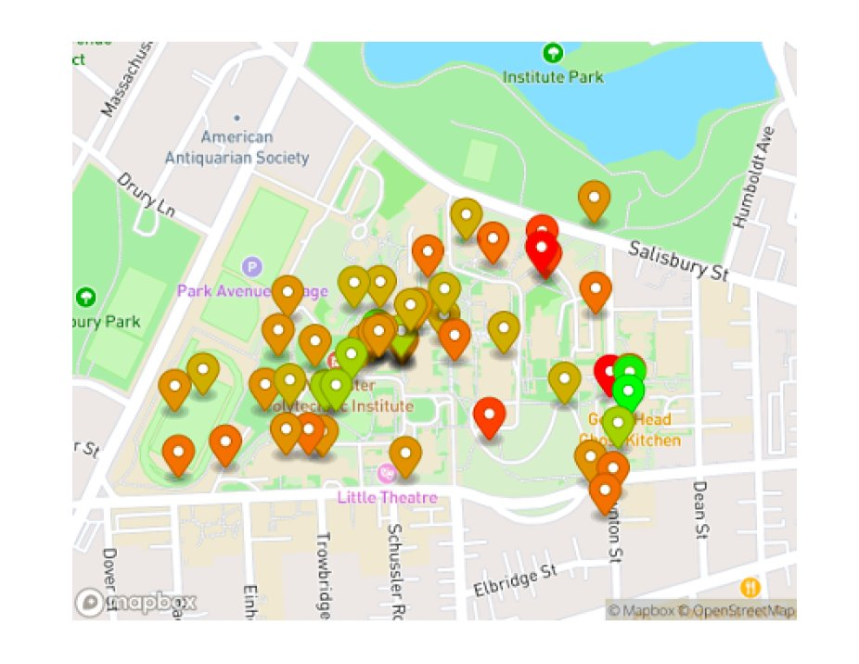
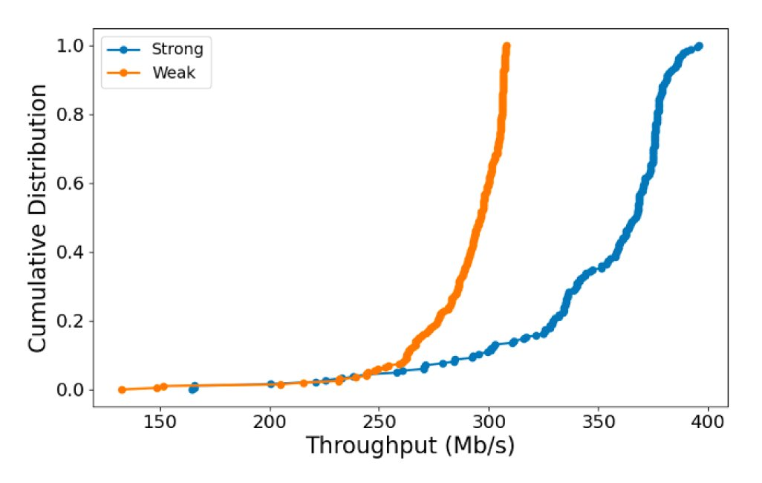
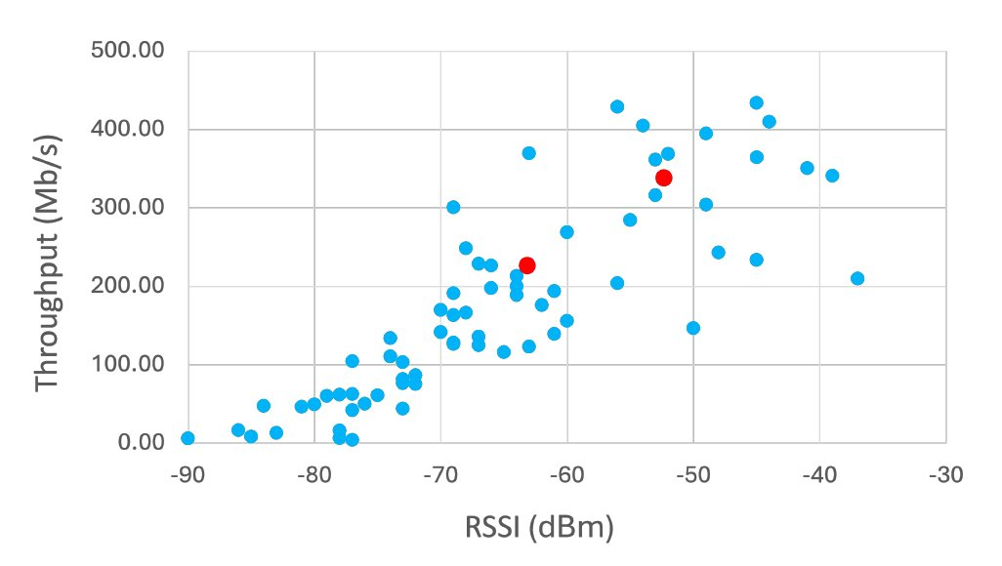
Evaluation: WiFi
Median throughput at strong location is higher than weak locations.​
General strong correlation between higher RSSI and higher throughput. ​
Other factors may cause inconsistence such as shared nature of campus APs. ​
Two red dots are manually examined locations. ​

Slide 37
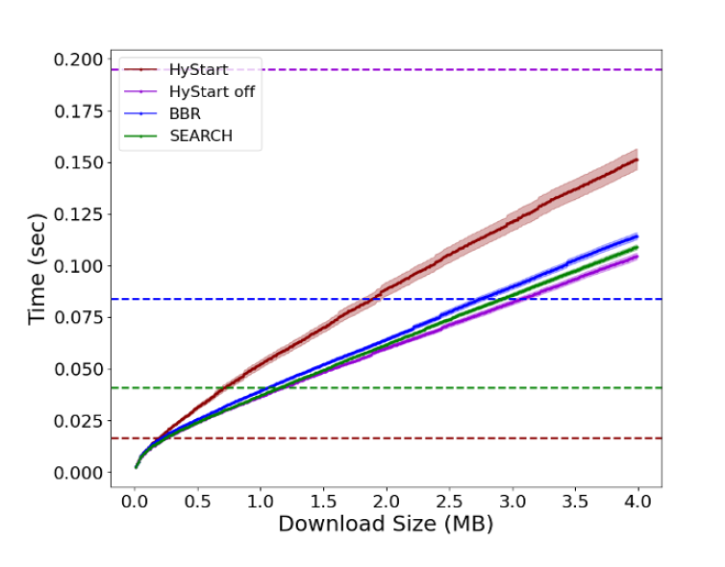
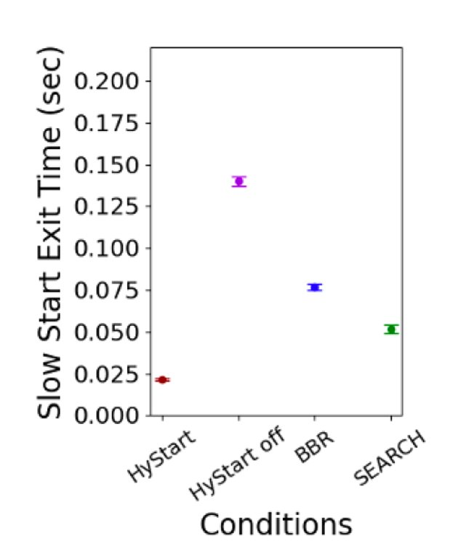
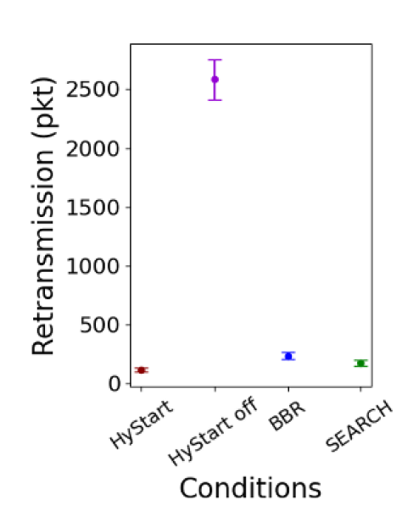
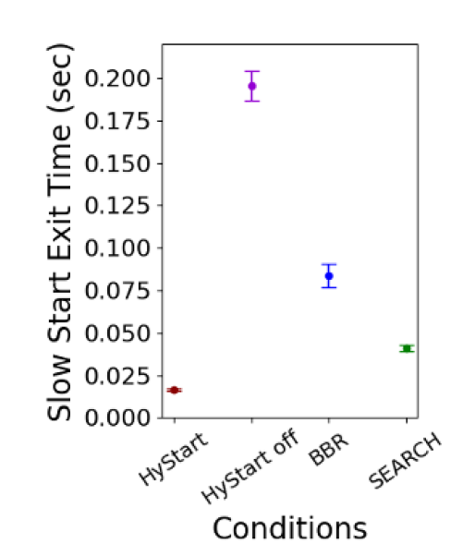
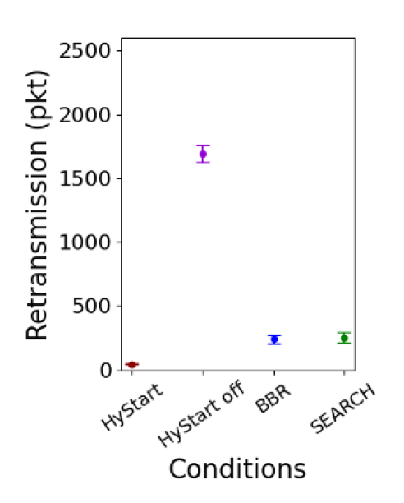
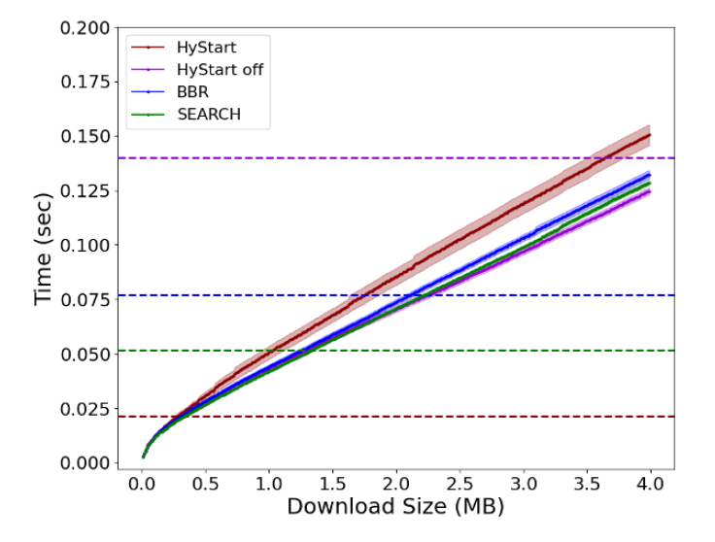
Evaluation: WiFi
Strong
Weak

Slide 38
Result
Network | Capacity (s) | Loss (s) | Exit (s) | Timely (%)
GEO | 11.8 (2.6) | 22.9 (8.7) | 13.7 (1.7) | 96.1
LEO | 0.4 (0.1) | 0.6 (0.1) | 0.5 (0.1) | 96.1
4G LTE | 0.3 (0.2) | 1.9 (1.8) | 0.7 (0.6) | 96.4
WiFi (strong) | 0.01 (0.004) | 0.77 (0.44) | 0.04 (0.02) | 95.2
WiFi (weak) | 0.02 (0.004) | 0.68(0.37) | 0.04 (0.03) | 99.0

Slide 39
Result
Network | Slow start Method | Early Exit (%) | Late Exit (%) | Choke Point Exit (%)
GEO | SEARCH | 3.9 | 2.6 | 93.5
 | HyStart | 100 | 0 | 0
 | Off | 0 | 100 | 0
LEO | SEARCH | 3.9 | 57.1 | 39.0
 | HyStart | 100 | 0 | 0
 | Off | 0 | 100 | 0
4G LTE | SEARCH | 3.6 | 36.4 | 60.0
 | HyStart | 100 | 0 | 0
 | Off | 0 | 100 | 0
WiFi (Strong) | SEARCH | 4.8 | 4.2 | 91.0
 | HyStart | 10.8 | 0 | 89.2
 | Off | 0 | 100 | 0
WiFi (Weak) | SEARCH | 1.0 | 8.5 | 90.5
 | HyStart | 4.8 | 0 | 95.2
 | Off | 0 | 100 | 0

Slide 41
SEARCH Algorithm
Parameters:
0: WINDOW_FACTOR = 3.5
1: W = 10
2: EXTRA_BINS = 15
3: NUM_BINS = W + EXTRA_BINS
4: THRESH = 0.35 Initialization():
5: window_size = *initial_rtt* x WINDOW_FACTOR
6: bin_duration = window_size / W
7: bin\[NUM_BINS\] = {}
8: curr_idx = -1
9: bin_end = *now* + bin_duration ACK_arrived(sequence_num, rtt): // Check if passed bin boundary.
10: if (*now* > bin_end) then
11: update_bins() // Check if enough data for SEARCH.
12: prev_idx = curr_idx - (rtt / bin_duration)
13: if (prev_idx >= W) and
14: (curr_idx - prev_idx) <= EXTRA_BINS then
15: curr_delv = compute_delv(curr_idx - W, curr_idx)
16: fraction = (rtt mod bin_duration) / bin_duration
17: prev_delv = compute_delv(prev_idx - W, prev_idx, fraction)
18: norm_diff = (2 x prev_delv - curr_delv) / (2 x prev_delv)
19: if (norm_diff >= THRESH) then
20: exit_slow_start()
21: end if
22: end if // Enough data for SEARCH.
23: end if // Each ACK. // Update bin statistics, accounting for cases where more // than one bin boundary might have been passed. update_bins():
24: passed_bins = (*now* - bin_end) / bin_duration + 1
25: bin_end += passed_bins x bin_duration
26: for i = (curr_idx + 1) to (curr_idx + passed_bins)
27: if (curr_idx >= 0) bin\[i mod NUM_BINS\] = bin\[curr_idx\]
28: end for
29: curr_idx += passed_bins
30: bin\[curr_idx mod NUM_BINS\] = sequence_num // Compute delivered bytes over the window of bins, interpolating a // fraction of each bin on the end (default is 0). compute_delv(idx1, idx2, fraction = 0):
31: delv = 0
32: delv = bin[(idx2 - 1) mod NUM_BINS] - bin[idx1 mod NUM_BINS]
33: delv += (bin[idx1 mod NUM_BINS] - bin[(idx1 - 1) mod NUM_BINS]) x (1 - fraction)
34: delv += (bin[idx2 mod NUM_BINS] - bin[(idx2 - 1) mod NUM_BINS]) x fraction
35: return delv // Exit slow start by setting ssthresh. exit_slow_start():
36: ssthresh = *cwnd*
Window size
Number of bins
Threshold

