Slide 1
360 Gunner – a 2d platformer to evaluate network latency compensation
Thanh long x. vu
Advisor:
Professor Mark Claypool
Readers:
Professor Charles Roberts
Professor Ralph sutter
Notes:
Hello everyone, welcome to my thesis presentation of 360 Gunner – a 2d platformer to evaluate network latency compensation
My name is long vu
My thesis advisor is professor mark claypool
My thesis readers are professor Charles Roberts and professor ralph sutter

Slide 2
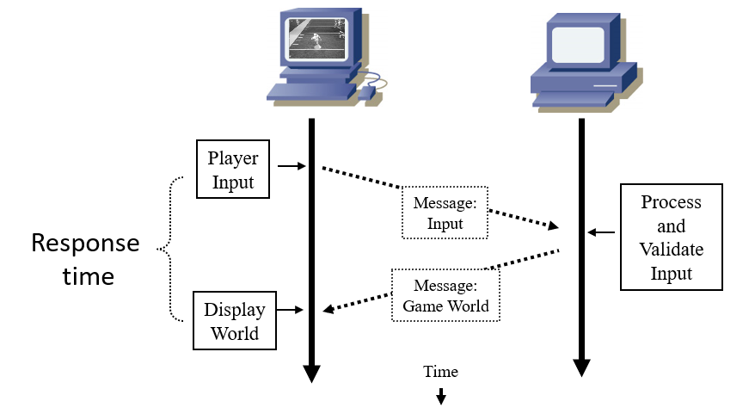
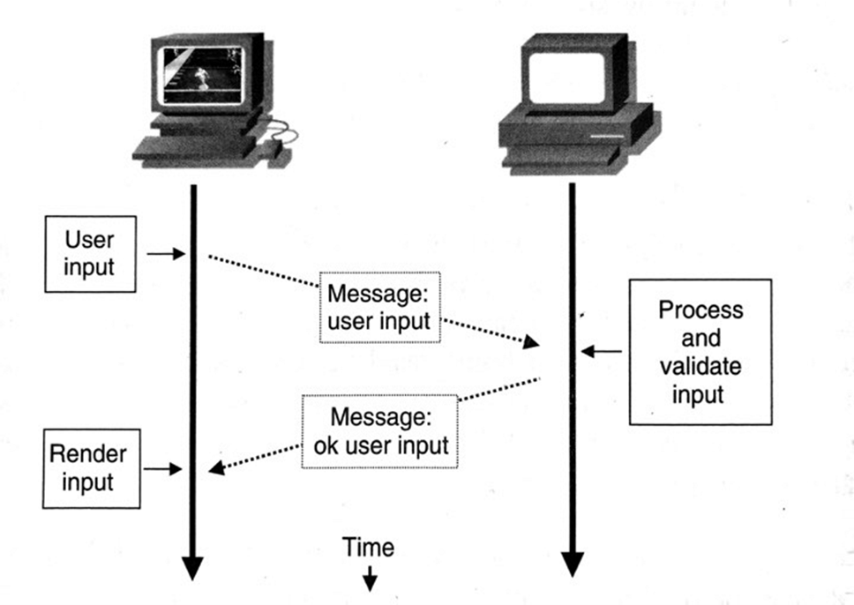
motivations
Online gaming is popular
Network latency problems affect many players
[1]
Notes:
What motivated me to work on this topic is that online gaming is becoming very popular, but sometimes when we play it’s less fun because of network lag.
this is because when we issue a command, our client sends the command to the server. The server then takes time to process the input and send necessary updates back to our clients. After receiving these updates, our client can apply them and display the game world.
Ideally, the delay time from when we issue the input command to when we see the input’s result the screen is small enough that it’s not perceivable.
But when the connection becomes slow, we notice the delay and game feel disruptive or unresponsive, resulting in a degraded quality of experience for players and also degraded player performance.

Slide 3
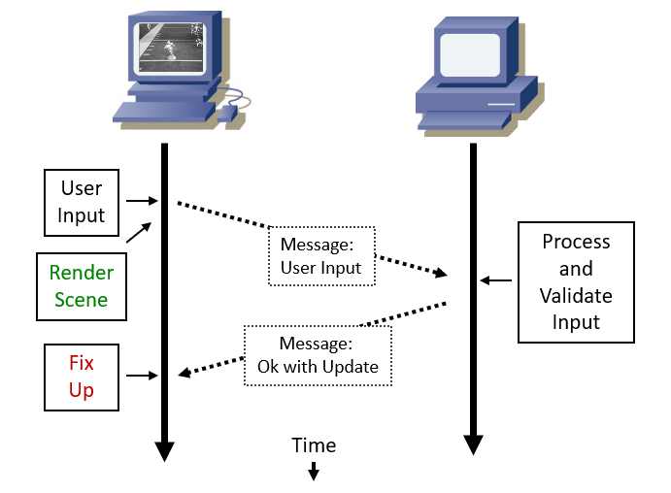
Motivations – cont’d
Latency compensation techniques
  Example: player prediction
[1]
Notes:
Latency compensation techniques are solutions for developers to mask the negative effects of latency or make the game fair for players with high latency.
A classic example is player prediction. With player prediction, when player input is received, the client sends the input to the server and tries to predict the input’s result and render it on the screen immediately. After receiving updates from the server, any state inconsistency needs to be fixed up. As a result, the game can appear immediately responsive but visually inconsistent due to incorrect predictions that need to be revoked or fixed up.

Slide 4
Motivations – cont’d
Latency compensation used but not fully studied and evaluated
Benefits not fully understood
  Different game actions
  Different game genres
Studies done in popular genres (first person shooters [2], sports [3], real-time strategies [4])
Less is known for 2D platformers
Thesis: study latency and player prediction for platformers
Notes:
Latency compensation techniques are widely used but have not been thoroughly studied and evaluated covering the wide range of different game actions and game genres. Research has been done in the most popular genres such as FPS, Sports or Real-time strategies, but not for platformers.
That’s why I want to study how gameplay and game actions are affected by different values of network latencies in a 2D platformer, and also the impact of a classic latency compensation technique like player prediction under such network conditions.

Slide 5
METHODOLOGY
Design game
Implement game with dragonfly in c++
  Non-networked single player version
  Online version
  Player prediction for movement
Design and run User Study
Analyze results
Notes:
I first designed the game then implemented it with the Dragonfly engine using c++. The dragonfly engine provides a small codebase that I can use and edit for my implementation. I first implemented a nonnetworked single player version, then mitigated it to an online version and implemented player prediction for player movement. I then designed and conducted a user study of player’s quality of experience and performance under network latency with and without player prediction. Lastly I analyzed the results from the subjective and objective data collected.

Slide 6
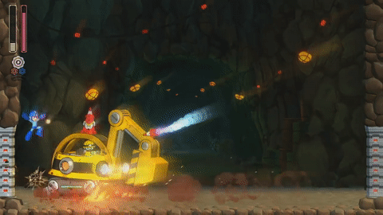

inspirations – frustration vs satisfaction
Megaman franchise
Cuphead (2017)
Notes:
Some of our inspirations come from very well-known 2d platformers like the Megaman franchise and Cuphead.
These games were designed to be extremely challenging, but the gameplay is satisfying enough to combat the frustration and keep players engaged.
Our goal was to achieve the same balance between high difficulty and satisfaction with our design.

Slide 7
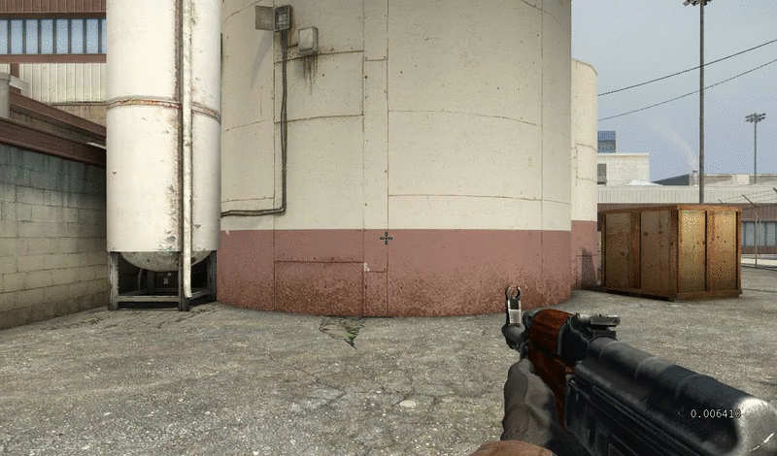
inspirations – realistic firing mechanics
Notes:
We also took inspirations from realistic firing mechanics of first person shooter games.
The weapons from these games are very diverse in many aspects such as fire rate, clip size or accuracy. Furthermore, each shot from a weapon would make the weapon recoil and inaccurate for following bullets. The weapon regain accuracy after a short time not being fired.

Slide 8
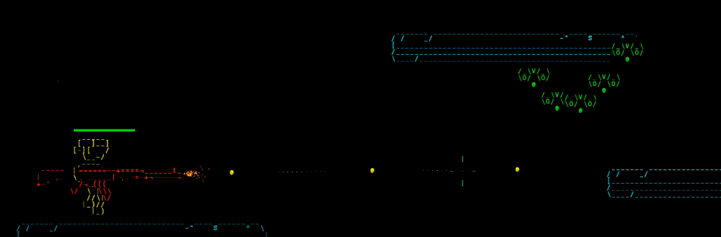
Features
Robot themed ascii graphics
Realistic attacking mechanics
Fast paced actions
Notes:
With these inspirations, our game features robot themed ascii graphics, which is supported by Dragonfly engine, realistic attacking mechanics and fast paced actions. There are 3 types of weapons in the game

Slide 9
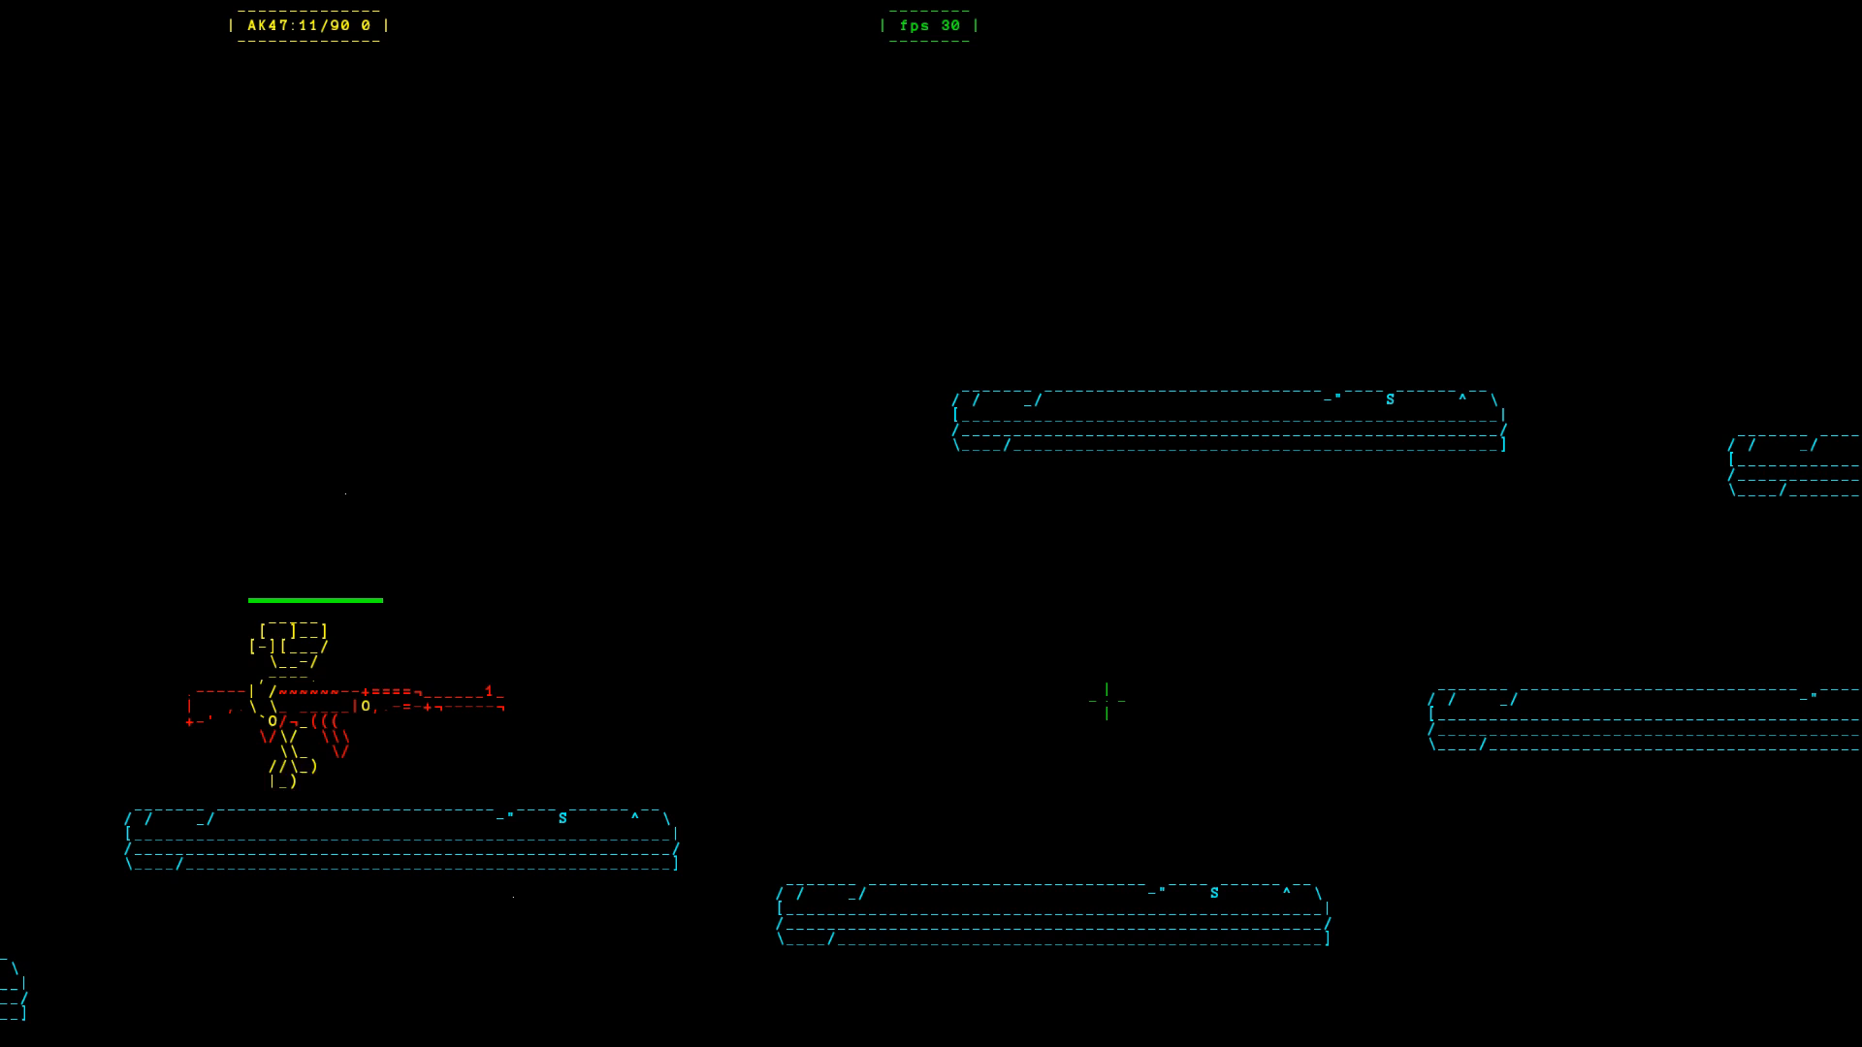
AK47
High fire rate
Average damage
Good accuracy
Notes:
The most basic weapon is AK47 with high fire rate, average damage and good accuracy. Bullet spraying will make the weapon less accurate.

Slide 10
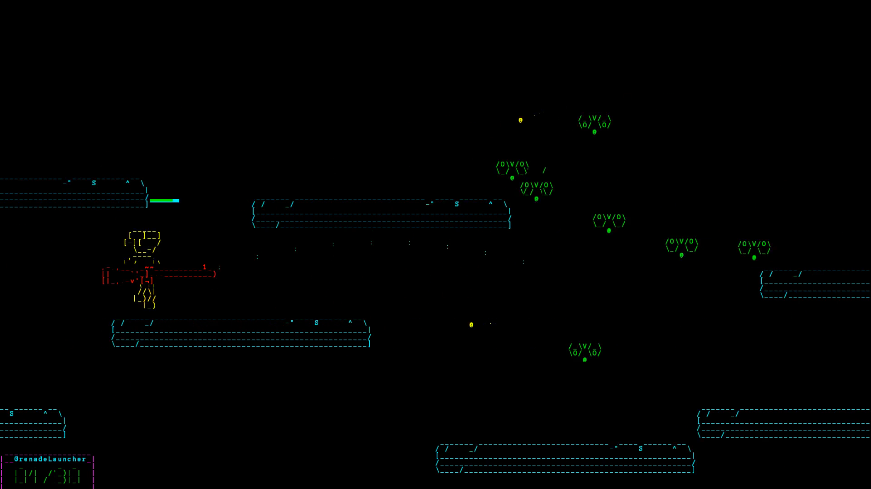
Grenade launcher
Low fire rate
Low bullet speed
Not easy to aim
Good AOE damage
Notes:
The 2nd type is grenade launcher with low fire rate and bullet speed. The bullet flies in an arc so it is a bit harder to aim, but the weapon has a good area of effect.

Slide 11
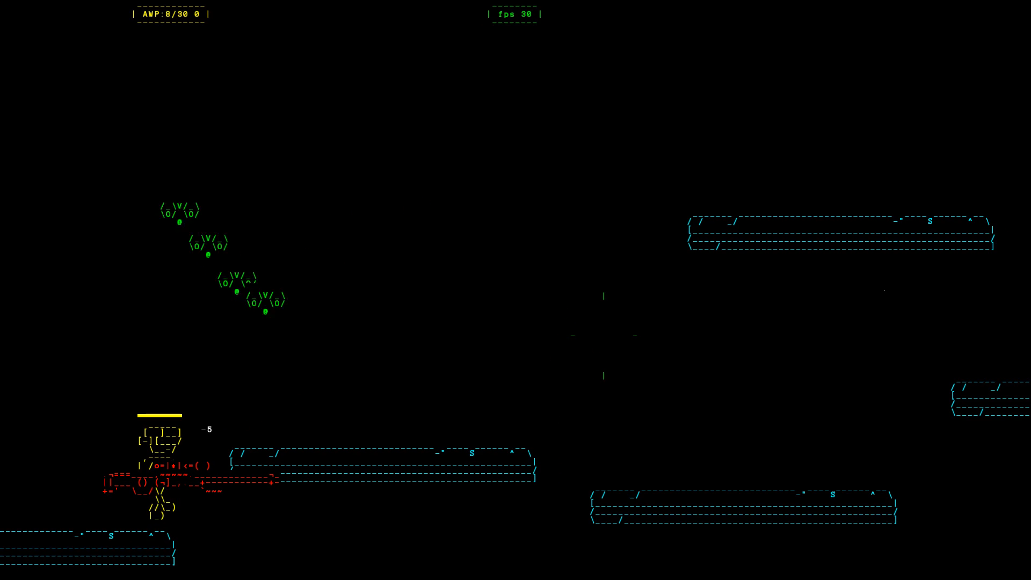
awp
Low fire rate
High damage
Perfectly accurate with scope
Notes:
The last weapon is AWP which is a sniper.it has low fire rate but very high damage. The damage is dealt instantly but the aim point is very small, so this is the hardest weapon to use.

Slide 12
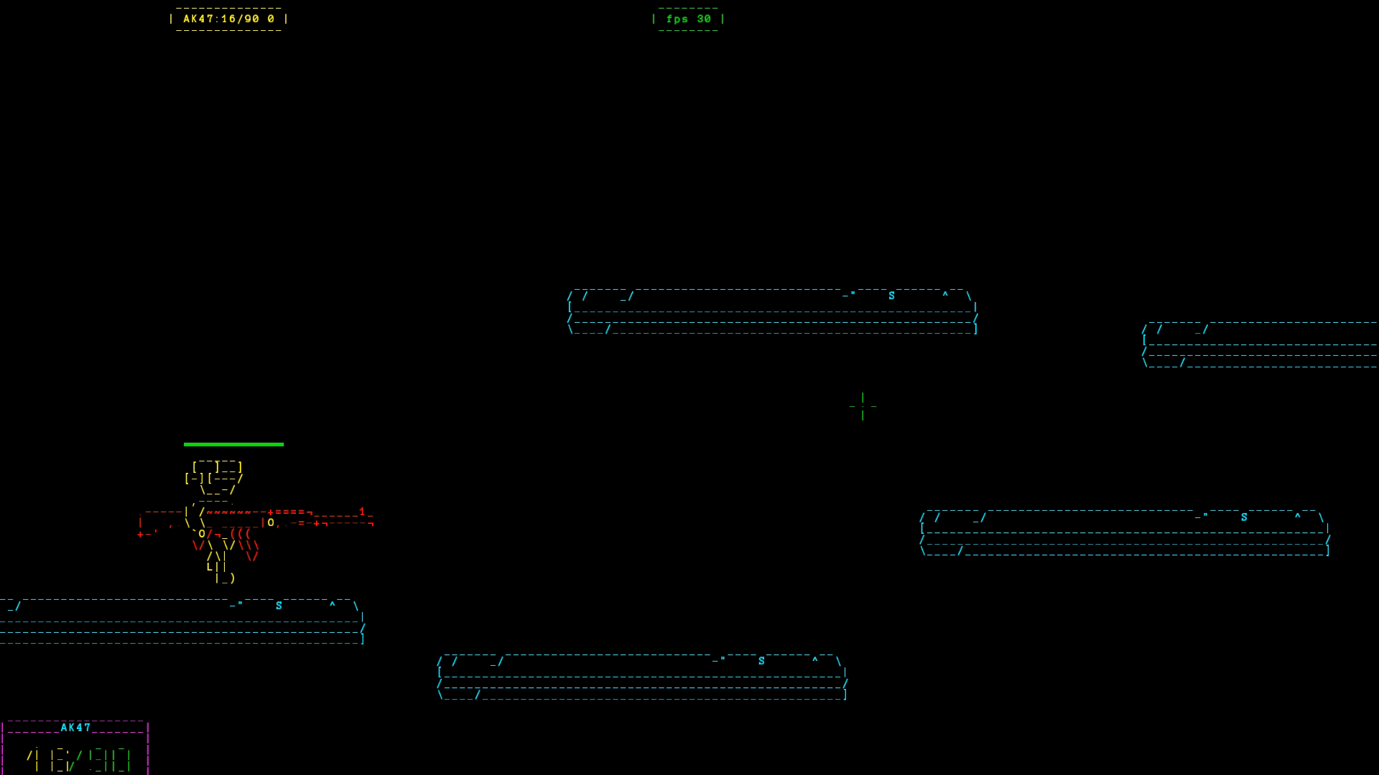
Non-networked version
Notes:
After the offline version of the game was implemented, it was brought to Alphafest. We received many positive comments as well as constructive feedback from 20 players. Based on the feedback, we made several gameplay tweaks in the online version.

Slide 13
Game implementation – online game
Without prediction
With prediction
Notes:
To mitigate the offline game to the online version, we first implemented the authoritative server-client architecture for it, which did not have prediction. To quickly recap, when player input is issued, it’s sent to the server for processing. The server then sends back necessary updates to the client to apply and display. After that, we implemented player prediction for player movement actions which includes running, jumping, crouching and dropping down from platforms. Player movement is rendered immediately on the screen, but needs to be fixed up by snapping the hero back to the correct position if it’s position on the client is too far off. Other game actions like attacking just work normally following the architecture without prediction.

Slide 14
Study objectives
Effects of latency on game actions
Evaluation of player prediction
  Quality of experience
  performance
Notes:
After the implementation is done, I designed an user study to help me study how different game actions are affected by latency, and evaluate player prediction regarding quality of experience and player performance.

Slide 15
experiment
Players take Background survey
Players warm up with tutorial level
players play the game 10 times:
  2 minutes each, or until the boss is killed
  Different network latency values (0 ms, 100 ms, 200 ms, 400 ms, 800 ms)
  Player prediction on & off
objective measurements recorded
Players take Gameplay survey after each playthrough
Notes:
When players arrive to participate, they are first briefed about the experiment and take background survey. After that they are allowed a few minutes to learn the game and warm up with the tutorial level. They then play the game 10 times with 2 minutes each or until the boss is killed. Each playthrough is under a different network latency value ranging from 0 to 800 milliseconds and with player prediction either on or off. The latency and player prediction values are shuffled to avoid players getting used to the delay. When the game is played, game clients record objective measurements on log files. After each playthrough, player’s opinion about the playthrough is collected through a short gameplay survey.

Slide 16
results

Slide 17
1. Effects of network latency on game actions
Difference between weapons
AK47: average precision
Grenade Launcher: marginally higher precision
AWP: highest precision
Notes:
First we look at the effects of network latency on game actions. We consider difference between weapons in the precision required for each of them. The AK47 is the most basic weapon, so we consider it a game action that requires average precision. The grenade launcher is a game action with marginally higher precision since the bullets are slower and don’t fly straight. The AWP is the game action that requires the highest precision because the damage is only dealt at 1 point on the screen.
We collected the player’s hit percentage with all weapons to study the degradation of different actions.

Slide 18
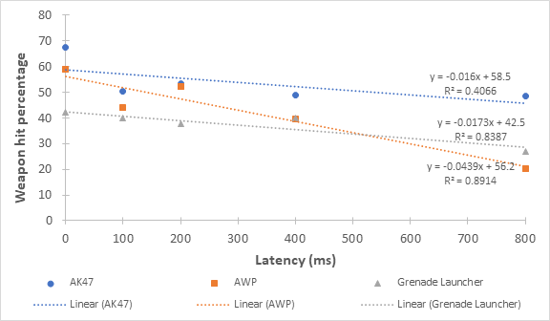
1. Effects of network latency on game actions – cont’d
Weapons hit percentages (without player prediction) versus Latency added
Notes:
The vertical axis is the average weapon hit percentage for all players and The horizontal axis is latency. Blue data points and trendline represents ak47, the basic weapon. Orange is AWP, the most precise weapon. Gray is grenade launcher. As can be seen from the linear regression lines plotted, player performance with the AWP degraded much more than the other two weapons as latency increased. This suggests that the higher precision a game action requires, the more severely it’s affected by network latency.

Slide 19
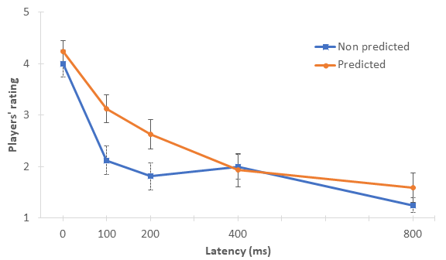
2. Evaluation of player prediction
How responsive was the game?
Notes:
To evaluate player prediction, first we look at the players’ subjective opinions from the gameplay survey that they took after each playthrough. The vertical axis show the average of all players’ rating, and the horizontal axis is the latency. The blue trendline is for when player prediction is off, and the orange is for it’s on. For this graph, the question is how responsive was the game. Under 400 ms of latency, the game’s responsiveness is improved, as expected. However, from 400ms the benefits of the responsiveness from movement is not clear anymore. We also notice that for other questions, like how much did lag affect your gameplay, at 400ms and above player prediction does not improve players’ subjective opinion on the gameplay experience anymore.

Slide 20
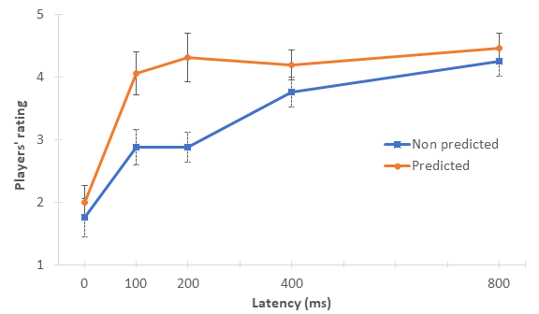
2. Evaluation of player prediction – cont’d
How many visual glitches did you see?
Notes:
For this graph, the question is how many visual glitches did you see. It can be seen that player prediction causes a higher degree of visual inconsistency in all cases.

Slide 21
2. Evaluation of player prediction – cont’d
Trade-off between responsiveness and visual consistency
Notes:
The trade-off between responsiveness and visual consistency is better shown on this graph. The horizontal axis is responsiveness and the vertical axis is visual glitches. For almost all of the data points, when player prediction is on, responsiveness is improved but there are visual fix-ups on the screen so that the game is less visually consistent.

Slide 22
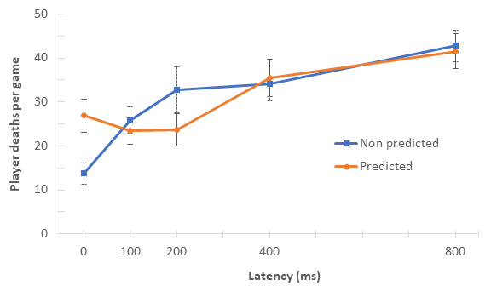
2. Evaluation of player prediction – cont’d
Average player deaths per game versus Latency added
Notes:
We now look at another objective measurement recorded: number of player deaths. Player prediction for movement actions did not help players perform better with weapon firing, but at 200ms of lag or less it helped players have fewer deaths. There is an exception when there was no network latency added, where players die a lot more when player prediction is on. This is because 0ms with prediction is the first playthrough for the players, where they were only getting used to the real level. 0ms with prediction off, on the other hand, is the last playthrough, where players had the most practice after having played the same level 9 times. Overall, player deaths in our game are caused by not being able to avoid enemies and enemy bullets and falling off from platforms. The responsiveness from player prediction helped players position their heroes better, thus having fewer deaths. From 400ms of latency however, player prediction no longer have a positive impact on player performance.

Slide 23
Conclusions
Latency problems affect players
Research of latency and latency compensation done in well-known genres
Our work fill the knowledge gap in the platformer genre
  100ms of latency noticeable
  Higher precision – more severely affected by latency
  With Player prediction: more responsive – more visual inconsistencies
  At 400ms, player prediction stops benefiting players
  Player prediction for movement helps players have fewer deaths under low latencies
Notes:
In conclusion, latency problems are affecting many players in online games. Research of latency and latency compensation have been done in well-known genres, like FPS or RTS. Our work attempt to fill the knowledge gap in the platformer genre.
We found that 2D platformers can be sensitive towards even modest amounts of network latency. Also, game actions requiring higher precision are more severely affected by network latency. In our game, player prediction helps the game feel more responsive, but introduces visual inconsistency and this outweighs its benefits at 400ms. Although not having any impact on player performance with attacking, player prediction helps players position their heroes better, therefore reduces number of player deaths below 400ms of network latency.

Slide 24
Future work
fine-tune the frustration-satisfaction balance
  Lower game difficulty
  Smooth fix-ups
  Better graphics
Different latency compensation techniques
Different game mechanics
Notes:
Future work following our project can include fine-tuning the frustration-satisfaction balance in the online game, which can be done by lowering the game difficulty, smooth

Slide 25
360 Gunner – a 2d platformer to evaluate network latency compensation
THANK YOU!
Notes:
Hello everyone, welcome to my thesis presentation
It’s called

Slide 26
https://giphy.com/gifs/linarf-games-l378aT9TtIdLVJJjG
https://giphy.com/gifs/megaman-11-3ohs8088OFtNfkiR2w
https://www.reddit.com/r/GlobalOffensive/comments/2z0w8q/the_tec9_is_an_inaccurate_weapon/
https://developer.valvesoftware.com/w/images/c/ca/Lag_compensation.jpg

Slide 27
(PRUNED) Study objectives
How does movement prediction change the players’ gameplay experience under different network conditions?
How are different types of game actions affected as network latency increases?
Does movement prediction help improve player performance?

Slide 28

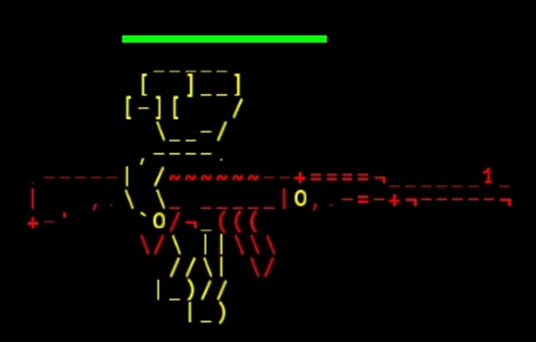
(PRUNED) Levels
Keeps track of Hero’s progress
Spawns Groups of enemies – different attack types and movement types
Notes:
The levels keep track of hero’s progress. Based on that, they carry out their own logic like spawning correct enemies and boss. The enemies have different attack types and movement types. For example, they can fly in a sine-wave path, a spring like path, up and down or chase after the hero.

Slide 29
(PRUNED) OUTLINE
Motivations & Background concepts
Methodology
  Game – Design and implementation
  User study
Study Results
conclusions
Notes:
Here’s a quick outline of what I’m going to talk about today.
First I will briefly talk about the motivations behind this project and also explain some important background concepts.
Next is the methodology, in which I’ll talk about the game and how it’s designed and implemented and also the user study
Then I’ll talk about the results that I’ve got, and finally summary and future work.

Slide 30
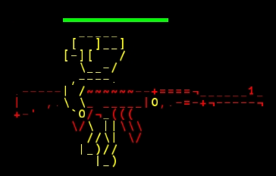
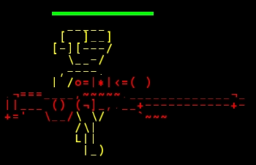
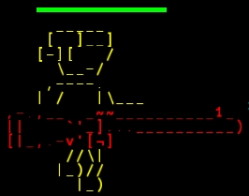
Weapons
AK47
AWP
Grenade launcher

Slide 31
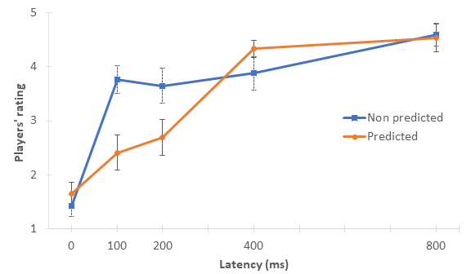
2. Evaluation of player prediction
How much did lag affect your gameplay?

