Slide 1
Scaling Web Services for the Lightweight Collector
Ivan Eroshenko, Yaru Gong, Sam Moran, Wenjing Ying

Slide 2
Lightweight Collector Overview

Slide 3
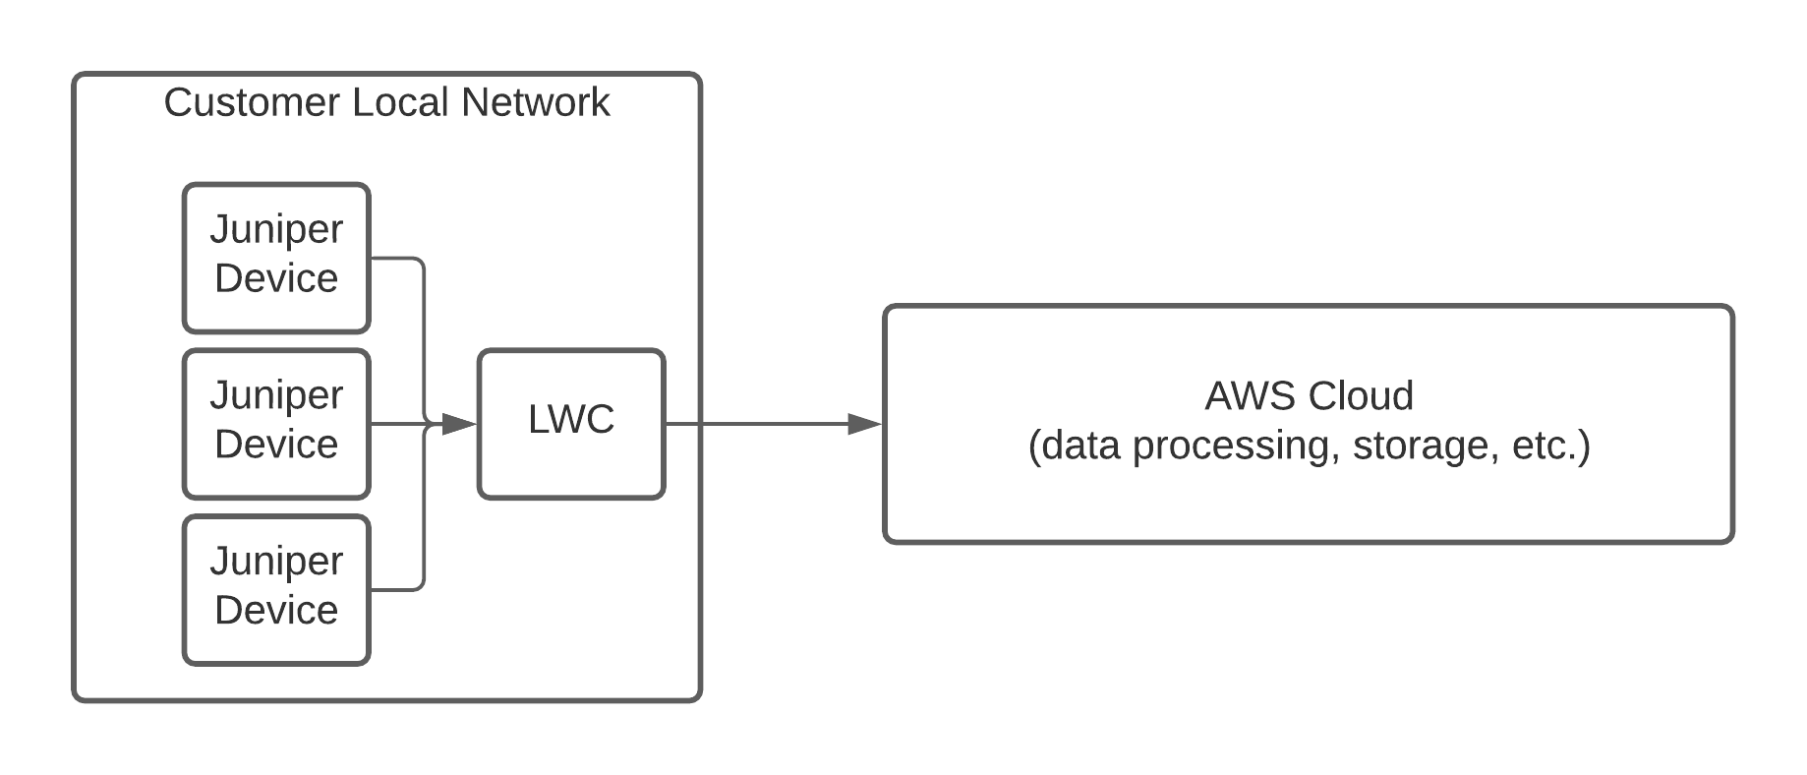
What is the Lightweight Collector?
Automated network support product
Deployed to customer sites, gathers data, interacts with AWS cloud
Currently in beta with handful of customers
Scaling up to support more
Notes:
Sam

Slide 4
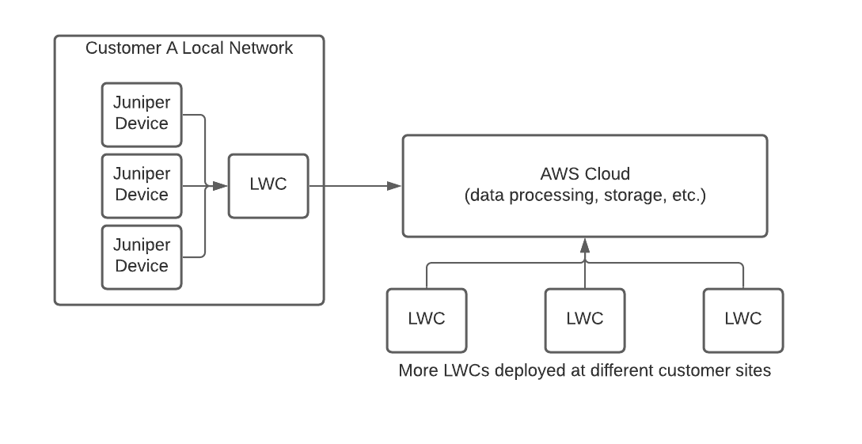
Problem Statement
Limitations of AWS services becoming apparent
LWC sometimes runs out of memory
Problems related to scale starting to emerge
Hundreds of log messages written every minute

Slide 5
What we did
Part 1: Enhanced Data Collection Monitoring
Part 2: Developed Anomaly Detection Solutions
Part 3: Designed Scalable Solutions

Slide 6
Part 1: Data Collection Monitoring
Notes:
Ivan

Slide 7
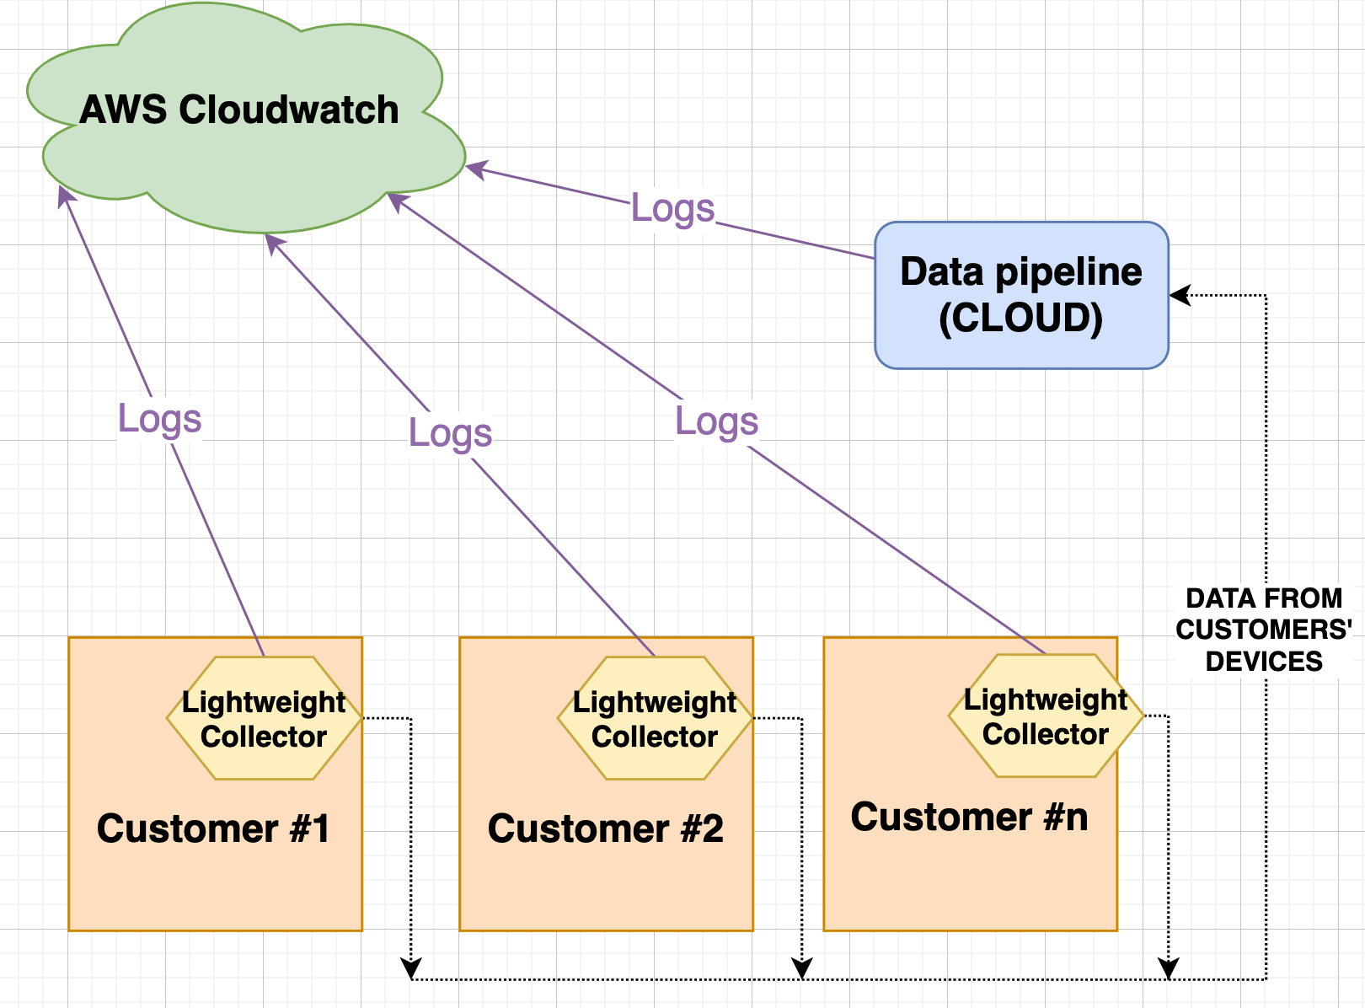
Background: Monitoring the Data Collection Processes
Notes:
AWS - store and process your logs in the cloud.

Slide 8
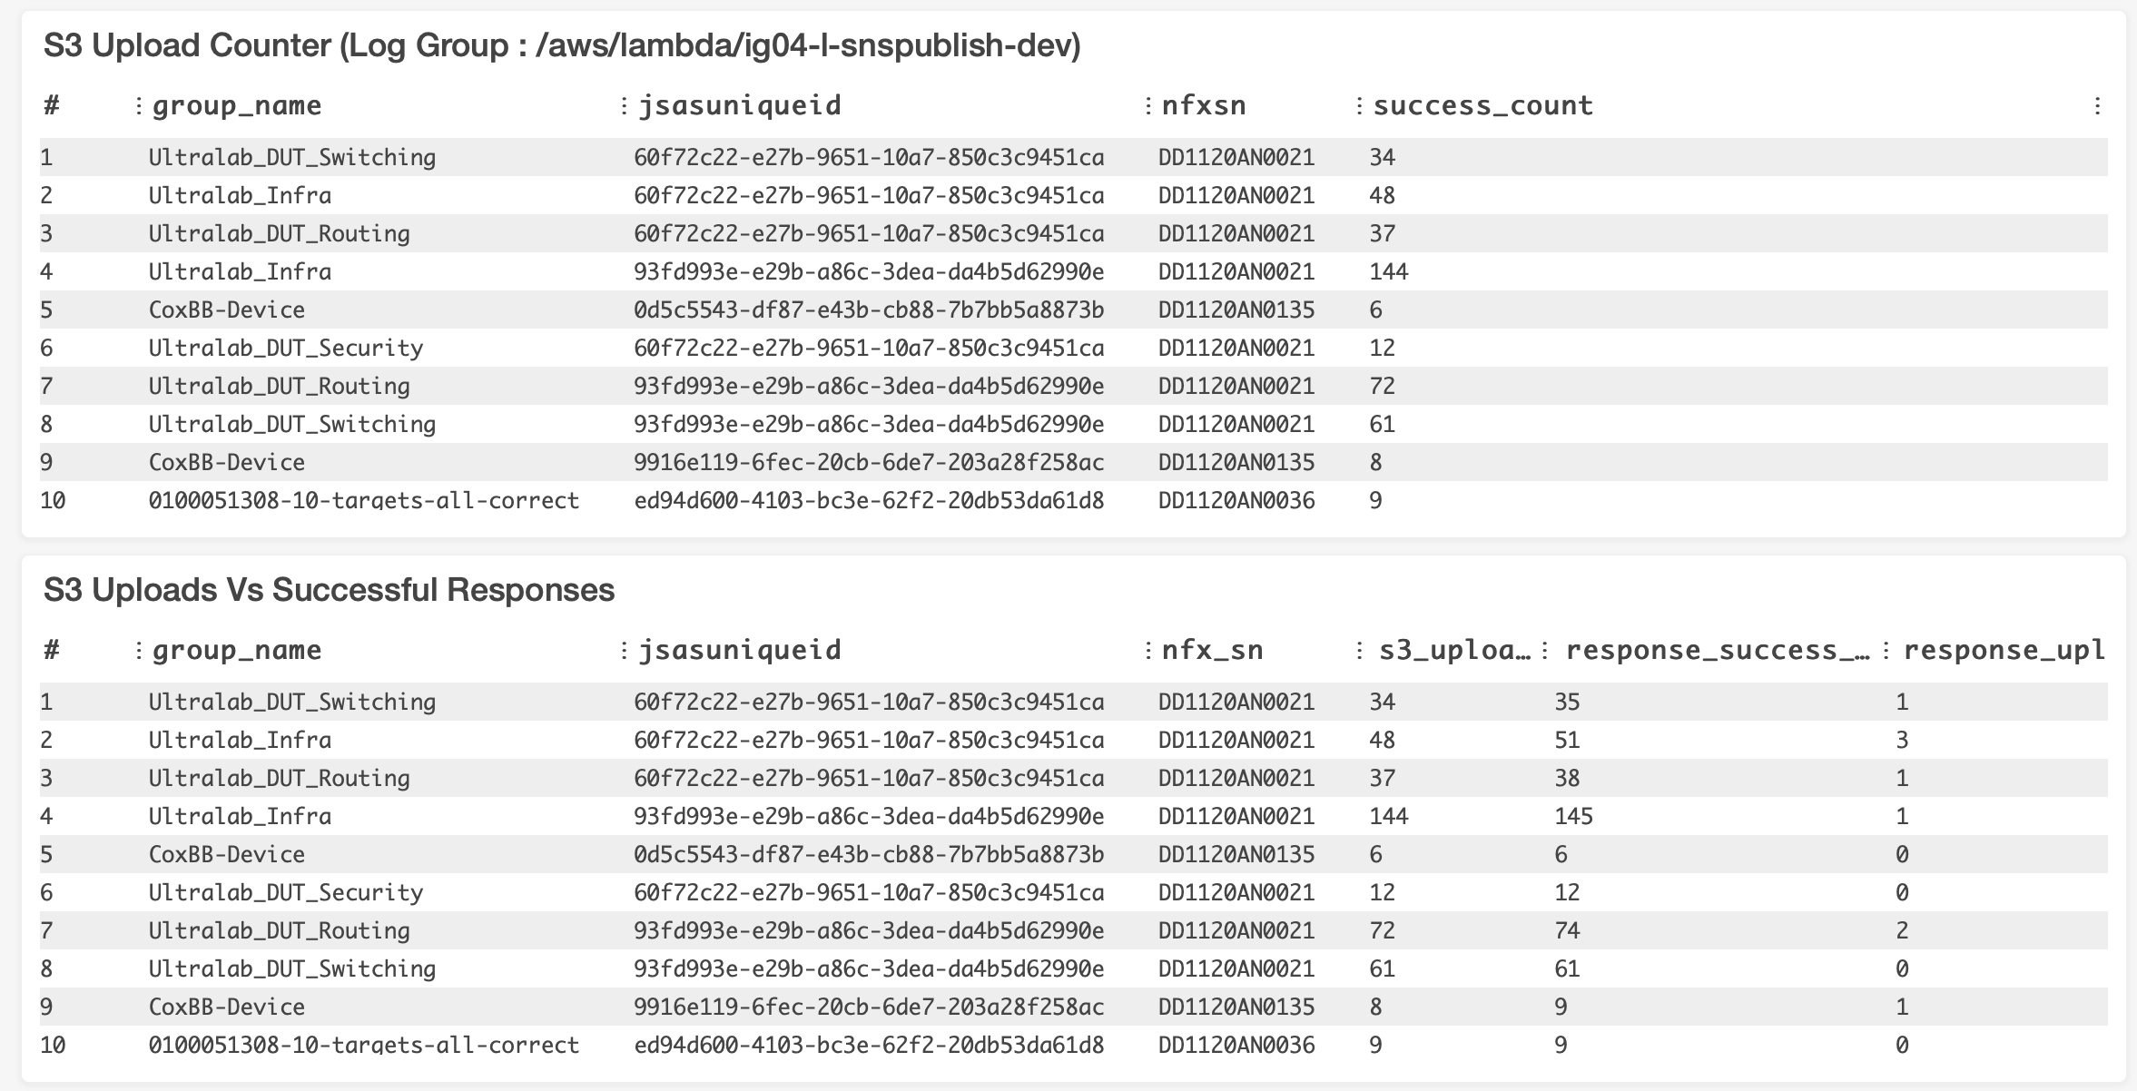
Background: Cloudwatch Dashboards
Notes:
Cool tool, customized widget + metrics, used by JSAS team to monitor in one place, example.

Slide 9
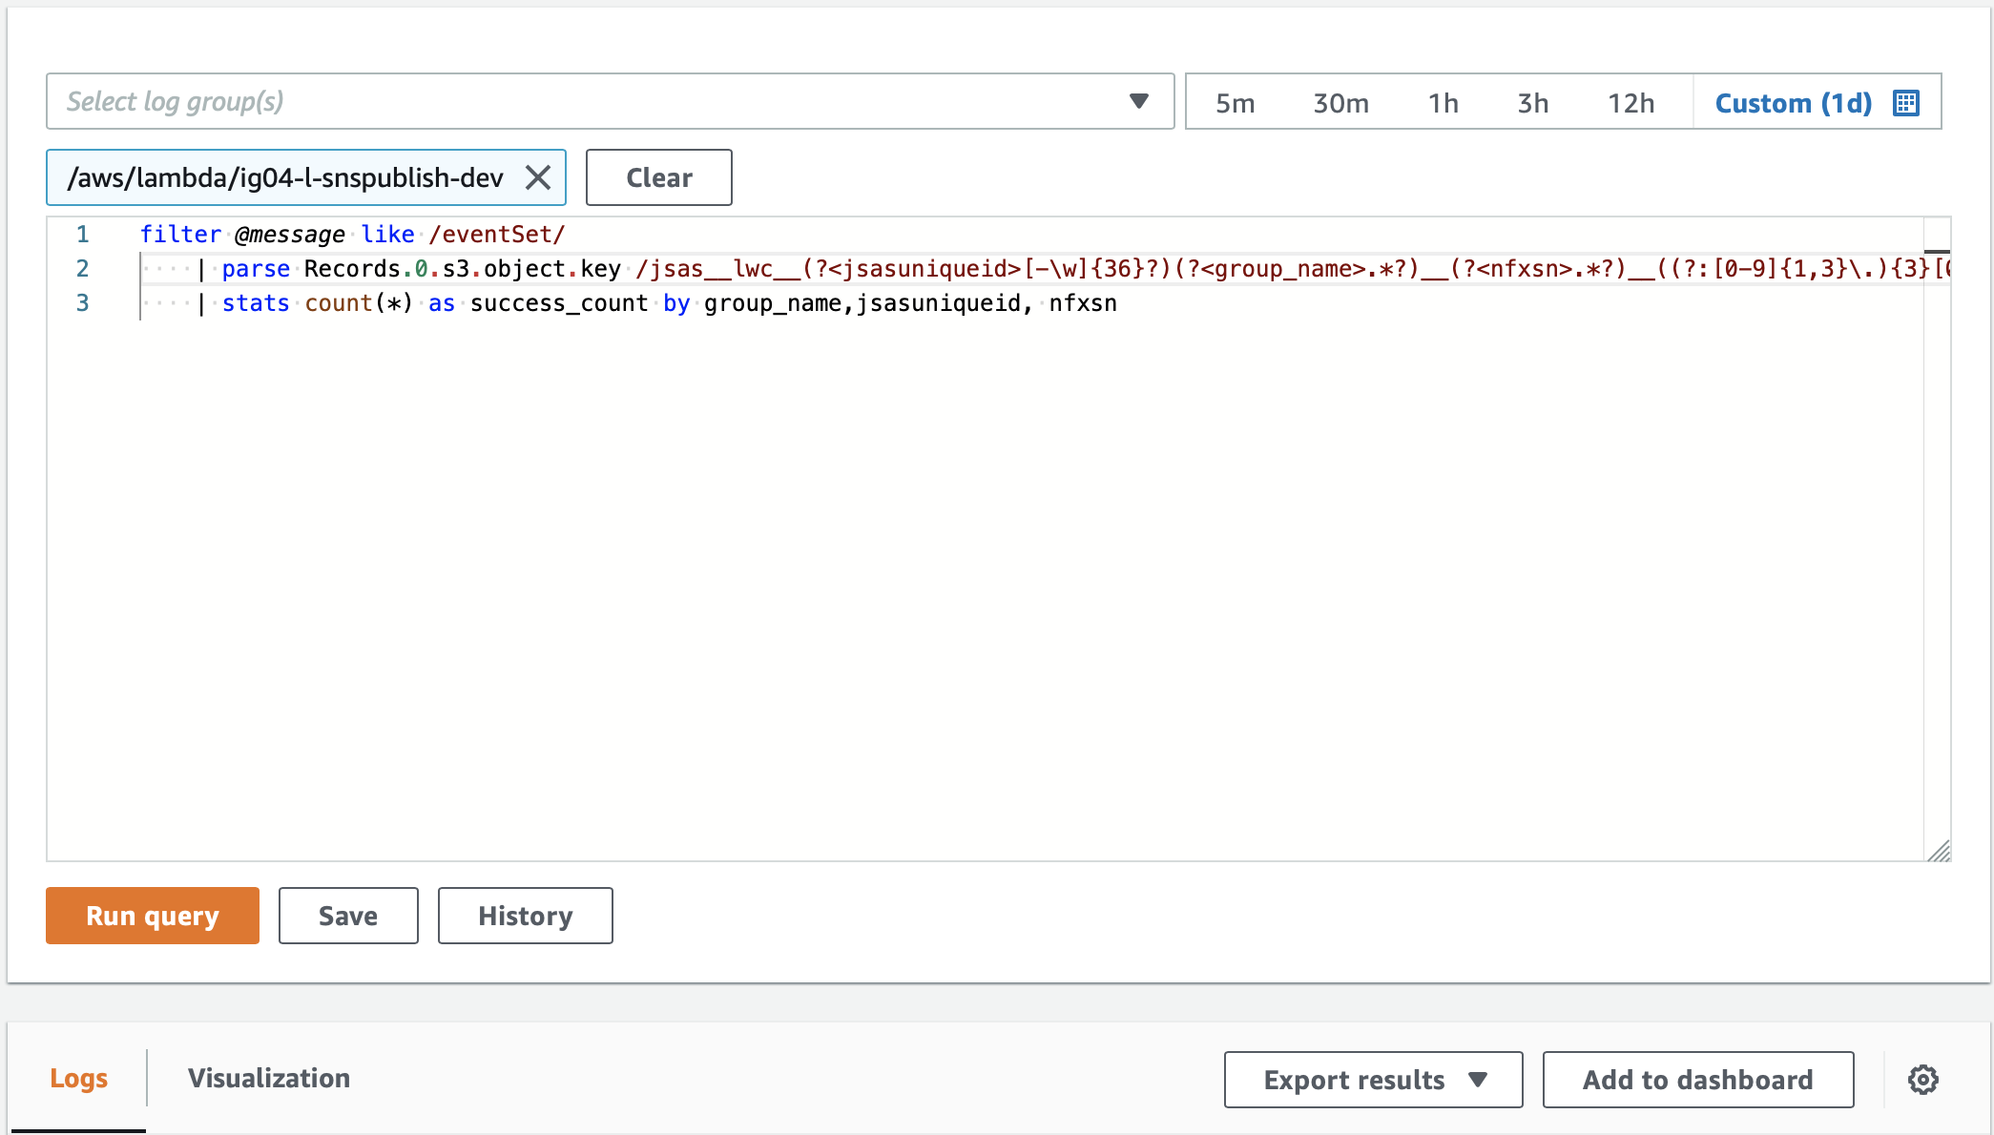
Background: Cloudwatch Logs Insights
Analyze Logs Data to extract meaningful information
Notes:
Allows to create widgets: Select log groups, Write queries using simple query language to manipulate data, extract insights, display the results, add to to dashboard.

Slide 10
Widgets we created:
Notes:
S3 Uploads - problem, solution, interesting because - different log groups different format, not like SQL, cool methodology can be further used by the JSAS team

Slide 11
Part 2: Anomaly Detection
Notes:
Yaru

Slide 12
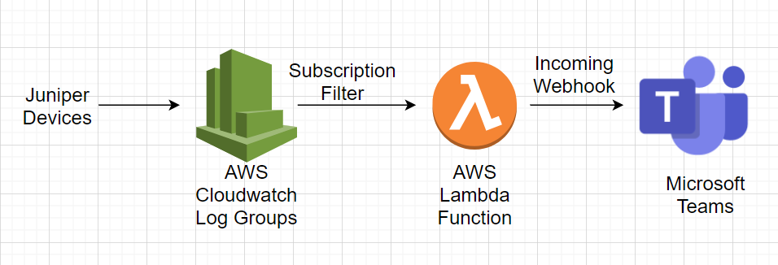
Errors we sent to Teams and the Method
Runtime Warning due to Allocated Memory Consumed
Invoke Handler Error

Slide 13
Errors we sent to Teams and the Method
3. Mismatch between the requested Target Count and Responses

Slide 14
Part 3: Designing Scalable Solutions
Notes:
Wenjing

Slide 15
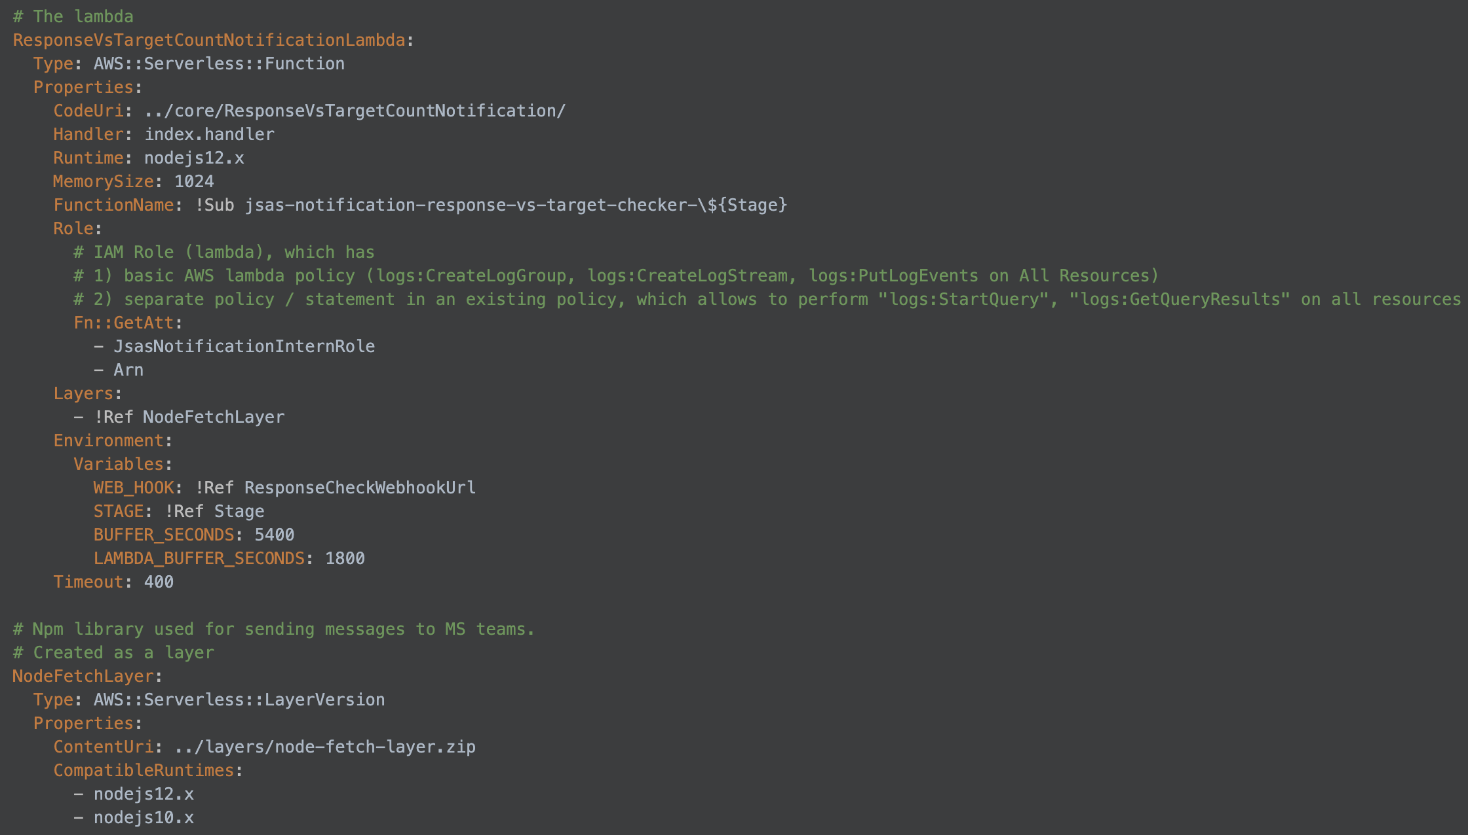
Provisioning Implemented Components with Cloudformation Template
AWS Cloudformation Template tool: provisioning the created software components as code in a Cloudformation template file.

Slide 16
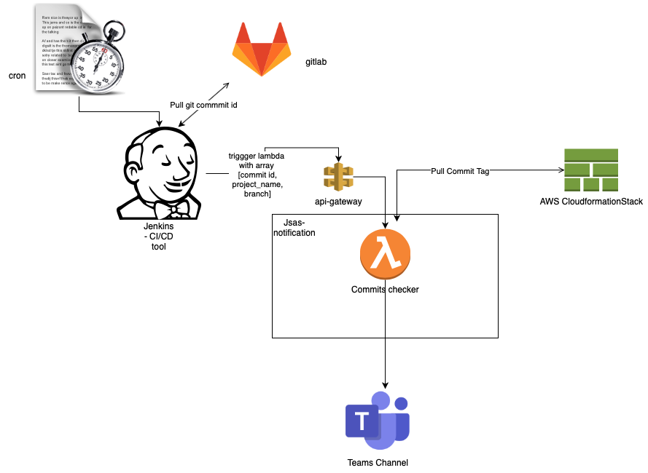
Version Control and Stack Checking
A tool that compares:
Application stacks deployed to AWS (with CloudFormation templates)
Code repositories deployed to GitLab
Notes:
Animate to emphasize

Slide 17
Conclusion and Future Work

Slide 18
Conclusion
Improved monitoring for data collection process
Created automated anomaly detection solutions
Implemented tool to keep AWS infrastructure up-to-date
Provisioned our components with CloudFormation

Slide 19
Future Work
Data Collection Monitoring
Create more advanced widgets
Anomaly Detection
Use our methodology to detect more types of errors
Scalable Solutions
Fully automate stack checking; implement CRON job/Jenkins

Slide 20
Thank you!
Questions?
by Ivan Eroshenko, Yaru Gong, Sam Moran, Wenjing Ying

