Slide 1
Quantifying the Effect of Latency on Game Actions in BZFlag
By: Christopher Burgess (CS)
and Nathan Roy (IMGD)
Advisor: Mark Claypool

Slide 2
Background: Precision and Deadline
Online games are not equally affected by network latency
Classifying actions based on precision and deadline characteristics can help determine a game’s susceptibility to network latency
Precision is the accuracy required to execute an action successfully
Deadline is the speed which an action must be completed in order to be successful
High precision and short deadline requirements make that action very susceptible to latency
Low precision and long deadline requirements are much less susceptible

Slide 3
Hit Large
Target
Precision
Tank
Movement
Shooting
Machine Gun
Shooting
Bullet
Shooting
Laser
Deadline

Slide 4
Test Hypothesis
Provide concrete test data to confirm the precision-deadline hypothesis
Methodology:
Modify a readily available game to create artificial latency
Modify game’s actions to simulate precision/deadline changes
Run experiments with varying degrees of latency and analyze the results
Show how the results can be applied to predicting the effects of latency on other games

Slide 5
BZFlag
Freely available open source game
Simple, only two action types – moving and shooting
Game already tracks score, hit percentage, and number of shots fired
Bullet speed and tank size freely able to be modified

Slide 6
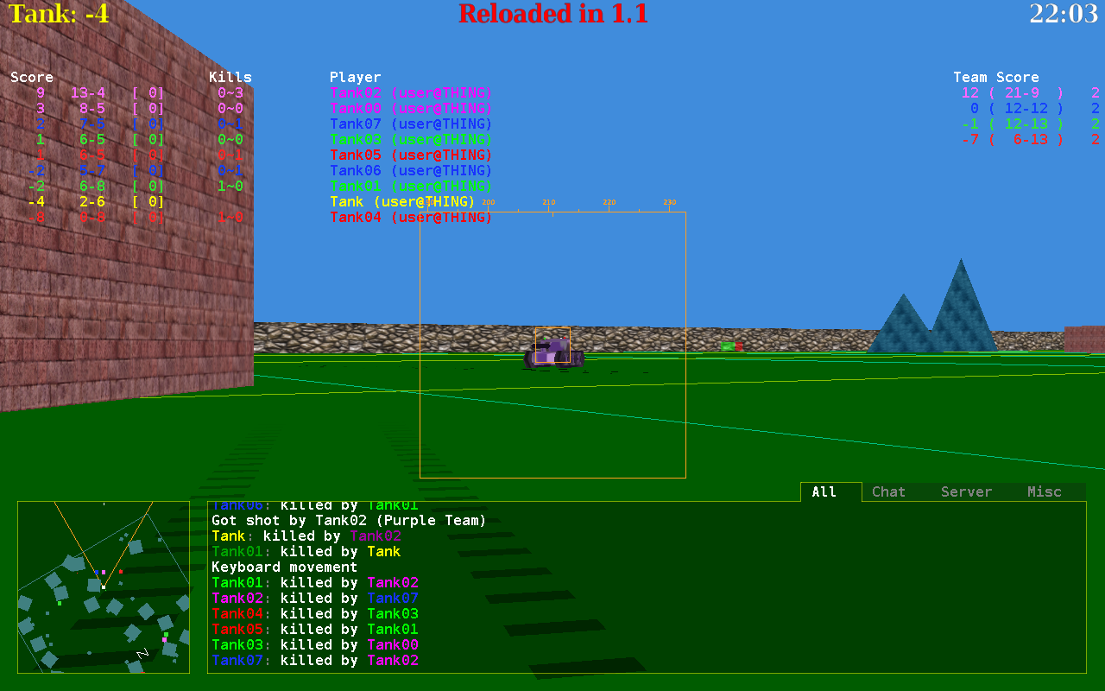

Slide 7
Modifications to BZFlag
Added code to induce artificial latency to any number of tanks
Created Latency Manager class that stores packets sent from a client and delays message for a specified time
Delay time can be changed for all tanks
Only the tanks’ shots are lagged, not movement
Modified tank AI to be more selective with its shots
Modified bullet speed and tank size to simulate precision and deadline adjustments

Slide 8
Experiment Design
Two hour test runs
Eight computer controlled players in four teams of two in a free-for all match
8 players is common for multiplayer online games
Score is used to determine performance
One tank was given a latency value of 100ms, 500ms, or 1000ms
Latency values represent close Internet to far Internet

Slide 9
Score vs. Tank Size

Slide 10
Score vs. Bullet Speed

Slide 11
Conclusions
Precision and deadline of a game’s actions have a significant impact on susceptibility to latency
Data supports the precision-deadline hypothesis
More testing could help improve accuracy of data
Results can still be applied to other games as a general indication of performance changes due to latency

Slide 12
Quantifying the Effect of Latency on Game Actions in BZFlag
By: Christopher Burgess (CS)
and Nathan Roy (IMGD)
Advisor: Mark Claypool
12

