Slide 1





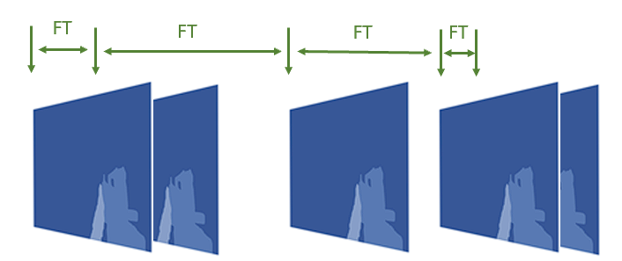








LGRG – Latency and Games Research Group
Game Systems research – Engine, PC, Network
Measure and improve systems
Better performance? Better player experience?
Teams of grad students + undergrad students
Game frames
\
~==-
/
____
/___o\
\
~==-
/
____
/___o\
\
~==-
/
.**
**.**
*.*
server
\
~==-
/
____
/___o\
server
Cloud-based
Player input
server
Mark Claypool
<claypool@wpi.edu>
Thin Client
Cloud Servers

Slide 2
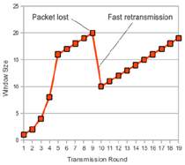



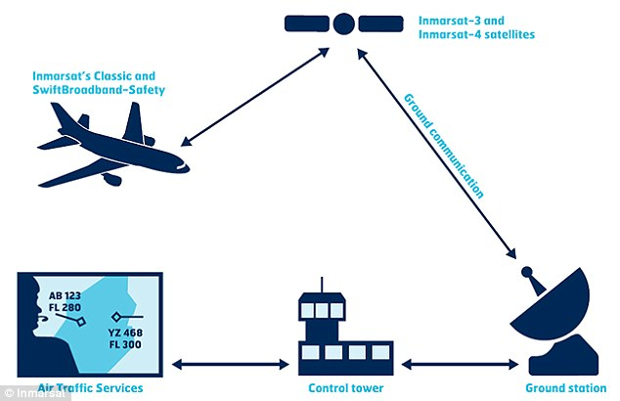

CCRG – Congestion Control Research Group
Network Protocol research – Systems: OS and Network
Measure and improve systems
TCP - Better slow start
Teams of grad student
+ undergrad students
Mark Claypool
<claypool@wpi.edu>

Slide 3

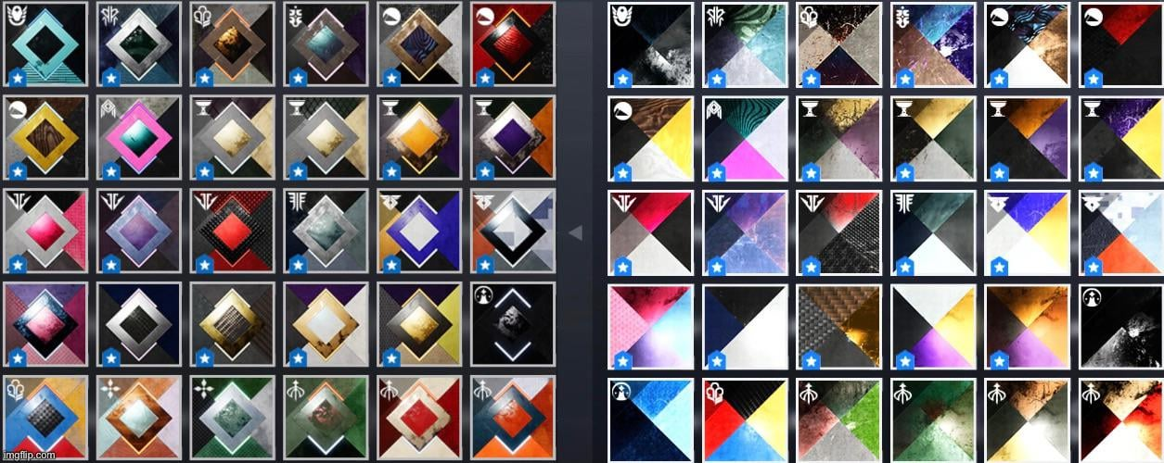

Resuable UI Shaders for Mobile Devices
Build shader algorithms for YouTube UI
Reusability, performance
Design, build, evaluate
Team of grad student + undergrad students

