Slide 1
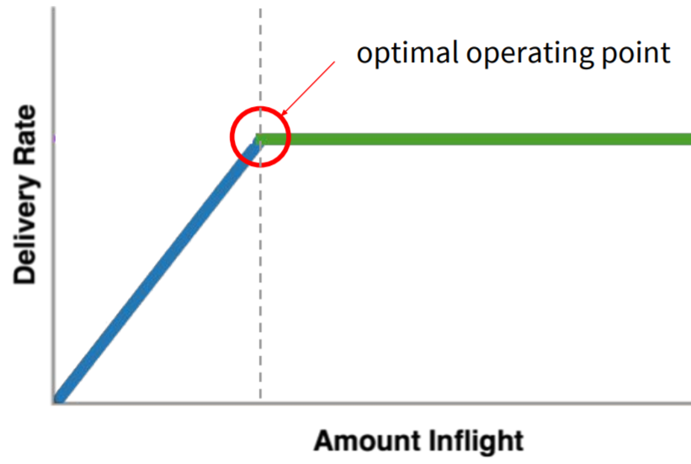

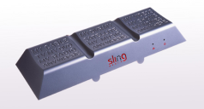
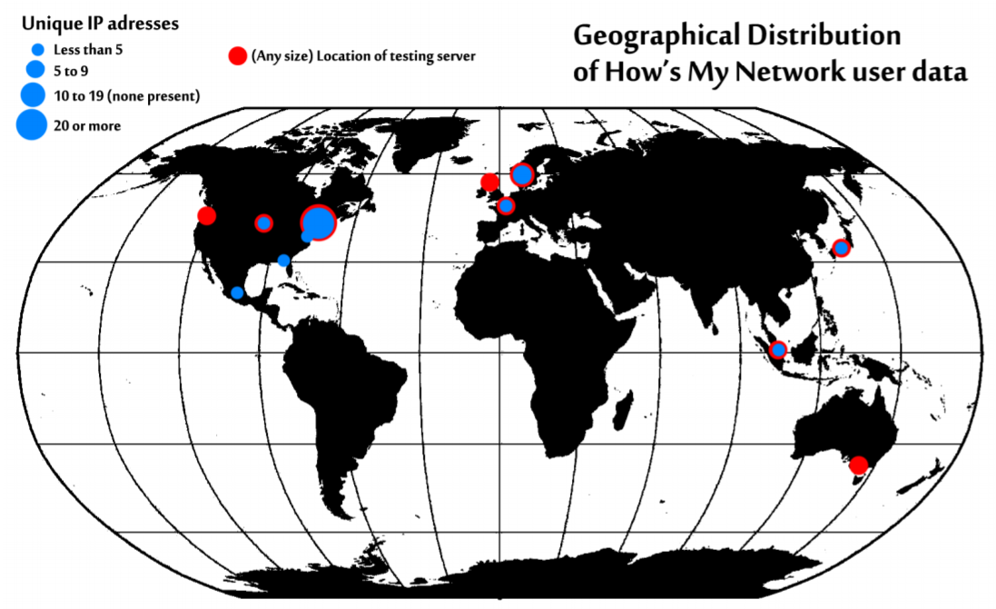
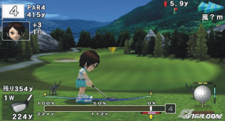
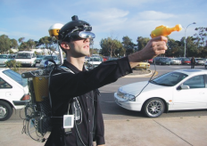
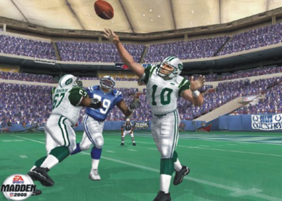


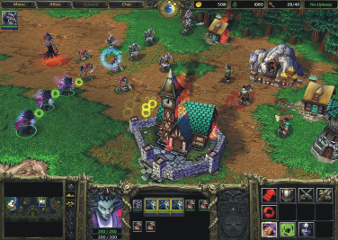

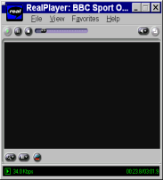
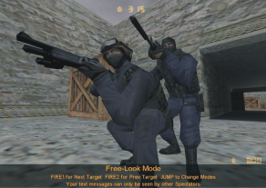
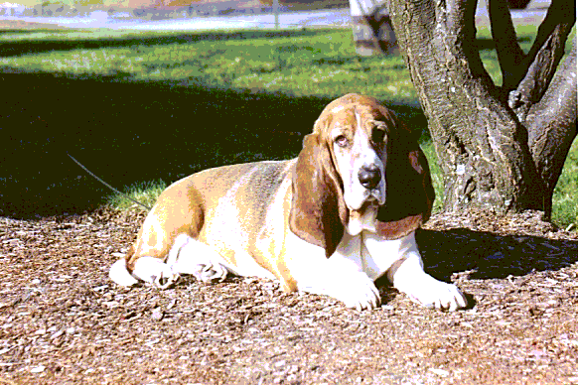





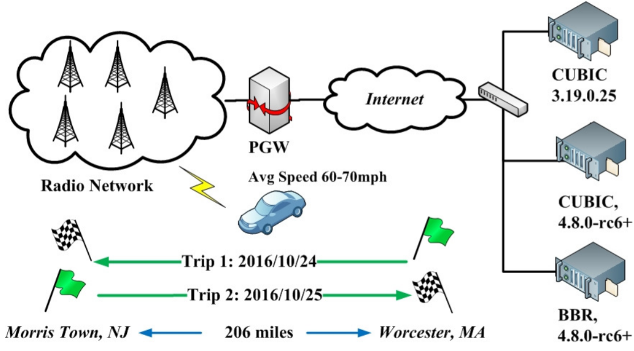
Latency and Games
Congestion Control
Lag can kill!
(your fun)
Make TCP fast!
current TCP operating point
Build game and game engine
Implement latency compensation
Run experiments
Bottleneck Bandwidth and Round-Trip Time
Video Streaming
Thin clients
Cloud games
How’s My Video?
Network Games
Streaming Media
Mark Claypool
Build video monitoring
Measure urban streaming video
Run experiments
claypool@cs.wpi.edu

